Slide 1
Merging SSNS GWAS data with 1000 Genomes
Amika Sood
Alejandro Ochoa
Department of Biostatistics and Bioinformatics
Duke University

Slide 2
Merge 1000 Genome with GWAS
 | SNP's removed | Remaining
common SNPS |  | 1404856
non standard allele | 769 | 1404087
missingness (variant) | 8824 | 1395263
missingness (sample) | 12
Hardy-Weinberg P<10-4 | 61108 | 1334155
transversions | 145853 | 1188302
combined without flip | 129250 | 1059052
Hardy-Weinberg P<10-4 | 227130 | 831922

Slide 3
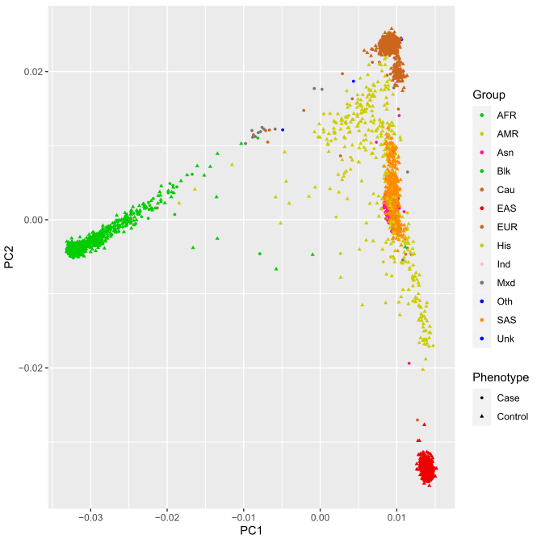
PCA analysis

Slide 4
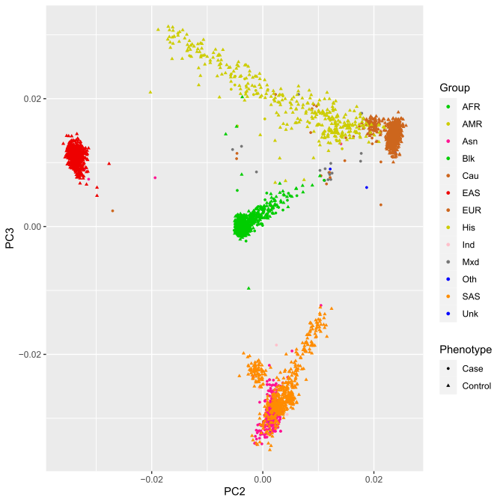
PCA analysis

Slide 5
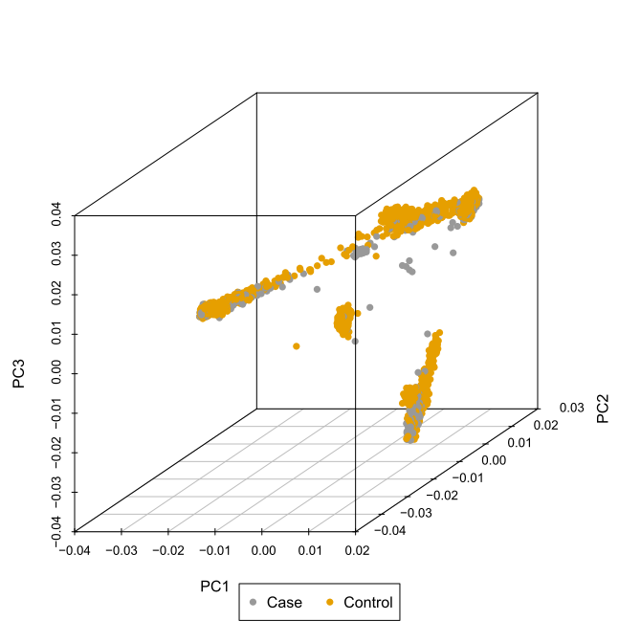
PCA analysis

Slide 6
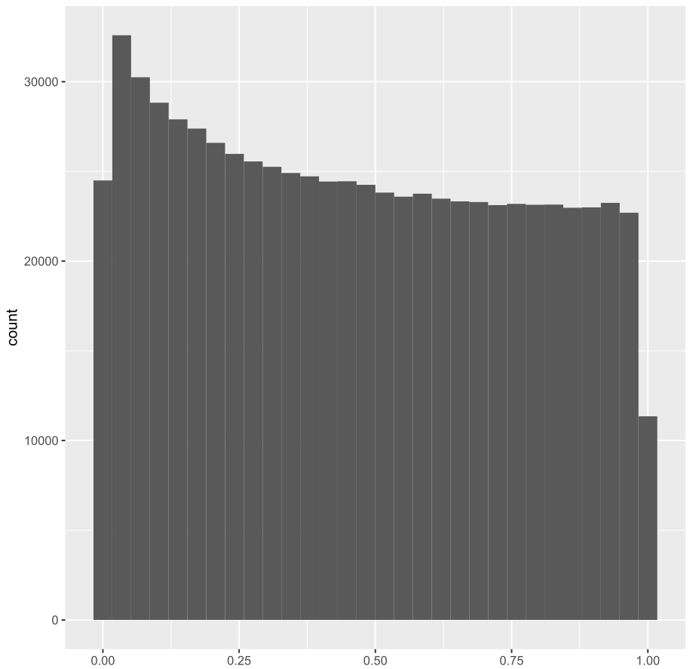
P-value histogram

Slide 7
Association analysis
Chromosome | Position | ID | REF | ALT | A1 | P
18 | 33116767 | rs2469450 | T | G | G | 4.36E-135
2 | 65359224 | rs11689448 | C | A | A | 1.63E-131
11 | 41426114 | rs7109826 | A | C | C | 1.81E-118
6 | 1.14E+08 | rs2473953 | T | C | C | 1.89E-115
15 | 35812437 | rs112391307 | C | A | A | 2.07E-114
10 | 63303214 | rs1456279 | G | A | A | 9.55E-113
1 | 1.7E+08 | rs2208165 | A | G | G | 2.56E-111
1 | 2.06E+08 | rs55762795 | C | T | T | 4.45E-111
6 | 55931763 | rs6914758 | A | G | G | 1.50E-110
19 | 47212229 | rs417328 | G | T | T | 2.18E-106

