Slide 1
Merging SSNS GWAS data with 1000 Genomes
Amika Sood
Alejandro Ochoa
Department of Biostatistics and Bioinformatics
Duke University

Slide 2
Merge 1000 Genome with GWAS
 | SNP's removed | Remaining
common SNPS |  | 1404856
non standard allele | 769 | 1404087
missingness (variant) | 8824 | 1395263
missingness (sample) | 12
Hardy-Weinberg P<10-4 | 61108 | 1334155
transversions | 145853 | 1188302
combined without flip | 129250 | 1059052
Hardy-Weinberg P<10-4 | 227130 | 831922

Slide 3
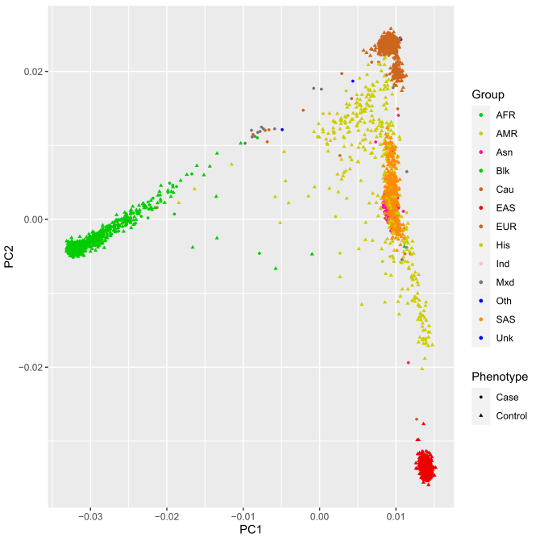
PCA analysis

Slide 4
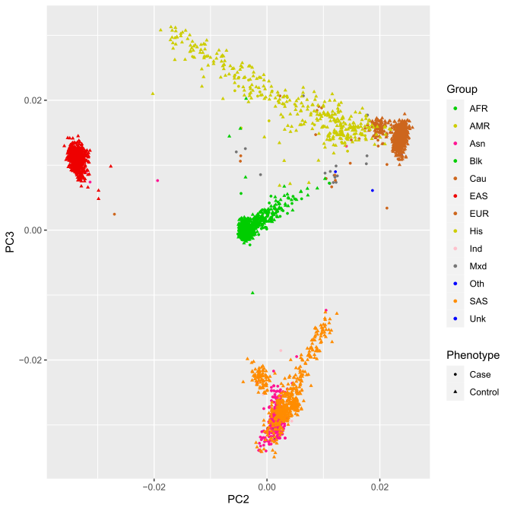
PCA analysis

Slide 5
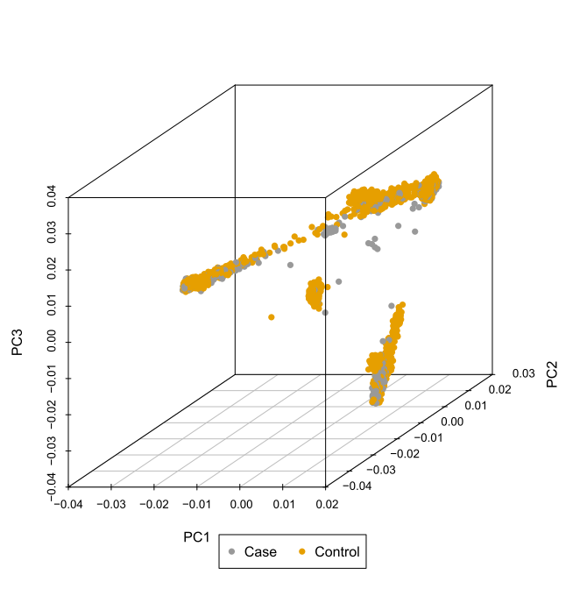
PCA analysis

Slide 6
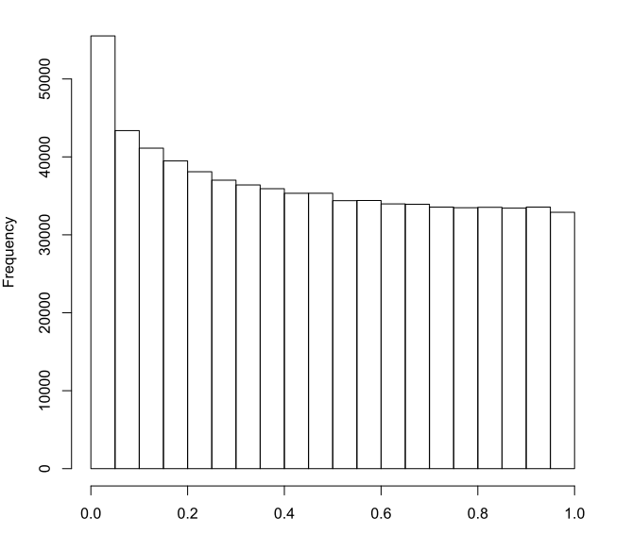
P-value histogram, 10 PCs

Slide 7
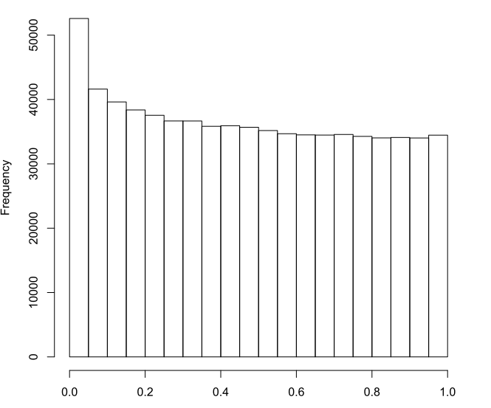
P-value histogram, 20 PCs

Slide 8
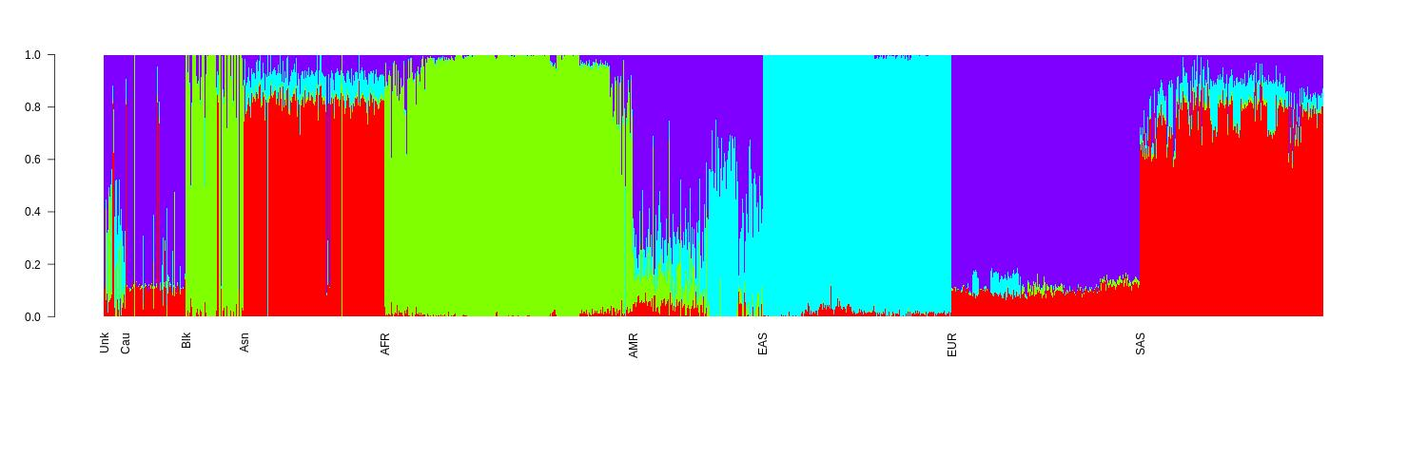
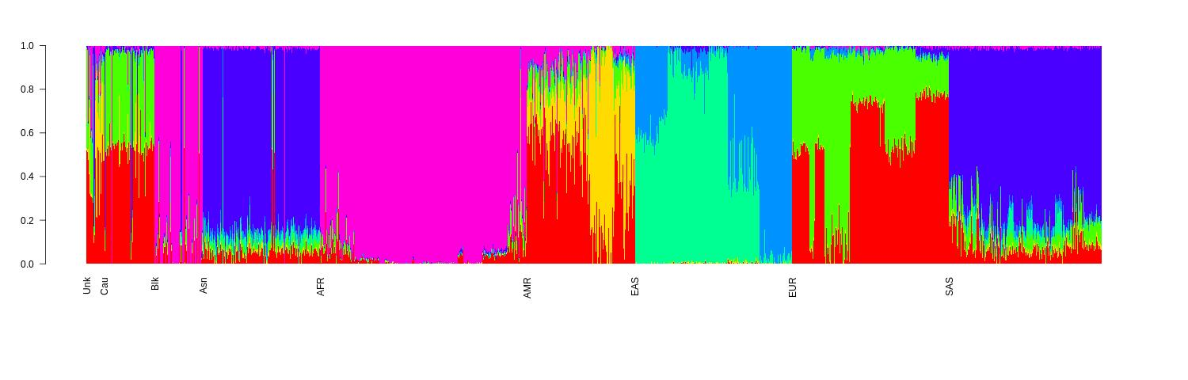
Structure plot pop=4 vs pop=7

Slide 9
Admixture cross validation error

Slide 10
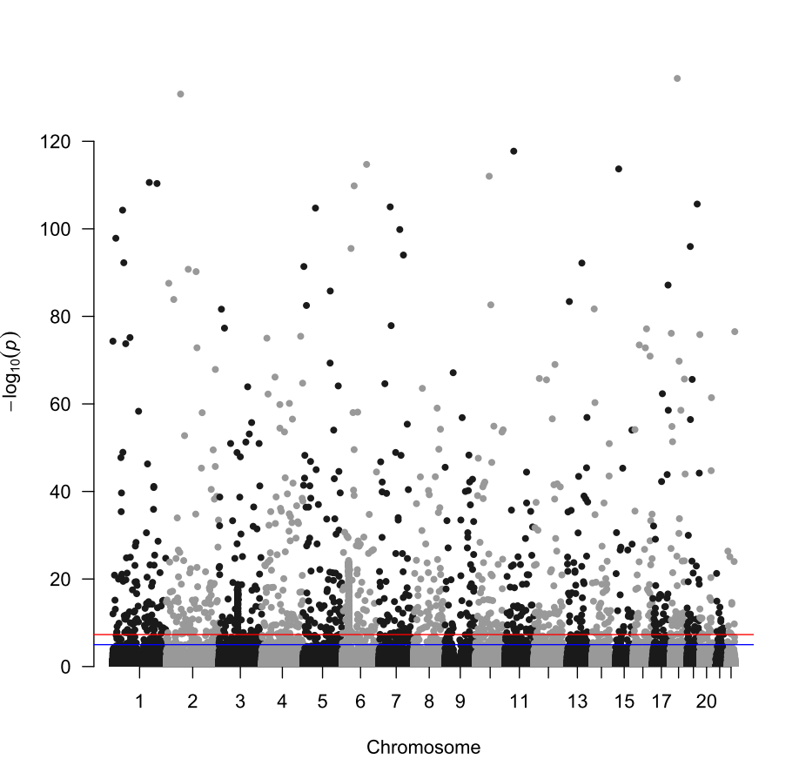

Slide 11
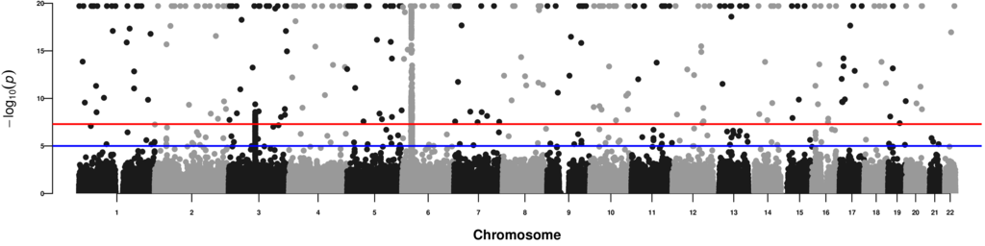
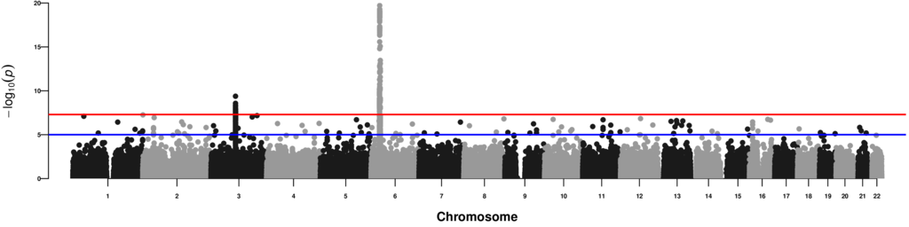
Alex’s manhattan plots
Clean version (bottom) removed loci with p < 5e-8 and no direct neighbors with p < 1e-5. Full version (top) capped p-values to minimum p-value in clean version (~1e-20).

Slide 12
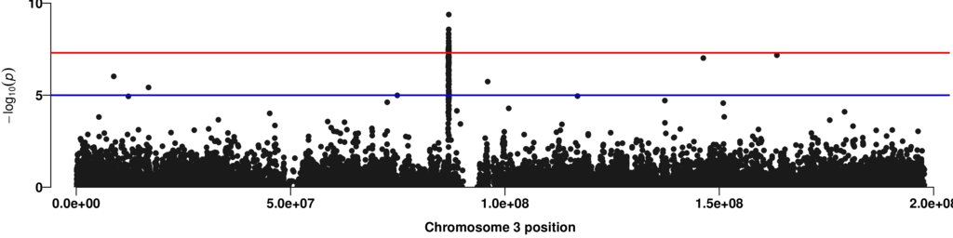
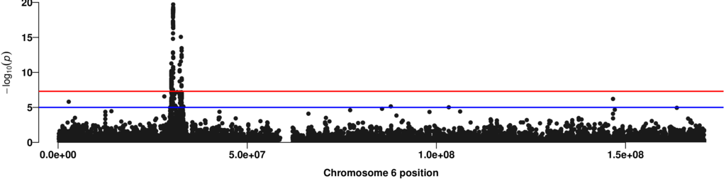
Chr 3 peak: 86,793,259 - 86,917,711
Chr 6 peak: 29,938,571 - 32,681,568

