Slide 1
POE
PROG6212
ST10395938

Slide 2
Overview
Updates from Part 2 to Part 3
Key Features by User Role
Unit Testing & Error Handling

Slide 3
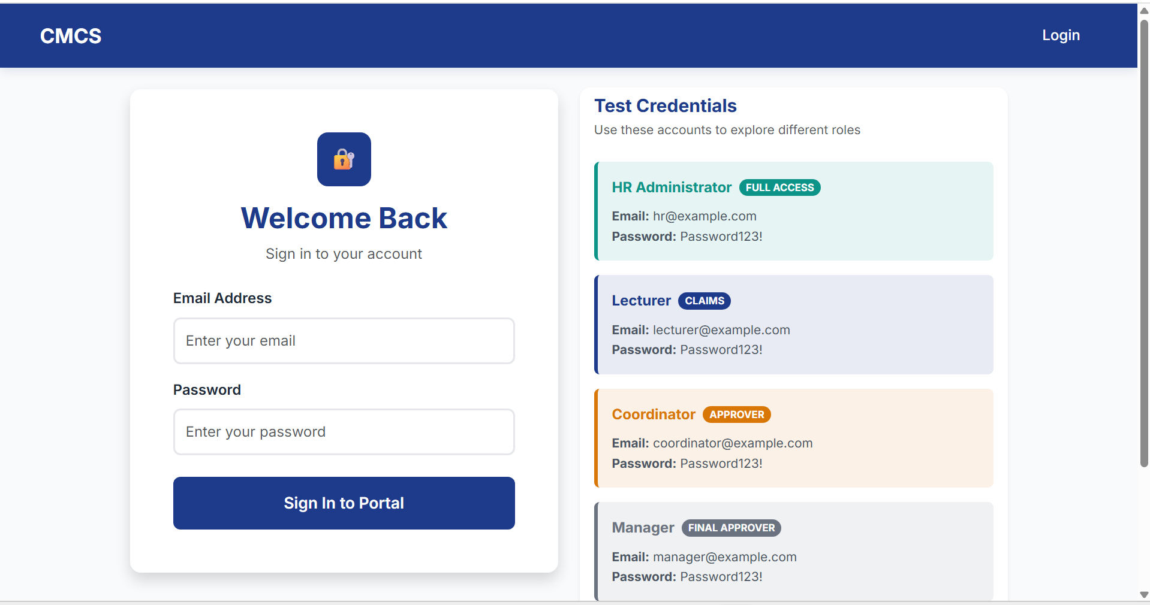
Updates from Part 2 to Part 3
Improved UI/UX
User friendly Layout
Color scheme

Slide 4
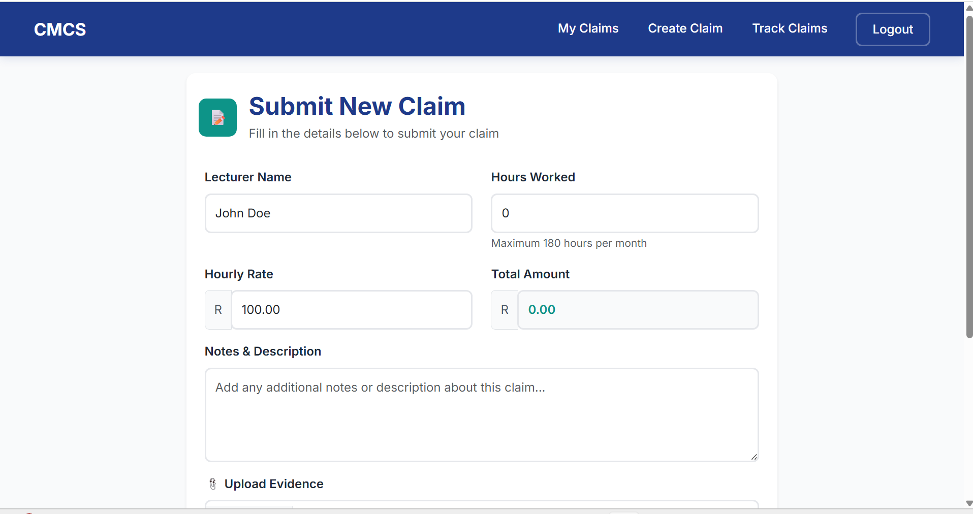
Updates from Part 2 to Part 3
Claim Submission Automation
Auto-fills Lecturer details and hourly rate

Slide 5
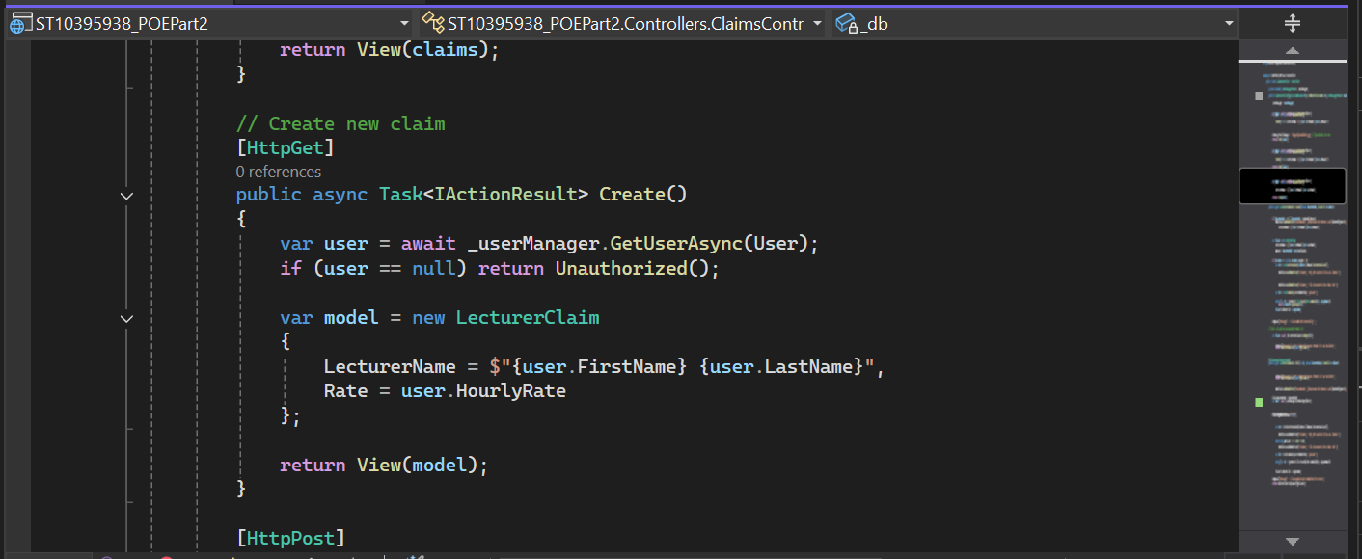
Updates from Part 2 to Part 3
Claim Submission Automation
Auto-fills Lecturer details and hourly rate

Slide 6
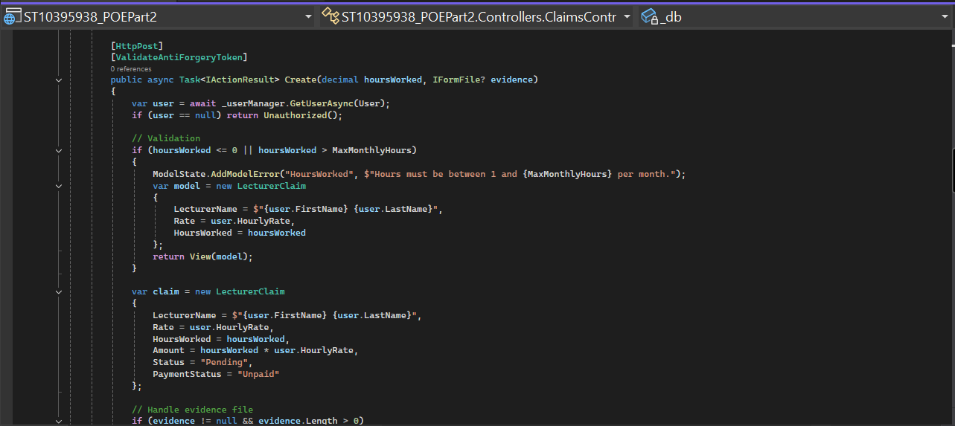
Updates from Part 2 to Part 3
Claim Submission Automation
Auto-fills Lecturer details and hourly rate

Slide 7
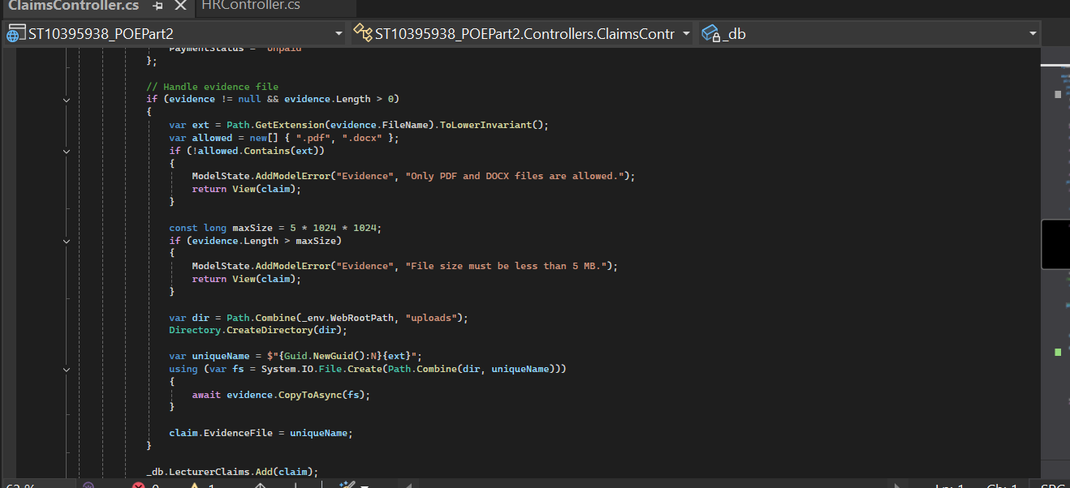
Updates from Part 2 to Part 3
Upload Documents Feature

Slide 8
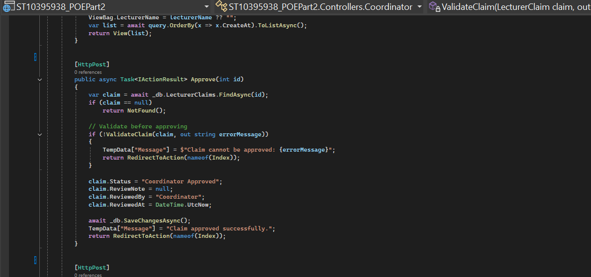
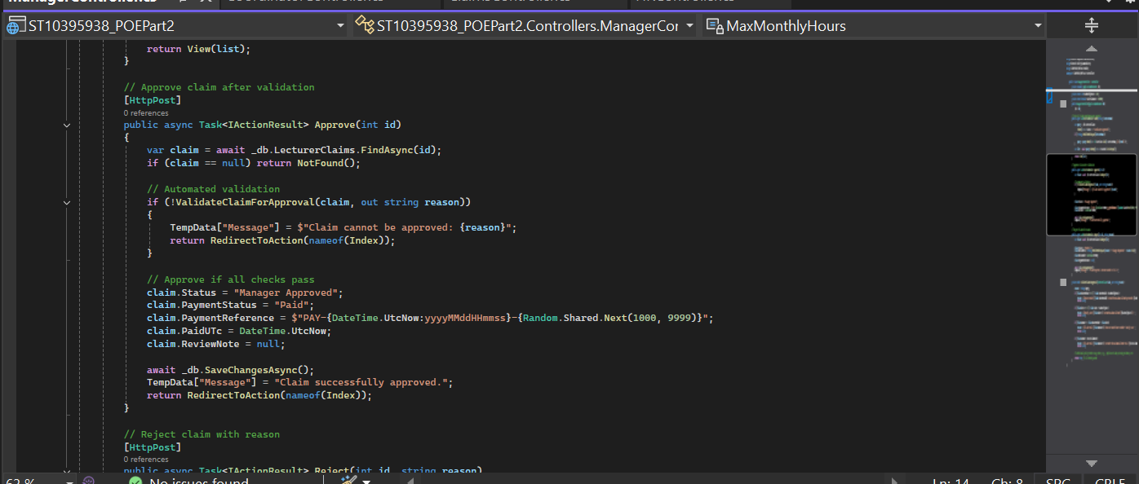
Updates from Part 2 to Part 3
Status Tracking
Claims move through approval stages

Slide 9
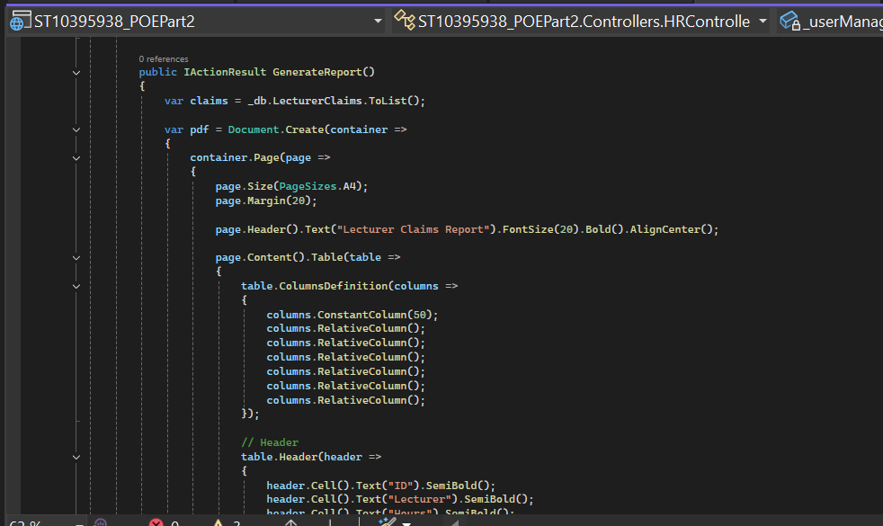
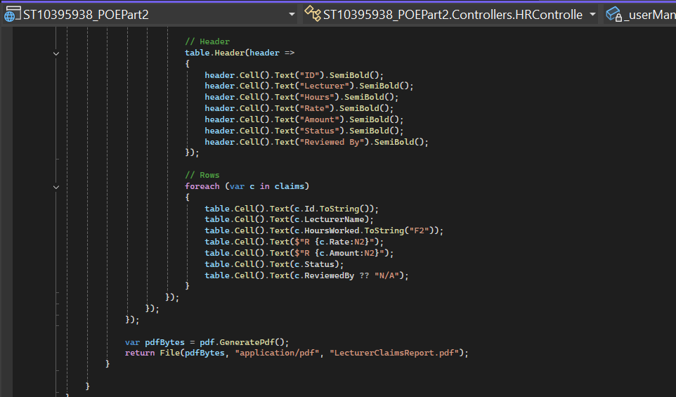
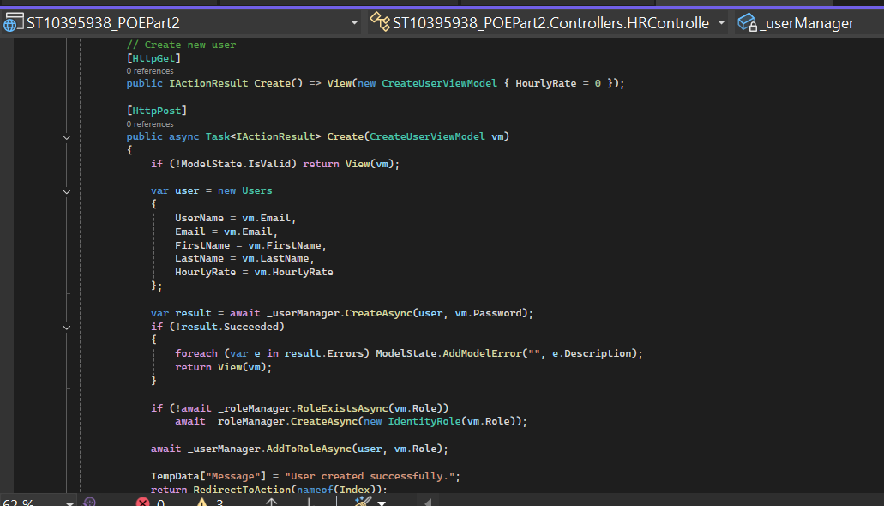
Updates from Part 2 to Part 3
Added HR Role
Handles User Creation and reports

Slide 10
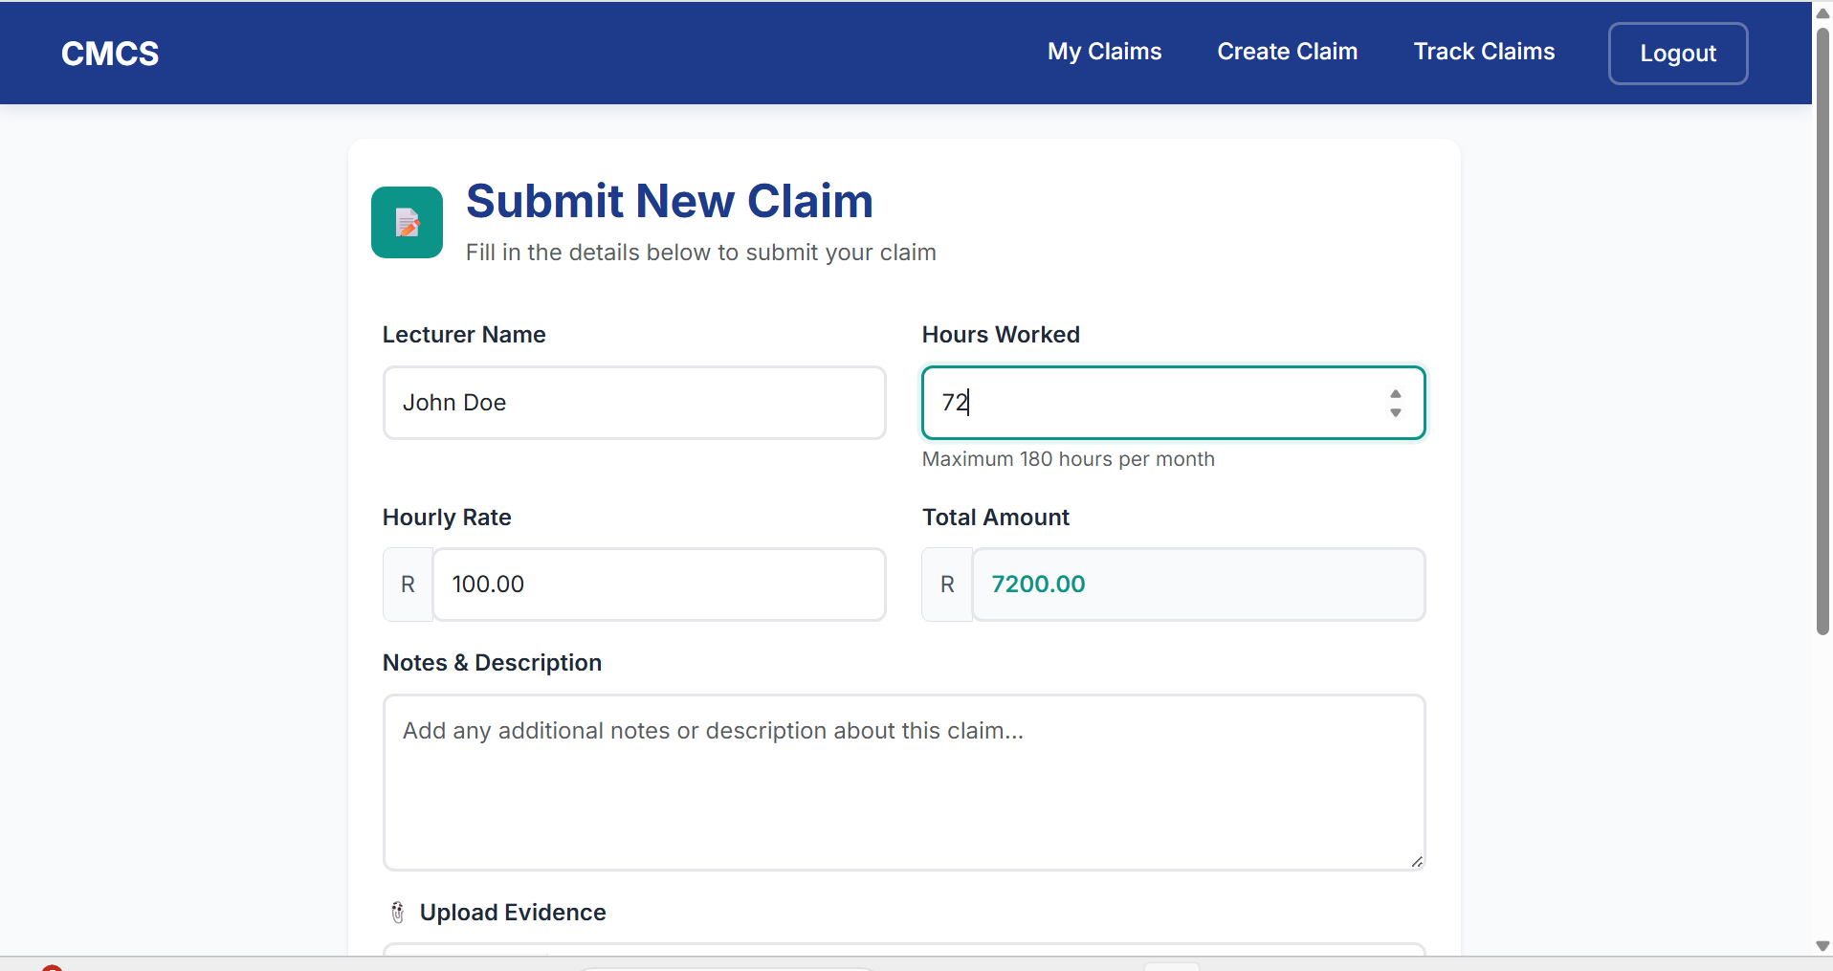
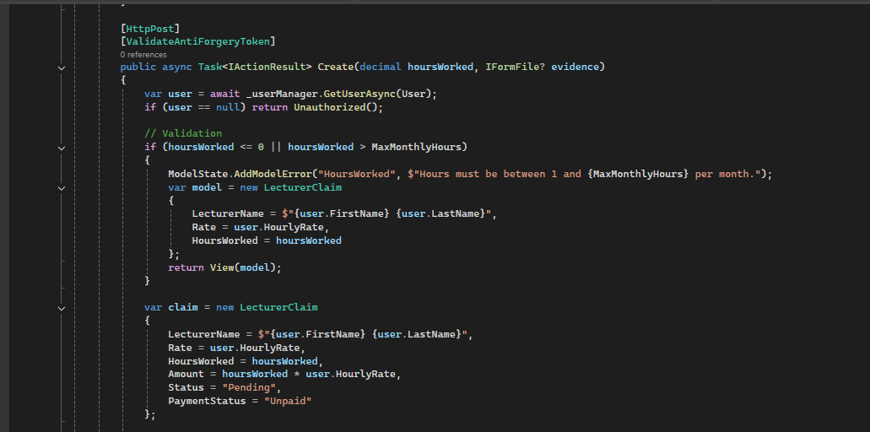
Lecturer View
Key Features
Auto-filled name, surname, hourly rate
Auto-calculation of total claim amount

Slide 11
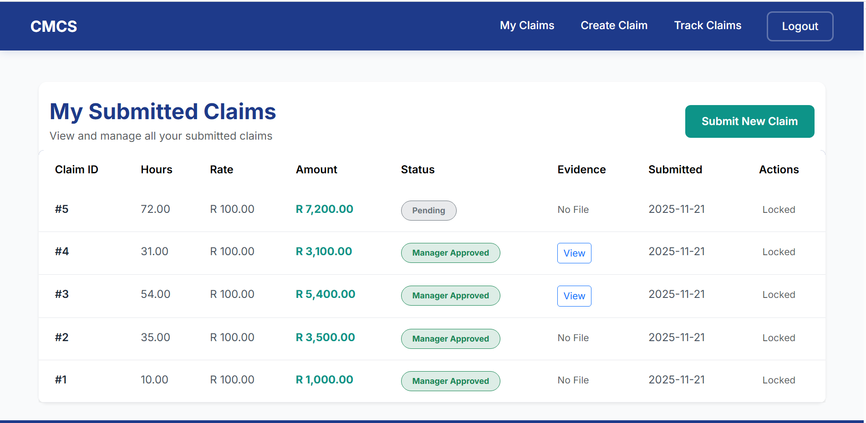
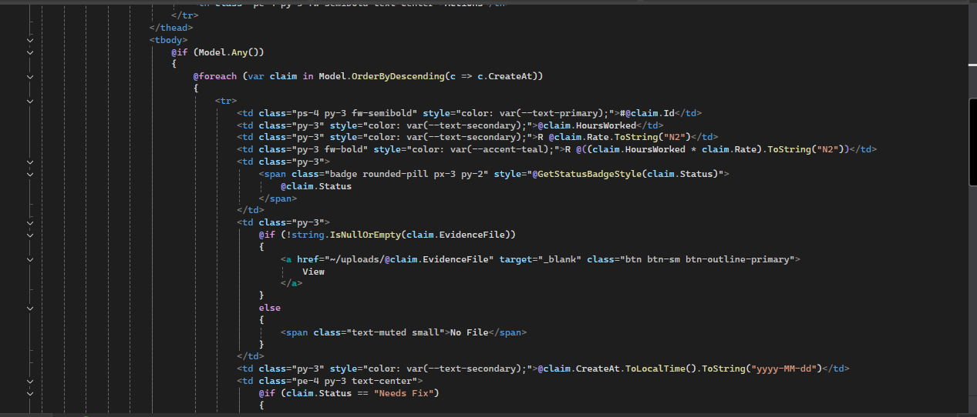
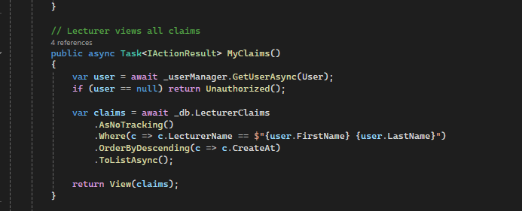
Lecturer View – Claim Tracking
Key Features
Track claim status: Pending, Approved, Rejected
Real-Time updates
Organised Table

Slide 12
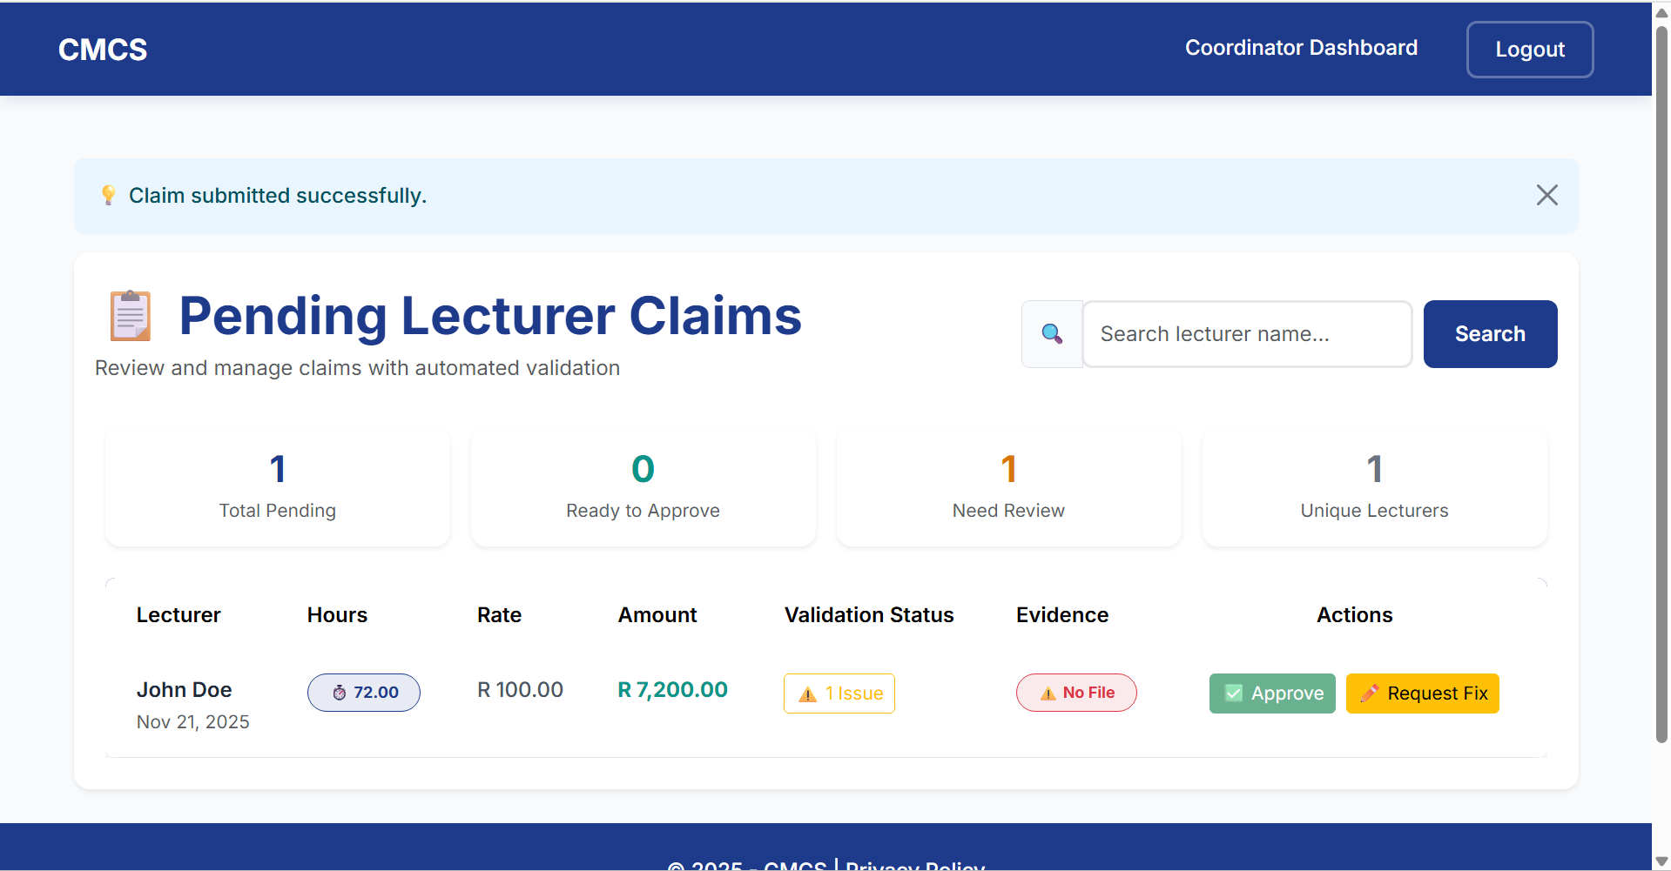
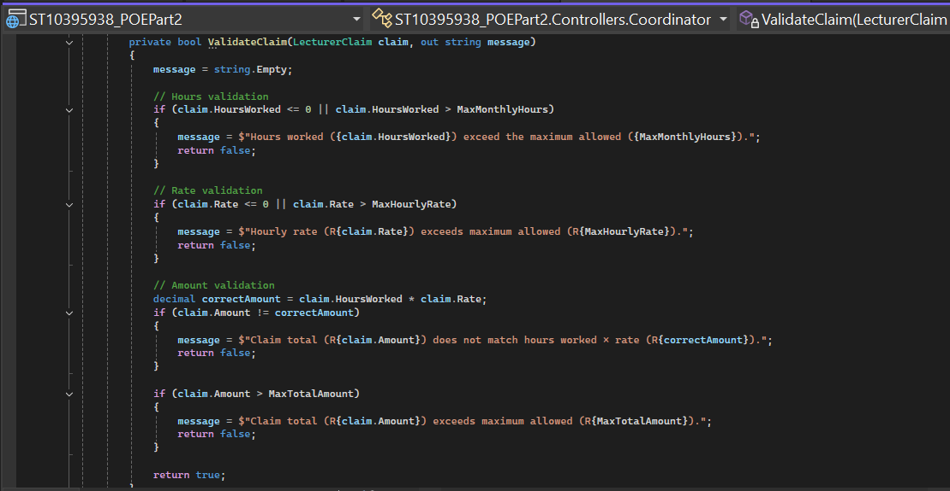
Programme Coordinator View
Key Features
View all pending claims in a table
Approve or Reject claims
Display claim details clearly for verification

Slide 13
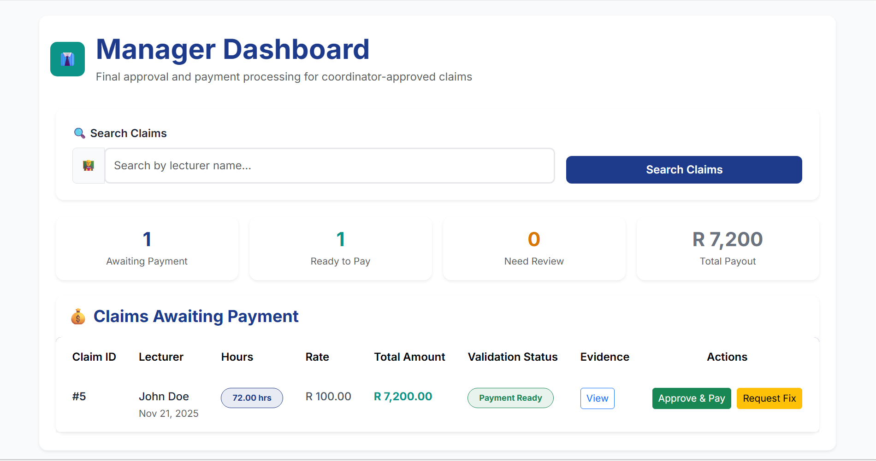
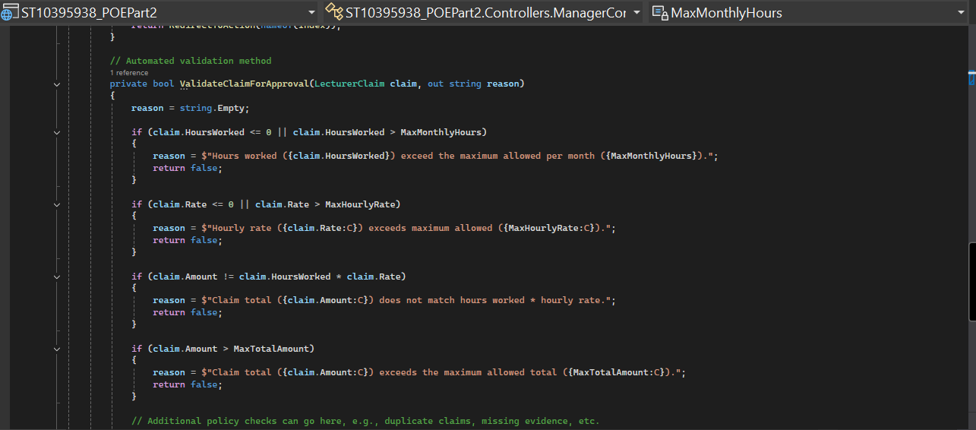
Academic Manager View
Key Features
View all pending claims in a table
Approve or Reject claims
Display claim details clearly for verification

Slide 14
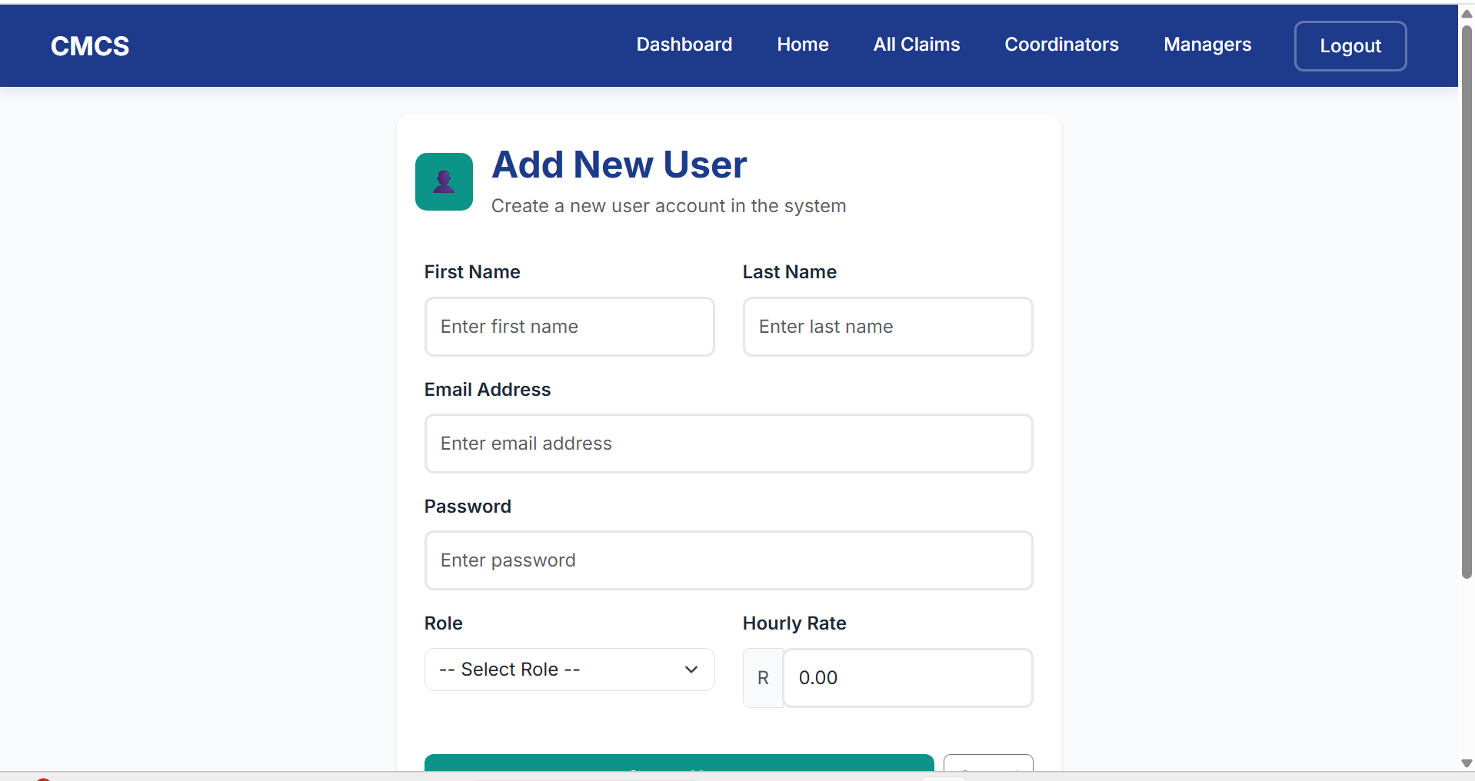
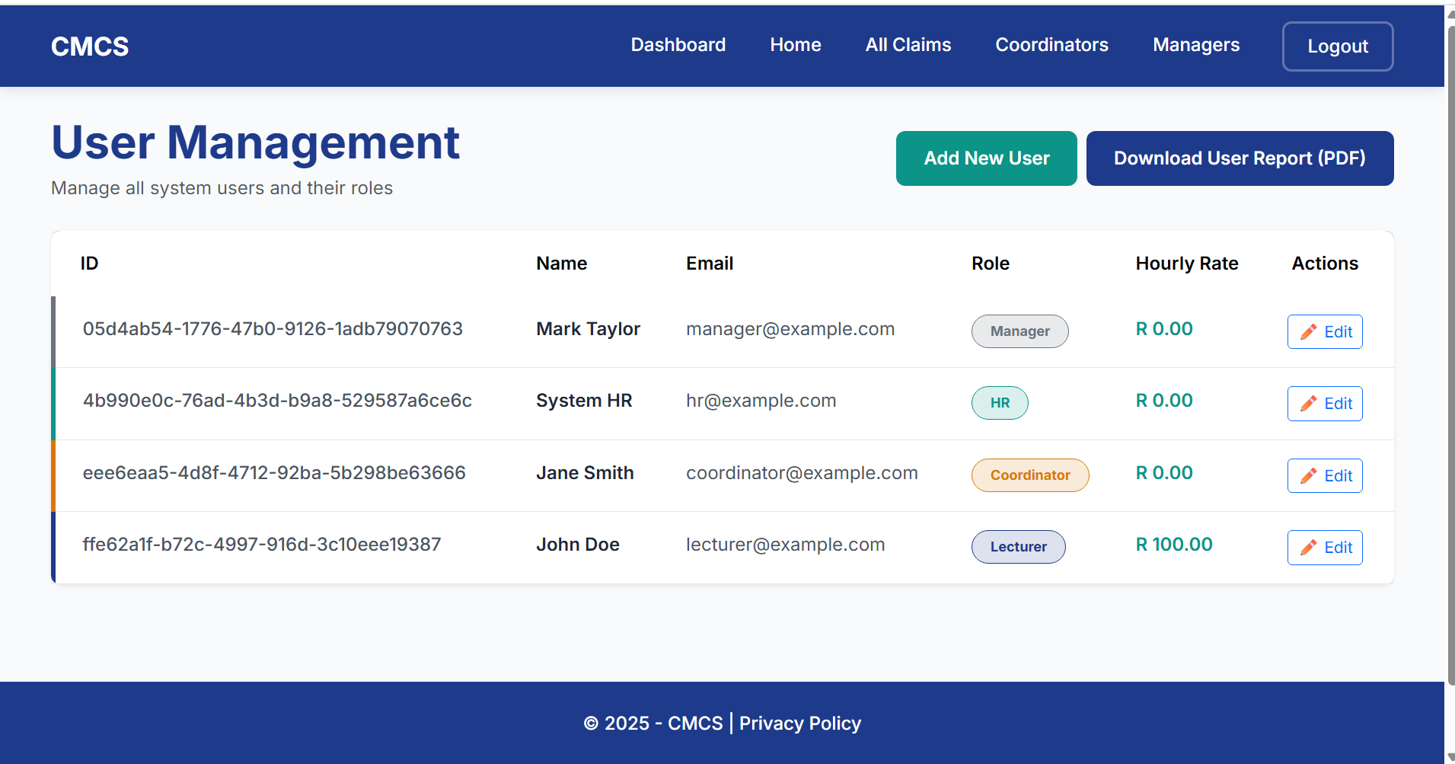
HR View
Key Features
HR super-user can create, update user profiles
Generate reports

Slide 15
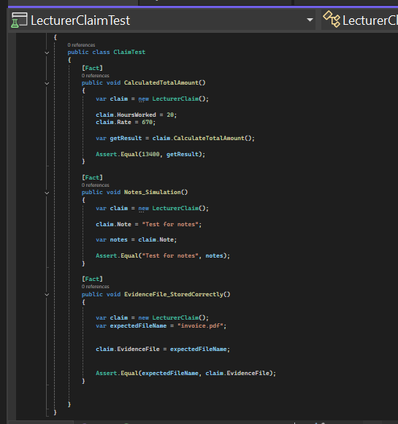
Unit Testing
Key Points
Unit Tests

Slide 16
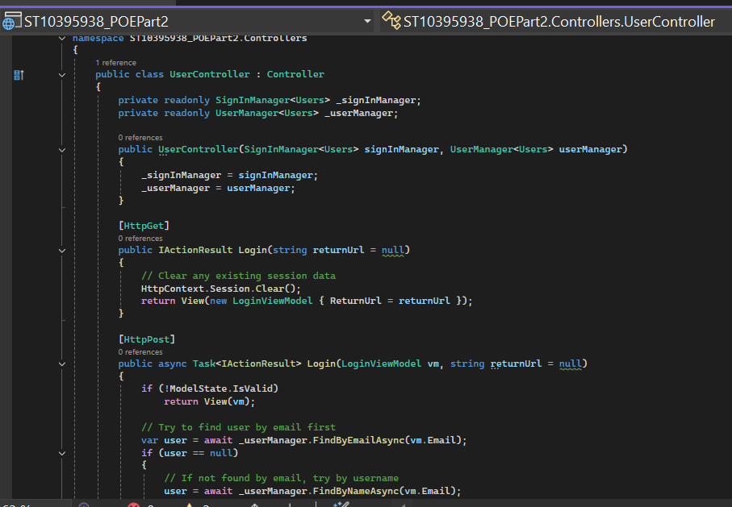
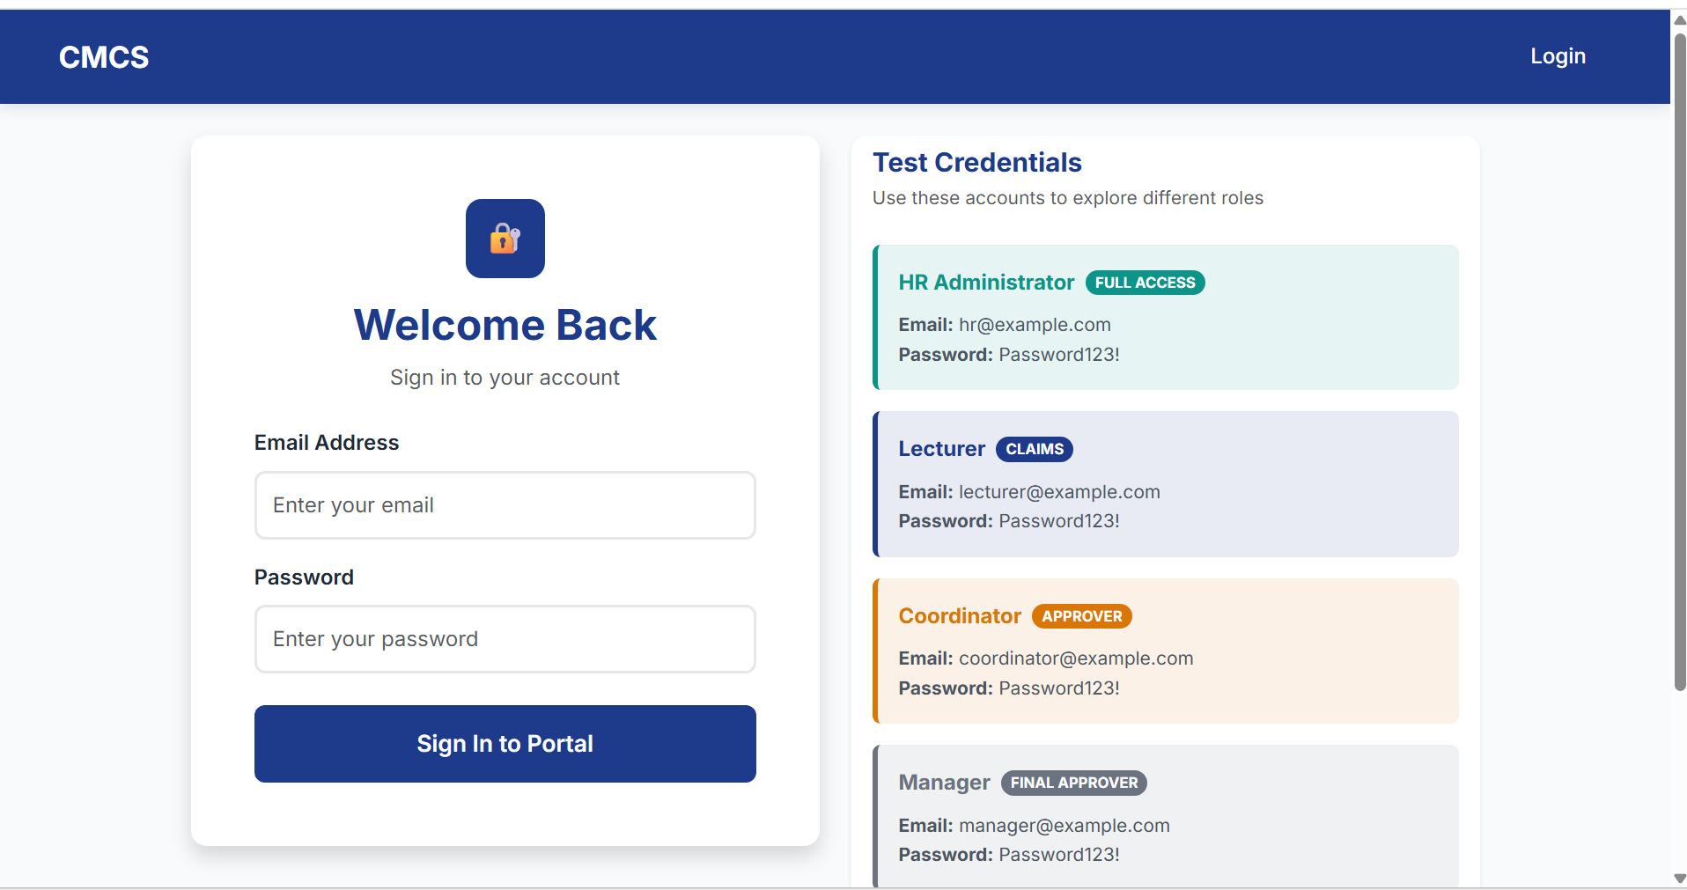
Custom Identity login
Custom Identity/Login
Each user has a secure login
HR creates user accounts

