Slide 1

Console game
C# Part II – Team work assignment
ThunderBird Team
Dian Penchev
Georgi Kostadinov
Georgi Yakimov
Hristo Tsekov
Vladislav Budnikov
Vladislava Atanasova
Telerik Software Academy
academy.telerik.com

Slide 2

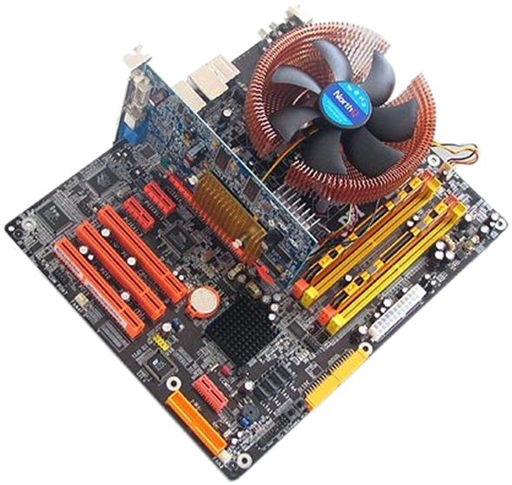
Match-U-Picture
game summary

Slide 3
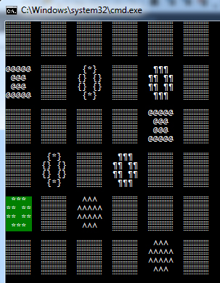
Rules and Controls
The objective of the game is to find all the pairs in the deck. The size of the deck depends on the level you choose:
1) Easy - 4x4 cards
2) Medium - 6x6 cards
3) Hard - 8x8 cards
Move the cursor with the arrow keys on the keyboard until you reach the card you want to open and then press Enter. Do the same for the second card. If they match you have found a pair and the cards will remain open. If they don't match the cards will be closed.
Do the same until you find all the pairs. Try to do it for the least possible time with the least possible moves.

Slide 4
Behind the curtains
Classes and methods
Class Field
• Print cards backs, symbols (simple combination of symbols).
• Coloring the cards over the deck while moving the cursor through the cards.
• Shuffle the symbols in the matrix.
• Comparing opened cards.
• Following player moves
Class Cell
• Constructor for creating objects of type Cell that fills the matrix.
• Displaying opened cards.

Slide 5
Behind the curtains
Classes and methods
Class Player
• Couple of methods that gets data about current player – time, moves, name
• Displaying player results
Class FrontPage
• Displaying all the menus
• Follows player’s choice
• Sound options

Slide 6
Behind the curtains
Exceptions & Sound effects
Exceptions
• If Symbol.txt file is not found
• If RulesAndControls.txt file is not found
• If the player do not enter a name
Sound effects
• When try to move the cursor out of the deck
• When win a game
https://thunderbird.codeplex.com/

Slide 7
Telerik Software Academy
?
?
?
?
?
Questions?
?
?
?
?
?

