Slide 1
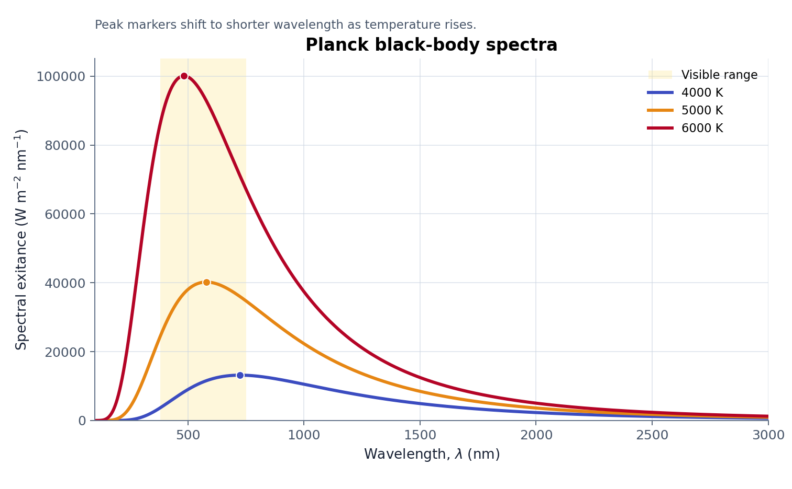
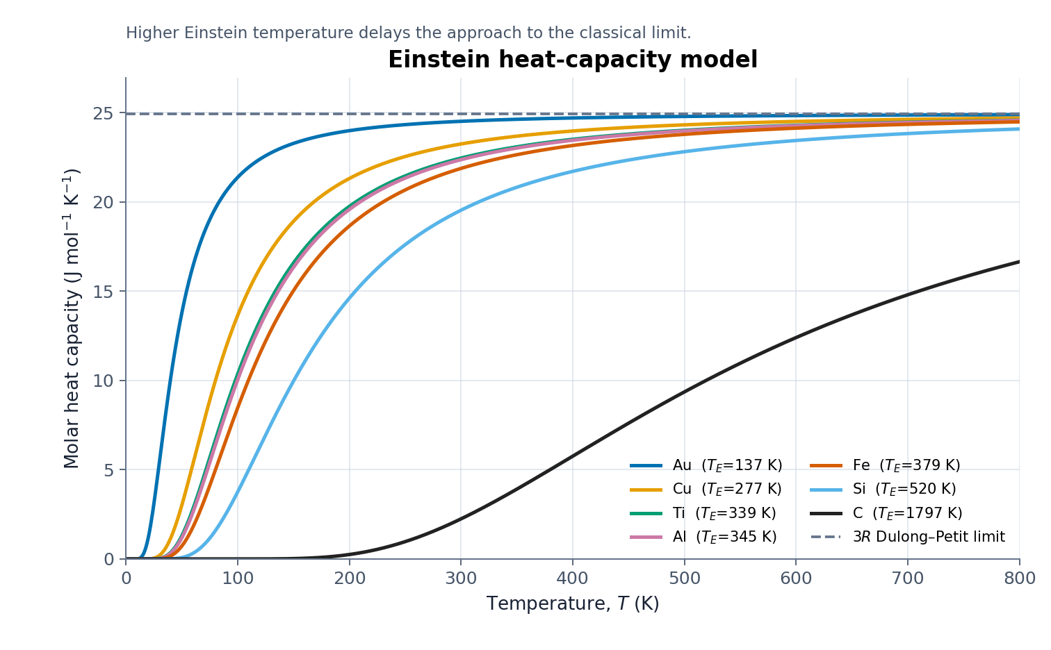
Task 3 — Thermal Radiation and Heat Capacity
Hotter black bodies peak at shorter wavelengths; higher Tₑ delays the rise to 3R.
Peak shifts 724 → 483 nm from 4000 → 6000 K
At 800 K: Au ≈ 3R; carbon remains below the limit
PLANCK VALIDATION
EINSTEIN VALIDATION
27/27 CHECKS PASS
λₘₐₓT = b • M = σT⁴
0 ≤ Cᵥ ≤ 3R • universal vs T/Tₑ
BPhO Computational Challenge 2026
Notes:
FINAL SCRIPT (approximately 17–18 seconds)
Task 3 models Planck radiation and Einstein heat capacity. Increasing temperature moves the black-body peak to shorter wavelengths, while total emission follows T to the fourth. For solids, the Einstein temperature sets how quickly heat capacity rises towards three R. All twenty-seven analytical and numerical checks passed.
CUES
0–7 s: Planck spectrum and peak shift.
7–14 s: Einstein curves and three-R limit.
14–18 s: validation band.

