Slide 1
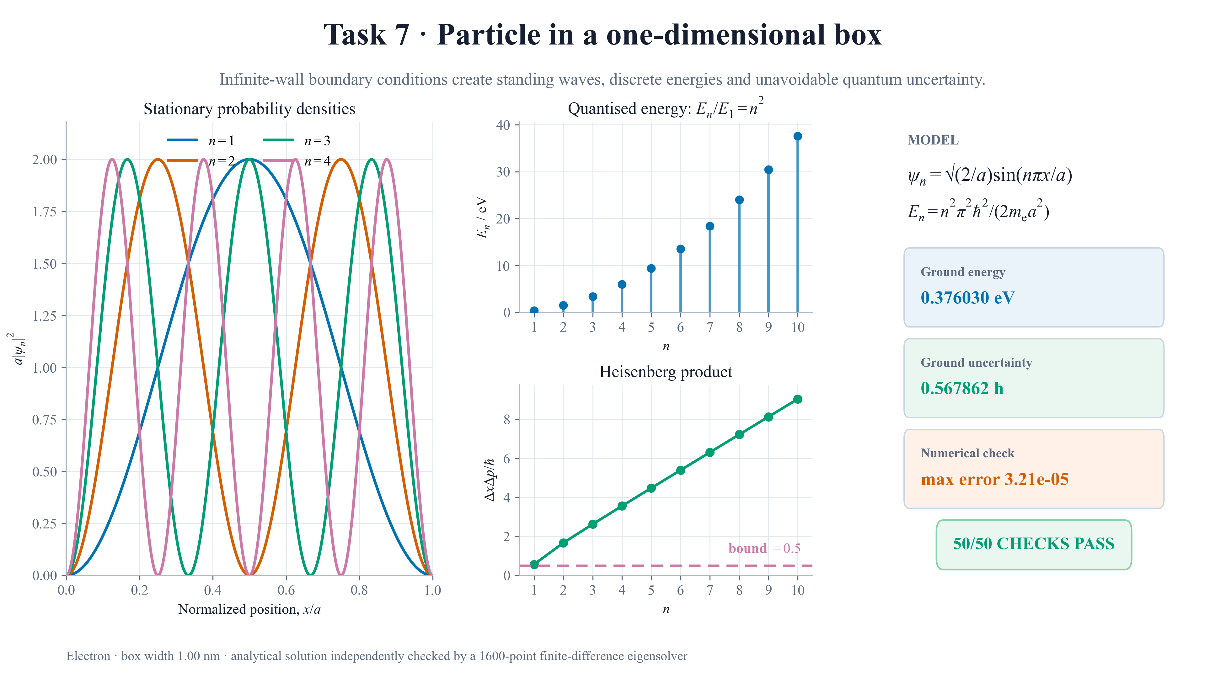
Notes:
FINAL SCRIPT (approximately 18 seconds)
Task 7 solves an electron in a one-nanometre infinite box. Boundary conditions create standing waves and discrete energies growing as n squared. The probability densities remain normalised, while the uncertainty calculation gives 0.568 h-bar in the ground state, above Heisenberg's half-h-bar limit. Fifty independent checks pass.
CUES
0–6 s: probability densities.
6–11 s: discrete energy spectrum.
11–16 s: uncertainty product and lower bound.
16–18 s: validation badge.

