Slide 1
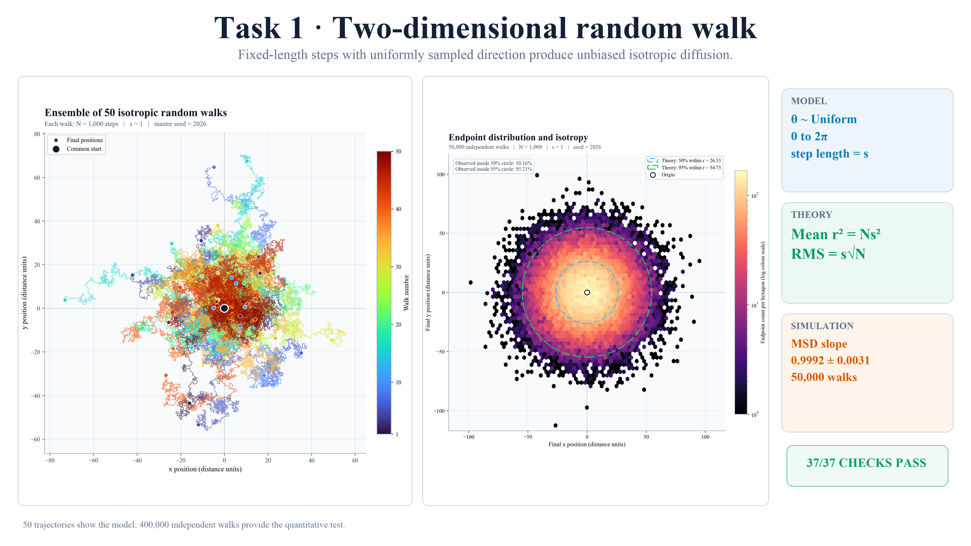
Notes:
TASK 1 FINAL MASTER SCRIPT
Task 1 samples fixed-length steps at uniformly distributed angles. Fifty paths show no preferred direction. Four hundred thousand independent walks give an MSD slope of 0.9992, matching the predicted N s squared and strongly confirming an unbiased, isotropic model.
VISUAL CUE
begin on the path ensemble, move to the endpoint cloud, and finish on the MSD result card.

Slide 2
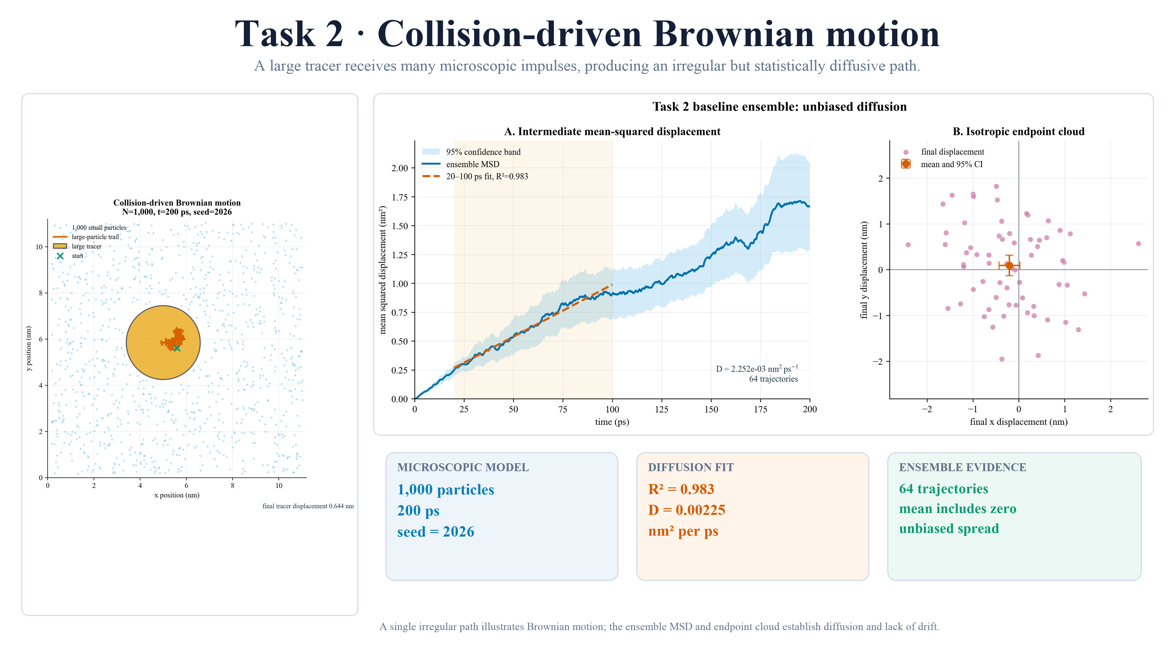
Notes:
TASK 2 FINAL MASTER SCRIPT
Task 2 replaces prescribed steps with collisions. One thousand small particles drive a larger tracer along an irregular path. Across sixty-four runs, endpoints are unbiased and MSD is linear: R squared 0.983, with diffusion coefficient 2.25 times ten to the minus three.
VISUAL CUE
show the tracer scene, then the linear MSD region and endpoint mean.

Slide 3
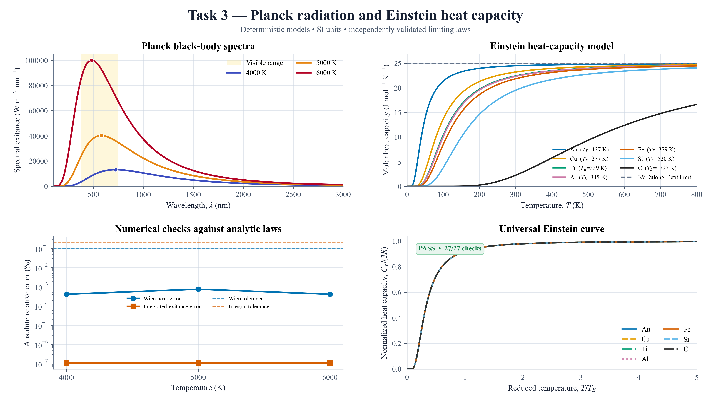
Notes:
TASK 3 FINAL MASTER SCRIPT
Task 3 moves to thermal quantum physics. Higher temperature shifts the black-body peak to shorter wavelength while total emission follows T to the fourth. Einstein temperatures set how seven solids approach the three-R heat-capacity limit. All twenty-seven analytical and numerical checks pass.
VISUAL CUE
compare the two upper plots, then close on the validation panels.

Slide 4
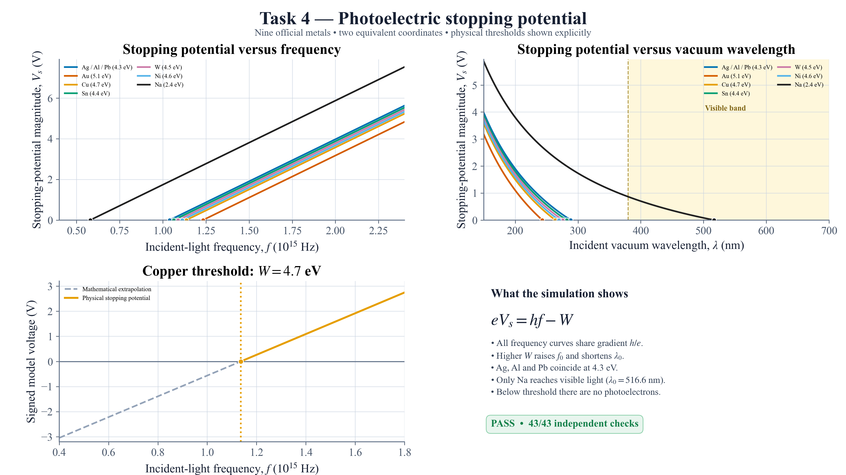
Notes:
TASK 4 FINAL MASTER SCRIPT
Task 4 applies Einstein's photoelectric equation to nine metals. Every stopping-potential curve has gradient h over e; work function sets the threshold. Only sodium reaches visible light at 517 nanometres, and below threshold no photoelectrons exist. All forty-three checks pass.
VISUAL CUE
follow frequency, wavelength and the explicit copper threshold in that order.

Slide 5
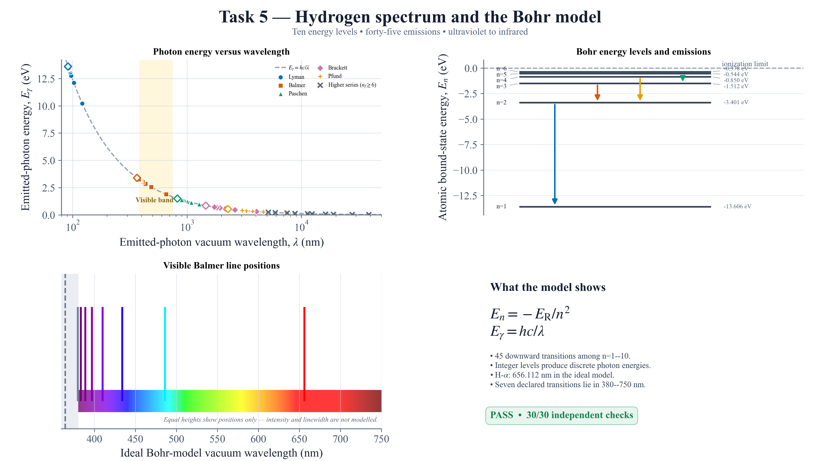
Notes:
TASK 5 FINAL MASTER SCRIPT
Task 5 uses ten Bohr levels to calculate all forty-five downward transitions. Photon energy follows h c over lambda, yet only discrete wavelengths occur. The Balmer series crosses visible light, including ideal H-alpha at 656 nanometres. All thirty checks pass.
VISUAL CUE
move from the energy-wavelength relation to the level diagram and visible Balmer lines.

Slide 6
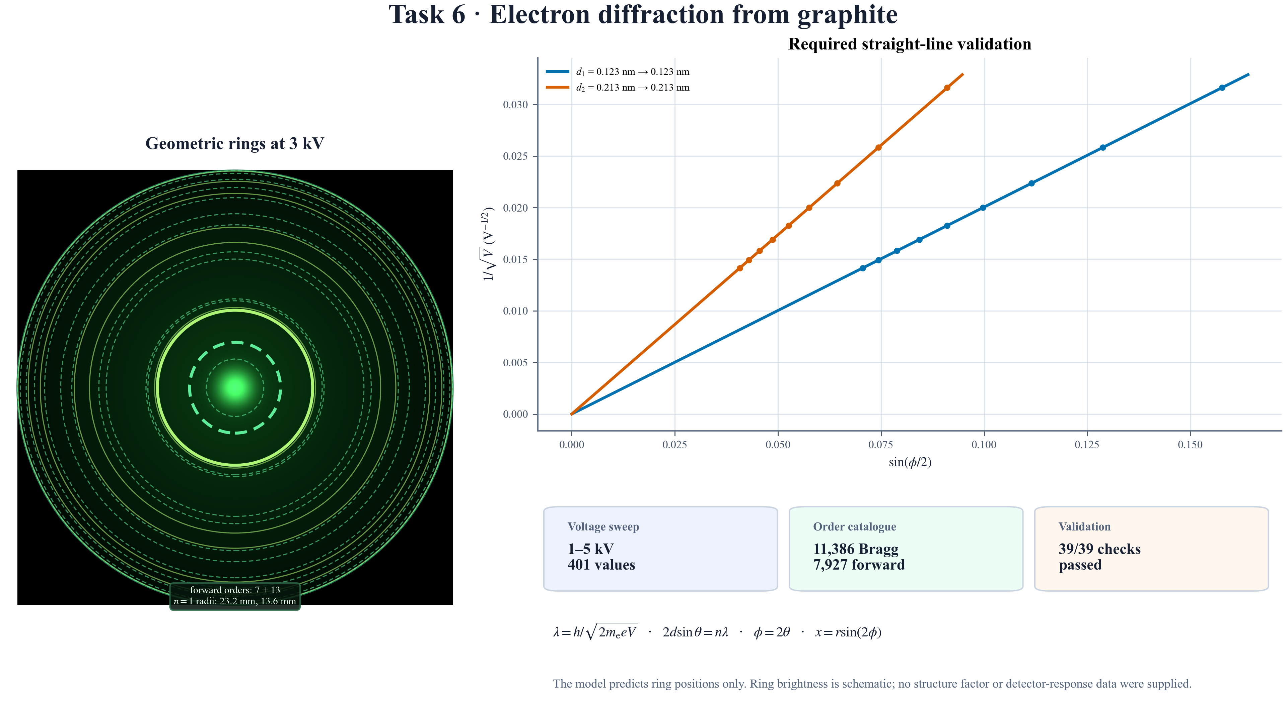
Notes:
TASK 6 FINAL MASTER SCRIPT
Task 6 turns waves into diffraction rings. Higher accelerating voltage shortens the electron de Broglie wavelength. Exact spherical geometry makes the required one-over-root-V graph linear and recovers both graphite spacings, 0.123 and 0.213 nanometres. All thirty-nine checks pass.
VISUAL CUE
begin on the ring geometry and finish on the two recovered slopes.

Slide 7
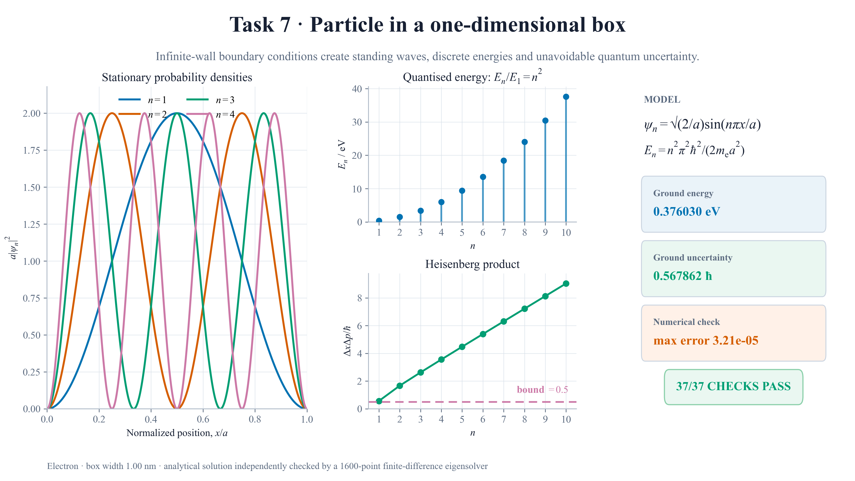
Notes:
TASK 7 FINAL MASTER SCRIPT
Task 7 confines an electron inside a one-nanometre box. Boundary conditions create standing waves and energies growing as n squared. Normalised probability densities and a ground-state uncertainty of 0.568 h-bar satisfy Heisenberg's bound. Thirty-seven independent checks pass.
VISUAL CUE
follow probability density, quantised energies and uncertainty.

Slide 8
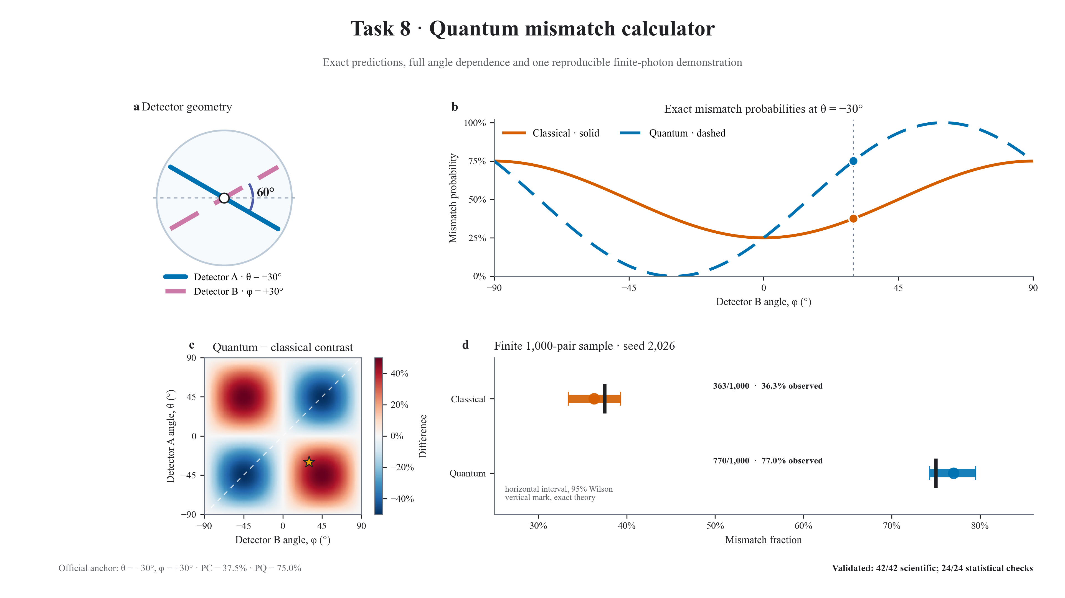
Notes:
TASK 8 FINAL MASTER SCRIPT
Task 8 compares classical Malus probabilities with entangled predictions. At minus and plus thirty degrees, classical mismatch is 37.5 percent, while quantum mismatch is 75 percent. The full sweep separates their angle dependence, and finite samples show counting fluctuations. Sixty-six checks pass.
VISUAL CUE
state the selected-angle comparison, then use the sweep and sample panel as evidence.

Slide 9
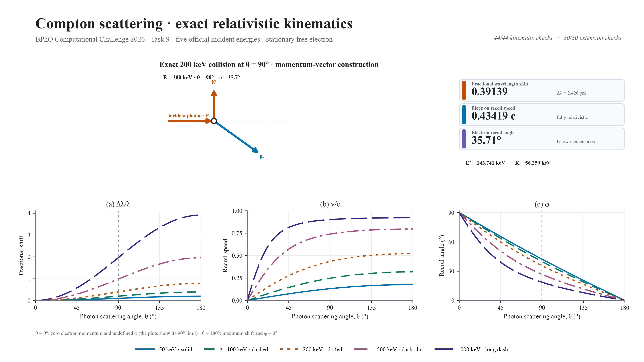
Notes:
TASK 9 FINAL MASTER SCRIPT
Task 9 models exact Compton scattering at five energies. Fractional shift and electron speed rise with angle, while recoil angle falls. At 200 kiloelectronvolts and 90 degrees, the results are 0.391, 0.434 c and 35.7 degrees. Forty-four conservation checks pass.
VISUAL CUE
trace the scattering geometry, then read the three angle-dependent results.

Slide 10
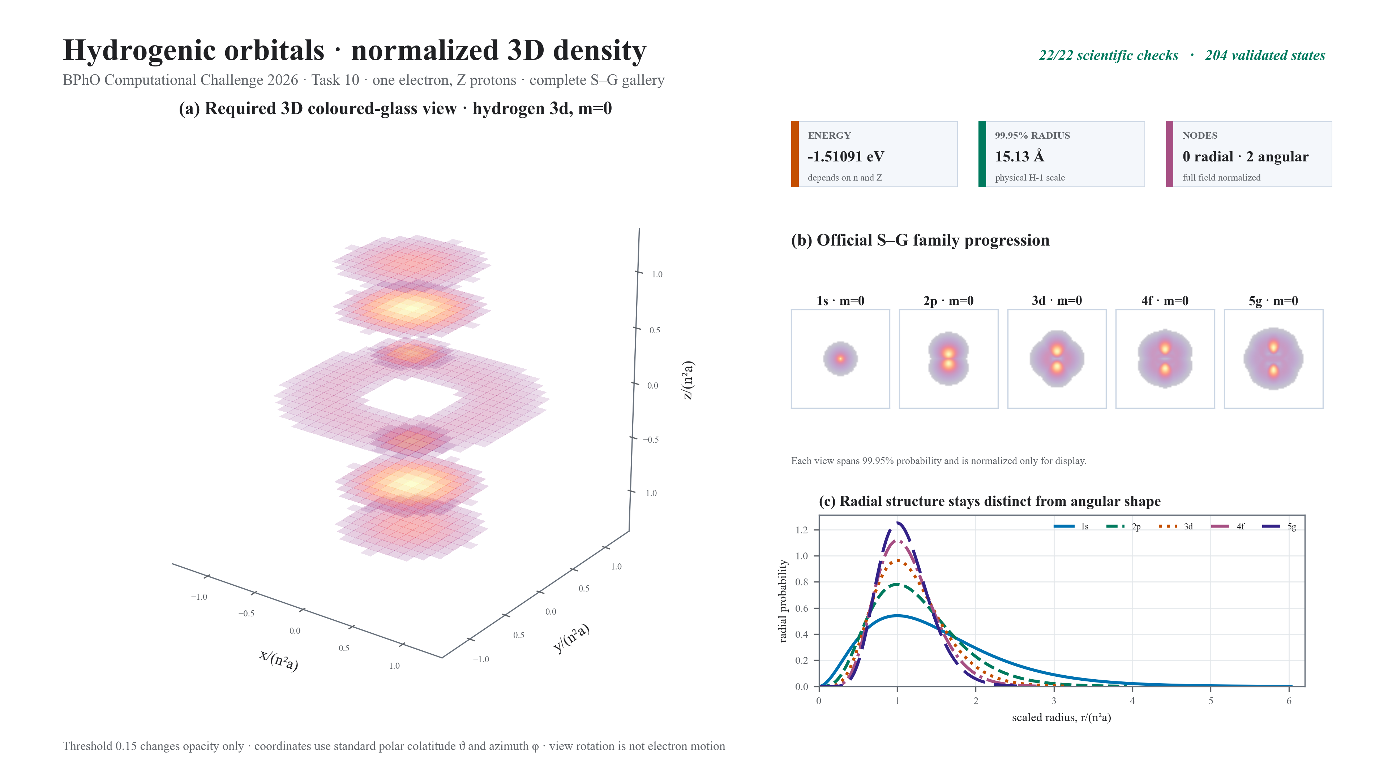
Notes:
TASK 10 FINAL MASTER SCRIPT
Finally, Task 10 constructs normalised hydrogenic orbitals from S through G. Twenty-five real states and coloured-glass slices reveal density and nodes. Energy scales as Z squared over n squared, while size scales inversely with Z. All twenty-two scientific checks pass.
VISUAL CUE
finish on the coloured-glass density, the S-through-G sequence and the validation badge, then pause.

