Slide 1
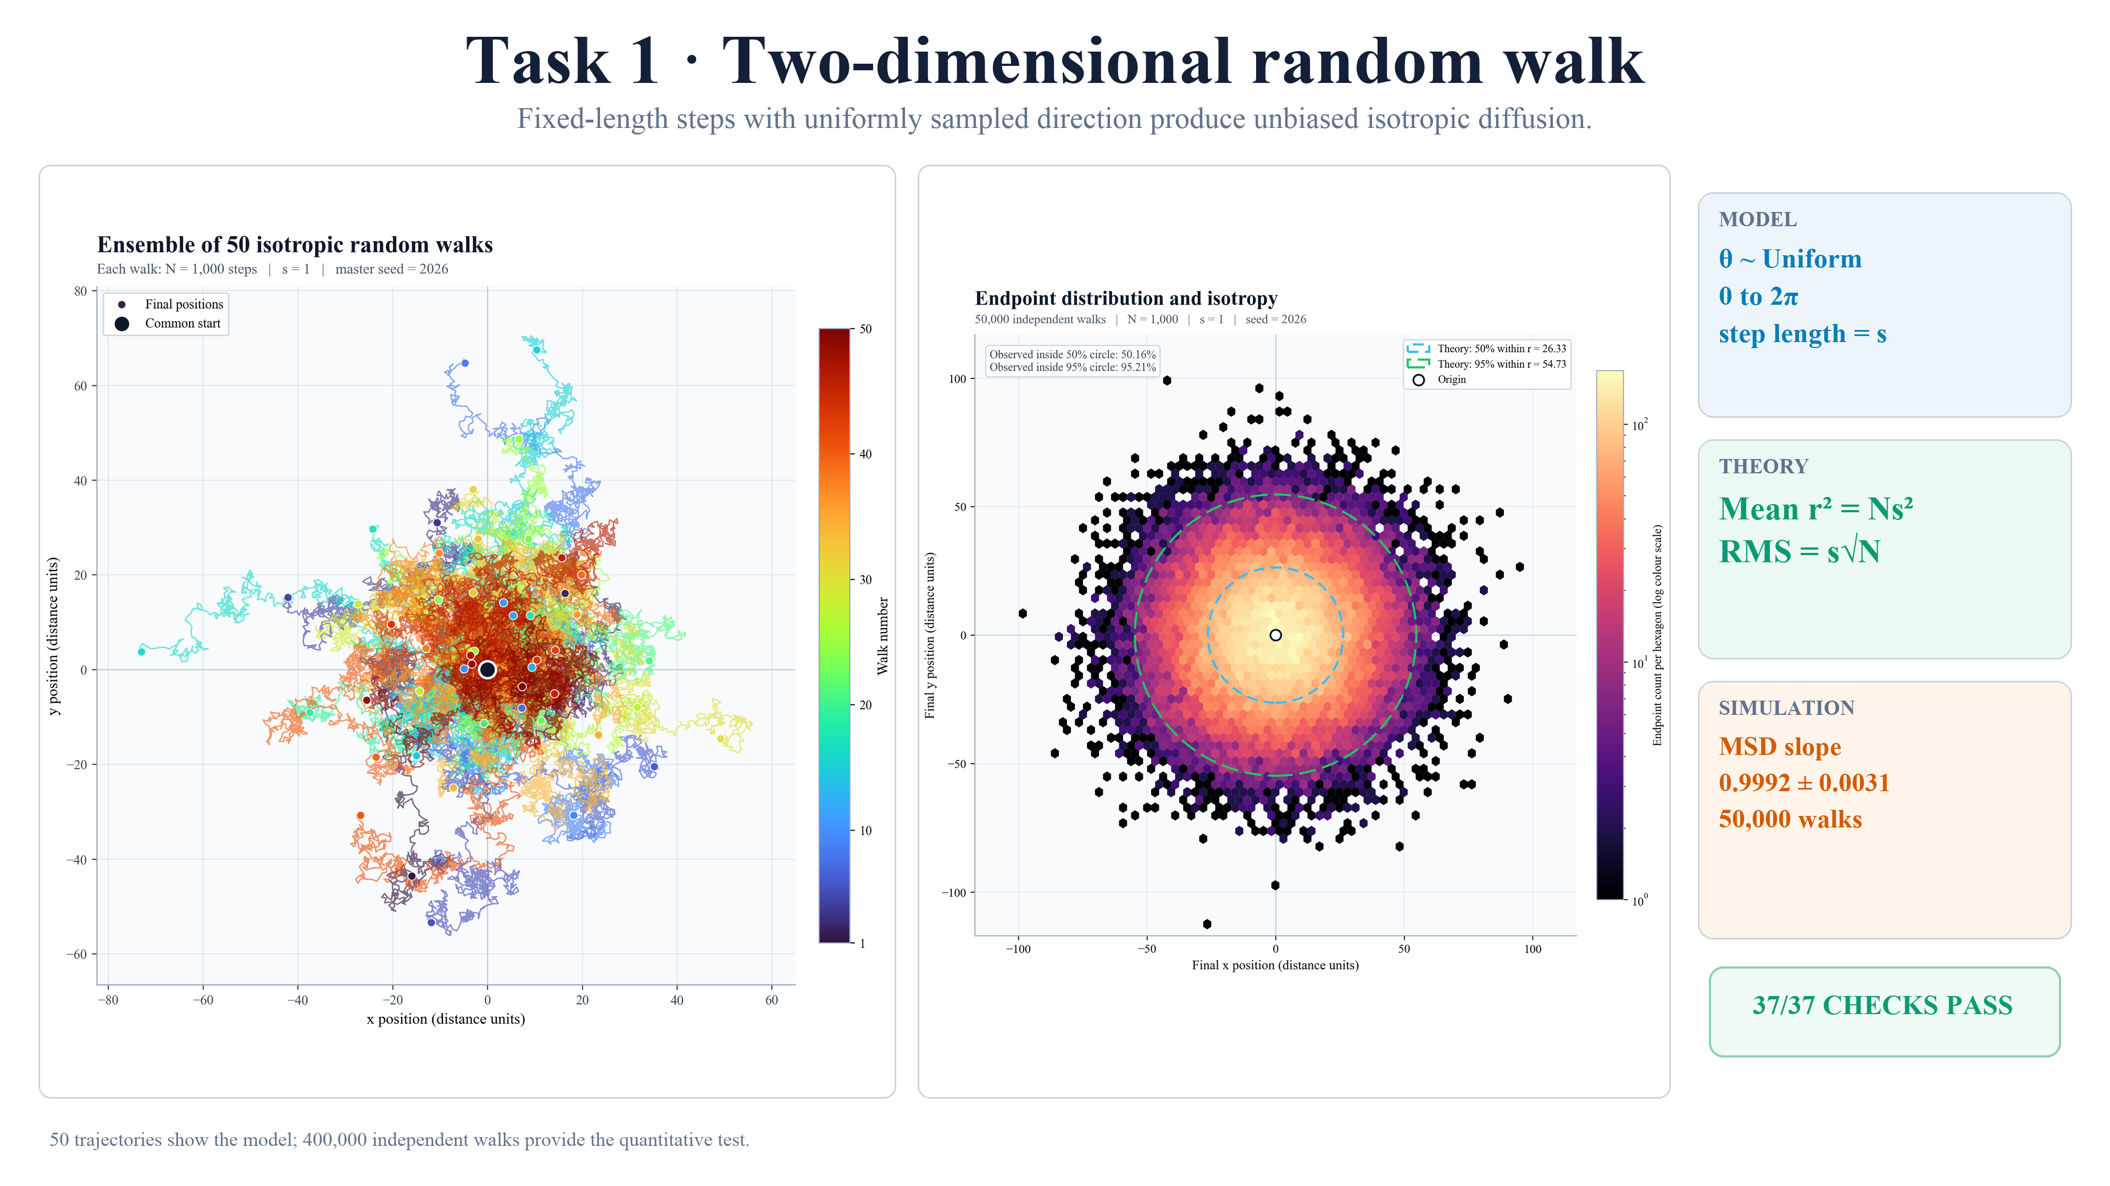
Notes:
FINAL SCRIPT
For Task 1, I modelled fixed-length steps with directions sampled uniformly from zero to two pi. Fifty walks show no preferred direction. Fifty thousand simulations per step count gave a mean squared displacement slope of 0.9992, matching the theoretical value of one.
MASTER-DECK CUE
Follow model, validation evidence, then result.

