Slide 1
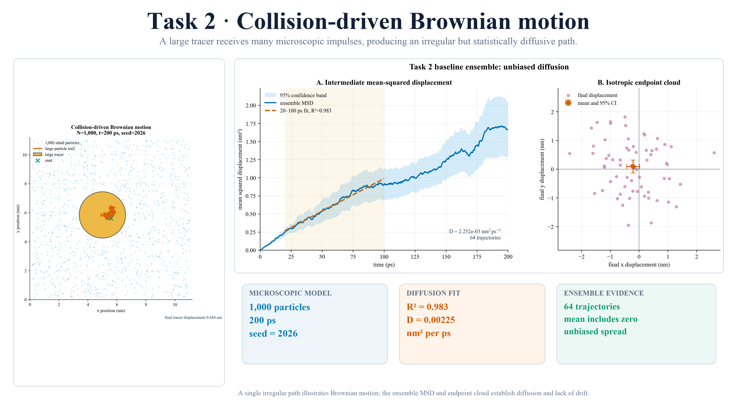
Notes:
FINAL SCRIPT
Task 2 models one thousand small particles colliding with a larger particle initially at rest, producing an irregular path. Across sixty-four runs, displacement was unbiased and mean-squared displacement was linear: R squared 0.983, with a diffusion coefficient of 2.25 times ten to the minus three.
MASTER-DECK CUE
Follow model, validation evidence, then result.

