Slide 1
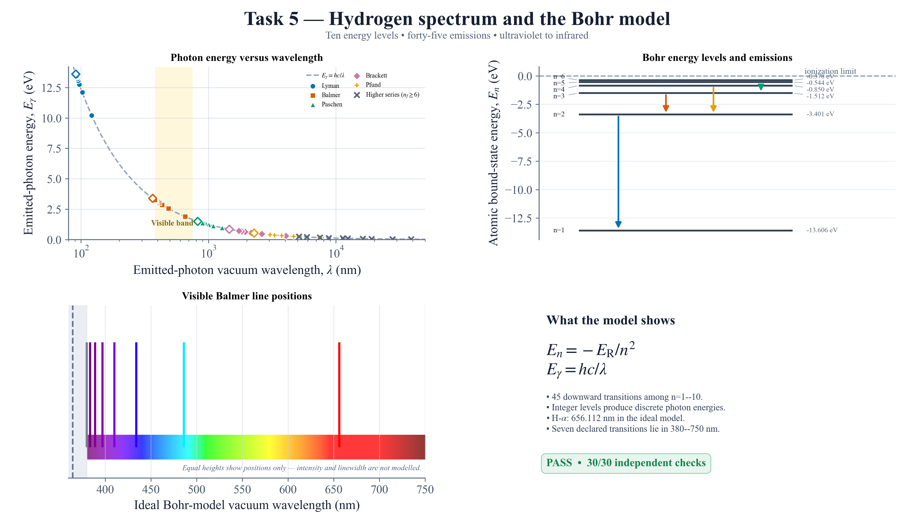
Notes:
FINAL SCRIPT
Task 5 uses ten ideal Bohr energy levels to calculate all forty-five downward level pairs. Each emitted photon follows E equals h c over lambda, but only discrete wavelengths occur. The Balmer series crosses visible light, including ideal H-alpha at 656 nanometres. All thirty independent checks pass.
MASTER-DECK CUE
Follow model, validation evidence, then result.

