Slide 1
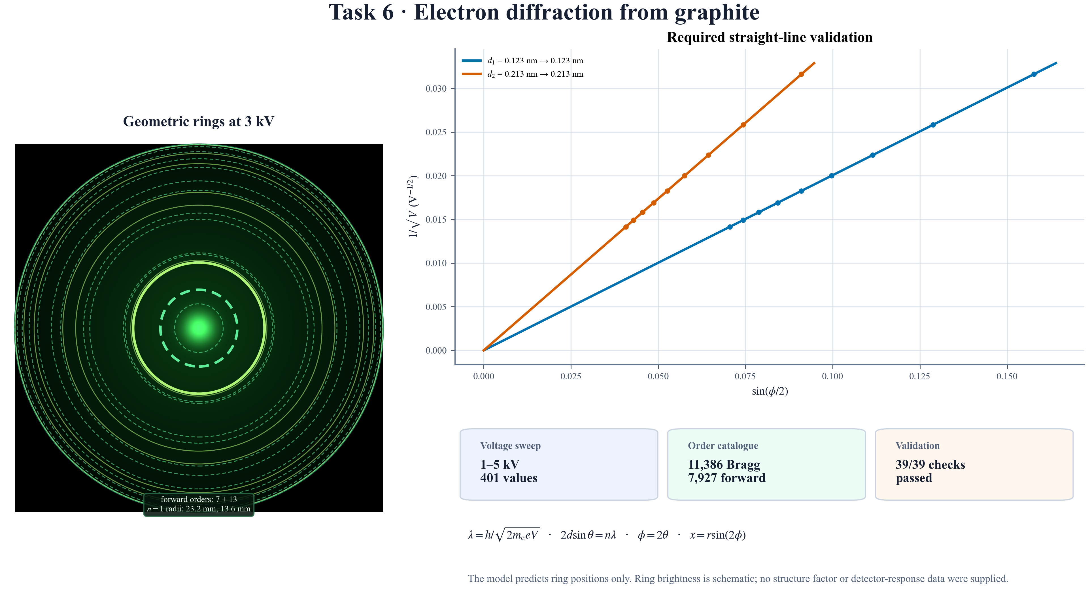
Notes:
FINAL SCRIPT
Task 6 models electrons accelerated through one to five kilovolts. Higher voltage shortens their de Broglie wavelength, changing the graphite diffraction rings. Using exact spherical geometry and both graphite spacings, the required one-over-root-V graph is perfectly linear and recovers 0.123 and 0.213 nanometres. All thirty-nine independent checks pass.
MASTER-DECK CUE
Follow model, validation evidence, then result.

