Slide 1
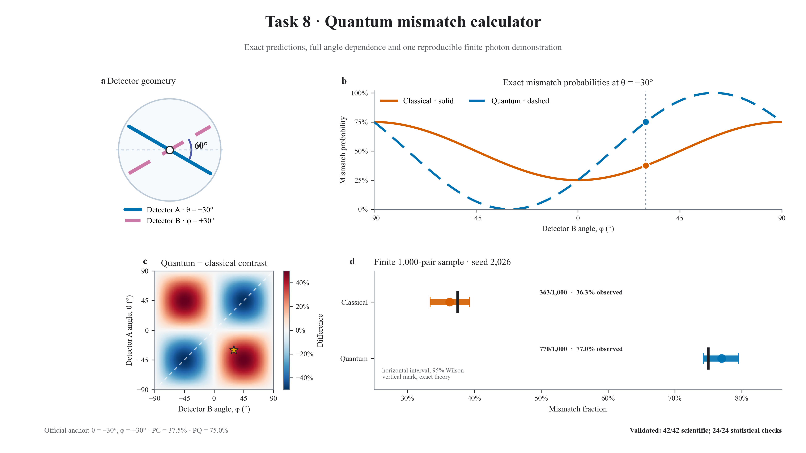
Notes:
FINAL SCRIPT (approximately 18 seconds)
Task 8 compares classical Malus probabilities with the entangled quantum prediction. At minus thirty and plus thirty degrees, classical mismatch is thirty-seven point five percent, while quantum mismatch is seventy-five percent. The sweep exposes their different angle dependence; a finite sample shows counting fluctuations. All sixty-six validation checks pass.
CUES
0–5 s: detector geometry and sixty-degree separation.
5–11 s: exact sweep and official probability markers.
11–15 s: contrast heatmap and finite sample.
15–18 s: scientific and statistical validation statement.

