Slide 1
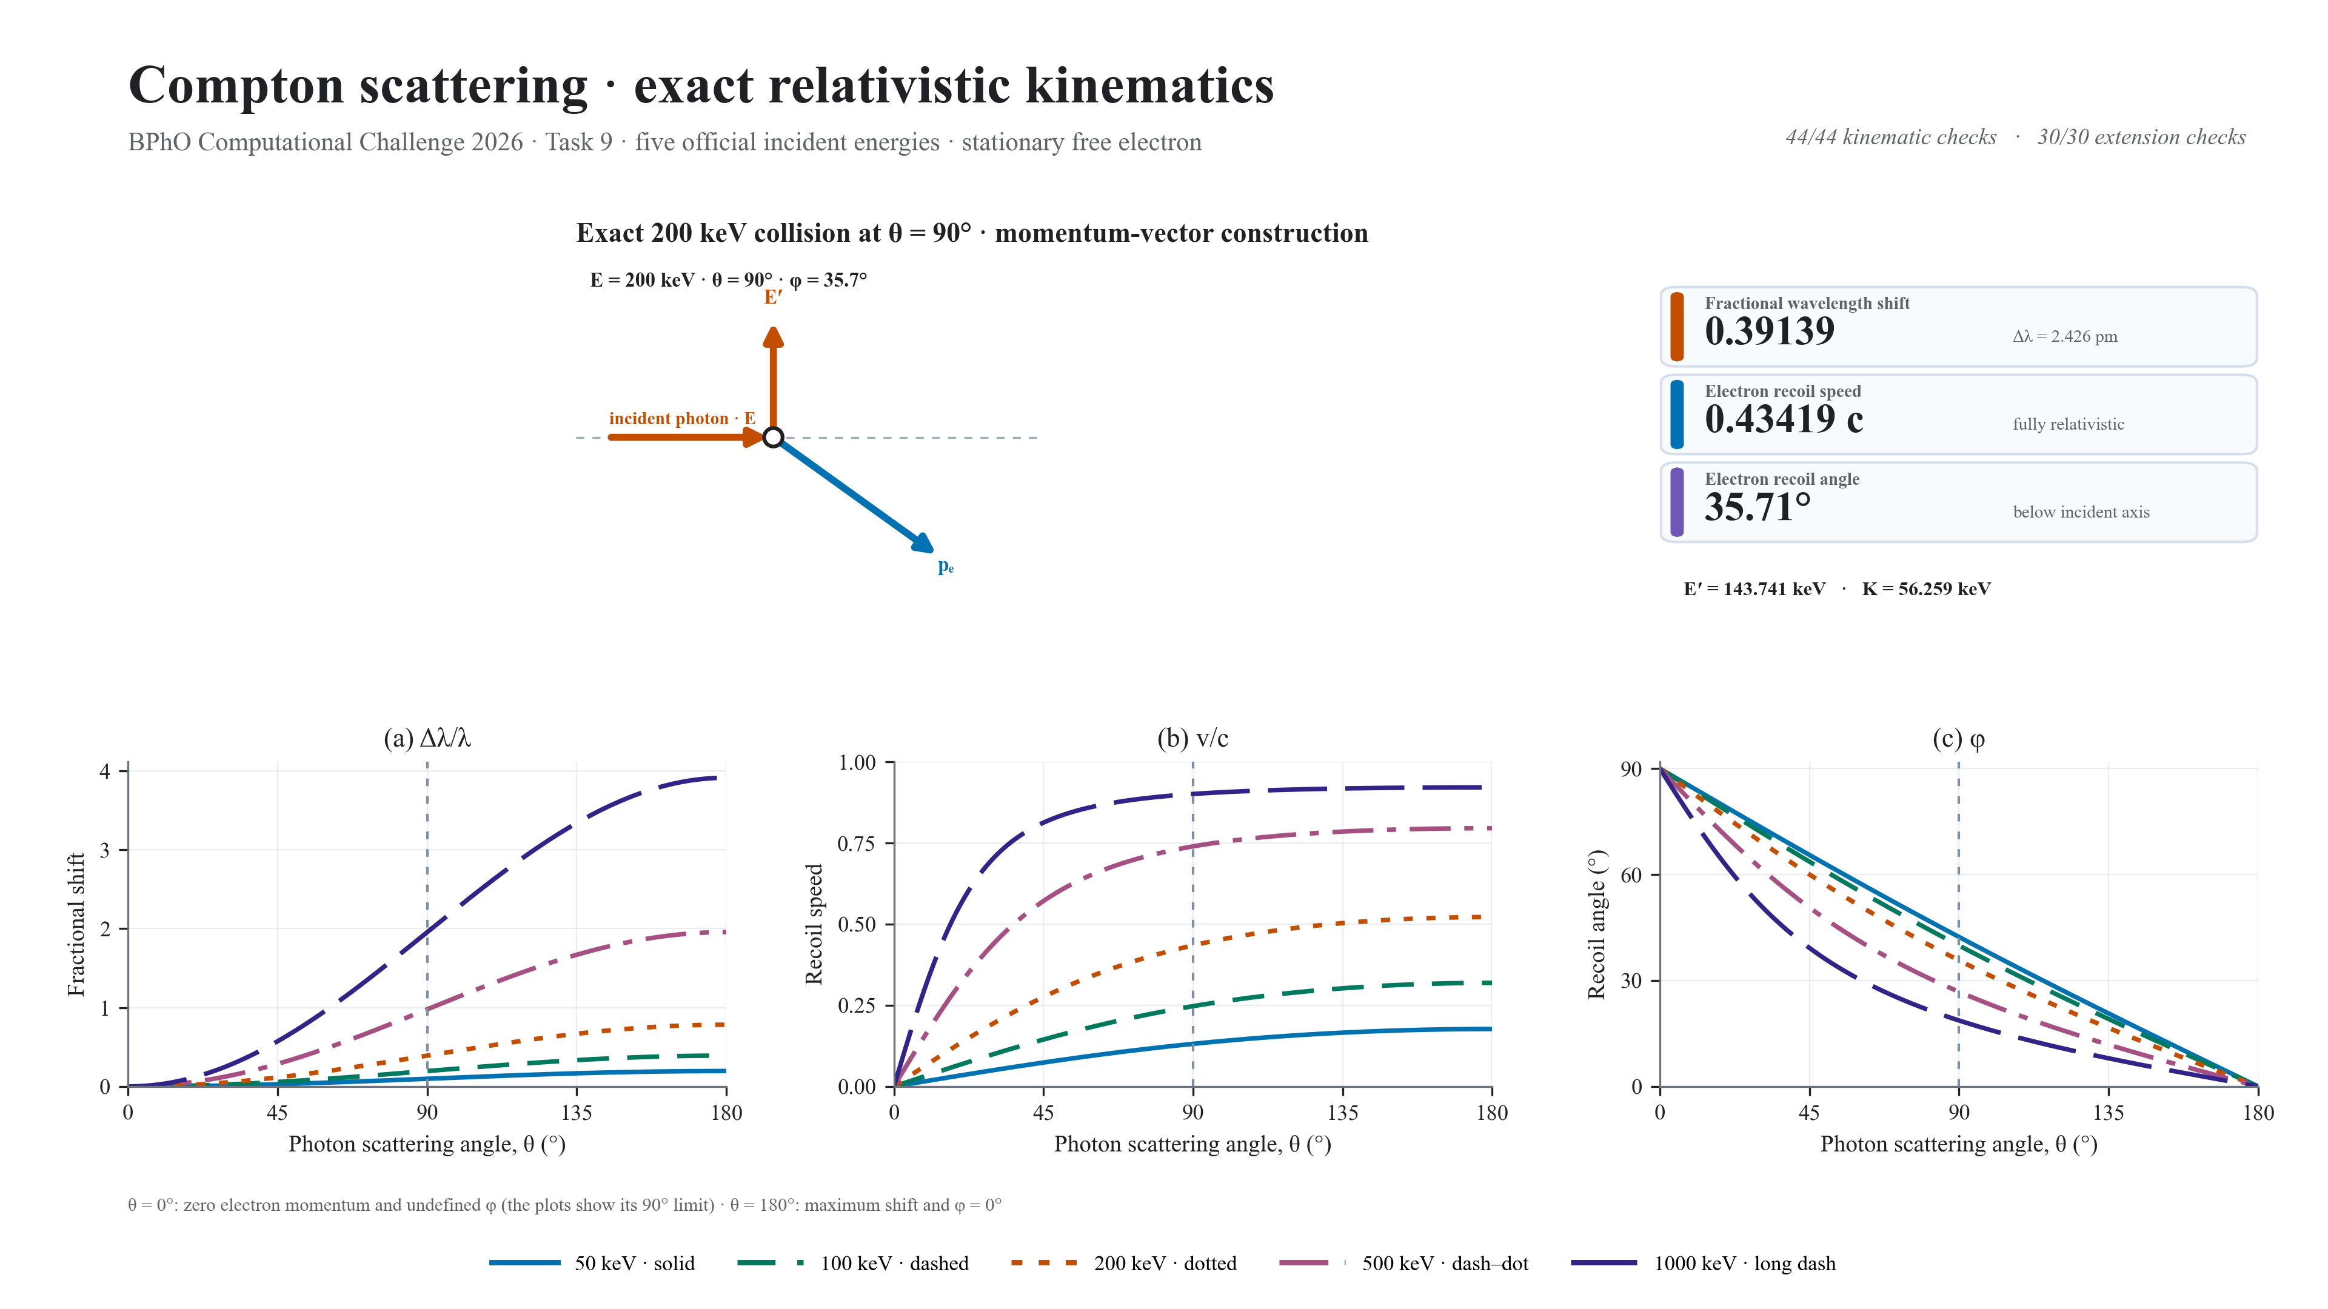
Notes:
FINAL SCRIPT (approximately 18 seconds)
Task 9 models exact Compton scattering at five energies. Fractional shift and electron speed rise with angle, while recoil angle falls to zero at backscatter. At 200 keV and 90 degrees we obtain 0.391, 0.434 c and 35.7 degrees. Energy-momentum conservation passed all 44 checks.
CUES
0–4 s: exact 200 keV momentum triangle.
4–10 s: wavelength-shift and relativistic-speed curves.
10–15 s: recoil-angle curves and 200 keV reference markers.
15–18 s: core and extension validation totals.

