Slide 1
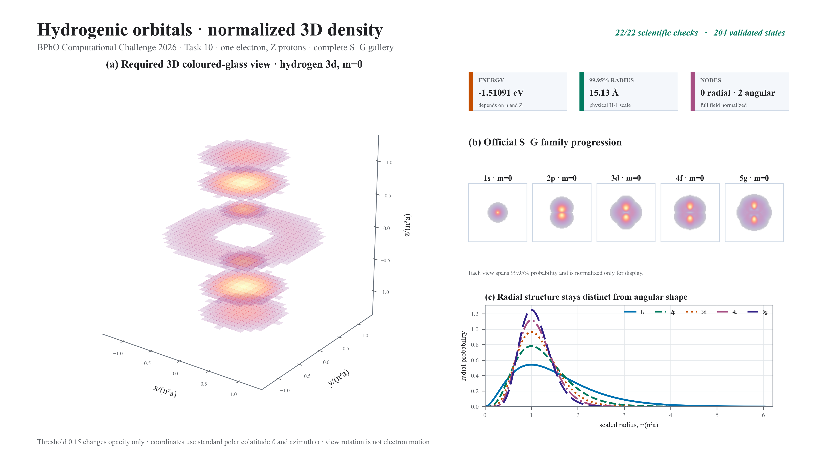
Notes:
FINAL SCRIPT (approximately 18 seconds)
Task 10 constructs normalized hydrogenic orbitals from S through G. The gallery contains twenty-five real states, while coloured-glass slices reveal three-dimensional density and nodes. Energy scales as Z squared over n squared, and size as one over Z. View rotation is camera motion, not electron motion; all twenty-two checks pass.
CUES
0–5 s: coloured-glass density and node result cards.
5–10 s: S-through-G family progression and 25-state gallery.
10–15 s: radial structure and Z-scaling relationships.
15–18 s: validation totals and camera-motion caveat.

