Slide 1
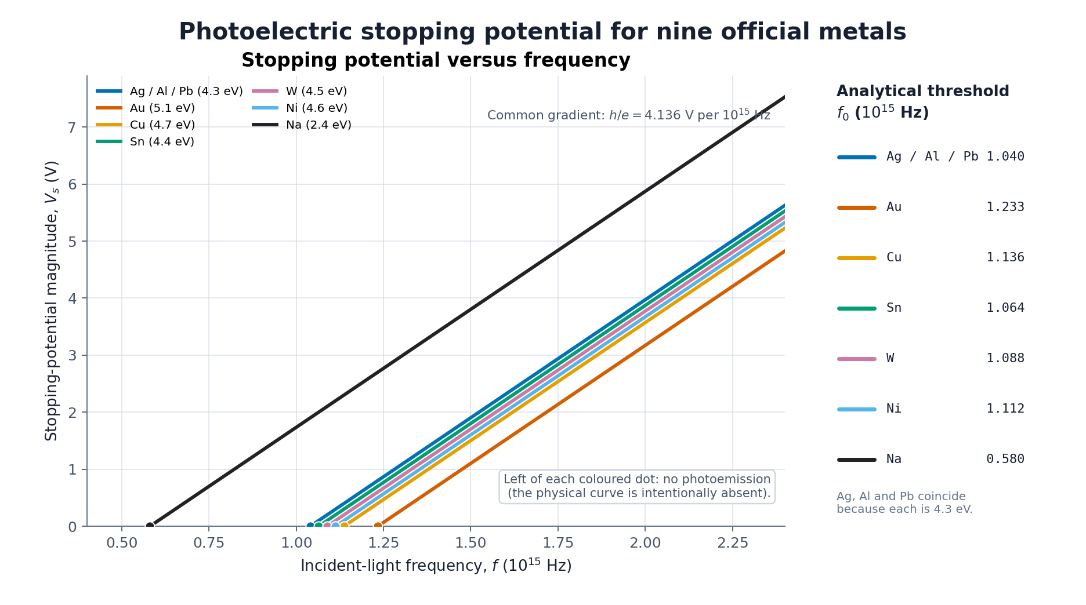
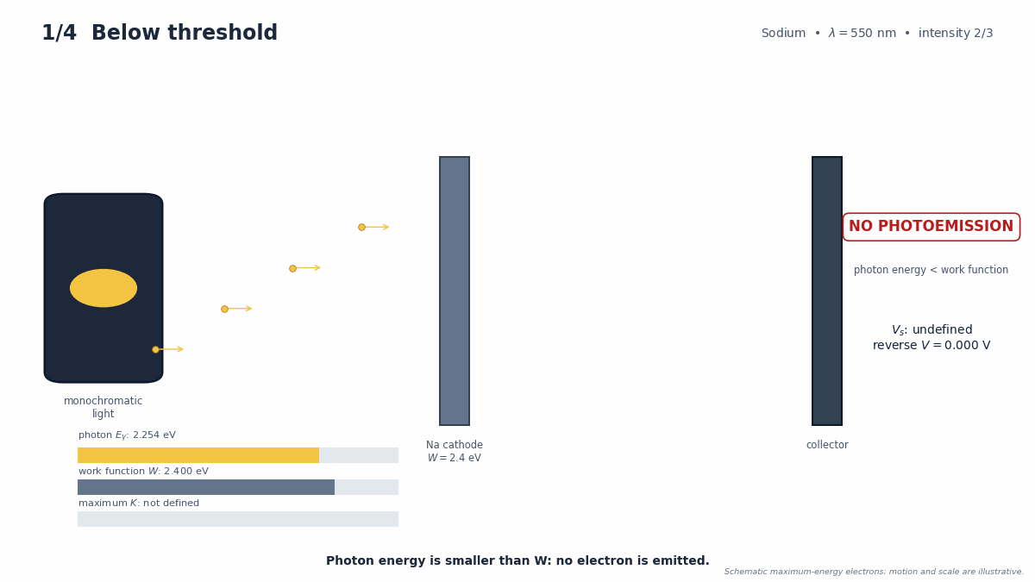
Task 4 — Photoelectric Effect
Work function sets the emission threshold; photon energy above it sets the stopping potential.
Intensity changes count, not maximum energy
eVₛ = hf − W
Vₛ = (h/e)f − W/e
Na visible cut-off: 516.6 nm
All physical curves share gradient h/e; W shifts the threshold
43/43 CHECKS PASS
BPhO Computational Challenge 2026
Notes:
FINAL SCRIPT (approximately 17–18 seconds)
Task 4 models Einstein's photoelectric equation for nine metals. Every stopping-potential curve has gradient h over e; the work function sets the threshold. Sodium reaches visible light up to 517 nanometres. Below threshold, no photoelectrons exist, so stopping potential is undefined. All forty-three independent checks passed.
CUES
0–7 s: curves and threshold markers.
7–12 s: sodium cut-off.
12–18 s: animation status and validation badge.

