Slide 1
Real-Time Strategy Games
Mostafa M. Aref
Ain Shams University
Faculty of Computer & Information Sciences

Slide 2
Topics for the term paper
Reinforcement Learning
Opponent Modeling
Spatial And Temporal Reasoning
Resource Management
Adversarial Real–time Planning
Planning Under Uncertainty
Case-based Planning
Case-based Reasoning
Decision making under uncertainty
Dynamic Scripting
Collaboration
Path Finding
Terrain Analysis
Tactical Reasoning
Multi-agents In RTS

Slide 3
Origins: Turn-Based Strategy Games
Early strategy games was dominated by turn-based games
  Derivated from board games
    Chess
    The Battle for Normandy (1982)
    Nato Division Commanders (1985)
Turn-based strategy:
  game flow is partitioned in turns or rounds.
  Turns separate analysis by the player from actions
  “harvest, build, destroy” in turns
  Two classes:
    Simultaneous
    Mini-turns

Slide 4
Real-Time Strategy Games
Gameflow is continuous
No turns between players
Often refer to as “harvest, build, destroy” games in real-time
Rewards speed of thinking rather then in-depth thinking
  Very popular genre: hundreds of RTS games released
    Warcraft, Red Alert, Dune II, Dark Reign, Starcraft, Command and Conquer, Earth 2140, Stronghold, Total Annihilation, This means war!

Slide 5
First Real-Time Strategy Game
Stonkers (for Spectrum): 1985
Units are moved using waypoints
Units attack enemies automatically on proximity.
Three kinds of combat units: Infantry, Artillery and Armour
Units must be resupplied by trucks

Slide 6
First RTS Game in PC
Dune II (1992)
Combines real-time from Eye of the Beholder with resource management
Based on Book/Movie
  Fractions fighting for only resource available, tiberium
Bases can be built anywhere in map
Technology tree
Different sides can have different units

Slide 7
Two Classics Head to Head
Warcraft (1994)
  Fantasy world (orcs!)
  Hand to hand fighting
  Two resources: wood and gold
  Units, technology of two sides is essentially equivalent
  Multiplayer!
Command and Conquer (1995)
  Futuristic
  Story told through cut-scenes
  As with Dune II difference between units:
    GDI: slow, more powerful, expensive
    Nod: fast, weaker, cheap
  Sole survivor: online version m ore action tan strategy but based on CnC world

Slide 8
Second Generation RTS
Total Annihilation (1997)
  3D and terrain playing a factor
  Units can be issued command queues
  Commander unit
    Outmost fun in multiplayer
  No story, no cut scenes
Dark Reign (1997)
  3D and terrain playing a factor
  Units can be issued command queues
  Setting of autonomy level for units
    If taking too many hits, units could go automatically to repair shop
    Or follow enemy for a while and then go back to initial location

Slide 9
Second Generation RTS (2)
Starcraft (1998)
  2D! so graphics is not a crucial factor in fun
  Fractions had very different units and technology
    Therefore, required different strategies
  Rock, scissors, paper well implemented
  Involved storyline: Sarah Kerrigan
Genre Today
  Empire Earth
    Captures in part scope of a turn-based game like civilization as an RTS
  Warcraft 3
    Adds RPG elements: hero units that influence other units in the game
  Age of Empire 3: coming soon
  Starcraft 2?

Slide 10
Game AI
Term refers to the algorithms controlling:
  The computer-controlled units/opponents
  Gaming conditions (e.g., weather)
  Path finding
Programming intentional mistakes is also part of controlling the computer opponent “AI”
Programming “Good” AI Opponent
  Move before firing
  Make mob/enemy visible
  Have horrible aim (rather than doing less damage)
  Miss the first time
  Warn the player (e.g., music, sound)

Slide 11
Case-based reasoning
Case-Based Reasoning (CBR) is a name given to a reasoning method that uses specific past experiences rather than a corpus of general knowledge.
It is a form of problem solving by analogy in which a new problem is solved by recognizing its similarity to a specific known problem, then transferring the solution of the known problem to the new one.
CBR systems consult their memory of previous episodes to help address their current task, which could be:
planning of a meal,
classifying the disease of a patient,
designing a circuit, etc.

Slide 12
CBR Solving Problems
Solution
Retain
Review
Database
Adapt
Retrieve
Similar
New
Problem

Slide 13
CBR System Components
Case-base
  database of previous cases (experience)
  episodic memory
Retrieval of relevant cases
  index for cases in library
  matching most similar case(s)
  retrieving the solution(s) from these case(s)
Adaptation of solution
  alter the retrieved solution(s) to reflect differences between new case and retrieved case(s)

Slide 14
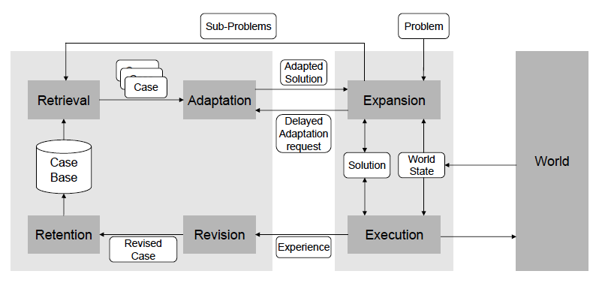
The on-line case-based planning cycle

Slide 15
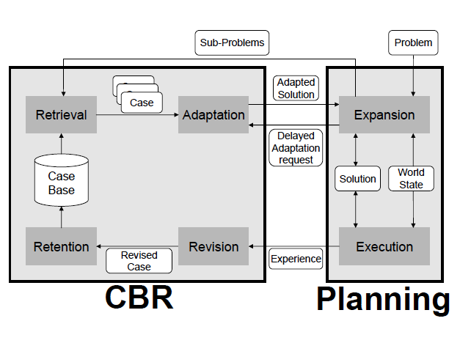
Two interpretations of the OLCBP

Slide 16
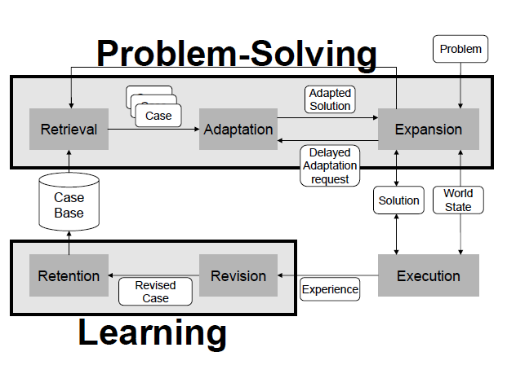
Two interpretations of the OLCBP

Slide 17
On-Line CBP in RTS Games
Real-time strategy (RTS) games have several characteristics that make the application of traditional planning approaches difficult:
  They have huge decision space (i.e. the set of dierent actions that can be executed in any given state is huge).
  Huge state space (the combination of the previous bullet and this bullet makes them not suitable for search based AI techniques.
  They are non-deterministic.
  They are incomplete information games, where the player can only sense the part of the map he has explored and include unpredictable opponents.
  They are real-time. Thus, while the system is deciding which actions to execute, the game continues executing and the game state changes constantly.
  They are difficult to represent using classical planning formalisms since post conditions for actions cannot be specified easily.

Slide 18
Plan Representation
The basic constituent piece is the snippet. Snippets are composed of three elements:
  A set of preconditions that must be satised before the plan can be executed.
  A set of alive conditions that represent the conditions that must be satisfied during the execution of the plan for it to have chances of success (“maintenance goals“).
  The plan itself. which can contain the following constructs: sequence,
  parallel, action, and subgoal, where:
    an action represents the execution of a basic action in the domain of application (a set of basic actions must be defined for each domain), and
    a subgoal means that the execution engine must find another snippet that has to be executed to satisfy that particular subgoal.

Slide 19
Plan Components
Three things need to be defined:
  A set of basic actions that can be used in the domain.
  A set of sensors, that are used to obtain information about the current state of the world, and are used to specify the preconditions, alive conditions and goals of snippets.
  A set of goals. Goals can be structured in a specialization hierarchy in order to specify the relations among them.
References
  “On-line Case-Based Planning”
  S. Ontanon, K. Mishra, N. Sugandh and A. Ram
  Georgia Institute of Technology

Slide 20
Reinforcement Learning
What is Learning ?
  Percepts received by an agent should be used not only for acting, but also for improving the agent’s ability to behave optimally in the future to achieve its goal.
Learning Types
  Supervised learning
  Unsupervised Learning
  Reinforcement learning: we examine how an agent can learn from success and failure, reward and punishment.
    learning from trial-and-error and reward by interaction with an environment.
When to provide Punishments & Rewards
  Reward when AI achieves objective or the opponent finds itself in a state where it can’t achieve its objective
  Reward when AI does something to increase the chance of achieving objective (guided rewards)
  Punish when AI does something to decrease the chance of achieving objective (guided negative rewards)

Slide 21
Why Learning of Game AI?
The process of learning in games generally implies the adaptation of behavior for opponent players in order to improve performance
  Self-correction
    Automatically fixing exploits
  Creativity
    Responding intelligently to new situations
  Scalability
    Better entertainment for strong players
    Better entertainment for weak players
The reinforcement learning model consists of:
  a discrete set of environment states: S ;
  a discrete set of agent actions A ; and
  a set of scalar reinforcement signals; typically {0,1} , or the real numbers (different from supervised learning)

Slide 22
An example
An example dialog for agent environment relationship:
    Environment: You are in state 65. You have 4 possible actions.
    Agent: I'll take action 2.
    Environment: You received a reinforcement of 7 units.
    You are now in state 15.
    You have 2 possible actions.
    Agent: I'll take action 1.
    Environment: You received a reinforcement of -4 units.
    You are now in state 65.
    You have 4 possible actions.
    Agent: I'll take action 2.
    Environment: You received a reinforcement of 5 units.
    You are now in state 44.
    You have 5 possible actions.

Slide 23
Learning Methods
Monte-Carlo methods
  Requires only episodic experience – on-line or simulated
  Based on averaging sample returns
  Value estimates and policies only changed at the end of each episode, not on a step-by-step basis
  Policy Evaluation
    Compute average returns as the episode runs
    Two methods: first-visit and every-visit
    First-visit is most widely studied

Slide 24
Learning Methods (2)
Dynamic Programming
  main idea
    use value functions to structure the search for good policies
    need a perfect model of the environment
  Classically, a collection of algorithms used to compute optimal policies given a perfect model of environment
  The classical view is not so useful in practice since we rarely have a perfect environment model
  Provides foundation for other methods
  Not practical for large problems
  Use value functions to organize and structure the search for good policies.
  Iterative policy evaluation using full backups

Slide 25
Learning Methods (2)
Temporal Difference methods
  Central and novel to reinforcement learning
  Combines Monte Carlo and DP methods
  Can learn from experience w/o a model – like MC
  Updates estimates based on other learned estimates (bootstraps) – like DP
  Works for continuous tasks, usually faster then MC

Slide 26
Opponent Modeling
What Is Good AI?
  Display of realistic behavior when reacting to the player.
  Able to challenge the player both tactically and strategically.
But What About
  Adaptation to the quirks and habits of a particular player over time.
  At the moment, many games only implement difficulty sliders.
The Player Model
  Something like a profile, the player model is a set of demographics on a particular individual’s skills, preferences, weaknesses, and other traits.
  The model can be easily updated as the game progresses, whenever the AI interacts with the player.

Slide 27
The Player Model
  The game AI can then query the user model, allowing it to select reactions and tactics that would best challenge the player’s personal style.
  The profile could be for a single play, or even be updated over multiple sessions.
Model Design
  The model is a collection of numerical attributes, representing the traits of the player.
  Each attribute is an aspect of player behavior, which can be associated with strategies, maneuvers, or skills.

Slide 28
Model Implementation
  At the most basic level, the player model is a statistical record of the frequency of some subset of player actions.
  Each trait is represented by a floating-point value between 0 and 1, where 0 roughly means “the player never does this” and 1 means “the player always does this.”
  Each trait is initialized to 0.5 to reflect the lack of knowledge.
  The update method is based on the least mean squares (LMS) training rule, often used in machine learning.
Model Updates
  In order for the user model to be effective, the game must be able to update the profile. This requires two steps.
  The game must detect when an update should be made.
  The game must then tell the model to update itself.

Slide 29
Model Updates
  While the latter is easy, with the function just displayed, the former can prove a more daunting task.
  The game must be able to recognize that the player has taken, or failed to take, an action, or sequence of actions, which correspond to a certain trait.
  For example, the “CanDoTrickyJumps” trait, might be triggered if the player can navigate across rooftops. Thus, the game must have a mechanism to determine that the player had made, or failed, such a jump.
  This detection can be hardcoded into the jump routines.

Slide 30
Model Updates (2)
  What about a trait like “DetectsHidingEnemies”?
  In a game where enemies hide in shadows and around corners, the game must compute the visibility of every nearby enemy. This also must include the processing of scene geometry.
  The game might be able to make use of the AI as it does all these calculations for interaction, or the keep a cache of past computations to help reduce the cost of the algorithm.
  A queue for player actions allows background processing as a solution.
  Once the game has detected a need for an update, a value is assigned to the action and placed into the profile.
  For example, a player that successfully makes the difficult jump, as previously described, would receive an update like this.

Slide 31
Using The Model
  The player model exists to make the AI less episodic and more aware of past interactions.
  From the player’s perspective, it appears as though his enemies have gotten smarter.
  The profile can also be used by the AI to exploit weaknesses in a player, to give them more of a challenge.
  In a friendly game, such demographics could be used to provide helpful advice to a novice player.
In Games Today…
  Rare are the games that implement user models well, when they do at all. At the moment, it is difficult to say when player modeling is being used, and when it is not.
  But we have a few guesses.

Slide 32
Dynamic Scripting
What is Scripting?
  Interpreted Language as the game runs
Advantages
  Ease of use
  Makes the game more data driven
    Instead of hard coding into game engine
  Allows for in-game “tweaking”
    Quick results
    Does not require a recompile
  Allows user modability
  Game can be patched at a later date
  Many publicly available scripting languages

Slide 33
Dynamic Scripting (2)
Disadvantages
  Performance
    Not noticeable most of the time in real world performance
  Automatic memory management
    Can cause problems if it interrupts a command or takes awhile to complete
  Poor debugging tools
    Some languages don’t give warnings
    Tends to be very hard to find the errors
Lua in The Industry
    Ease of Use: for non-programmers
    Speed: don’t slow down the game
    Size: Lua executable is ~ 160kb
    Well Documented: Lua documentation is lacking
    Flexible : Clean and flexible interface

Slide 34
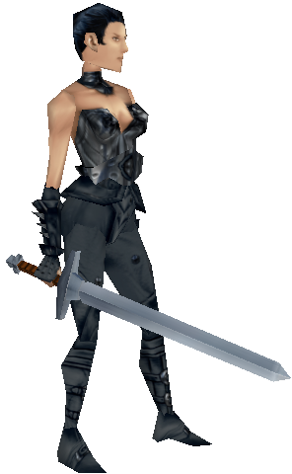
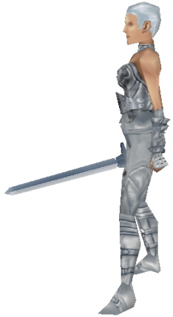
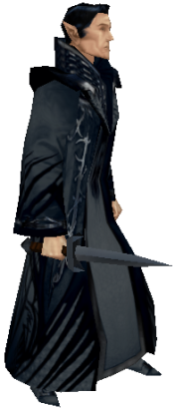
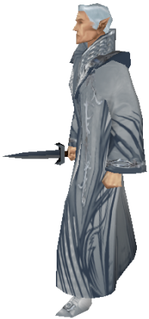
Dynamic Scripting (3)
team controlled
team controlled
b
y computer
by human player
generate
scripted
A
human
Rulebase A
script
Script A
control
control
weight updates
Combat
generate
scripted
B
human
Rulebase B
script
Script B
control
control

Slide 35
Dynamic Scripting (4)
  Online learning technique >> therefore pitted against human player
    Two teams >> one human, one computer
    Computer player is controlled by script, a dynamic script that is generated on the fly
    Dynamic script is generated by extracting rules from rulebase
    Rules in this game include rules such as (1) attacking an enemy, (2) drinking a potion, (3) casting a spell, (4) moving, and (5) passing.
    These rules are grouped in different rulebases.
    Each different game character type has a set of rules it is allowed to choose from (wizard – spells, warrior – attack sword)
    The chance for a rule to be selected depends on the weight value associated with the rule. The larger the weight value, the higher the chance this rule is selected.

Slide 36
Dynamic Scripting (5)
  When script is assembled, combat between human player and computer player.
  Based on the results of the fight, the weights for the rules selected in the script are updated.
  Rules that had positive contribution to the outcome (eg. dynamic AI won) are being rewarded, which means their weight value will be increased, hence increasing the chance that this rule will be selected in future games.
  Rules that had negative contribution to the outcome (eg. dynamic AI lost) are being punished, which means their weight value will be decreased, and thereby decreasing the chance that this rule will be selected in future games.
  Through this process of rewarding and punishing behavior, DS will gradually adapt to the human player tactics.

Slide 37
Dynamic Scripting Requirements
Computationally Cheap - Script generation and weight updates once per encounter
  Fast: Should not disturb flow of game play. It’s obviously fast.
Effective - Rules are manually designed
  Effective: Should not generate too many bad inferior opponents. It’s effective because rules are not stupid, even if they are not optimal.
Robust - Reward/penalty system
  Robust: Should be able to deal with randomness. It’s robust, because a penalty does not remove a rule, it just gets selected less often.
  Fast Learning – Experiments showed that DS is able to adapt fast to an unchanging tactic
  Efficient: Should lead to results quickly. Yes experiments showed that it is.

Slide 38
Terrain Analysis
What is terrain analysis?
  Supply information about the map to various systems in the game
    Abstract information about the map into chunks of data for game systems to make decisions
    Used in every RTS (Real Time Strategy) game
  Can be utilized by several systems in RTS game
    Computer Player (CP) AI processing
    Path finding
    Random map generation

Slide 39
Definitions
Tile-based map
  2D height field map with varying heights in the upward direction
Arbitrary poly map
  A non-regular terrain system
Area
  Collection of terrain that shares similar properties
Area connectivity
  The link between two Areas
Path finding
  “Can Path” concept
  Execution speed matters
  Quality of the path finding algorithm is important
  One of the slowest things most RTS games do
    Ex) Age of Empires 2 spends roughly 60 to 70% of simulation time doing path finding

Slide 40
Influence Maps
  2D arrays that represent some area of the terrain
  Adds attractors and detractors, then iterates to find best-valued position
    ex) best place to gather resource
  Brute force
  Can be simply abstracted to 3D influence volumes
Area decomposition
  Newer component of the terrain analysis
  Classify the map to several area that has similar properties
    “Good place to gather resources”
    “Good place to build town”
  Excellent at abstracting large areas of the map into easily usable chunks

Slide 41
AGE 1 Terrain Analysis
Zones
  A simple area system
  Calculated minimum distance between zones as an optimization
  Unbounded size
  No obstruction information
Influence Maps
  Single Layer
  1 cell per tile
  1 BYTE per cell
  Initialized to a non-zero value
  Dynamic influences (based on use)
  Used for
    Building Placement
    Group Staging point determination
    “Back of the town” attacks

Slide 42
AGE 2 Terrain Analysis
  Goal was reuse, ended up doing quite a bit of work
  Many passes through influence map heuristic values
  New path finding
  Wall placement
Path finding
  3 different pathfinders
    Mip-map (long distance)
    Polygonal (short distance)
    Simplified Tile (medium distance/fallback)
  Allowed specialized uses
    Faster
    More consistent execution times

Slide 43
AGE 2 Terrain Analysis
Wall Placement
  Placed walls at a variable distance from the player start location
    Used obstructions (e.g. trees, water) when possible
  Did a mip-map path between impassabilities
  CP AI rated/prioritized the wall sections and managed the building (when directed by scripts)
Useful Terrain Analysis Tidbits
  It doesn’t need to be exact for the CP AI
  Abstract the area representation away from the CP AI
  Support dynamic terrain
  Time-slice everything; then time-slice it again
  Put area specification/hint-giving tools in the scenario editor
  Do good graphical debugging tools
  Pass Random Map generation information on to the terrain analysis
  Don’t use tiles as your measure of distance
  If you can get away without using pattern recognition, do so

Slide 44
Path Finding
Goal of Path finding algorithms
  Optimal path = not always straight line
    Travel around swamp versus through it
  “Least expensive” path
  Trade off between simplicity and optimality (too simple a representation and path finding will be fast, but will not find very high quality path)
Capabilities of AI
  Different characters have different movement capabilities and a good representation will take that into account
    Agents ask “Can I exist there?”
    Large monsters can’t move through narrow walkways

Slide 45
Capabilities of AI

Slide 46
Path Finding (2)
Another Goal
  Search Space generation should be automatic
    Generate from world’s raw geometry or from physics collision mesh
    Manual node placement must be done for all world pieces. Takes time and effort
Scripted AI Paths
  Search Space representation is different than patrol path creation tool
  Designers want predefined patrol paths, so they script them
    Works well only in predefined sequences
    Not good for interactive behavior (i.e. combat, area-searching)
  Keep scripted patrol sequences separate from search space

Slide 47
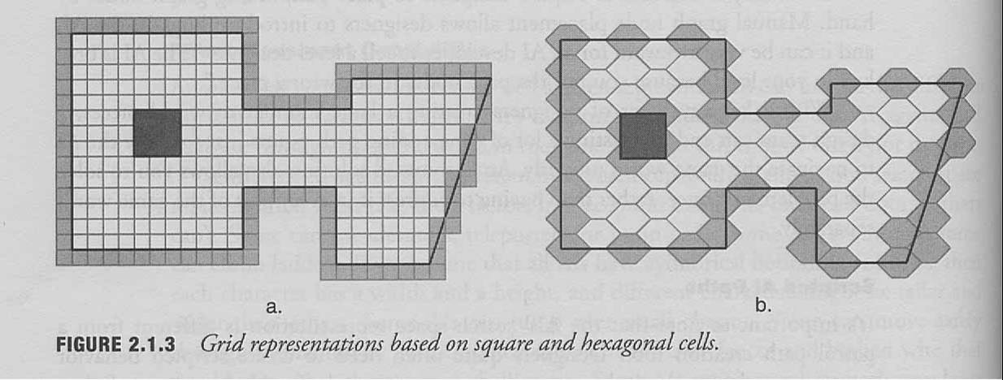
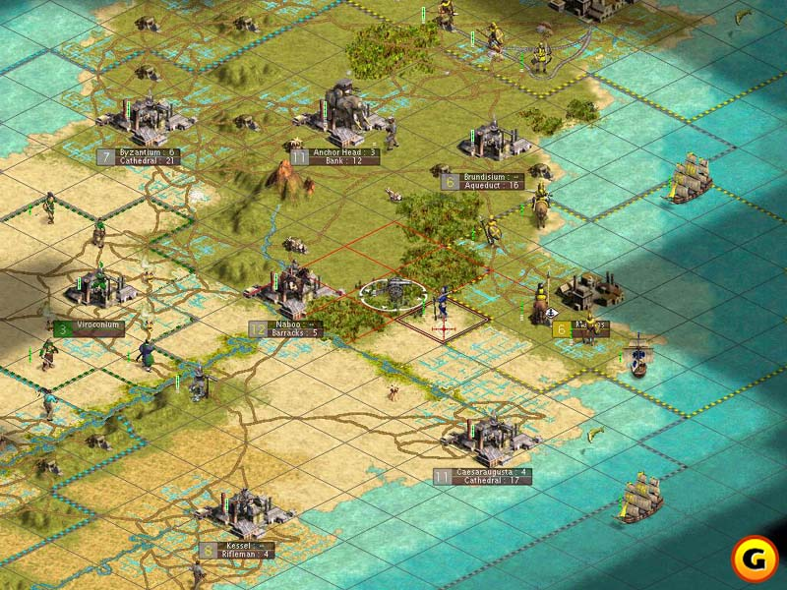
Regular Grids
  Won’t work for 3D game worlds without some modification
  Mostly used in strategy games (typically with a top-down perspective)
  Civilization 3 displays only four sides to each cell, but actually can move in 8 directions (along the diagonals)
  Disadvantage: High resolution grids have large memory footprint
  Advantage: Provide random access look-up

Slide 48
An Optimization
  String-pulling or Line-of-sight testing can be used to improve this further
  Delete any point P_{n} from path when it is possible to get from P_{n-1} to P_{n+1} directly
  Don’t need to travel through node centers
  Use Catmull-Rom splines to create a smooth curved path

Slide 49
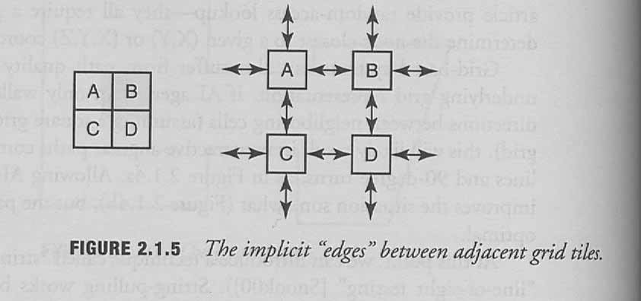
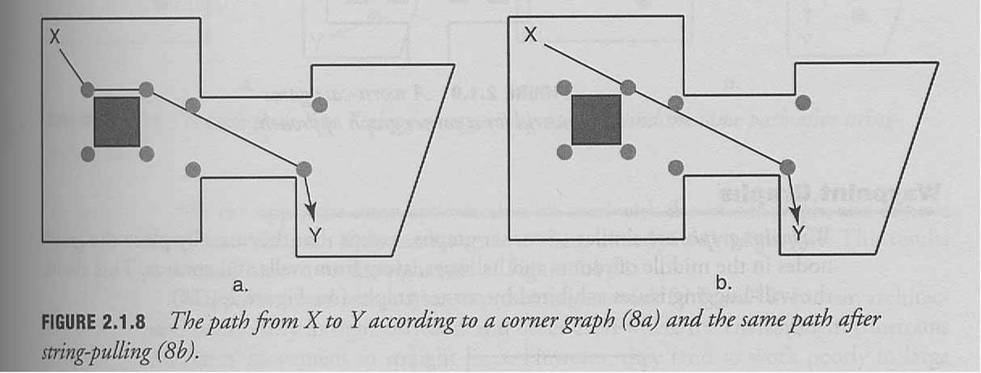
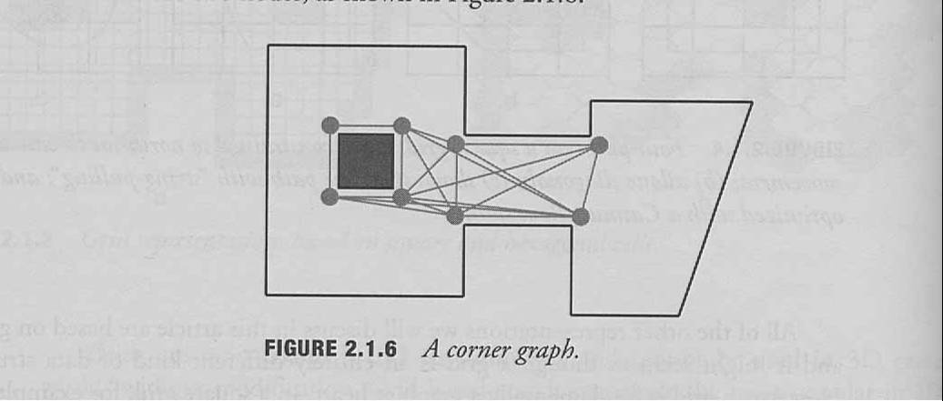
Graphs
  The rest of the search space representations are graphs
  You can think of grids as graphs
    Could be useful to have directed graphs (cliffs)
Corner graphs
  Place waypoints on the corners of obstacles
  Place edges between nodes where a character could walk in a straight line between them
  Sub-optimal paths
  AI agents appear to be “on rails”
  Can get close to the optimal path
  in some cases with String-pulling
  Requires expensive line-testing

Slide 50
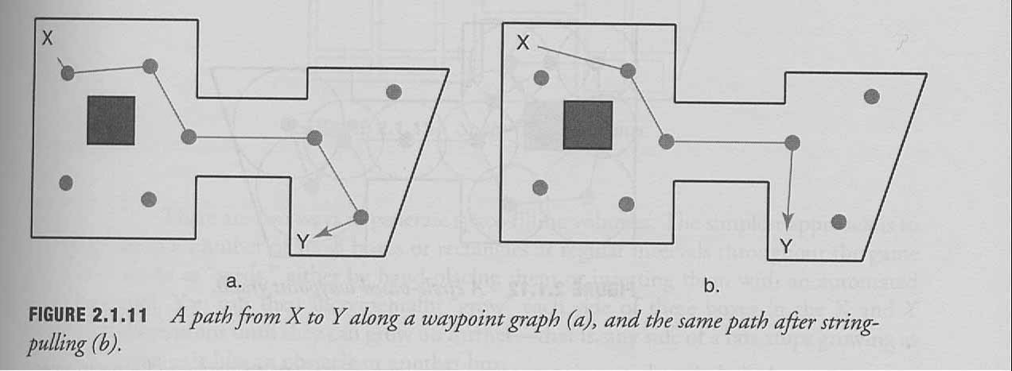
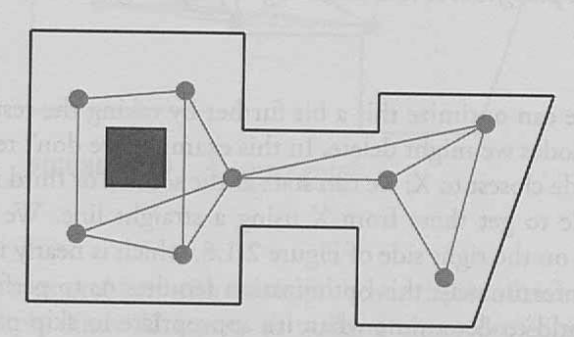
Waypoint Graphs
  Work well with 3D games and tight spaces
  Similar to Corner Graphs
    Except nodes are further from walls and obstacles
    Avoids wall-hugging issues
  Cannot always find optimal path easily, even with string-pulling techniques

Slide 51
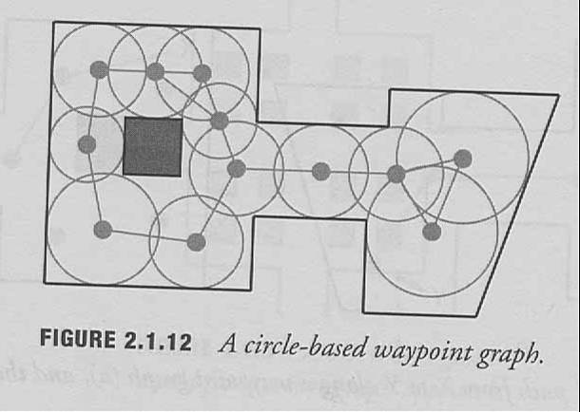
Circle-based Waypoint Graphs
  Same as waypoint graphs
    Except add a radius around each node indicating open space
  Adds a little more information to each node
  Edges exist only between nodes whose circles overlap
  Several games use a hybrid of Circle-based waypoint graphs and regular waypoint graphs, using Circle-based for outdoor open terrain and regular for indoor environments
Circular Waypoint Graphs
  Good in open terrain
  Not good in angular game worlds

Slide 52
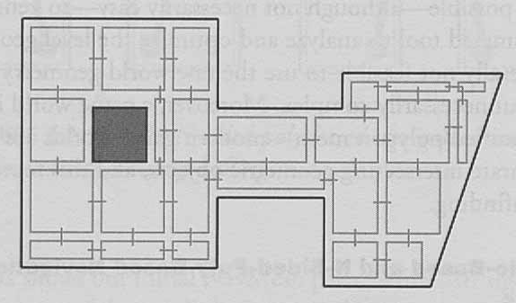
Space-Filling Volumes
  Similar to Circle based approach, but use rectangles instead of circles
  Work better than circle based in angular environments, but might not be able to completely fill all game worlds

Slide 53
Navigation Meshes
  Handles indoor and outdoor environments equally well
  Cover walkable surfaces with convex polygons
  Requires storage of large number of polygons, especially in large worlds or geometrically complex areas
  Used in Thief 3 and Deus Ex 2 (video)
  Polygons must be convex to guarantee that an agent can walk from any point within a polygon to any other point within that same polygon
  Is possible to generate NavMesh with automated tool (was done in Thief 3 and Deus Ex 2) – difficult

Slide 54
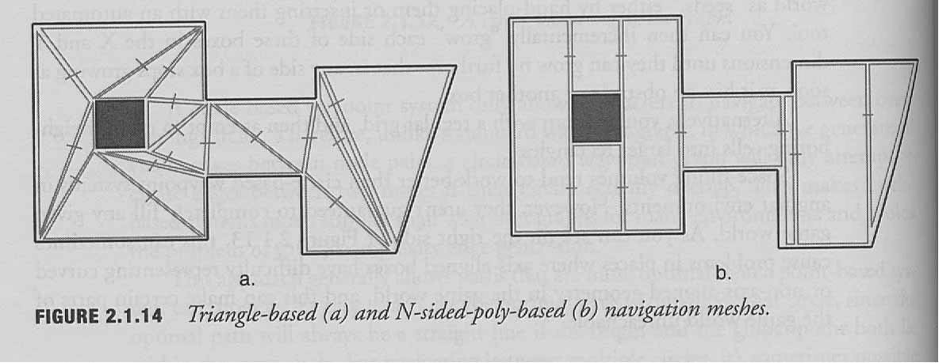
2 types of NavMeshs
Triangle based
  All polygons must be triangles
  When done correctly, will not hug walls too tightly
N-Sided-Poly-based
  Can have any number of sides, but must remain convex
  Can usually represent a search space more simply than triangle based (smaller memory footprint)
  Can lead to paths that hug walls too tightly

Slide 55
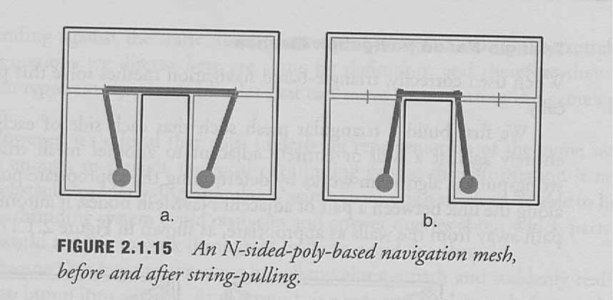
N-Sided-Poly-Based
Can address this problem with post-processing

Slide 56
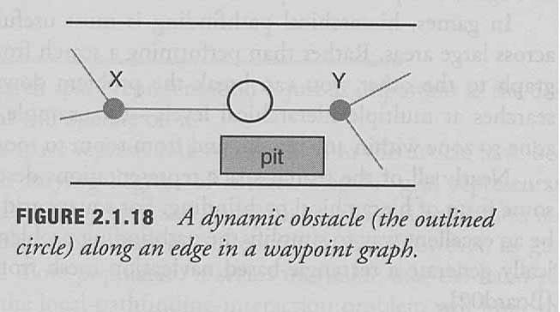
Interacting with local pathfinding
  Pathfinding algorithm must be able to deal with dynamic objects (things player can move)
  Can use simple object avoidance systems, but can break down in worlds with lots of dynamic objects
  Search Space is static, so it can’t really deal with dynamic objects
  Should design it to give some information to pathfinding algorithm that will help
  “Can I go this way instead?” – search space should be able to answer this
  Don’t want to do this

Slide 57
Hierarchical Representations
  Break navigation problem down into levels
  Paul Tozour may have done this too much in Thief 3 for the City
    “game environments just don't seem big enough from one loading screen to the next” – Gamespot review
    When trying to move quickly through the City, loading times detract from gameplay
Conclusion
  There is no right or wrong way to design search space representations
    Should depend on world layout, your AI system and pathfinding algorithm, and also memory and performance criteria
    Understand benefits and drawbacks and make the best choice based on that

Slide 58
Multi-agents in RTS

Slide 59


