Slide 1
Spectral object reflectance estimation using smartphones
Miguel Cruz Fernandes
16/02/2018

Slide 2
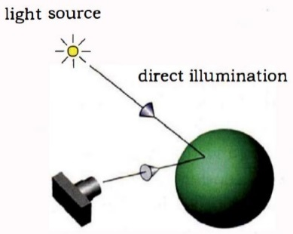
Introduction
2
Components
Surface
Illuminant
Camera
Smartphone
Camera
Screen
Miguel Cruz Fernandes
16/02/2018
Notes:
Spectrophotometry – study of the electromagnetic spectrum
Spectrophotometer – measures the amount of light reflected/absorbed by a sample object
------
It is composed by a surface, illuminant and camera
Radiation is incident into the object, which reflects/absorbs said radiation and a camera takes a picture of it

Slide 3
Introduction
2
Components
Surface
Illuminant
Camera
Smartphone
Camera
Screen
Miguel Cruz Fernandes
16/02/2018
Notes:
Spectrophotometry – study of the electromagnetic spectrum
Spectrophotometer – measures the amount of light reflected/absorbed by a sample object
------
It is composed by a surface, illuminant and camera
Radiation is incident into the object, which reflects/absorbs said radiation and a camera takes a picture of it

Slide 4
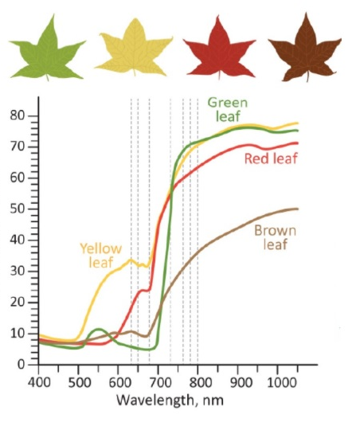
Motivation and goals
3
Usability
Agriculture
Medicine
Manufacturing
Smartphones vs High-end equipment
Price
Accessibility
How close can we get?
Miguel Cruz Fernandes
16/02/2018
Notes:
Usability – Object reflectance is widely used in different study fields, such as medicine, industrial quality or agriculture
----
Picture – example on usability for healthiness/life spawn of plants
----
Standard hardware as used in smartphones – Expensive hardware is used right now, what would change if we had it in the palm of our hand? How accurate can it be?
Smartphone manipulation – How can we use the smartphone? As illuminant/camera
Measurements and calibration – The color output of the screen needs calibration. What color is comming out of the screen?
Reconstruction of the O.R. – How good is it? Can it be used? Which method works best?

Slide 5
Implementation
Miguel Cruz Fernandes
16/02/2018

Slide 6
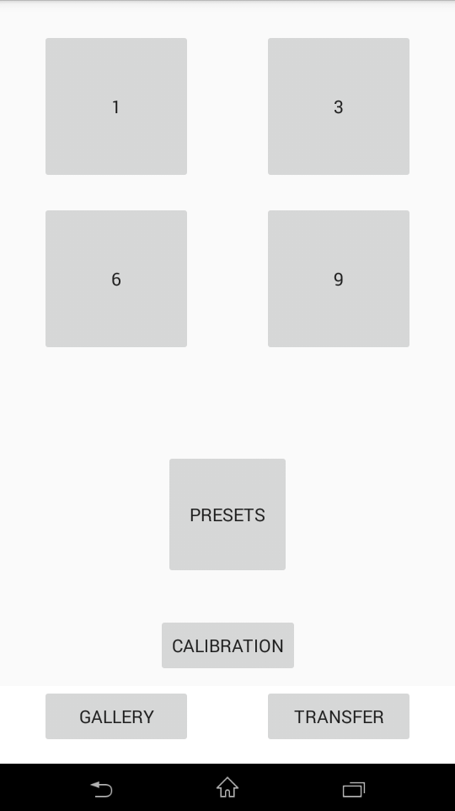
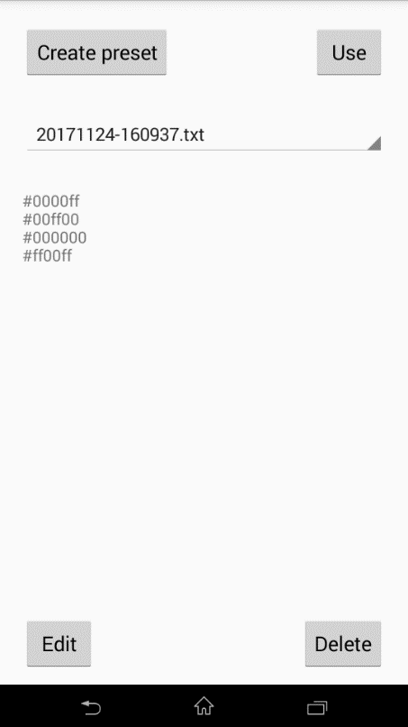
Implementation
5
Android application
Basic functions
Choose colors
Change screen background
Manually
Remotely (calibration)
Take and save picture
Transfer it to a computer
Miguel Cruz Fernandes
16/02/2018
Notes:
Basic functions – the basic function of the app is to be able to serve as the illuminant and be able to change between the defined colors.
We can do so, manually or remotely, for calibration purposes. Manually, the color is changed by pressing the volume UP button and the picture is taken with volume DOWN button. The reason for this being as such is to, in a real scanning, be able to have minimal interaction with the screen.

Slide 7
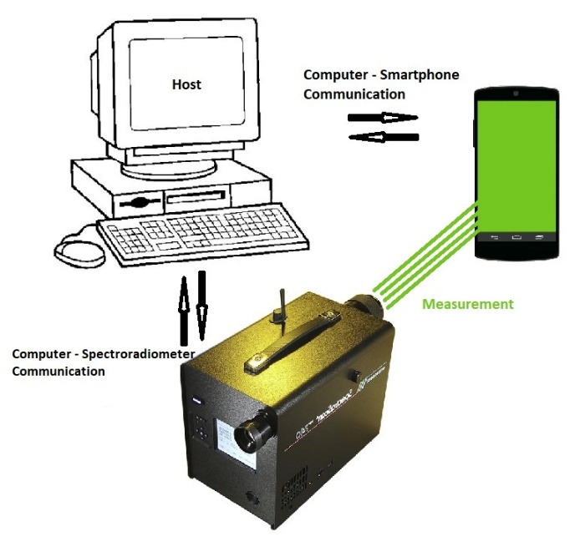
Implementation
6
Screen calibration (1/2)
Setup with Matlab for spectroradiometer
Interaction between devices
Measurement conditions
Dark room
Minimal human interference
Go through the visible spectrum (380-780 nm)
21 power distributions (every 20 nm)
Miguel Cruz Fernandes
16/02/2018
Notes:
The calibration process to evaluate the output color is done using a spectroradiometer. The computer acts as host and serves as middle man in the communication between changing color of the screen and a measurement being taken.
The measurements were taken in a dark room, with minimal human interference, so it would affect the measurement as minimal as possible.
We chose the colors to be measured,

Slide 8
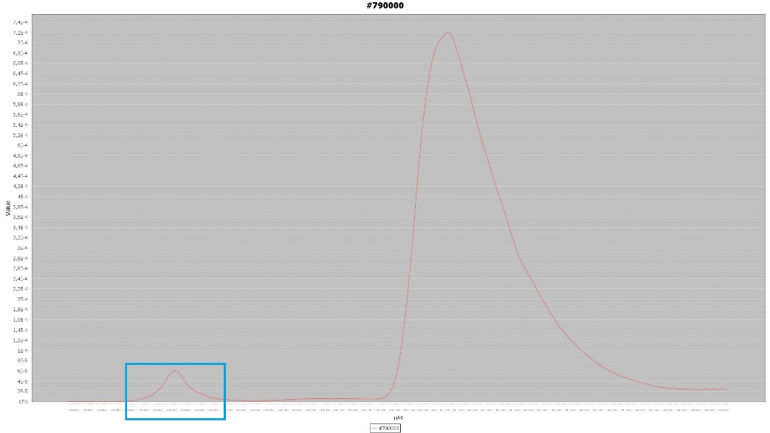
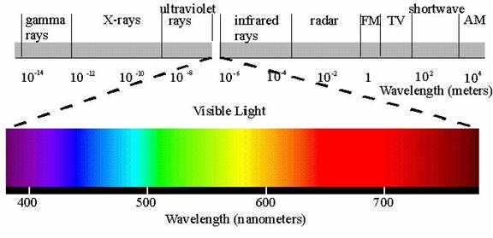
Implementation
7
#790000
Screen calibration (2/2)
380
780
Miguel Cruz Fernandes
16/02/2018
Notes:
Here we can see that error in 3 different measurements: ff0000

Slide 9
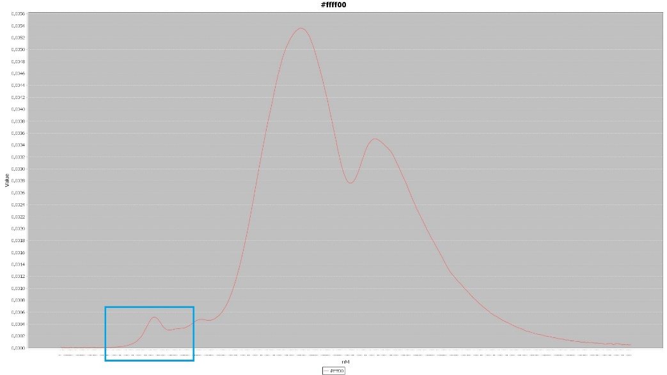
Implementation
7
#ffff00
Screen calibration (2/2)
380
780
Miguel Cruz Fernandes
16/02/2018
Notes:
Here we can see that error in 3 different measurements: ffff00, 790000

Slide 10
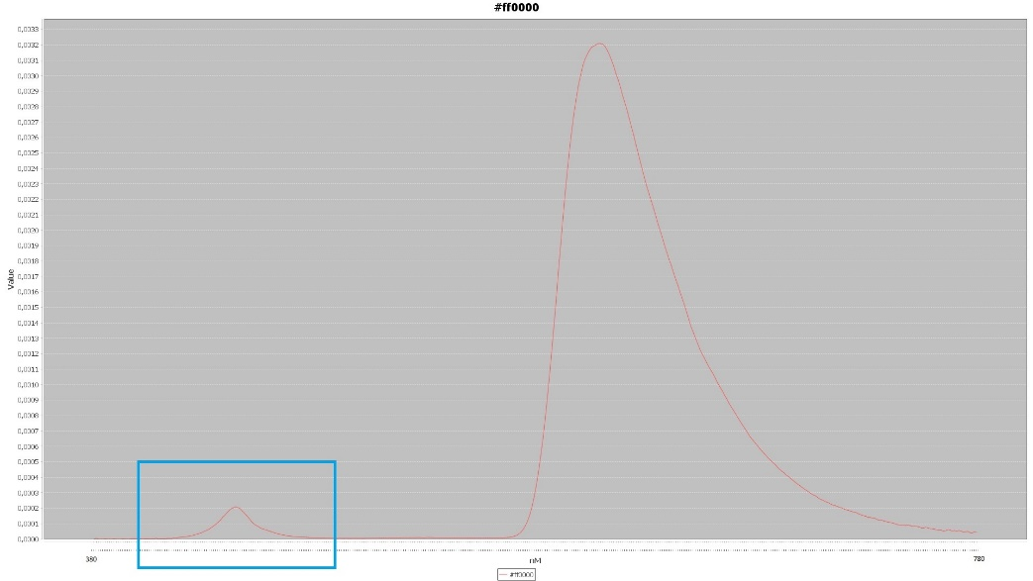
Implementation
7
#ff0000
Screen calibration (2/2)
380
780
Miguel Cruz Fernandes
16/02/2018
Notes:
Here we can see that error in 3 different measurements: 790000

Slide 11
Spectral object reconstruction in a simulation framework
Miguel Cruz Fernandes
16/02/2018

Slide 12
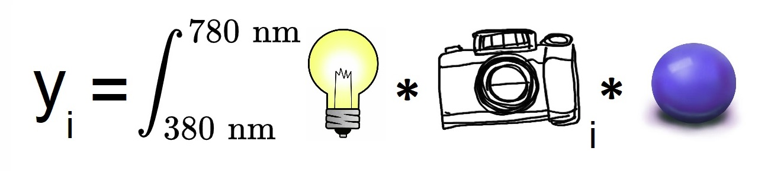
Spectral object reconstruction in a simulation framework
9
Spectral object reconstruction (1/3)
Standard RGB camera sensitivity
Sample object spectral reflectance
Smartphone screen – 21 colors
( )
( )
r
r
g
g
b
b
Miguel Cruz Fernandes
16/02/2018
Notes:
The formula works as such:
Given a certain radiation, camera sensitivity and spectral reflectance, the tristimulus values are calculated. Since we are dealing with an RGB camera, there are only 3 channels.
The response y of a given channel, is represented as such. Having those 3 values, it is possible to reconstruct the spectral reflectance and see how close it is to the original curve.

Slide 13
Spectral object reconstruction in a simulation framework
10
Spectral object reconstruction (2/3)
Tristimulus values
( )
( )
( )
( )
r
r
r
r
g
g
g
g
...
b
b
b
b
Color #1
Color #2
Color #3
Color #21
Miguel Cruz Fernandes
16/02/2018
Notes:
Having those 3 values, it is possible to reconstruct the spectral reflectance and see how close it is to the original curve.

Slide 14
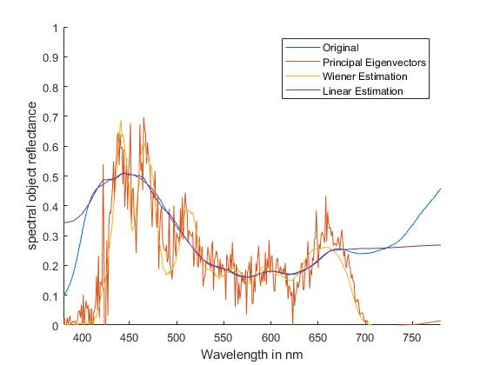
Spectral object reconstruction in a simulation framework
10
Spectral object reconstruction (2/3)
Tristimulus values
( )
( )
( )
( )
Reconstruction
methods
r
r
r
r
g
g
g
g
...
b
b
b
b
Color #1
Color #2
Color #3
Color #21
Wiener estimation
Principal Eigenvectors
Linear estimation
Miguel Cruz Fernandes
16/02/2018
Notes:
After having the measurements we can then reconstruct the spectral reflectance of given object.
To do so, 3 estimation methods were used, such as wiener estimation, linear estimation and the principal eigenvectors.
The formula works as such:
Given a certain radiation, camera sensitivity and spectral reflectance, the tristimulus values are calculated. Since we are dealing with an RGB camera, there are only 3 channels. So the response y of a given channel, is represented as such. Having those 3 values, it is possible to reconstruct the spectral reflectance and see how close it is to the original curve.

Slide 15
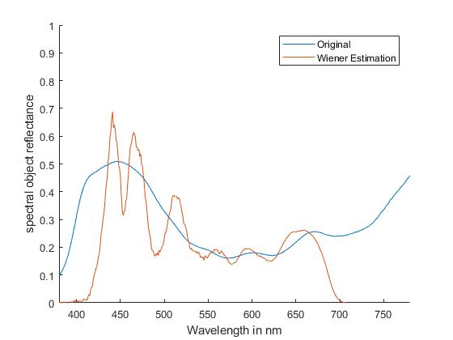
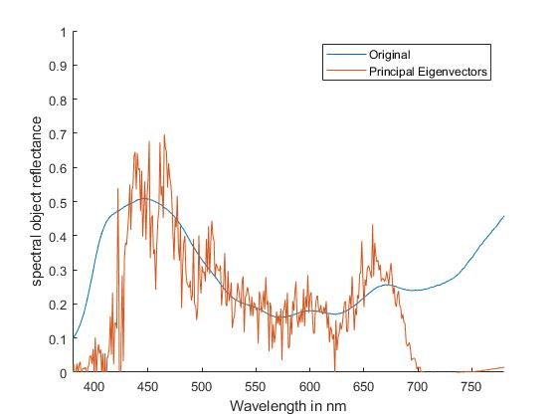
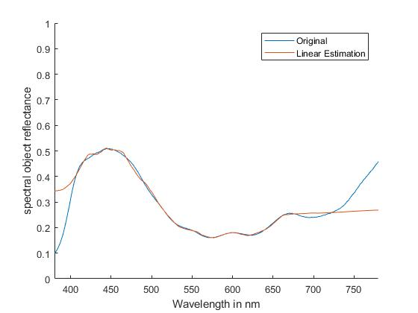
Spectral object reconstruction in a simulation framework
11
Spectral reflectance reconstruction (3/3)
Miguel Cruz Fernandes
16/02/2018
Notes:
By reconstructing one of the sample objects, these were the first results. As we can see, visually they are not very accurate, besides the linear estimation.

Slide 16
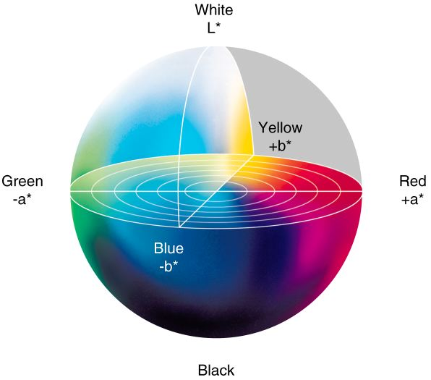
Original curve vs reconstructed curve
12
Spectral Root Mean Square
CIEDE2000 Color Difference
CIELAB Color space
Miguel Cruz Fernandes
16/02/2018
Notes:
Since one spectral reflectance is not enough to evaluate the reconstruction of the same, 2 methods were applied to compare the reconstructions with the original curves.
The spectral root mean square error is one of the methods of comparison.
To compare the actual color difference, CIEDE2000 was used. This method evaluates the perception of two colors, to see how close they are to eachother. The tristimulus values are converted into the CIELAB color space, that we see represented here. Comparing the Lab values of both, results in a final value.

Slide 17
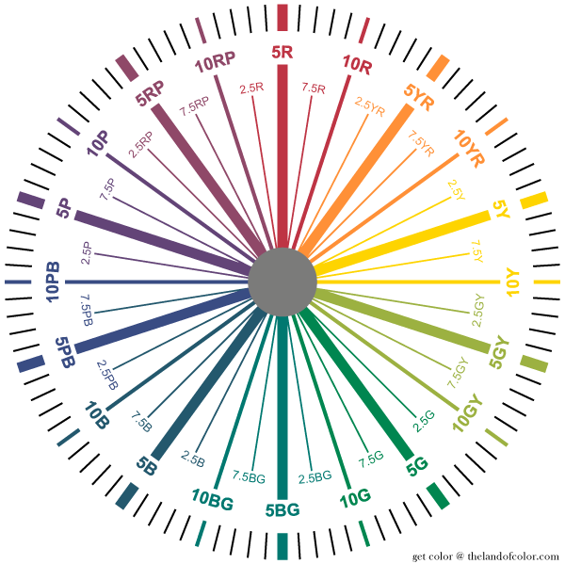
Experimental results
13
Munsell color system
1600 objects reflectance dataset
Miguel Cruz Fernandes
16/02/2018
Notes:
Utilizing the 1600 object reflectances dataset, we are able to take a closer look at the results. In the right, we have 2 practical interpretations of the color difference. Calculating the mean, standard deviation and max value of the results, we can see that even tho the wiener estimation and the principal eigenvectors have satisfatory results, the linear estimation proved to have incredible results.

Slide 18
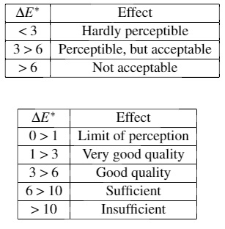
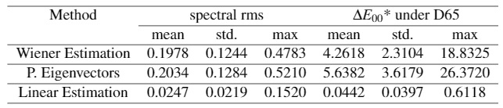
Experimental results
13
Munsell color system
1600 objects reflectance dataset
< 3
3 < 6
> 6
Miguel Cruz Fernandes
16/02/2018
Notes:
Utilizing the 1600 object reflectances dataset, we are able to take a closer look at the results. In the right, we have 2 practical interpretations of the color difference. Calculating the mean, standard deviation and max value of the results, we can see that even tho the wiener estimation and the principal eigenvectors have satisfatory results, the linear estimation proved to have incredible results.

Slide 19
Conclusions and future work
Miguel Cruz Fernandes
16/02/2018

Slide 20
Conclusions and Future work
15
Conclusions
Android application development
Utilises screen as an illuminant
Accurate screen color measurements
Spectral estimation methods comparison
Linear estimation
Promising results as a simulation
Miguel Cruz Fernandes
16/02/2018
Notes:
So in this thesis was able to explore android and smartphone limitations and how to use them for spectral reflectance reconstruction. There was a small error on the screen color measurement, which could bring better results had it not been there. We have to consider that this is in a very small scale and that we are trying to replicate what expensive and professional devices do, so for it to be as accurate as a spectrophotometer, in the future, is a long shot. From the spectral estimation methods, the linear estimation proved to have very promising results, even tho it is only a simulation, with premeasured datasets.

Slide 21
Conclusions and Future work
16
Future work
Smartphone camera calibration
Apply RGB camera sensitivity
Apply RGB camera sensitivity + screen illuminant
Apply method in real conditions
Different devices
Lower quality vs Higher quality
Miguel Cruz Fernandes
16/02/2018
Notes:
As future work, it would be interesting to do a camera calibration, where the camera sensitivity also belongs to the smartphone, measure the results and apply it together with the screen as an illuminant. Having the results proved positive, start measuring the spectral reflectance by taking a picture of a real object, instead of simulating one.
It would also be interesting to see the difference between different smartphones and if it is justifiable to invest for this purpose.

Slide 22
Miguel Cruz Fernandes
16/02/2018

