Slide 1
Key Length Determination in Polyalphabtic Ciphers
INSERT
VIDEO
HERE

Slide 2
Key Length Determination in Polyalphabtic Ciphers
Monoalphabetic ciphers
Symbol frequencies can be smoothed
INSERT
VIDEO
HERE

Slide 3
Key Length Determination in Polyalphabtic Ciphers
Monoalphabetic ciphers
Symbol frequencies can be smoothed
Underlying nonrandomness still remains
INSERT
VIDEO
HERE

Slide 4
Key Length Determination in Polyalphabtic Ciphers
Monoalphabetic ciphers
Symbol frequencies can be smoothed
Underlying nonrandomness still remains
Polyalphabetic ciphers
INSERT
VIDEO
HERE

Slide 5
Key Length Determination in Polyalphabtic Ciphers
Monoalphabetic ciphers
Symbol frequencies can be smoothed
Underlying nonrandomness still remains
Polyalphabetic ciphers
Al Kindi (9th century) and Alberti (16th century)
INSERT
VIDEO
HERE

Slide 6
Key Length Determination in Polyalphabtic Ciphers
Monoalphabetic ciphers
Symbol frequencies can be smoothed
Underlying nonrandomness still remains
Polyalphabetic ciphers
Al Kindi (9th century) and Alberti (16th century)
Either no key, or too complicated
INSERT
VIDEO
HERE

Slide 7
Key Length Determination in Polyalphabtic Ciphers
Monoalphabetic ciphers
Symbol frequencies can be smoothed
Underlying nonrandomness still remains
Polyalphabetic ciphers
Al Kindi (9th century) and Alberti (16th century)
Either no key, or too complicated
Bellaso and Vigenere (16th century)
INSERT
VIDEO
HERE

Slide 8
Key Length Determination in Polyalphabtic Ciphers
Monoalphabetic ciphers
Symbol frequencies can be smoothed
Underlying nonrandomness still remains
Polyalphabetic ciphers
Al Kindi (9th century) and Alberti (16th century)
Either no key, or too complicated
Bellaso and Vigenere (16th century)
Secure for approx 300 years
INSERT
VIDEO
HERE

Slide 9
Key Length Determination in Polyalphabtic Ciphers
Monoalphabetic ciphers
Symbol frequencies can be smoothed
Underlying nonrandomness still remains
Polyalphabetic ciphers
Al Kindi (9th century) and Alberti (16th century)
Either no key, or too complicated
Bellaso and Vigenere (16th century)
Secure for approx 300 years
Broken by Babbage and Kasiski
INSERT
VIDEO
HERE

Slide 10
The tabula recta is a simple way to layout all possible Caesar ciphers
A B C D E F G H I J K L M N O P Q R S T U V W X Y Z
B C D E F G H I J K L M N O P Q R S T U V W X Y Z A
C D E F G H I J K L M N O P Q R S T U V W X Y Z A B
D E F G H I J K L M N O P Q R S T U V W X Y Z A B C
E F G H I J K L M N O P Q R S T U V W X Y Z A B C D
F G H I J K L M N O P Q R S T U V W X Y Z A B C D E
G H I J K L M N O P Q R S T U V W X Y Z A B C D E F
H I J K L M N O P Q R S T U V W X Y Z A B C D E F G
I J K L M N O P Q R S T U V W X Y Z A B C D E F G H
J K L M N O P Q R S T U V W X Y Z A B C D E F G H I
K L M N O P Q R S T U V W X Y Z A B C D E F G H I J
L M N O P Q R S T U V W X Y Z A B C D E F G H I J K
M N O P Q R S T U V W X Y Z A B C D E F G H I J K L
N O P Q R S T U V W X Y Z A B C D E F G H I J K L M
O P Q R S T U V W X Y Z A B C D E F G H I J K L M N
P Q R S T U V W X Y Z A B C D E F G H I J K L M N O
Q R S T U V W X Y Z A B C D E F G H I J K L M N O P
R S T U V W X Y Z A B C D E F G H I J K L M N O P Q
S T U V W X Y Z A B C D E F G H I J K L M N O P Q R
T U V W X Y Z A B C D E F G H I J K L M N O P Q R S
U V W X Y Z A B C D E F G H I J K L M N O P Q R S T
V W X Y Z A B C D E F G H I J K L M N O P Q R S T U
W X Y Z A B C D E F G H I J K L M N O P Q R S T U V
X Y Z A B C D E F G H I J K L M N O P Q R S T U V W
Y Z A B C D E F G H I J K L M N O P Q R S T U V W X
Z A B C D E F G H I J K L M N O P Q R S T U V W X Y
INSERT
VIDEO
HERE

Slide 11
The tabula recta is a simple way to layout all possible Caesar ciphers
A B C D E F G H I J K L M N O P Q R S T U V W X Y Z
B C D E F G H I J K L M N O P Q R S T U V W X Y Z A
C D E F G H I J K L M N O P Q R S T U V W X Y Z A B
D E F G H I J K L M N O P Q R S T U V W X Y Z A B C
E F G H I J K L M N O P Q R S T U V W X Y Z A B C D
F G H I J K L M N O P Q R S T U V W X Y Z A B C D E
G H I J K L M N O P Q R S T U V W X Y Z A B C D E F
H I J K L M N O P Q R S T U V W X Y Z A B C D E F G
I J K L M N O P Q R S T U V W X Y Z A B C D E F G H
J K L M N O P Q R S T U V W X Y Z A B C D E F G H I
K L M N O P Q R S T U V W X Y Z A B C D E F G H I J
L M N O P Q R S T U V W X Y Z A B C D E F G H I J K
M N O P Q R S T U V W X Y Z A B C D E F G H I J K L
N O P Q R S T U V W X Y Z A B C D E F G H I J K L M
O P Q R S T U V W X Y Z A B C D E F G H I J K L M N
P Q R S T U V W X Y Z A B C D E F G H I J K L M N O
Q R S T U V W X Y Z A B C D E F G H I J K L M N O P
R S T U V W X Y Z A B C D E F G H I J K L M N O P Q
S T U V W X Y Z A B C D E F G H I J K L M N O P Q R
T U V W X Y Z A B C D E F G H I J K L M N O P Q R S
U V W X Y Z A B C D E F G H I J K L M N O P Q R S T
V W X Y Z A B C D E F G H I J K L M N O P Q R S T U
W X Y Z A B C D E F G H I J K L M N O P Q R S T U V
X Y Z A B C D E F G H I J K L M N O P Q R S T U V W
Y Z A B C D E F G H I J K L M N O P Q R S T U V W X
Z A B C D E F G H I J K L M N O P Q R S T U V W X Y
K: SECRE T
INSERT
VIDEO
HERE

Slide 12
The tabula recta is a simple way to layout all possible Caesar ciphers
A B C D E F G H I J K L M N O P Q R S T U V W X Y Z
B C D E F G H I J K L M N O P Q R S T U V W X Y Z A
C D E F G H I J K L M N O P Q R S T U V W X Y Z A B
D E F G H I J K L M N O P Q R S T U V W X Y Z A B C
E F G H I J K L M N O P Q R S T U V W X Y Z A B C D
F G H I J K L M N O P Q R S T U V W X Y Z A B C D E
G H I J K L M N O P Q R S T U V W X Y Z A B C D E F
H I J K L M N O P Q R S T U V W X Y Z A B C D E F G
I J K L M N O P Q R S T U V W X Y Z A B C D E F G H
J K L M N O P Q R S T U V W X Y Z A B C D E F G H I
K L M N O P Q R S T U V W X Y Z A B C D E F G H I J
L M N O P Q R S T U V W X Y Z A B C D E F G H I J K
M N O P Q R S T U V W X Y Z A B C D E F G H I J K L
N O P Q R S T U V W X Y Z A B C D E F G H I J K L M
O P Q R S T U V W X Y Z A B C D E F G H I J K L M N
P Q R S T U V W X Y Z A B C D E F G H I J K L M N O
Q R S T U V W X Y Z A B C D E F G H I J K L M N O P
R S T U V W X Y Z A B C D E F G H I J K L M N O P Q
S T U V W X Y Z A B C D E F G H I J K L M N O P Q R
T U V W X Y Z A B C D E F G H I J K L M N O P Q R S
U V W X Y Z A B C D E F G H I J K L M N O P Q R S T
V W X Y Z A B C D E F G H I J K L M N O P Q R S T U
W X Y Z A B C D E F G H I J K L M N O P Q R S T U V
X Y Z A B C D E F G H I J K L M N O P Q R S T U V W
Y Z A B C D E F G H I J K L M N O P Q R S T U V W X
Z A B C D E F G H I J K L M N O P Q R S T U V W X Y
K: SECRE T
P: RETRE ATTOR IVER
INSERT
VIDEO
HERE

Slide 13
The tabula recta is a simple way to layout all possible Caesar ciphers
A B C D E F G H I J K L M N O P Q R S T U V W X Y Z
B C D E F G H I J K L M N O P Q R S T U V W X Y Z A
C D E F G H I J K L M N O P Q R S T U V W X Y Z A B
D E F G H I J K L M N O P Q R S T U V W X Y Z A B C
E F G H I J K L M N O P Q R S T U V W X Y Z A B C D
F G H I J K L M N O P Q R S T U V W X Y Z A B C D E
G H I J K L M N O P Q R S T U V W X Y Z A B C D E F
H I J K L M N O P Q R S T U V W X Y Z A B C D E F G
I J K L M N O P Q R S T U V W X Y Z A B C D E F G H
J K L M N O P Q R S T U V W X Y Z A B C D E F G H I
K L M N O P Q R S T U V W X Y Z A B C D E F G H I J
L M N O P Q R S T U V W X Y Z A B C D E F G H I J K
M N O P Q R S T U V W X Y Z A B C D E F G H I J K L
N O P Q R S T U V W X Y Z A B C D E F G H I J K L M
O P Q R S T U V W X Y Z A B C D E F G H I J K L M N
P Q R S T U V W X Y Z A B C D E F G H I J K L M N O
Q R S T U V W X Y Z A B C D E F G H I J K L M N O P
R S T U V W X Y Z A B C D E F G H I J K L M N O P Q
S T U V W X Y Z A B C D E F G H I J K L M N O P Q R
T U V W X Y Z A B C D E F G H I J K L M N O P Q R S
U V W X Y Z A B C D E F G H I J K L M N O P Q R S T
V W X Y Z A B C D E F G H I J K L M N O P Q R S T U
W X Y Z A B C D E F G H I J K L M N O P Q R S T U V
X Y Z A B C D E F G H I J K L M N O P Q R S T U V W
Y Z A B C D E F G H I J K L M N O P Q R S T U V W X
Z A B C D E F G H I J K L M N O P Q R S T U V W X Y
K: SECRE TSECR ETSE
P: RETRE ATTOR IVER
INSERT
VIDEO
HERE

Slide 14
The tabula recta is a simple way to layout all possible Caesar ciphers
A B C D E F G H I J K L M N O P Q R S T U V W X Y Z
B C D E F G H I J K L M N O P Q R S T U V W X Y Z A
C D E F G H I J K L M N O P Q R S T U V W X Y Z A B
D E F G H I J K L M N O P Q R S T U V W X Y Z A B C
E F G H I J K L M N O P Q R S T U V W X Y Z A B C D
F G H I J K L M N O P Q R S T U V W X Y Z A B C D E
G H I J K L M N O P Q R S T U V W X Y Z A B C D E F
H I J K L M N O P Q R S T U V W X Y Z A B C D E F G
I J K L M N O P Q R S T U V W X Y Z A B C D E F G H
J K L M N O P Q R S T U V W X Y Z A B C D E F G H I
K L M N O P Q R S T U V W X Y Z A B C D E F G H I J
L M N O P Q R S T U V W X Y Z A B C D E F G H I J K
M N O P Q R S T U V W X Y Z A B C D E F G H I J K L
N O P Q R S T U V W X Y Z A B C D E F G H I J K L M
O P Q R S T U V W X Y Z A B C D E F G H I J K L M N
P Q R S T U V W X Y Z A B C D E F G H I J K L M N O
Q R S T U V W X Y Z A B C D E F G H I J K L M N O P
R S T U V W X Y Z A B C D E F G H I J K L M N O P Q
S T U V W X Y Z A B C D E F G H I J K L M N O P Q R
T U V W X Y Z A B C D E F G H I J K L M N O P Q R S
U V W X Y Z A B C D E F G H I J K L M N O P Q R S T
V W X Y Z A B C D E F G H I J K L M N O P Q R S T U
W X Y Z A B C D E F G H I J K L M N O P Q R S T U V
X Y Z A B C D E F G H I J K L M N O P Q R S T U V W
Y Z A B C D E F G H I J K L M N O P Q R S T U V W X
Z A B C D E F G H I J K L M N O P Q R S T U V W X Y
K: SECRE TSECR ETSE
P: RETRE ATTOR IVER
INSERT
VIDEO
HERE

Slide 15
The tabula recta is a simple way to layout all possible Caesar ciphers
A B C D E F G H I J K L M N O P Q R S T U V W X Y Z
B C D E F G H I J K L M N O P Q R S T U V W X Y Z A
C D E F G H I J K L M N O P Q R S T U V W X Y Z A B
D E F G H I J K L M N O P Q R S T U V W X Y Z A B C
E F G H I J K L M N O P Q R S T U V W X Y Z A B C D
F G H I J K L M N O P Q R S T U V W X Y Z A B C D E
G H I J K L M N O P Q R S T U V W X Y Z A B C D E F
H I J K L M N O P Q R S T U V W X Y Z A B C D E F G
I J K L M N O P Q R S T U V W X Y Z A B C D E F G H
J K L M N O P Q R S T U V W X Y Z A B C D E F G H I
K L M N O P Q R S T U V W X Y Z A B C D E F G H I J
L M N O P Q R S T U V W X Y Z A B C D E F G H I J K
M N O P Q R S T U V W X Y Z A B C D E F G H I J K L
N O P Q R S T U V W X Y Z A B C D E F G H I J K L M
O P Q R S T U V W X Y Z A B C D E F G H I J K L M N
P Q R S T U V W X Y Z A B C D E F G H I J K L M N O
Q R S T U V W X Y Z A B C D E F G H I J K L M N O P
R S T U V W X Y Z A B C D E F G H I J K L M N O P Q
S T U V W X Y Z A B C D E F G H I J K L M N O P Q R
T U V W X Y Z A B C D E F G H I J K L M N O P Q R S
U V W X Y Z A B C D E F G H I J K L M N O P Q R S T
V W X Y Z A B C D E F G H I J K L M N O P Q R S T U
W X Y Z A B C D E F G H I J K L M N O P Q R S T U V
X Y Z A B C D E F G H I J K L M N O P Q R S T U V W
Y Z A B C D E F G H I J K L M N O P Q R S T U V W X
Z A B C D E F G H I J K L M N O P Q R S T U V W X Y
K: SECRE TSECR ETSE
P: RETRE ATTOR IVER
INSERT
VIDEO
HERE

Slide 16
The tabula recta is a simple way to layout all possible Caesar ciphers
A B C D E F G H I J K L M N O P Q R S T U V W X Y Z
B C D E F G H I J K L M N O P Q R S T U V W X Y Z A
C D E F G H I J K L M N O P Q R S T U V W X Y Z A B
D E F G H I J K L M N O P Q R S T U V W X Y Z A B C
E F G H I J K L M N O P Q R S T U V W X Y Z A B C D
F G H I J K L M N O P Q R S T U V W X Y Z A B C D E
G H I J K L M N O P Q R S T U V W X Y Z A B C D E F
H I J K L M N O P Q R S T U V W X Y Z A B C D E F G
I J K L M N O P Q R S T U V W X Y Z A B C D E F G H
J K L M N O P Q R S T U V W X Y Z A B C D E F G H I
K L M N O P Q R S T U V W X Y Z A B C D E F G H I J
L M N O P Q R S T U V W X Y Z A B C D E F G H I J K
M N O P Q R S T U V W X Y Z A B C D E F G H I J K L
N O P Q R S T U V W X Y Z A B C D E F G H I J K L M
O P Q R S T U V W X Y Z A B C D E F G H I J K L M N
P Q R S T U V W X Y Z A B C D E F G H I J K L M N O
Q R S T U V W X Y Z A B C D E F G H I J K L M N O P
R S T U V W X Y Z A B C D E F G H I J K L M N O P Q
S T U V W X Y Z A B C D E F G H I J K L M N O P Q R
T U V W X Y Z A B C D E F G H I J K L M N O P Q R S
U V W X Y Z A B C D E F G H I J K L M N O P Q R S T
V W X Y Z A B C D E F G H I J K L M N O P Q R S T U
W X Y Z A B C D E F G H I J K L M N O P Q R S T U V
X Y Z A B C D E F G H I J K L M N O P Q R S T U V W
Y Z A B C D E F G H I J K L M N O P Q R S T U V W X
Z A B C D E F G H I J K L M N O P Q R S T U V W X Y
K: SECRE TSECR ETSE
P: RETRE ATTOR IVER
C: J
INSERT
VIDEO
HERE

Slide 17
The tabula recta is a simple way to layout all possible Caesar ciphers
A B C D E F G H I J K L M N O P Q R S T U V W X Y Z
B C D E F G H I J K L M N O P Q R S T U V W X Y Z A
C D E F G H I J K L M N O P Q R S T U V W X Y Z A B
D E F G H I J K L M N O P Q R S T U V W X Y Z A B C
E F G H I J K L M N O P Q R S T U V W X Y Z A B C D
F G H I J K L M N O P Q R S T U V W X Y Z A B C D E
G H I J K L M N O P Q R S T U V W X Y Z A B C D E F
H I J K L M N O P Q R S T U V W X Y Z A B C D E F G
I J K L M N O P Q R S T U V W X Y Z A B C D E F G H
J K L M N O P Q R S T U V W X Y Z A B C D E F G H I
K L M N O P Q R S T U V W X Y Z A B C D E F G H I J
L M N O P Q R S T U V W X Y Z A B C D E F G H I J K
M N O P Q R S T U V W X Y Z A B C D E F G H I J K L
N O P Q R S T U V W X Y Z A B C D E F G H I J K L M
O P Q R S T U V W X Y Z A B C D E F G H I J K L M N
P Q R S T U V W X Y Z A B C D E F G H I J K L M N O
Q R S T U V W X Y Z A B C D E F G H I J K L M N O P
R S T U V W X Y Z A B C D E F G H I J K L M N O P Q
S T U V W X Y Z A B C D E F G H I J K L M N O P Q R
T U V W X Y Z A B C D E F G H I J K L M N O P Q R S
U V W X Y Z A B C D E F G H I J K L M N O P Q R S T
V W X Y Z A B C D E F G H I J K L M N O P Q R S T U
W X Y Z A B C D E F G H I J K L M N O P Q R S T U V
X Y Z A B C D E F G H I J K L M N O P Q R S T U V W
Y Z A B C D E F G H I J K L M N O P Q R S T U V W X
Z A B C D E F G H I J K L M N O P Q R S T U V W X Y
K: SECRE TSECR ETSE
P: RETRE ATTOR IVER
C: JIVII TLXQI MOWV
INSERT
VIDEO
HERE

Slide 18
The tabula recta is a simple way to layout all possible Caesar ciphers
A B C D E F G H I J K L M N O P Q R S T U V W X Y Z
B C D E F G H I J K L M N O P Q R S T U V W X Y Z A
C D E F G H I J K L M N O P Q R S T U V W X Y Z A B
D E F G H I J K L M N O P Q R S T U V W X Y Z A B C
E F G H I J K L M N O P Q R S T U V W X Y Z A B C D
F G H I J K L M N O P Q R S T U V W X Y Z A B C D E
G H I J K L M N O P Q R S T U V W X Y Z A B C D E F
H I J K L M N O P Q R S T U V W X Y Z A B C D E F G
I J K L M N O P Q R S T U V W X Y Z A B C D E F G H
J K L M N O P Q R S T U V W X Y Z A B C D E F G H I
K L M N O P Q R S T U V W X Y Z A B C D E F G H I J
L M N O P Q R S T U V W X Y Z A B C D E F G H I J K
M N O P Q R S T U V W X Y Z A B C D E F G H I J K L
N O P Q R S T U V W X Y Z A B C D E F G H I J K L M
O P Q R S T U V W X Y Z A B C D E F G H I J K L M N
P Q R S T U V W X Y Z A B C D E F G H I J K L M N O
Q R S T U V W X Y Z A B C D E F G H I J K L M N O P
R S T U V W X Y Z A B C D E F G H I J K L M N O P Q
S T U V W X Y Z A B C D E F G H I J K L M N O P Q R
T U V W X Y Z A B C D E F G H I J K L M N O P Q R S
U V W X Y Z A B C D E F G H I J K L M N O P Q R S T
V W X Y Z A B C D E F G H I J K L M N O P Q R S T U
W X Y Z A B C D E F G H I J K L M N O P Q R S T U V
X Y Z A B C D E F G H I J K L M N O P Q R S T U V W
Y Z A B C D E F G H I J K L M N O P Q R S T U V W X
Z A B C D E F G H I J K L M N O P Q R S T U V W X Y
K: SECRE TSECR ETSE
P: RETRE ATTOR IVER
C: JIVII TLXQI MOWV
INSERT
VIDEO
HERE

Slide 19
The tabula recta is a simple way to layout all possible Caesar ciphers
A B C D E F G H I J K L M N O P Q R S T U V W X Y Z
B C D E F G H I J K L M N O P Q R S T U V W X Y Z A
C D E F G H I J K L M N O P Q R S T U V W X Y Z A B
D E F G H I J K L M N O P Q R S T U V W X Y Z A B C
E F G H I J K L M N O P Q R S T U V W X Y Z A B C D
F G H I J K L M N O P Q R S T U V W X Y Z A B C D E
G H I J K L M N O P Q R S T U V W X Y Z A B C D E F
H I J K L M N O P Q R S T U V W X Y Z A B C D E F G
I J K L M N O P Q R S T U V W X Y Z A B C D E F G H
J K L M N O P Q R S T U V W X Y Z A B C D E F G H I
K L M N O P Q R S T U V W X Y Z A B C D E F G H I J
L M N O P Q R S T U V W X Y Z A B C D E F G H I J K
M N O P Q R S T U V W X Y Z A B C D E F G H I J K L
N O P Q R S T U V W X Y Z A B C D E F G H I J K L M
O P Q R S T U V W X Y Z A B C D E F G H I J K L M N
P Q R S T U V W X Y Z A B C D E F G H I J K L M N O
Q R S T U V W X Y Z A B C D E F G H I J K L M N O P
R S T U V W X Y Z A B C D E F G H I J K L M N O P Q
S T U V W X Y Z A B C D E F G H I J K L M N O P Q R
T U V W X Y Z A B C D E F G H I J K L M N O P Q R S
U V W X Y Z A B C D E F G H I J K L M N O P Q R S T
V W X Y Z A B C D E F G H I J K L M N O P Q R S T U
W X Y Z A B C D E F G H I J K L M N O P Q R S T U V
X Y Z A B C D E F G H I J K L M N O P Q R S T U V W
Y Z A B C D E F G H I J K L M N O P Q R S T U V W X
Z A B C D E F G H I J K L M N O P Q R S T U V W X Y
K: SECRE TSECR ETSE
P: RETRE ATTOR IVER
C: JIVII TLXQI MOWV
INSERT
VIDEO
HERE

Slide 20
The tabula recta is a simple way to layout all possible Caesar ciphers
A B C D E F G H I J K L M N O P Q R S T U V W X Y Z
B C D E F G H I J K L M N O P Q R S T U V W X Y Z A
C D E F G H I J K L M N O P Q R S T U V W X Y Z A B
D E F G H I J K L M N O P Q R S T U V W X Y Z A B C
E F G H I J K L M N O P Q R S T U V W X Y Z A B C D
F G H I J K L M N O P Q R S T U V W X Y Z A B C D E
G H I J K L M N O P Q R S T U V W X Y Z A B C D E F
H I J K L M N O P Q R S T U V W X Y Z A B C D E F G
I J K L M N O P Q R S T U V W X Y Z A B C D E F G H
J K L M N O P Q R S T U V W X Y Z A B C D E F G H I
K L M N O P Q R S T U V W X Y Z A B C D E F G H I J
L M N O P Q R S T U V W X Y Z A B C D E F G H I J K
M N O P Q R S T U V W X Y Z A B C D E F G H I J K L
N O P Q R S T U V W X Y Z A B C D E F G H I J K L M
O P Q R S T U V W X Y Z A B C D E F G H I J K L M N
P Q R S T U V W X Y Z A B C D E F G H I J K L M N O
Q R S T U V W X Y Z A B C D E F G H I J K L M N O P
R S T U V W X Y Z A B C D E F G H I J K L M N O P Q
S T U V W X Y Z A B C D E F G H I J K L M N O P Q R
T U V W X Y Z A B C D E F G H I J K L M N O P Q R S
U V W X Y Z A B C D E F G H I J K L M N O P Q R S T
V W X Y Z A B C D E F G H I J K L M N O P Q R S T U
W X Y Z A B C D E F G H I J K L M N O P Q R S T U V
X Y Z A B C D E F G H I J K L M N O P Q R S T U V W
Y Z A B C D E F G H I J K L M N O P Q R S T U V W X
Z A B C D E F G H I J K L M N O P Q R S T U V W X Y
K: SECRE TSECR ETSE
P: RETRE ATTOR IVER
C: JIVII TLXQI MOWV
INSERT
VIDEO
HERE

Slide 21
Modular arithmetic concisely sums up the Vigener cipher
INSERT
VIDEO
HERE

Slide 22
Modular arithmetic concisely sums up the Vigener cipher
Each of the N letters assigned integer 0 … N-1
INSERT
VIDEO
HERE

Slide 23
Modular arithmetic concisely sums up the Vigener cipher
Each of the N letters assigned integer 0 … N-1
Encryption
C = (P + K) mod N
INSERT
VIDEO
HERE

Slide 24
Modular arithmetic concisely sums up the Vigener cipher
Each of the N letters assigned integer 0 … N-1
Encryption
C = (P + K) mod N
Decryption
P = (C - K) mod N
INSERT
VIDEO
HERE

Slide 25
Vigenere cipher becomes a One-Time Pad in the limit
INSERT
VIDEO
HERE

Slide 26
Vigenere cipher becomes a One-Time Pad in the limit
IF key is
same length as plaintext
INSERT
VIDEO
HERE

Slide 27
Vigenere cipher becomes a One-Time Pad in the limit
IF key is
same length as plaintext
chosen randomly
INSERT
VIDEO
HERE

Slide 28
Vigenere cipher becomes a One-Time Pad in the limit
IF key is
same length as plaintext
chosen randomly
never reused
INSERT
VIDEO
HERE

Slide 29
Vigenere cipher becomes a One-Time Pad in the limit
IF key is
same length as plaintext
chosen randomly
never reused
THEN
Vigenere cipher IS a one-time pad
INSERT
VIDEO
HERE

Slide 30
Vigenere cipher becomes a One-Time Pad in the limit
IF key is
same length as plaintext
chosen randomly
never reused
THEN
Vigenere cipher IS a one-time pad
This is how most real one-time pads worked
INSERT
VIDEO
HERE

Slide 31
Given key length, ciphertext can be split into monoalphabetic sets
INSERT
VIDEO
HERE

Slide 32
Given key length, ciphertext can be split into monoalphabetic sets
If keylength is N
INSERT
VIDEO
HERE

Slide 33
Given key length, ciphertext can be split into monoalphabetic sets
If keylength is N
Every Nth letter uses same key
INSERT
VIDEO
HERE

Slide 34
Given key length, ciphertext can be split into monoalphabetic sets
If keylength is N
Every Nth letter uses same key
Vigenere is simple Caesar shift
INSERT
VIDEO
HERE

Slide 35
Given key length, ciphertext can be split into monoalphabetic sets
If keylength is N
Every Nth letter uses same key
Vigenere is simple Caesar shift
Frequency analysis applies
INSERT
VIDEO
HERE

Slide 36
Given key length, ciphertext can be split into monoalphabetic sets
If keylength is N
Every Nth letter uses same key
Vigenere is simple Caesar shift
Frequency analysis applies
Ciphertext could, by trial and error, be partitioned into sets that have the expected frequency distribution.
INSERT
VIDEO
HERE

Slide 37
Given key length, ciphertext can be split into monoalphabetic sets
If keylength is N
Every Nth letter uses same key
Vigenere is simple Caesar shift
Frequency analysis applies
Ciphertext could, by trial and error, be partitioned into sets that have the expected frequency distribution.
Coincidences determine key length
INSERT
VIDEO
HERE

Slide 38
Index of Coincidence helps identify the key length in polyalphabetic ciphers
INSERT
VIDEO
HERE

Slide 39
Index of Coincidence helps identify the key length in polyalphabetic ciphers
ITWASADARKANDSTORMYNIGHT
WHILEEVERYONEATCOURTWASB
INSERT
VIDEO
HERE

Slide 40
Index of Coincidence helps identify the key length in polyalphabetic ciphers
ITWASADARKANDSTORMYNIGHT
WHILEEVERYONEATCOURTWASB
INSERT
VIDEO
HERE

Slide 41
Index of Coincidence helps identify the key length in polyalphabetic ciphers
ITWASADARKANDSTORMYNIGHT
WHILEEVERYONEATCOURTWASB
3 coincidences out of 24 pairs
r = 3/ 24 = 12.5%
INSERT
VIDEO
HERE

Slide 42
Toy language with f_{A} = 75% and f_{B} = 25% highlights effect of coincidence rate
INSERT
VIDEO
HERE

Slide 43
Toy language with f_{A} = 75% and f_{B} = 25% highlights effect of coincidence rate
AABAAABBAAAABAAAAAABAAABBBAAAAA
BAAABAABAAAABAAAABABABBAAABBAAA
INSERT
VIDEO
HERE

Slide 44
Toy language with f_{A} = 75% and f_{B} = 25% highlights effect of coincidence rate
_ _ _ __________ ___ ___
AABAAABBAAAABAAAAAABAAABBBAAAAA
BAAABAABAAAABAAAABABABBAAABBAAA
INSERT
VIDEO
HERE

Slide 45
Toy language with f_{A} = 75% and f_{B} = 25% highlights effect of coincidence rate
_ _ _ __________ ___ ___
AABAAABBAAAABAAAAAABAAABBBAAAAA
BAAABAABAAAABAAAABABABBAAABBAAA
32 characters
16 coincidences with A
3 coincidences with B
19/32 = 59.4% coincidence rate
INSERT
VIDEO
HERE

Slide 46
Toy language with f_{A} = 75% and f_{B} = 25% has expected coincidence rate of 62.5%
INSERT
VIDEO
HERE

Slide 47
Toy language with f_{A} = 75% and f_{B} = 25% has expected coincidence rate of 62.5%
f g
A f_{A}
B
INSERT
VIDEO
HERE

Slide 48
Toy language with f_{A} = 75% and f_{B} = 25% has expected coincidence rate of 62.5%
f g
A f_{A} g_{A}
INSERT
VIDEO
HERE

Slide 49
Toy language with f_{A} = 75% and f_{B} = 25% has expected coincidence rate of 62.5%
f g
A f_{A} * g_{A} = f_{A}g_{A}
B
INSERT
VIDEO
HERE

Slide 50
Toy language with f_{A} = 75% and f_{B} = 25% has expected coincidence rate of 62.5%
f g
A f_{A} * g_{A} = f_{A}g_{A}
B f_{B} * g_{B} = f_{B}g_{B}
INSERT
VIDEO
HERE

Slide 51
Toy language with f_{A} = 75% and f_{B} = 25% has expected coincidence rate of 62.5%
f g
A f_{A} * g_{A} = f_{A}g_{A}
B f_{B} * g_{B} = f_{B}g_{B}
r = f_{A}g_{A} + f_{B}g_{B}
INSERT
VIDEO
HERE

Slide 52

Toy language with f_{A} = 75% and f_{B} = 25% has expected coincidence rate of 62.5%
f g
A f_{A} * g_{A} = f_{A}g_{A}
B f_{B} * g_{B} = f_{B}g_{B}
r = f_{A}g_{A} + f_{B}g_{B}
$$r=\sum_{i=1}^{N}{fi∙gi}$$
INSERT
VIDEO
HERE

Slide 53
Toy language with f_{A} = 75% and f_{B} = 25% has expected coincidence rate of 62.5%
SAME ALPHABET: r_{SAME} = 62.50%
f g
A 75% * 75% = 56.25%
B 25% * 25% = 6.25%
INSERT
VIDEO
HERE

Slide 54
Toy language with f_{A} = 75% and f_{B} = 25% has expected coincidence rate of 62.5%
SAME ALPHABET: r_{SAME} = 62.50%
f g
A 75% * 75% = 56.25%
B 25% * 25% = 6.25%
DIFFERENT ALPHABET: r_{DIFF} = 37.50%
f g
A 75% * 25% = 18.75%
B 25% * 75% = 18.75%
INSERT
VIDEO
HERE
r_{DIFF} = 37.50%
r_{DIFF} = 37.50%

Slide 55
Index of Coincidence is the coincidence rate normalized to the random rate
INSERT
VIDEO
HERE

Slide 56

Index of Coincidence is the coincidence rate normalized to the random rate
$$r=\sum_{i=1}^{N}{{fi}_{}^{2}}$$
INSERT
VIDEO
HERE

Slide 57
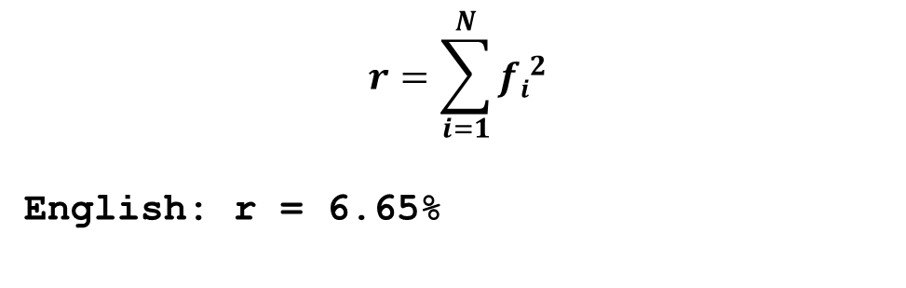
Index of Coincidence is the coincidence rate normalized to the random rate
$$r=\sum_{i=1}^{N}{{fi}_{}^{2}}$$
English: r = 6.65%
INSERT
VIDEO
HERE

Slide 58
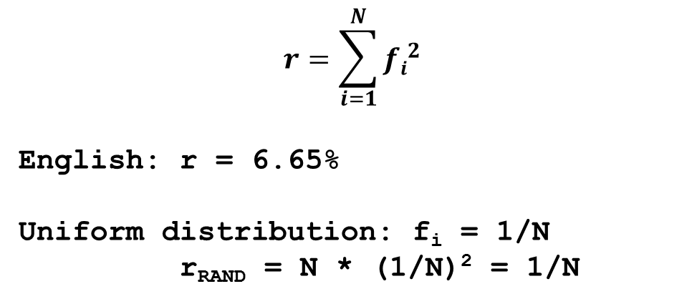
Index of Coincidence is the coincidence rate normalized to the random rate
$$r=\sum_{i=1}^{N}{{fi}_{}^{2}}$$
English: r = 6.65%
Uniform distribution: f_{i} = 1/N
r_{RAND} = N * (1/N)² = 1/N
INSERT
VIDEO
HERE

Slide 59
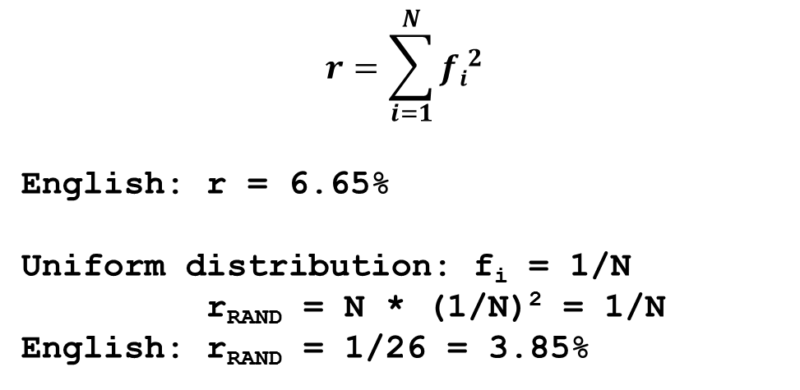
Index of Coincidence is the coincidence rate normalized to the random rate
$$r=\sum_{i=1}^{N}{{fi}_{}^{2}}$$
English: r = 6.65%
Uniform distribution: f_{i} = 1/N
r_{RAND} = N * (1/N)² = 1/N
English: r_{RAND} = 1/26 = 3.85%
INSERT
VIDEO
HERE

Slide 60

Index of Coincidence is the coincidence rate normalized to the random rate
$$IC= \frac{r}{r_{RAND}}=N\sum_{i=1}^{N}{{fi}_{}^{2}}$$
INSERT
VIDEO
HERE

Slide 61
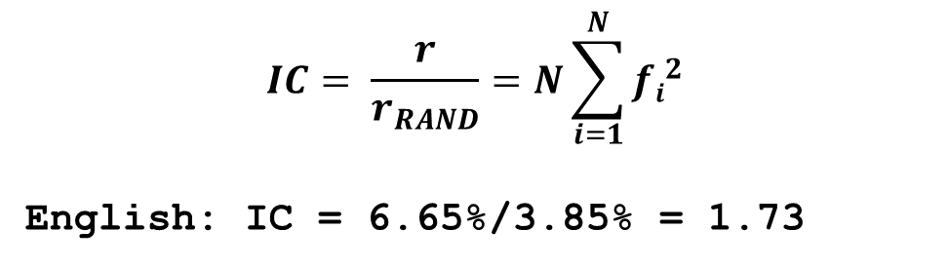
Index of Coincidence is the coincidence rate normalized to the random rate
$$IC= \frac{r}{r_{RAND}}=N\sum_{i=1}^{N}{{fi}_{}^{2}}$$
English: IC = 6.65%/3.85% = 1.73
INSERT
VIDEO
HERE

