Slide 1
A Study of a Treatment for Diabetes Measured as Change in HbA1c Level
Jonathan Stathakis

Slide 2
Sample Categorical Variables
levels | Absolute Frequency |  | Relative Frequency
 | Frequency | Cumsum | Frequency | Cumsum
Sex
Female | 604 | 604 | 0.49 | 0.49
Male | 630 | 1234 | 0.51 | 1.00
Age
0 - 55 | 1006 | 1006 | 0.82 | 0.82
56+ | 228 | 1234 | 0.18 | 1.00
BMI
Normal | 31 | 31 | 0.03 | 0.03
Overweight | 597 | 628 | 0.48 | 0.51
Obese | 606 | 1234 | 0.49 | 1.00
Group
Control | 625 | 625 | 0.51 | 0.51
Treatment | 609 | 1234 | 0.49 | 1.00

Slide 3
Numerical Variable Statistics of Sample
Variable | Mean | SD | CI Lower | CI Upper
Age (years) | 53.0 | 2.84 | 52.88 | 53.20
Height (cm) | 172.2 | 8.54 | 171.71 | 172.67
Weight (kg) | 88.7 | 14.59 | 87.89 | 89.51
BMI (kg/m²) | 29.7 | 2.41 | 29.54 | 29.81
HbA1c_Pre | 8.1 | 0.72 | 8.07 | 8.15
HbA1c_Post | 7.1 | 1.46 | 6.99 | 7.15
HbA1c_Delta | 1.0 | 1.30 | 0.96 | 1.11

Slide 4
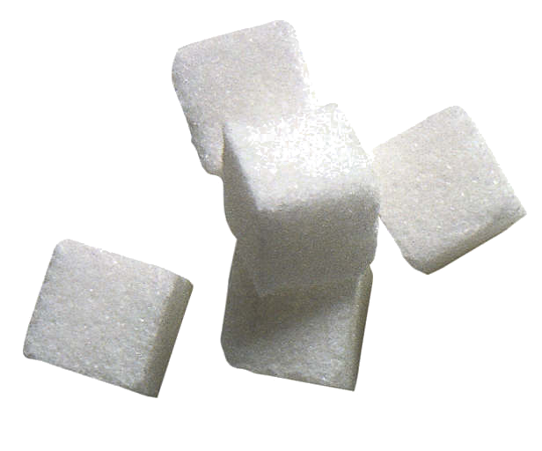

Change in HbA1c
After Treatment
Subpopulation | Mean | SD | 95% CI Lower | 95% CI Upper
Sex_Female | −2.0 | 0.00 | −2.04 | −2.03
Sex_Male | −2.0 | 0.03 | −2.01 | −2.01
BMI_normal | −1.5 | 0.12 | −1.62 | −1.47
BMI_Overweight | −2.1 | 0.05 | −2.07 | −2.05
BMI_Obese | −2.0 | 0.01 | −2.01 | −2.02
Age_0-55 | −2.0 | 0.01 | −2.02 | −2.02
Age_56+ | −2.0 | 0.16 | −2.05 | −1.99

Slide 5
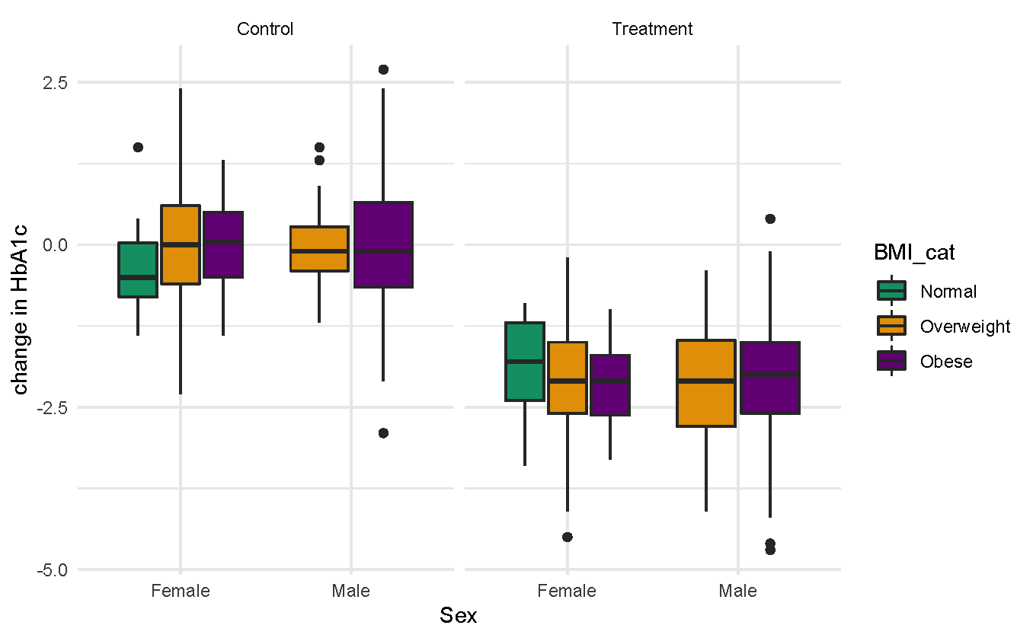
Decrease in HbA1c for Treatment Group, Sex and BMI

Slide 6
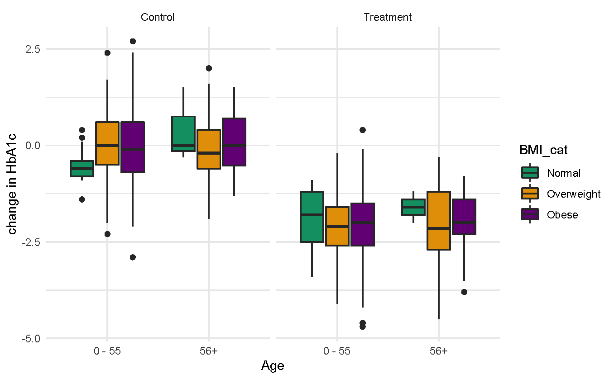
Change in HbA1c for Treatment Group, Age and BMI

Slide 7

Thank you!

