Slide 1
EPA Digital Services – User Personas
Overview The goal of building personas is to define the mindset, desires, and daily tasks of the users. UX Analysts inform the persona creation process by conducting research, user interviews and surveys which help reinforce the purposed personas.
The ultimate goal of user persona research is answering the following questions.
What factors help potential residents decide on moving to a certain county?
What factors help potential business owners decide on setting up their business in a certain county?
How are users completing those tasks today?
What features would be useful for them to enable a decision?

Slide 2
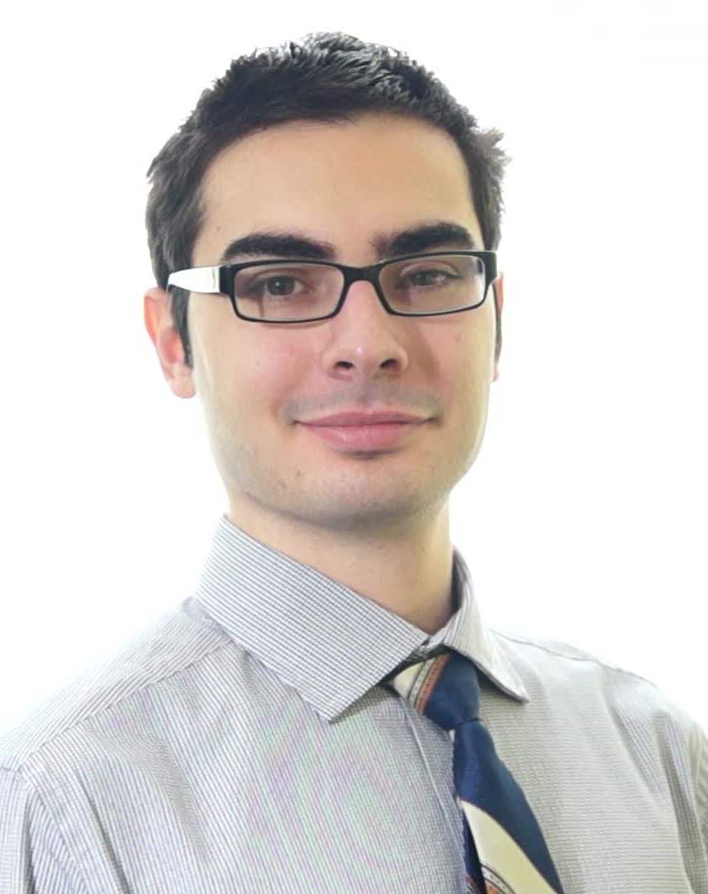
Software Programmer
Profile Tech Savvy, Super User
Age 32
Occupation Independent Consultant
Role An independent consultant, mostly works for home on multiple projects
Description
He loves coding and working from home. He is looking for a a place that relatively quiet and not very busy so that he can focus on his multiple assignments. Since he is working from home and will be mostly based out of there, he is looking for a high standard of living which includes high water and air quality (Note: he does not want to spend on water, rather just drink off the tap).
In addition, he wants to move to a location that is safe (to protect his valuable electronics). He does not care too much about travel issues or at least as much as crime.
Objectives
Continue working from home on multiple projects
Quiet surroundings so that he can focus on his work
Wants a home in a low crime area
High water and air quality – considers this a bare minimum necessity
Willing to pay extra for a home in a sub-urban neighbourhood

Slide 3
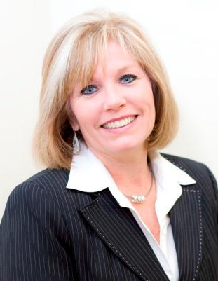
Business Owner
Profile Intermediate User
Age 47
Occupation Chief Executive Officer
Role Sole-Owner of a business, would like to set up a new office at a new location to handle corporate growth
Description
Her current office is not able to meet current demands so she is scouting for a new office in a different location in order to cater to growing business needs. Would like to sign an office space for 5-7 years in a location that is booming for the industry she is in but would also like to make sure the location is marketable at a later time and is relatively crime-free. She would also like to ensure water quality is high so that her employees are safe from any illnesses.
She and her employees commute frequently in and out of the office and also to different locations so ideally a county that is rated high in travel is preferable.
Objectives
Crime and drug free work place
A county that has qualified candidates to employ and satisfy the booming industry
Easy commute possibility for travelling employees
Water quality and consistent supply in the office

