Slide 1

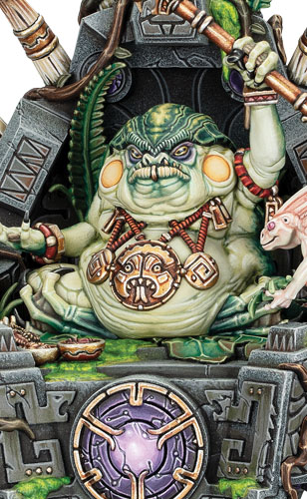


SLANN STARMASTER
5’’
Move
9
Health
5+
Save
6+
Ward
3
Wizard
2
Control
Melee Weapons | Attacks | Hit | Wound | Rend | Damage
Azure Lightning Crit (Mortal) | 6 | 3+ | 3+ | 1 | 1
6
Once Per Turn (army) Your Hero Phase | Once Per Turn, Any Hero Phase | Passive | Your Hero Phase
Celestial Reinforcement | Arcane Vassal | Masters of Order | Celestial Equilibrium
Pick a friendly SERAPHON unit that started the battle with 3 or more models and that has been destroyed to be the target. | Pick a friendly SKINK WIZARD wholly within 18" of this unit to be the target. |  | Make a casting roll of 2D6.
Roll a dice. On a 4+, set up a replacement unit with half the number of models from the target unit (rounding up) wholly within 12" of this unit and more than 9" from all enemy units. | Measure the range and visibility of the next SPELL ability used by this unit this phase from the target instead of from this unit. | Add 1 to casting rolls for this unit. In addition, this unit can use an UNBIND ability if an enemy WIZARD anywhere on the battlefield uses a SPELL ability (instead of 30’’) | For the rest of the turn, add 1 to casting rolls made for other friendly SERAPHON WIZARDS while they are wholly within 12" of this unit. Keywords: Spell
Keywords : Warmaster, Hero, Wizard (3), Infantry, Fly, Ward (6+), Order, Seraphon, Slann

Slide 2




LORD KROAK
5’’
Move
18
Health
4+
Save
4+
Ward
3
Wizard
5
Control
Ranged Weapons | Range | Attacks | Hit | Wound | Rend | Dmg
Gaze of Kroak Shoot in Combat | 12’’ | 1 | 2+ | 3+ | 2 | D6
Melee Weapons | Attacks | Hit | Wound | Rend | Damage
Azyrite Force Barrier Crit (Mortal) | 2D6 | 3+ | 3+ | 1 | 1
7
End of Any Turn | Once Per Turn, Any Hero Phase | Passive | Your Hero Phase
Dead for Innumerable Ages | Arcane Vassal | Supreme Master of Order | Celestial Deliverance
This unit must use this ability each turn while it is damaged. Roll 3D6 and add the number of damage points this unit has to the roll. On a 20+, this unit is destroyed. Otherwise, Heal (18) this unit. | Pick a friendly SKINK WIZARD wholly within 18" of this unit to be the target. | Add 2 to casting rolls, and add 1 to unbinding rolls and banishment rolls for this unit. In addition, this unit can use an Unbind and Banish Manifestation anywhere on the battlefield. | This unit can cast this spell more than once per phase. Pick up to 3 different visible enemy units within 18" of this unit to be the targets, then make a casting roll of 2D6.
 | Measure the range and visibility of the next SPELL ability used by this unit this phase from the target instead of from this unit.
 |  |  | Inflict D3 mortal damage on each target. Keyword : Spell
Keywords : Warmaster, Unique, Hero, Wizard (3), Fly, Ward (4+), Order, Seraphon, Slann

