Slide 1

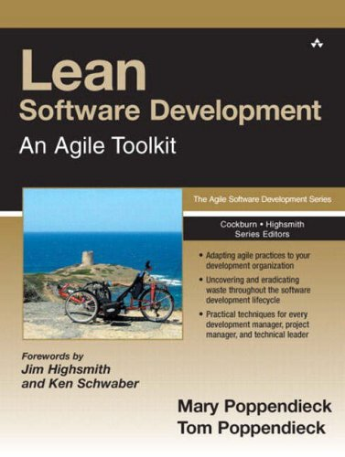
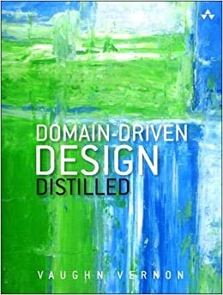
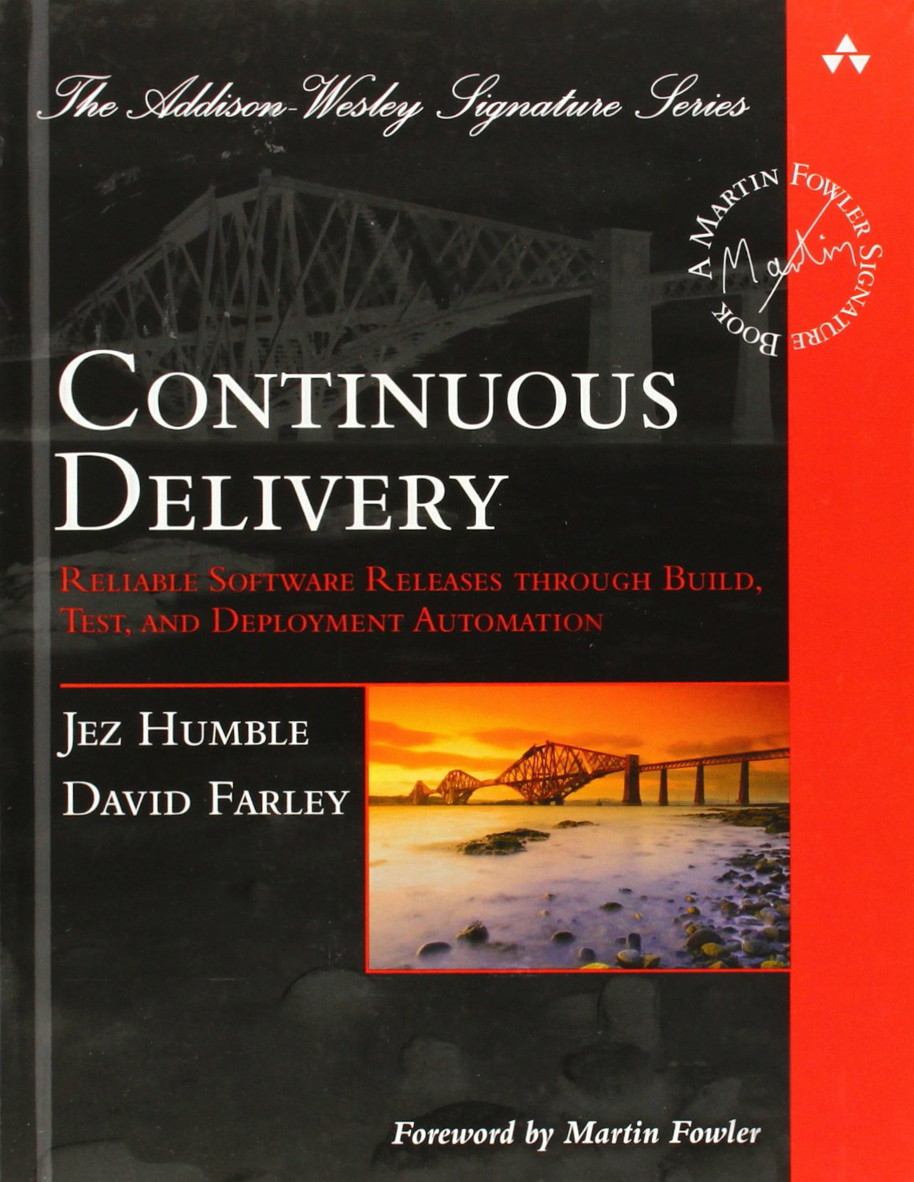
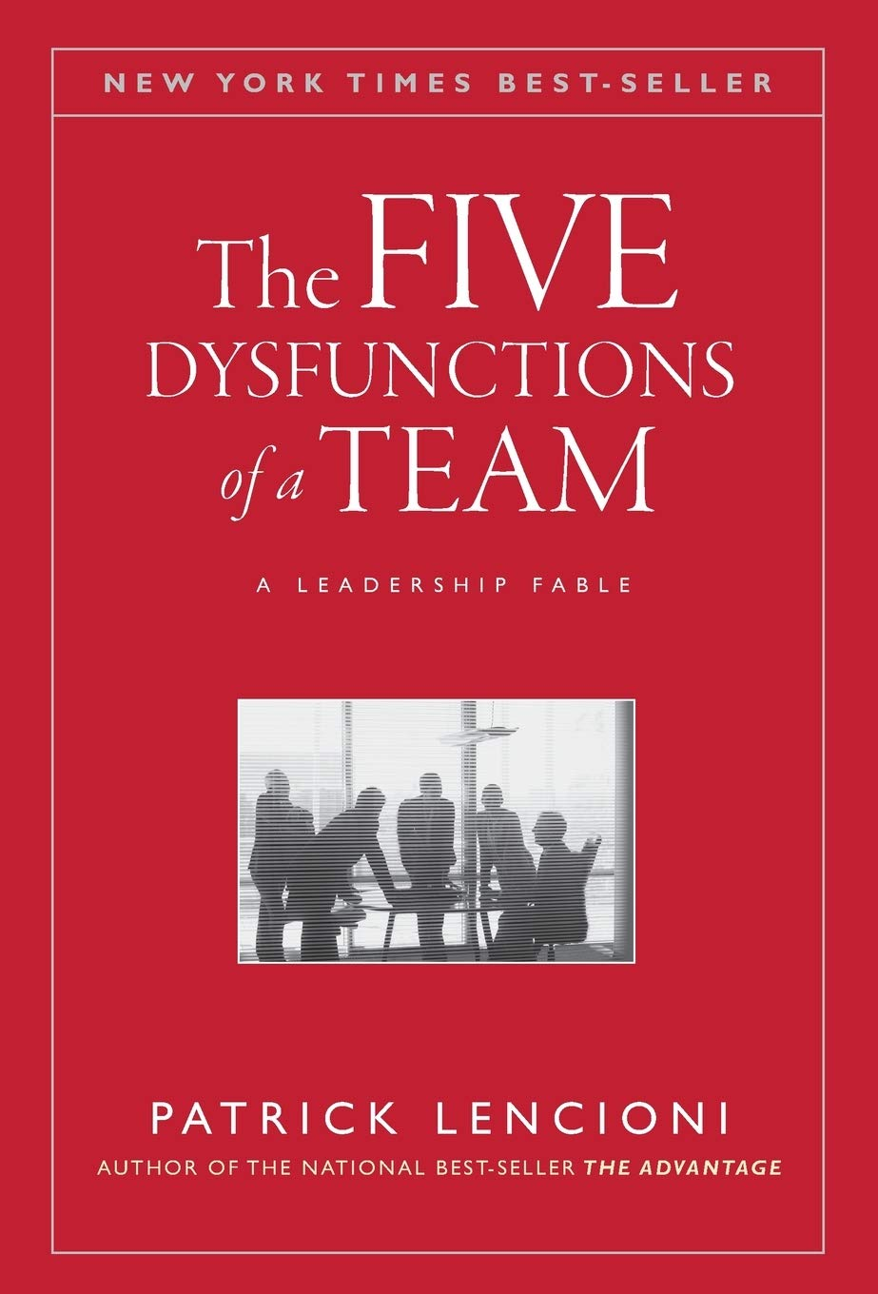
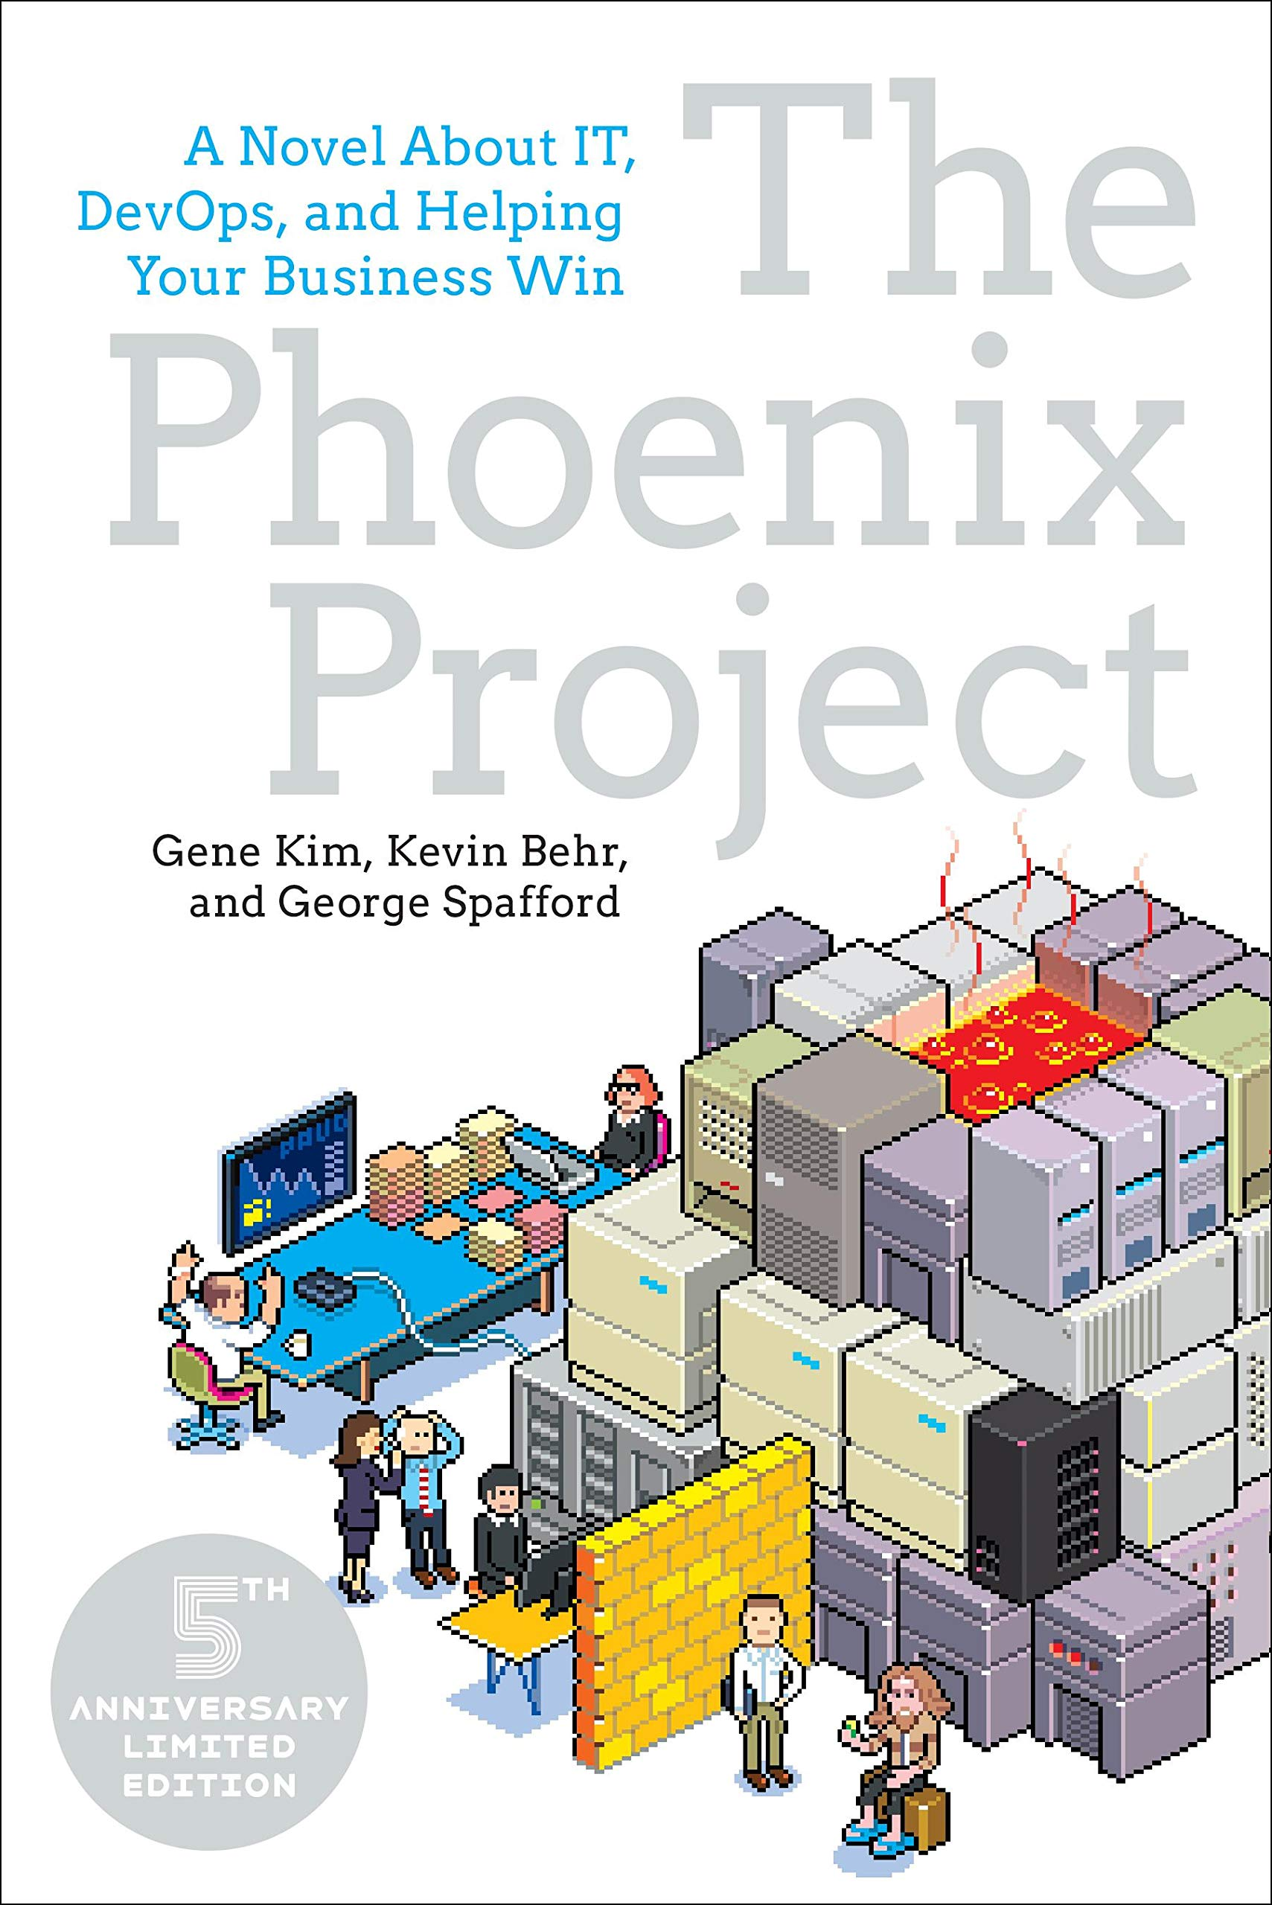
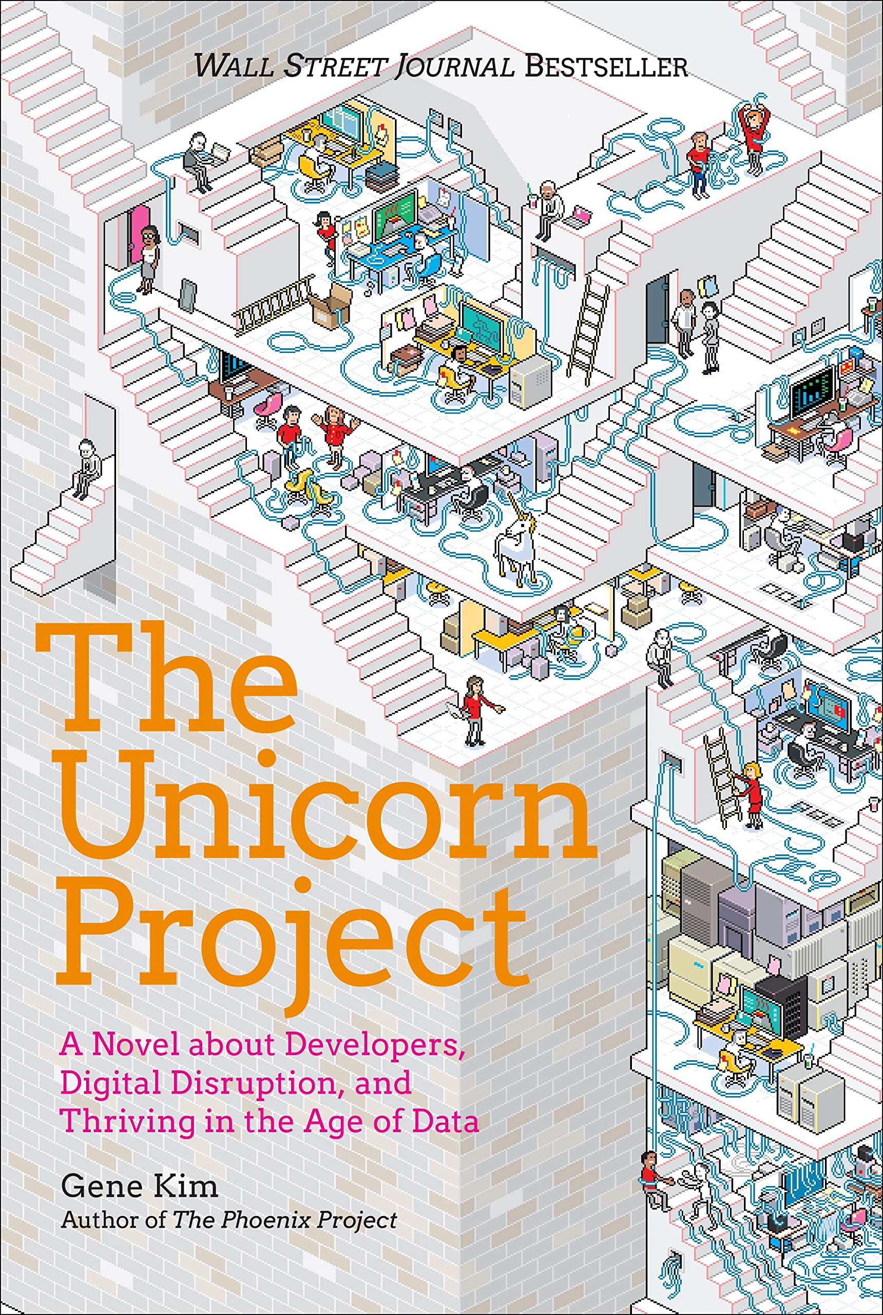
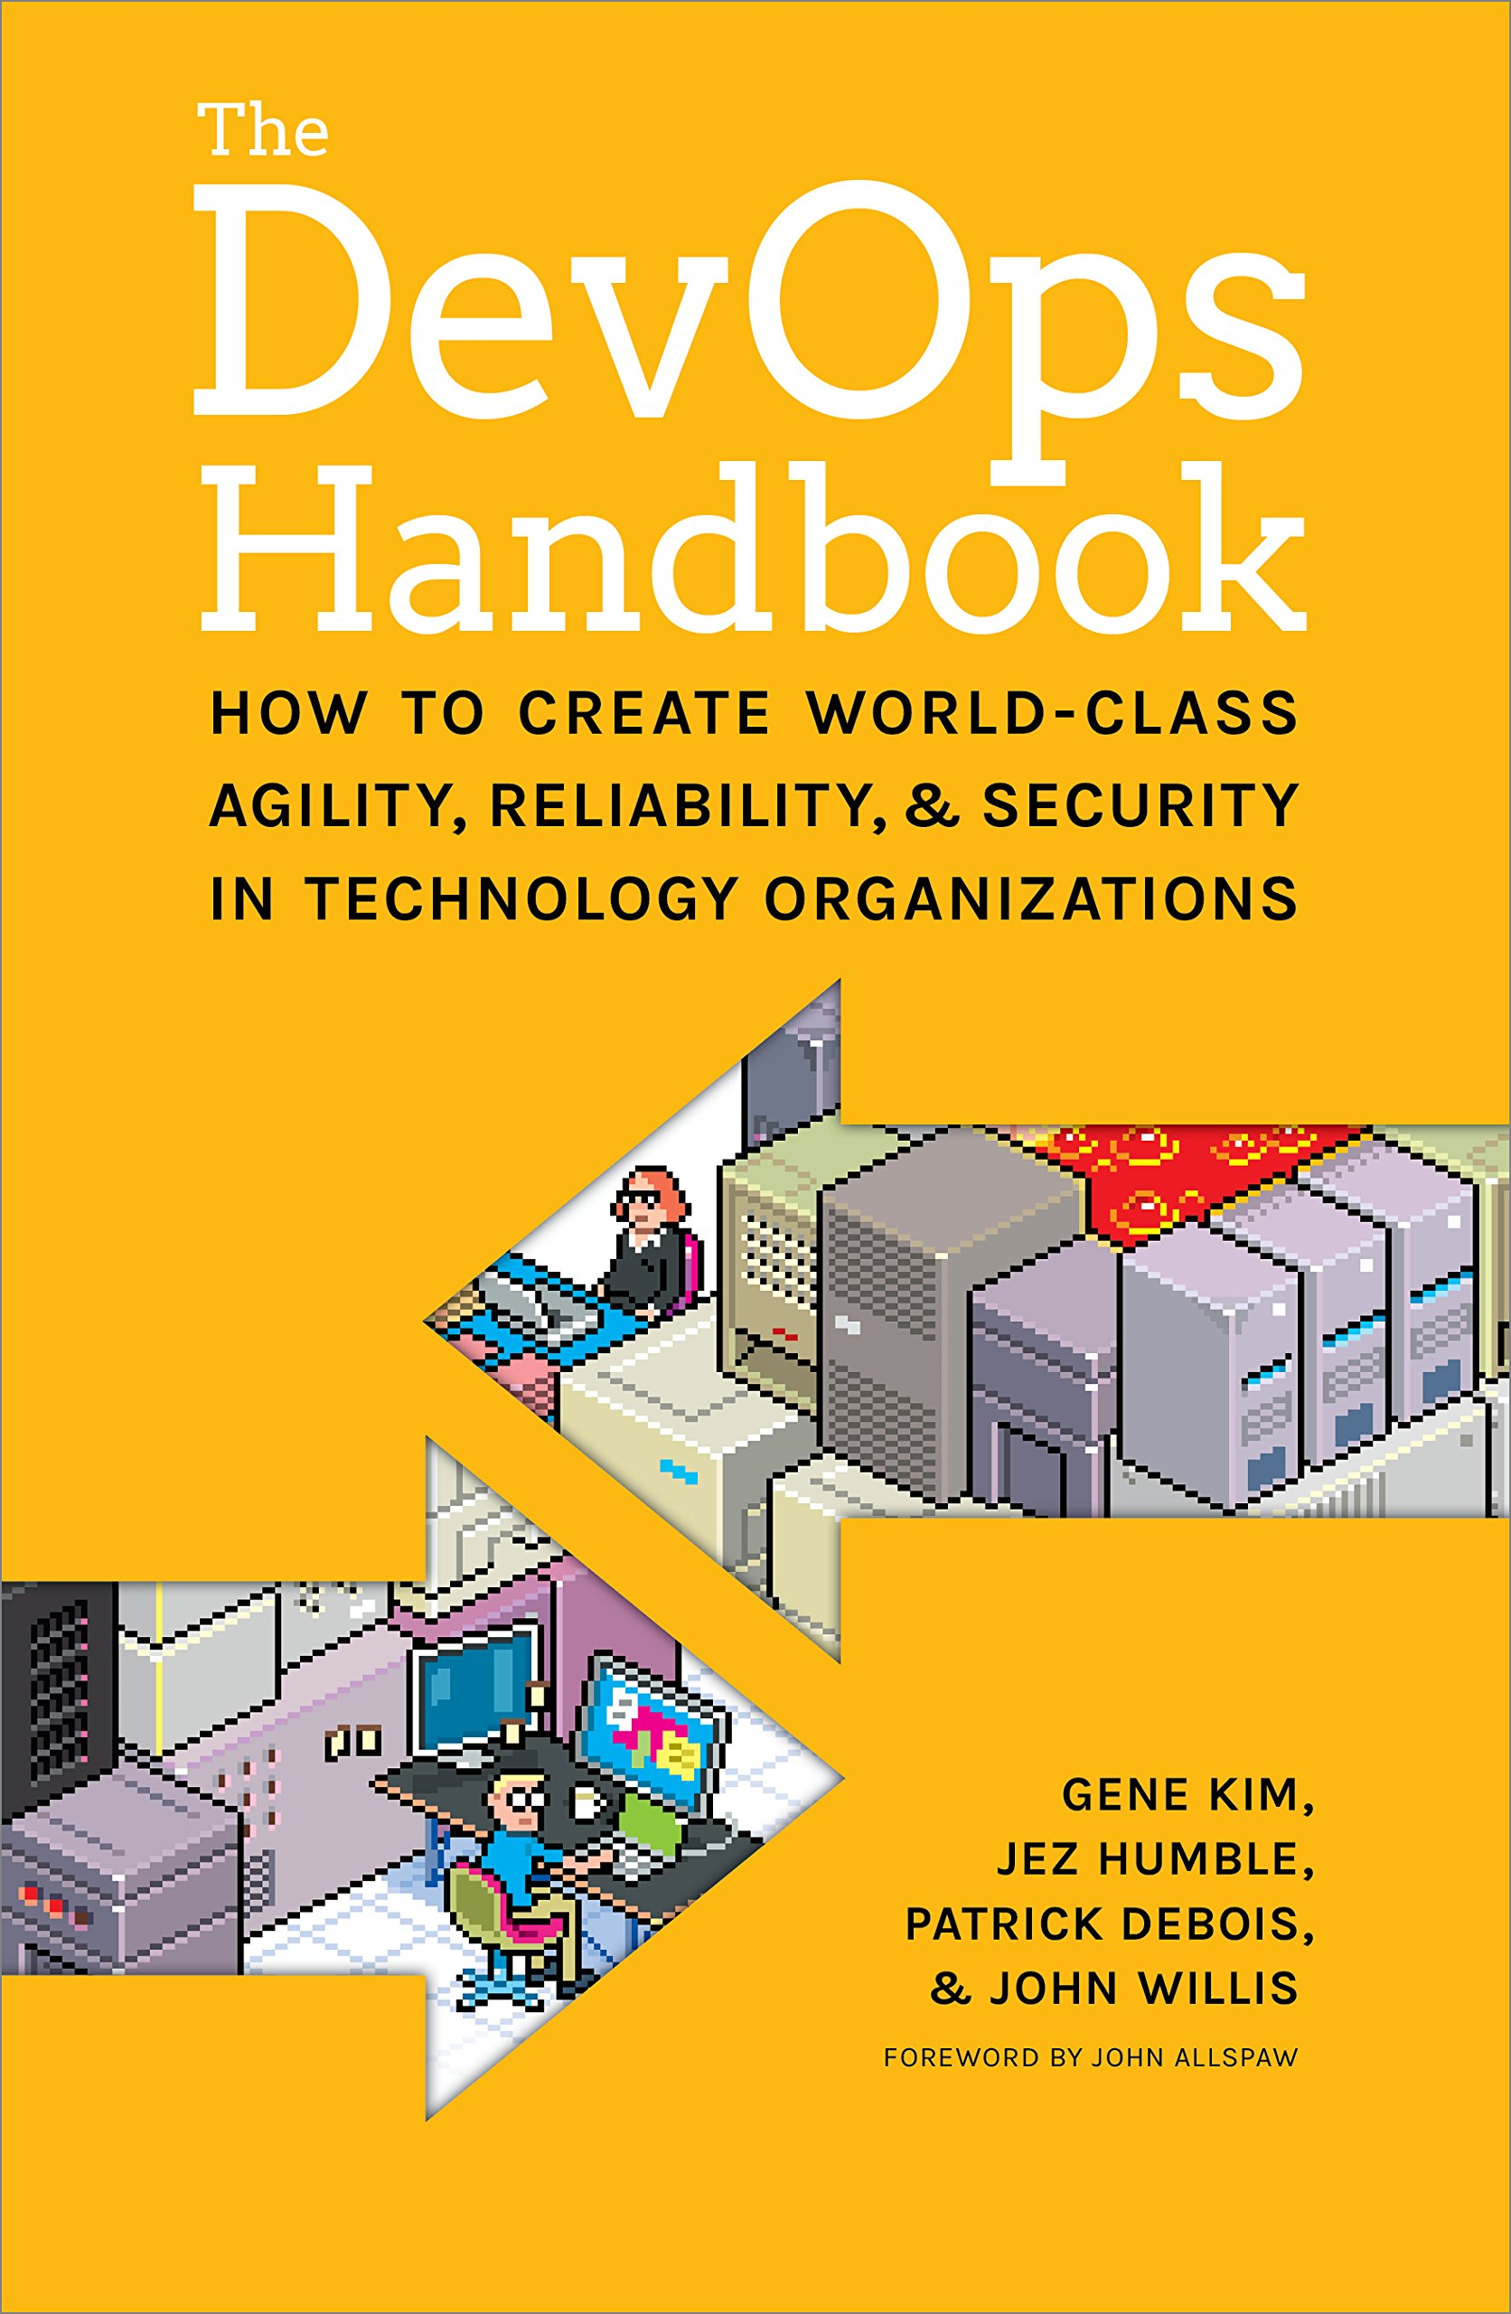

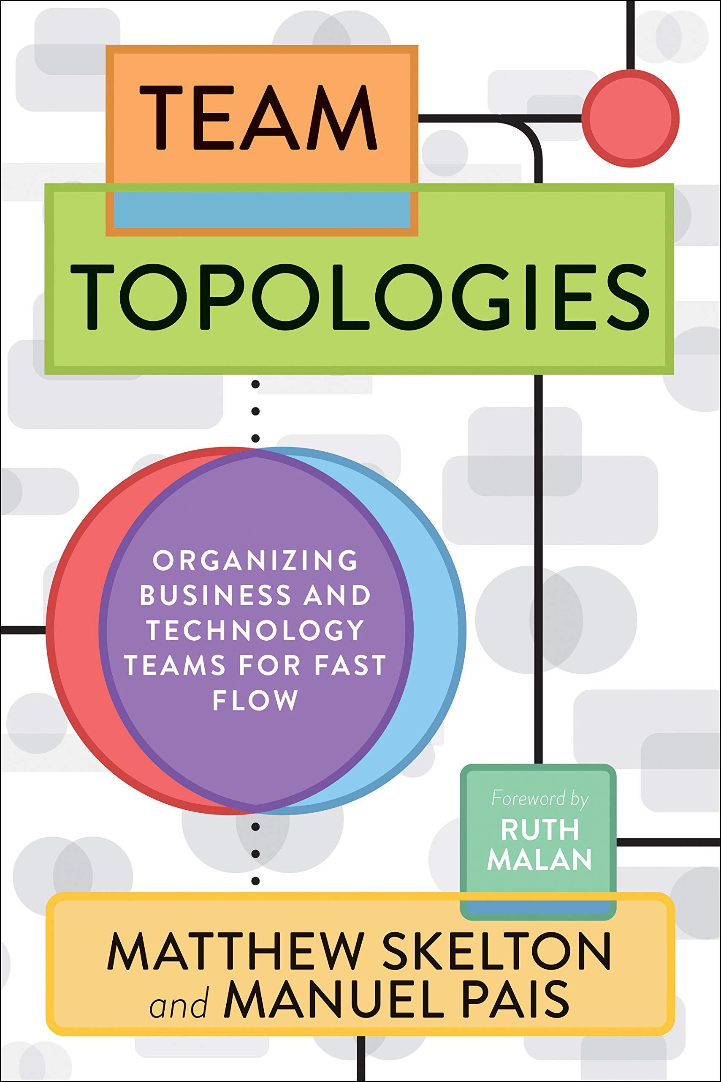
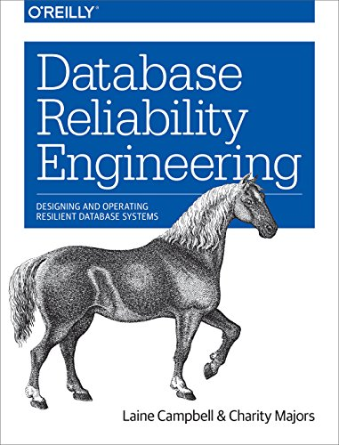
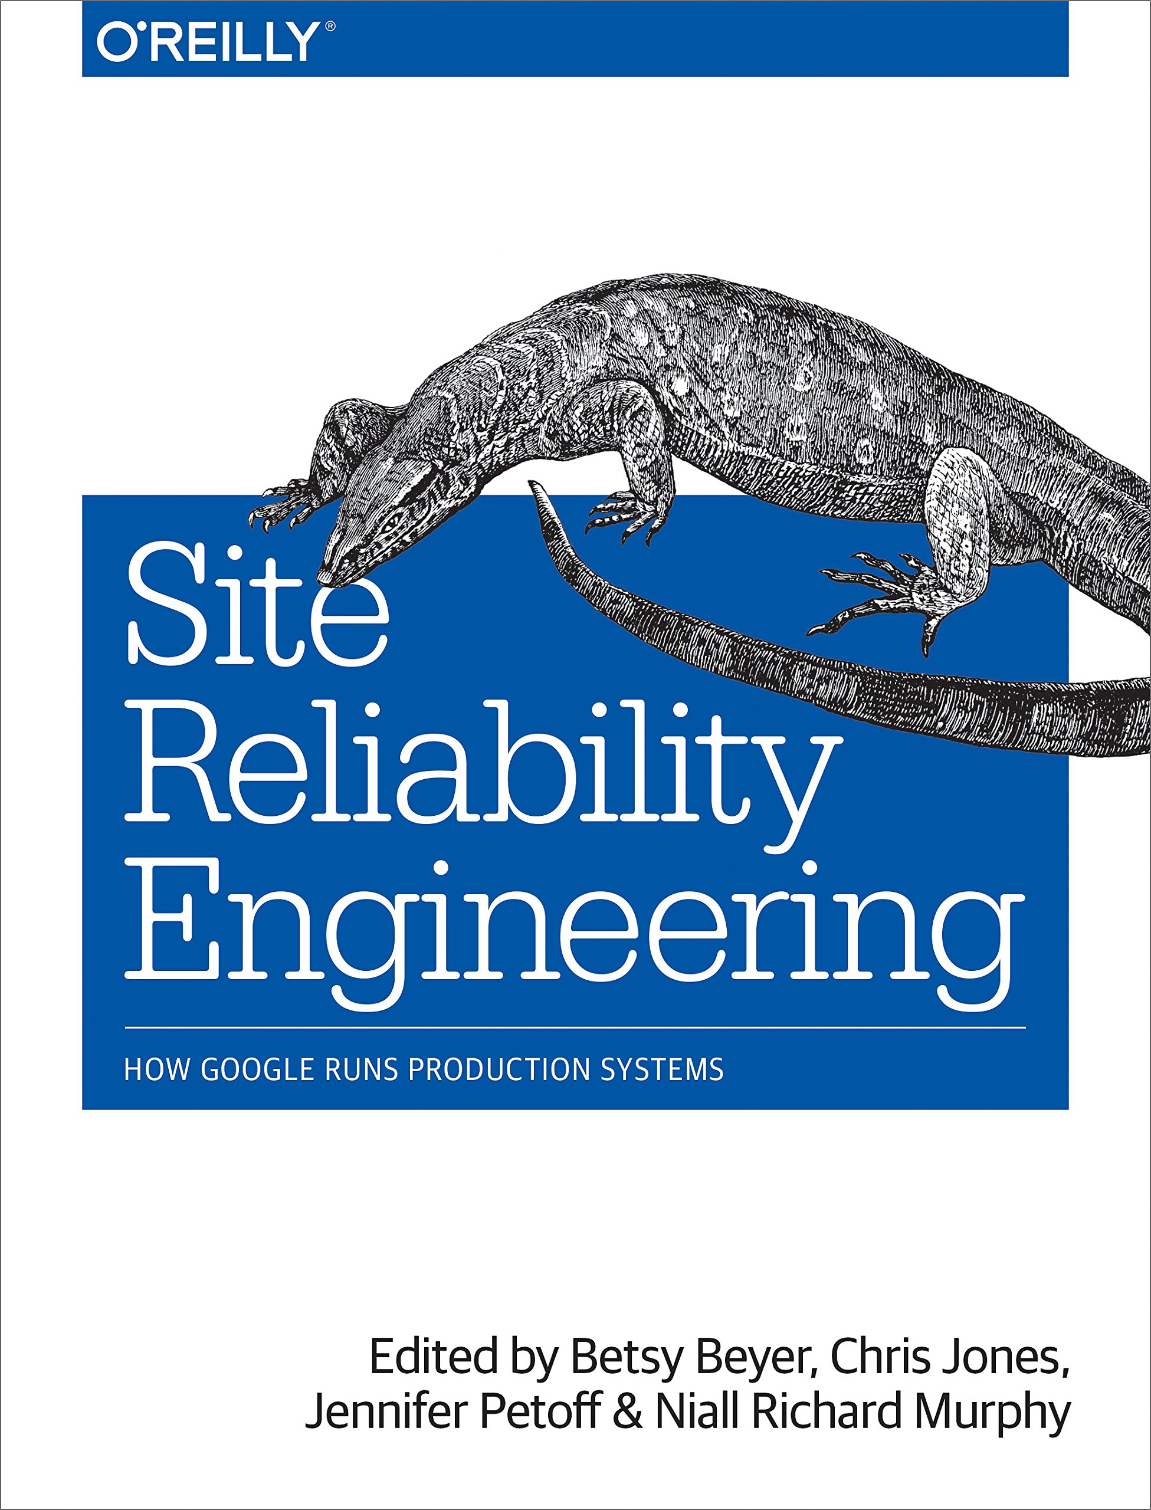
Lean/Agile Foundations or Practicing DevOps?
(See below for more info)
Lean/Agile Foundations
Practicing DevOps
Lean principles or Agile practices?
(See below for more info)
DevOps or SRE?
(See below for more info)
Lean principles
Agile practices
DevOps
SRE
Novel or textbook?
(See below for more info)
Tech or Culture?
Novel or textbook?
(See below for more info)
Are you a
database specialist?
Tech
Culture
Novel
Textbook
Novel
Textbook
Yes
No
Design or Delivery?
Are you Ops/Management
or a Dev/Architect?
Manual/handbook, data-driven
analysis or org blueprint?
Design
Delivery
Ops/
Mgmt
Dev/
Arch…
Manual
Blueprint
Analysis
1
2
3
4
5
6
7
8
9
10
11
12

