Slide 1
Internal Presenter Notes: What Attendees Should Take Away
Content creators: Write 3 things an attendee should take away from the presentation. This will help presenters home in on the main points.
1. Learn about Octopus Deploy
2. Introduce Infrastructure as Code
3. Explain what Azure Bicep is, and how it fits into an infrastructure as code approach

Slide 2

Combine Azure Bicep and Octopus Deploy
Name
Job Title
Twitter Handle

Slide 3
Infrastructure As Code

Slide 4
Infrastructure As Code
Deploying Azure Bicep with Octopus Deploy

Slide 5
Who am I?
Introduce yourself to the audience

Slide 6
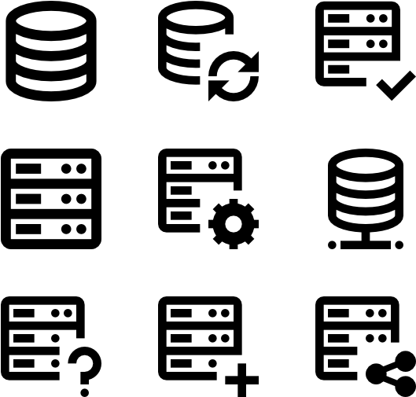
Deploying infrastructure
Deploying infrastructure in the Cloud can be complex.
A solution needs to help resolve problems with consistency, repeatability, and reduce management overhead.
Notes:
This slide is to introduce the concept of deploying infrastructure in the cloud. How it can be complex with different parts relying on each other, options to choice from, ways to do it and human error that can be introduce into the process.
Cloud providers have graphical user interfaces that end users can use to deploy resources, however, that’s not an efficient way when you are deploying a lot of infrastructure, a lot of different resources.
A solution needs to be introduced that can help remove some of the problems, and introduce things like consistency, repeatability and reduce the work/time that is required to actually deploy the resources in the cloud.

Slide 7


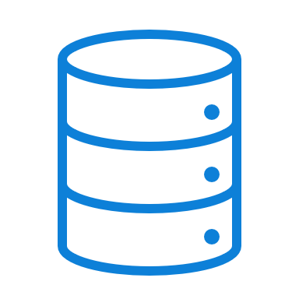


Infrastructure as Code
Infrastructure as code, sometimes referred to as IaC, is the process of provisioning infrastructure resources like how software is deployed.
Notes:
Introduce what Infrastructure as Code is.

Slide 8
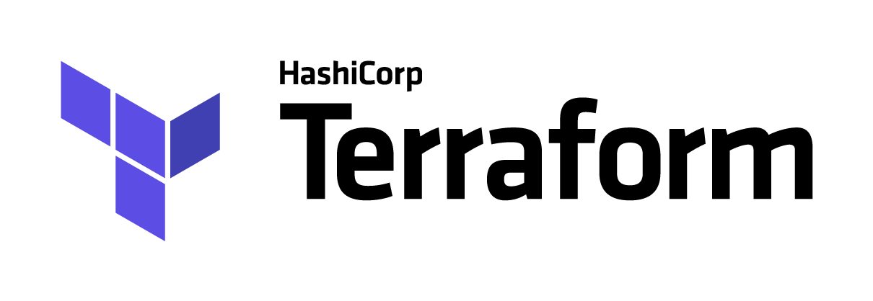

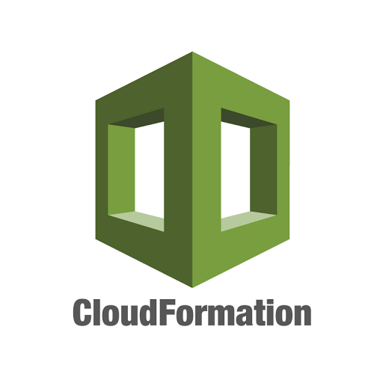
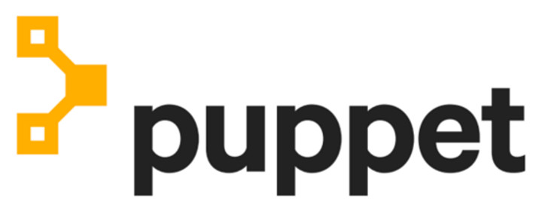
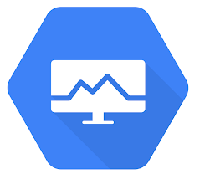

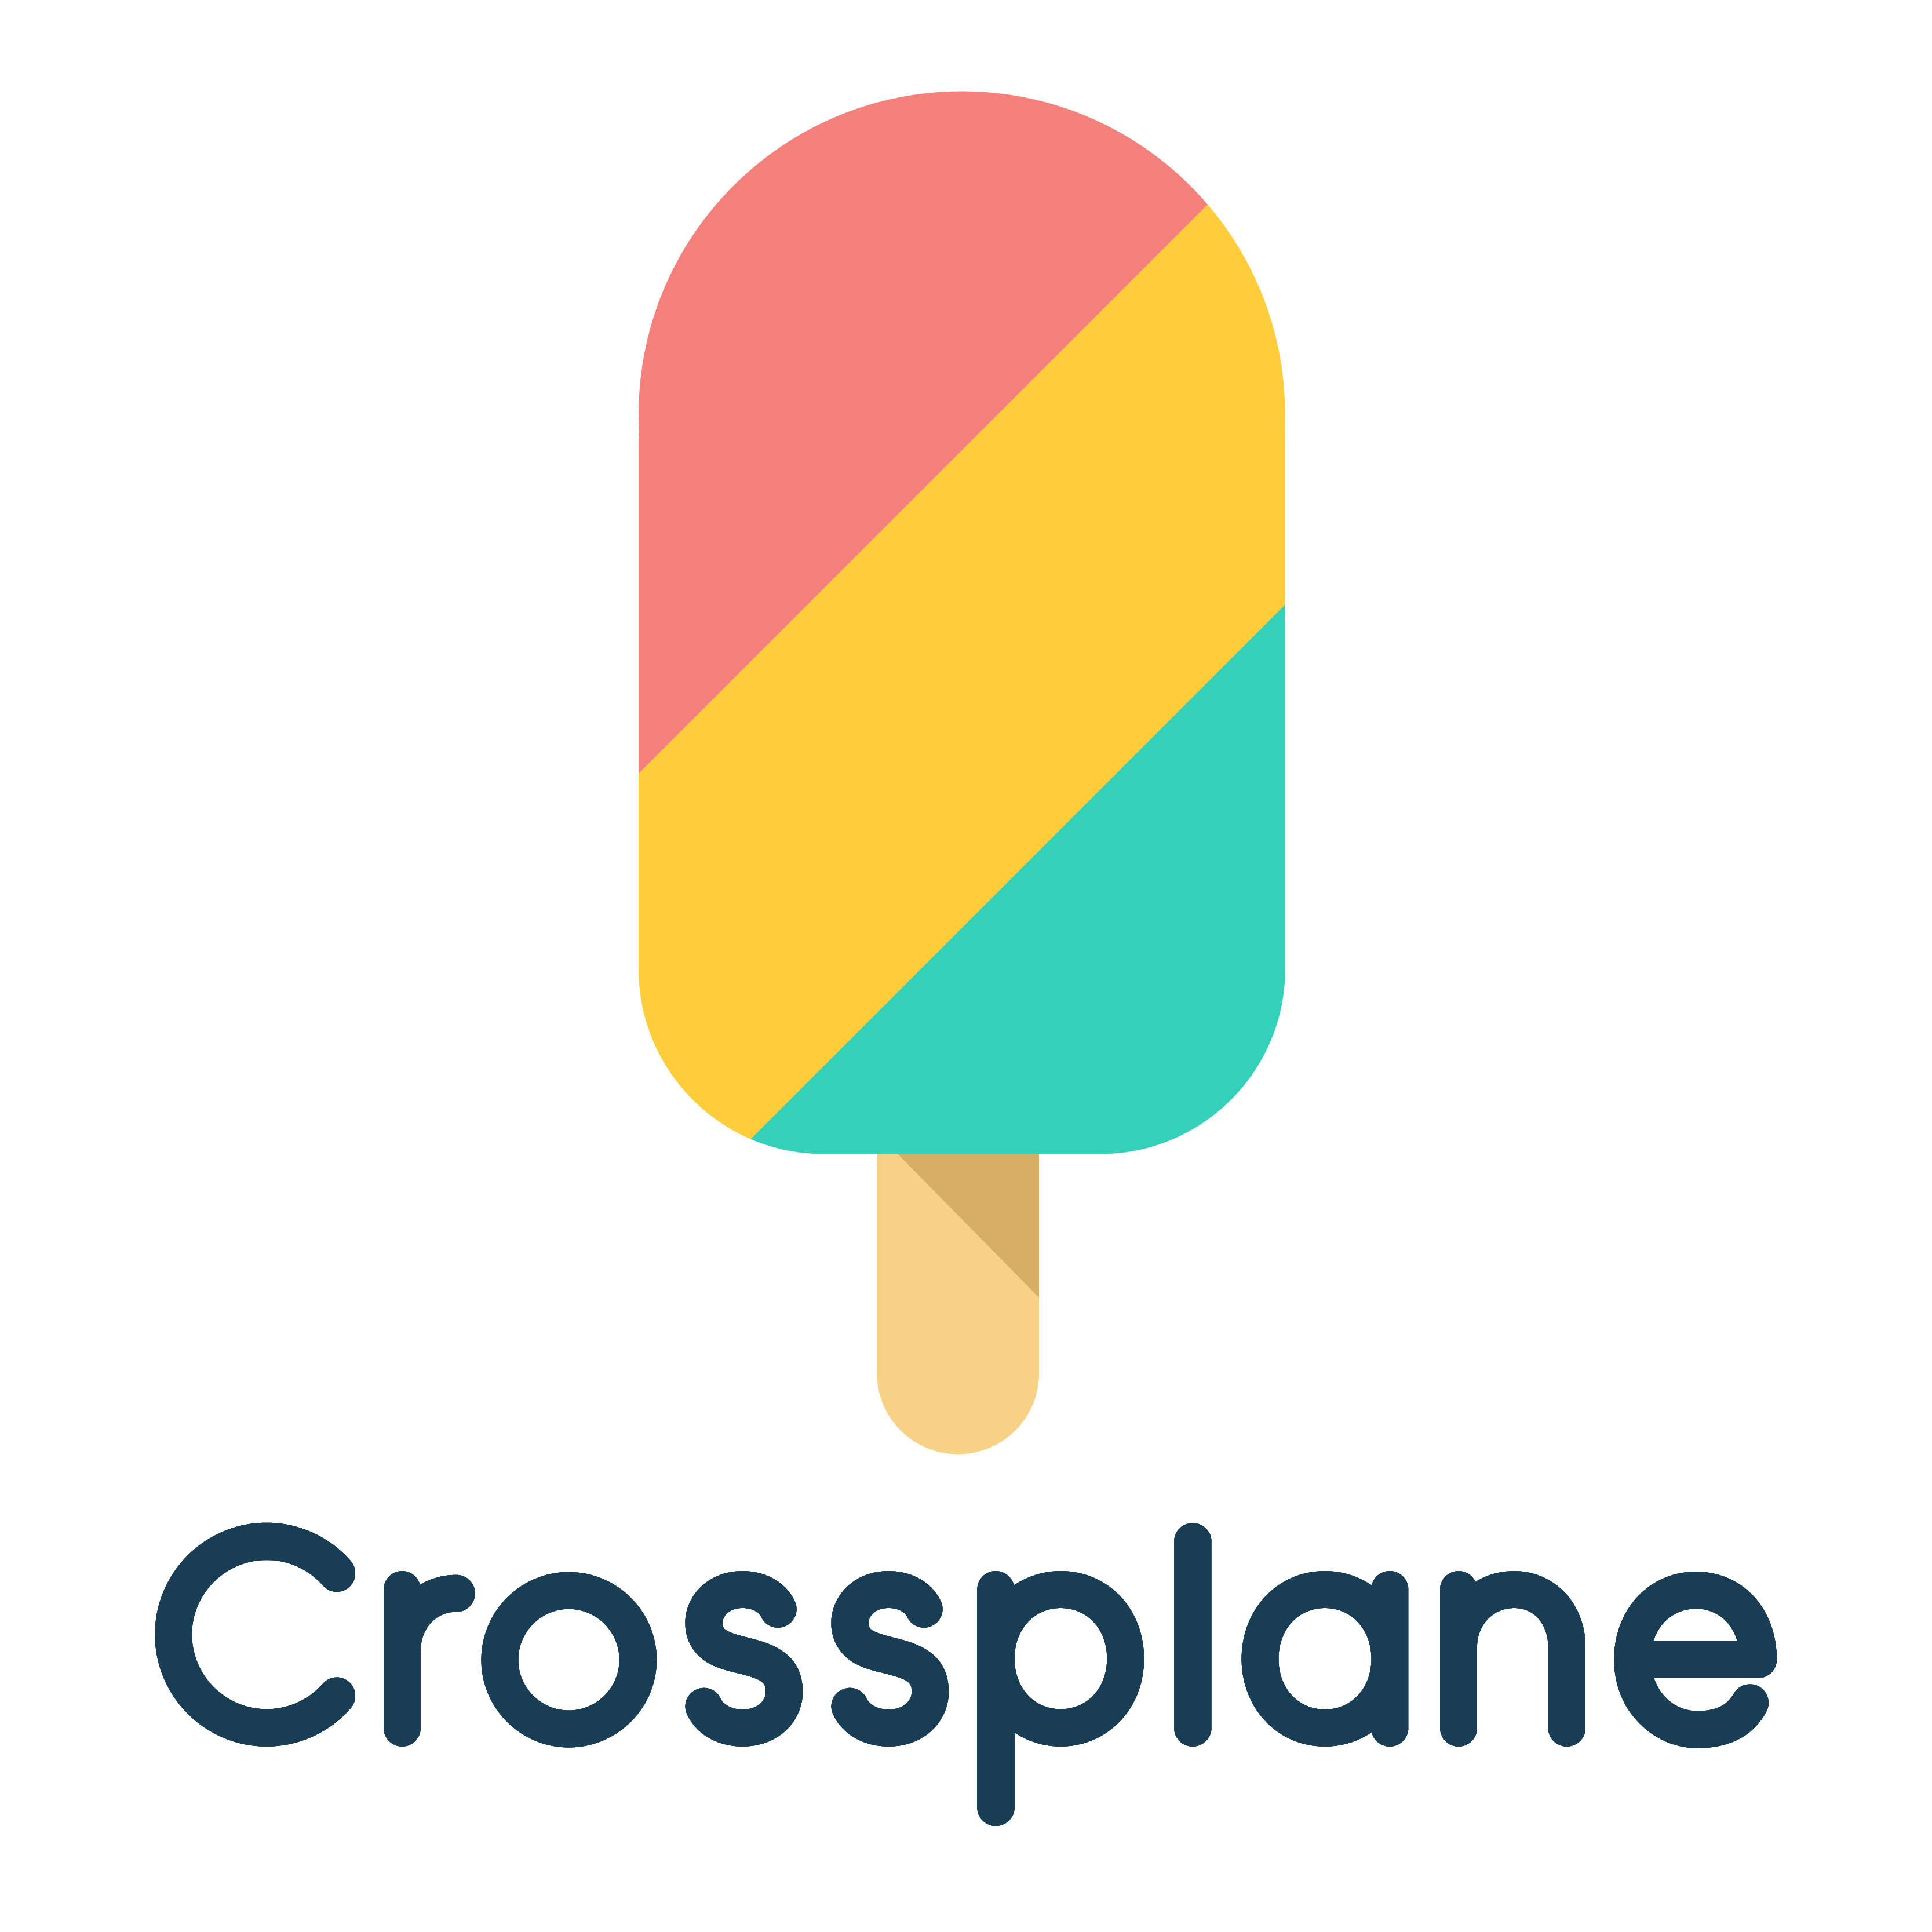
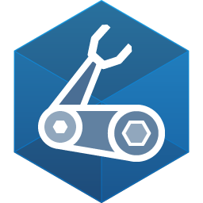
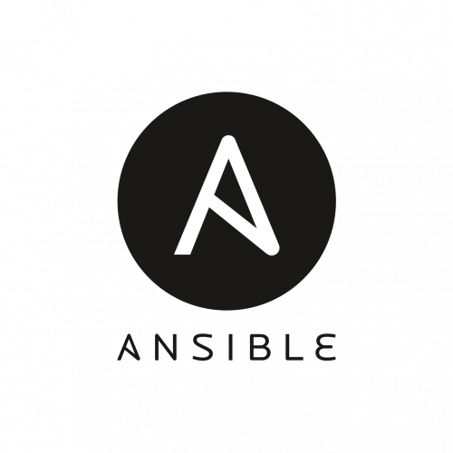

Infrastructure as Code languages
Notes:
List the types of infrastructure as code languages available.
Terraform
CloudFormation
Pulumi
Puppet
Google Cloud Deployment Manager
Azure ARM
Crossplane
Bicep
Ansible
Chef
Remember to explain we are going to focus on Azure Bicep.

Slide 9
What is Azure Bicep?

Slide 10
What is Azure Bicep?
Bicep is a Resource Manager template language that's used to declaratively deploy Azure resources.
Intended to be easy to understand and straightforward to learn.
It is a Domain Specific Language (DSL).
100% free and open source.

Slide 11



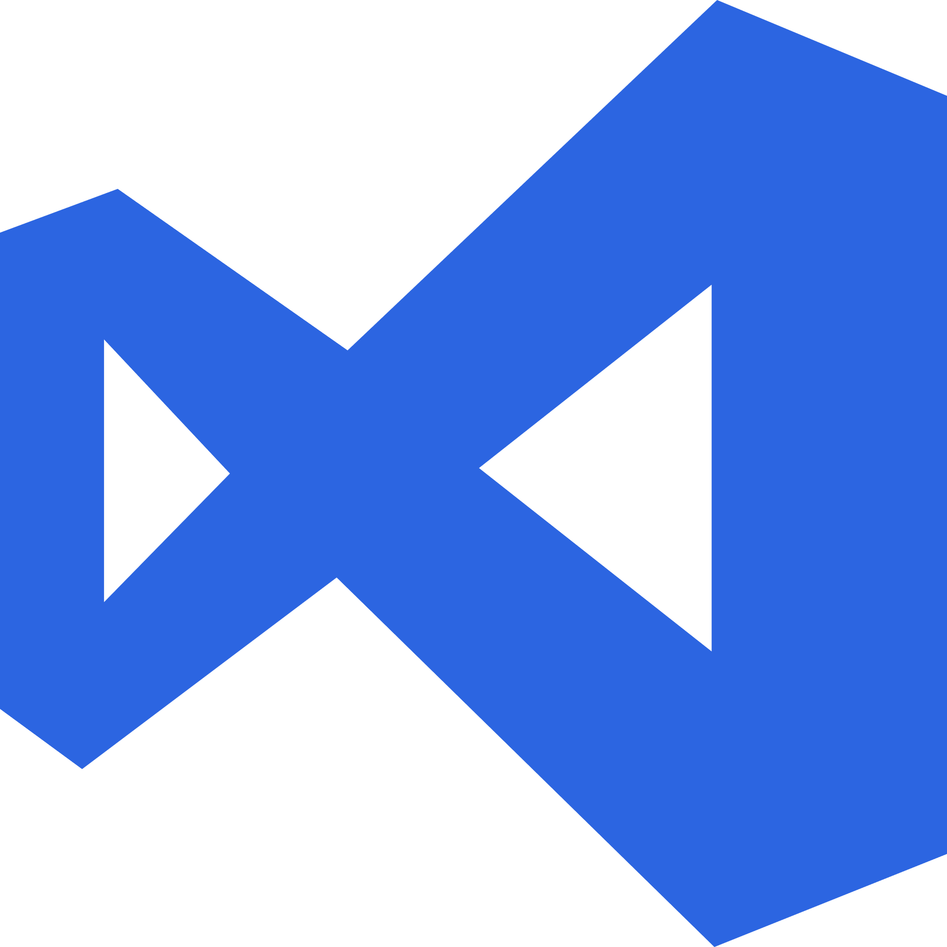
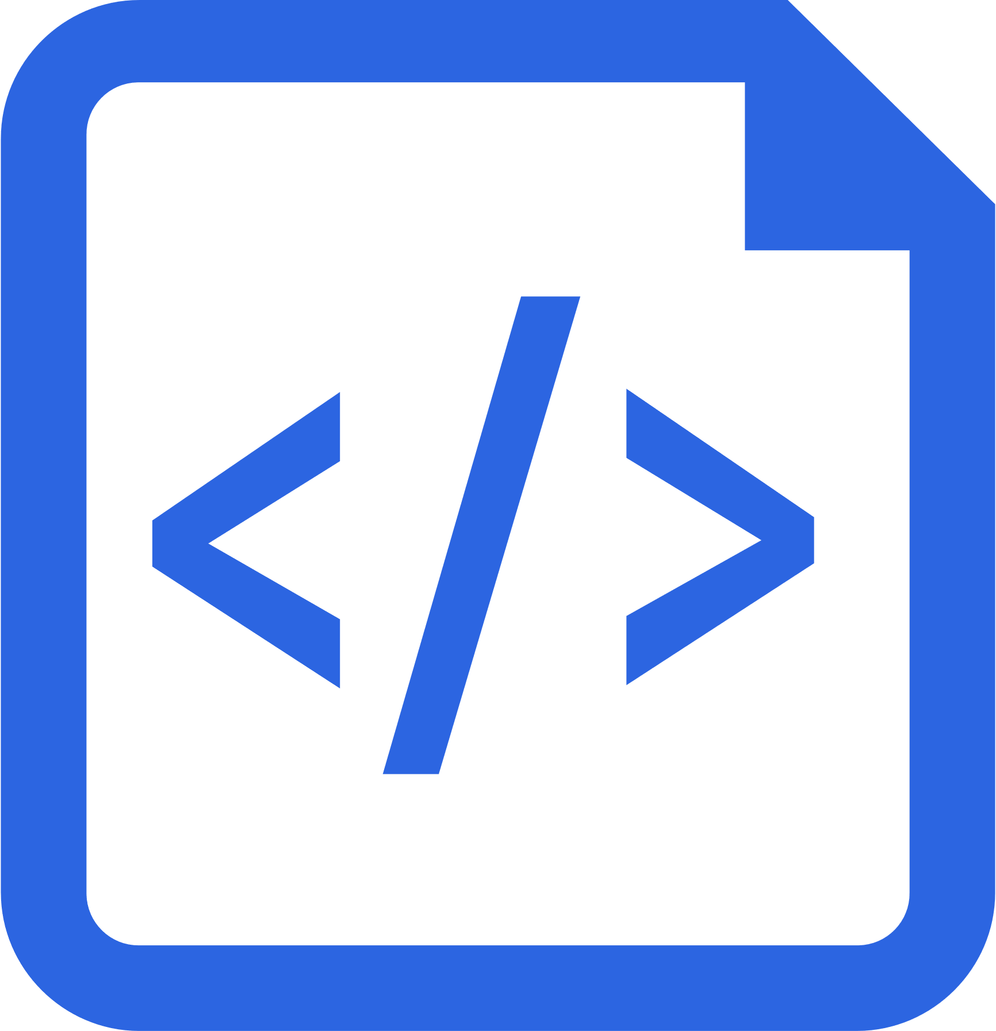
Benefits of Azure Bicep
Simpler Syntax. No JSON noise
Define Azure resources using a simple language to learn, read and understand.
Declarative Syntax
Declare how the resources should be and Azure Resource Manager “makes it so”.
Modularity
Modules to break your bicep code into manageable chunks. Public and Private module registries
Built for tool-ability
First class authoring experience in VSCode. Rich type-safety, intellisense and validation.
Convert existing templates
Easy conversion of ARM Templates to Bicep
Notes:
More readable and write-able syntax. No JSON noise.
Day Zero support for all Azure resource types.
No state management. State is managed by the Azure platform.
Richer type-safety, validation, IntelliSense. Built for Toolability.
Modules to break your bicep code into manageable chunks.
Integrated into the platform (Export Templates, Remediate resources with templates in policy)

Slide 12
What is Octopus Deploy?

Slide 13
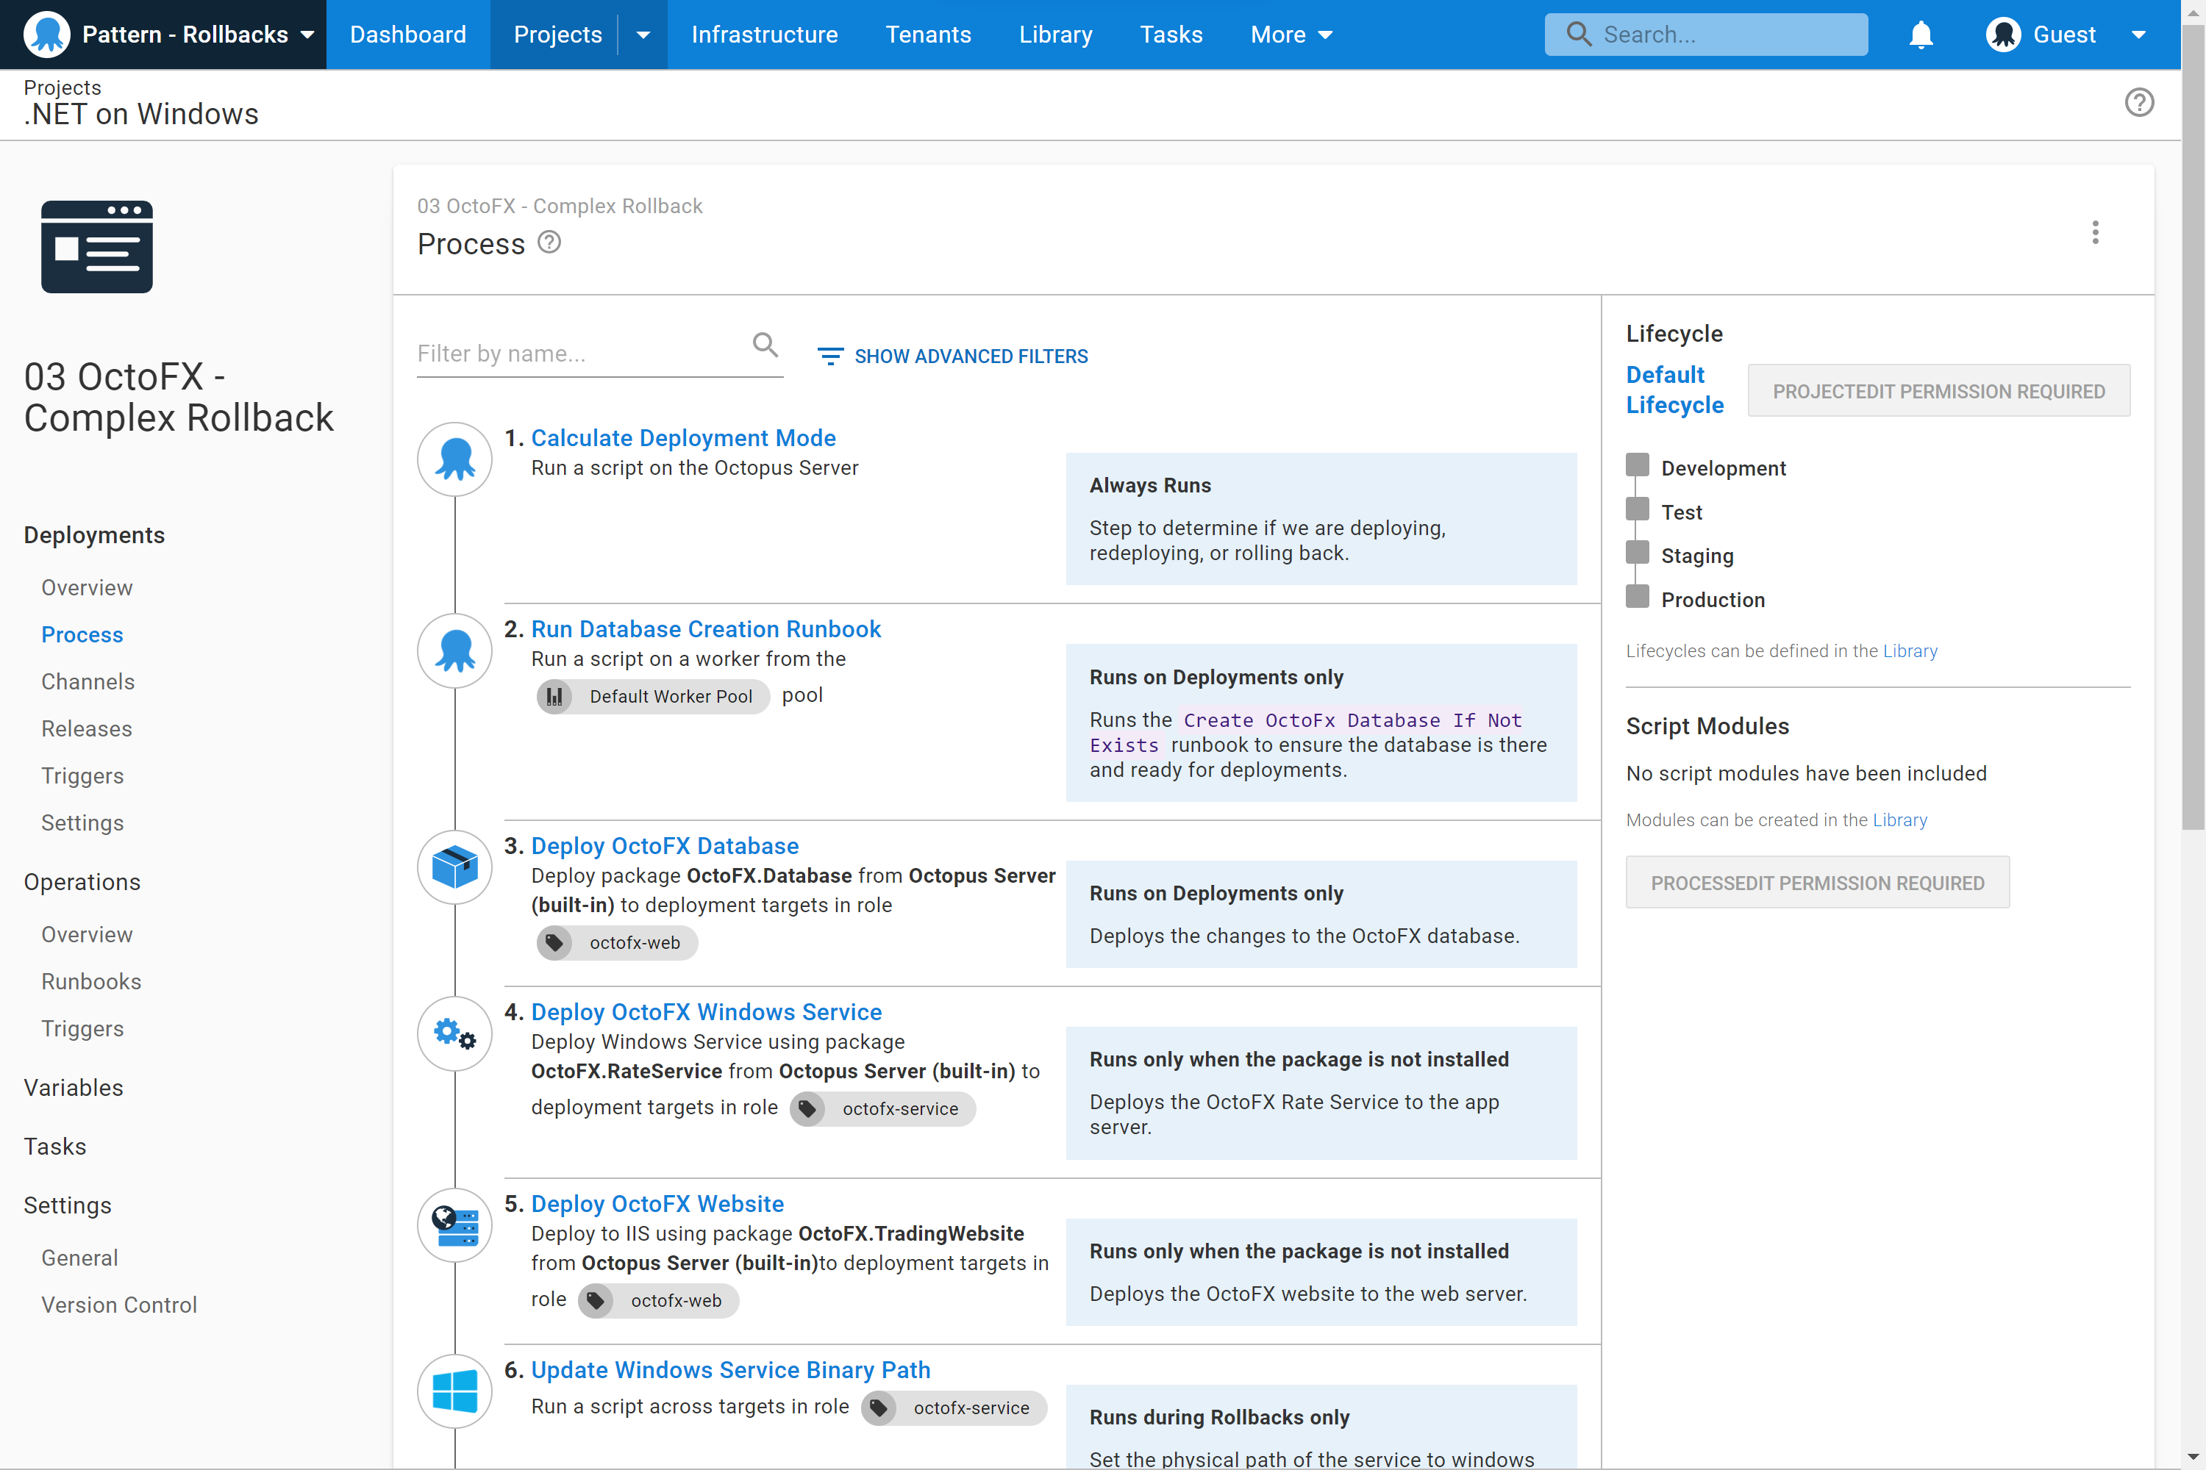
What is Octopus Deploy?
A unified DevOps Automation platform.
Octopus Deploy is a single place for your team to manage releases, automate deployments, and automate the runbooks that keep your software operating.
Notes:
DevOps is about bringing teams together to collaborate. But when it comes to automation, the tooling is fragmented. Most CI/CD tools do a basic job of deployments and are designed for developers. Operations teams, meanwhile, need to use completely different tooling to automate the runbooks that keep the software running.
There’s no reuse and no single source of truth. The tooling reinforces the silos and discourages sharing and collaboration, and forces a duplication of effort to connect to the infrastructure in multiple tools.
Octopus Deploy is the first platform to enable your developers, release managers, and operations folks to bring all automation into a single place.
By reusing configuration variables, environment definition, API keys, connection strings, permissions, service principals, and automation logic, teams work together from a single platform. Silos break down, collaboration begins, and your team can ship –⁠ and operate –⁠ software with greater confidence.

Slide 14
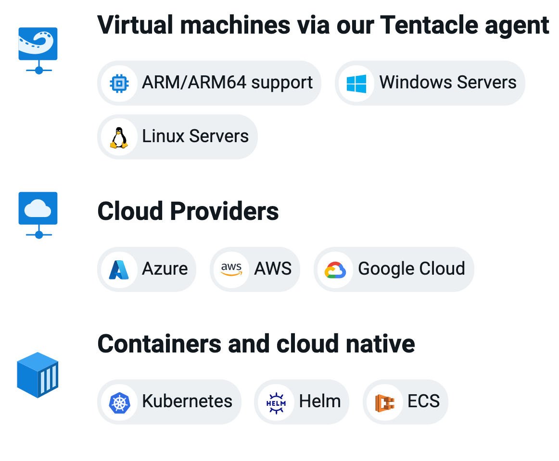
Run on any infrastructure
Support for legacy to modern infrastructure from virtual machines to containers
Cloud agnostic with built-in functionality for Azure, AWS, and Google Cloud
Support for all major CI servers with native plugins including Jenkins, GitHub Actions, Jetbrains TeamCity, Azure DevOps and more
Notes:
This is talks about all the different platforms that Octopus can interact with and support.
The main points to enforce is that Octopus works with whatever you are using, cloud, or on prem technology.

Slide 15
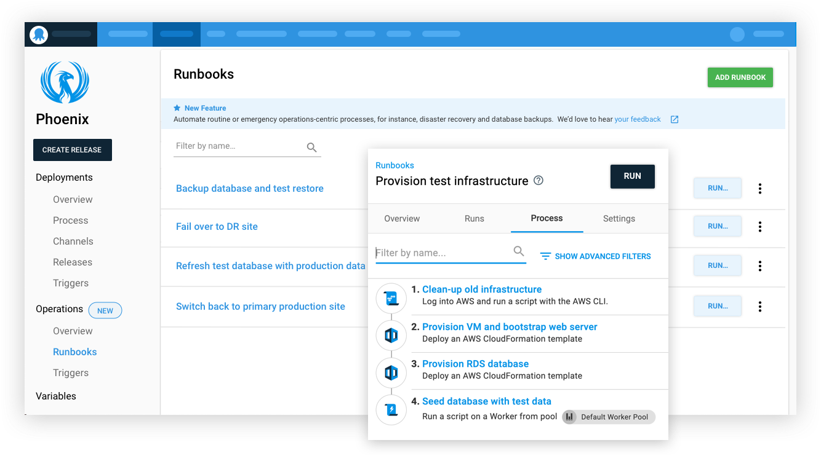
Runbooks
Runbooks allow teams to automate routine maintenance and incident management (emergency) operations tasks
Notes:
Talk to the audience about Octopus Runbooks.
Runbooks are the Ops in DevOps and automate routine maintenance and emergency operations (incident response) tasks, such as:
Infrastructure provisioning
Database management
Website failover and restoration
Server maintenance
Further reading:
Self-service runbooks examples - Octopus Deploy
Self-service runbooks for operations teams - Octopus Deploy
Operations Runbooks: Putting the Ops in DevOps - Octopus Deploy

Slide 16
DEMO

Slide 17
Internal Presenter Notes: Demo Overview
There are several demos to this.
First Demo, walking the audience through a simple Azure Storage Account Bicep template. You’ll then deploy this through Azure PowerShell.
We’ll then introduce Octopus Deploy and do a brief introduction. Focusing on Runbooks. Talk the audience through packing and pushing the Bicep file to the Octopus Library.
Then we’ll create variables and the Runbook and trigger the deployment of the Bicep template through the Runbook.
Second Demo, we’ll introduce the concept of Nested templates. And explain those to the audience. You’ll deploy this to Azure using Azure PowerShell.
We’ll then walk through the process of packing and pushing to the Octopus Library again.
And then we’ll create the relevant variables and Runbook then trigger the deployment.

Slide 18
























Next Steps
Notes:
This section starts to talk about what to do beyond what we’ve just shown.
Treat your infrastructure code the same way you do your software code.
Start storing your code in a central repository.
Start introducing testing before deployment.
Start testing after deployment.

Slide 19
What did we cover?
What is Azure Bicep
Deploying an Azure Bicep template with PowerShell
What is Octopus Deploy
Deploying an Azure Bicep template with Octopus Deploy
Notes:
This is a summary slide, remind the audience of what you’ve just shown them and reiterate what they can do and why.

Slide 20

Sign up for a free trial
https://octopus.com/start
Notes:
This is your call to action, ask the audience to sign up for an Octopus trial and try implementing Azure Bicep with a Runbook

Slide 21
Thank you! Resources: https://g.octopushq.com/bicepoctopus
Name
Job Title
Twitter Handle
Contact information

Slide 22
Why Infrastructure as Code?
Adopting an infrastructure as code approach offers many benefits to resource provisioning.
Increase confidence in your deployments.
Manage multiple environments.
Better understand your cloud resources.
Notes:
Explain the advantages of infrastructure as code

Slide 23

When is Azure Bicep the right tool?
Azure Support: Bicep is fully supported by Microsoft Support.
Easy transition from JSON: If you are already using Azure ARM JSON templates you can easily transition to Azure Bicep templates.
Azure-native: When new Azure resources are released or updated, Bicep will support those features on day one.
Notes:
We want to introduce the concept that Bicep is the right tool for certain scenarios but isn’t always the right tool.

Slide 24
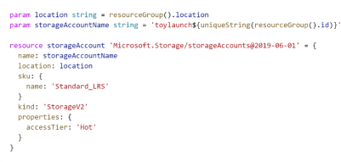

When is Azure Bicep not the right tool?
Existing tool set: Sometimes it make sense to use existing financial and knowledge investments.
Multi-cloud: Other cloud providers don’t support Azure Bicep as a template language.
Notes:
Existing tool set: When you are determining when to use Bicep, the first question to ask is, "Does my organization already have a tool set in use?" Many tooling options are available that can be used for infrastructure as code-based resource provisioning. Sometimes, it makes sense to use existing financial and knowledge investments when you consider adopting a new process.
Multi-cloud: If your organization uses multiple cloud providers to host its infrastructure, Bicep might not be the right tool. Other cloud providers don't support Bicep as a template language. Open-source tools like Terraform can be used for multi-cloud deployments, including deployments to Azure.

Slide 25
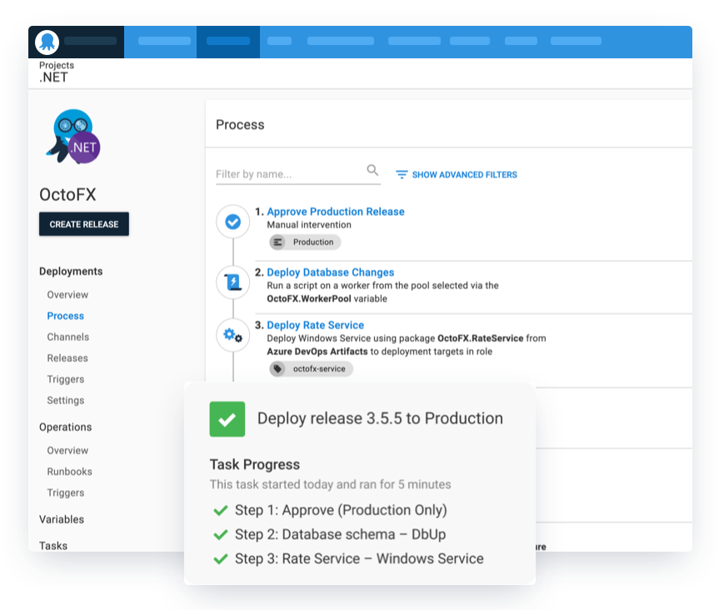
Define your deployment process once
Differences are handled via variables and scoping steps to specific environments
Releases snapshot your deployment configuration and build artifacts for repeatable and reliable deployments
Advanced deployment patterns including rolling, blue-green, canary deployments and multi-tenancy
Notes:
How you deploy to test is exactly how you deploy to production
Differences are handled via variables and scoping steps to specific environments
Releases snapshot your deployment configuration and build artifacts for repeatable and reliable deployments
Advanced deployment patterns including rolling, blue-green, canary deployments and multi-tenancy

Slide 26
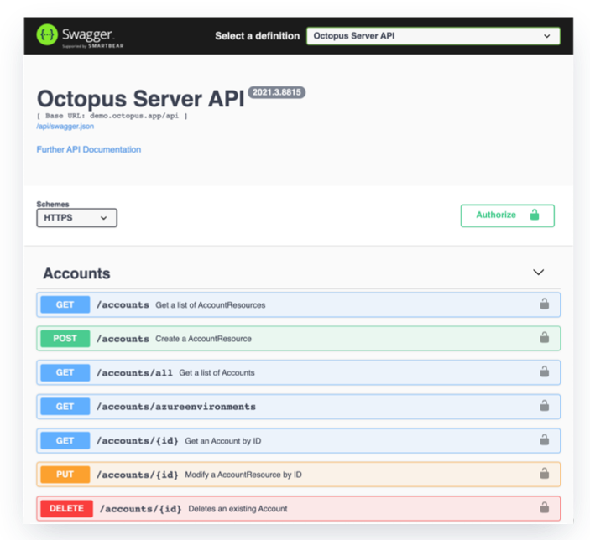
API-first architecture
API-first architecture for automation, customization and flexibility
Cross-platform integrations that suit your team. Octopus CLI, RESTful client, C# API client, Java SDK, Golang API client, and TypeScript API client

