Slide 1

REACT.JS

Slide 2
React.JS
React is JavaScript library that is used for building user interfaces specifically for single-page applications. It's used for handling the view layer for web and mobile apps. React also allows us to create reusable UI components.

Slide 3
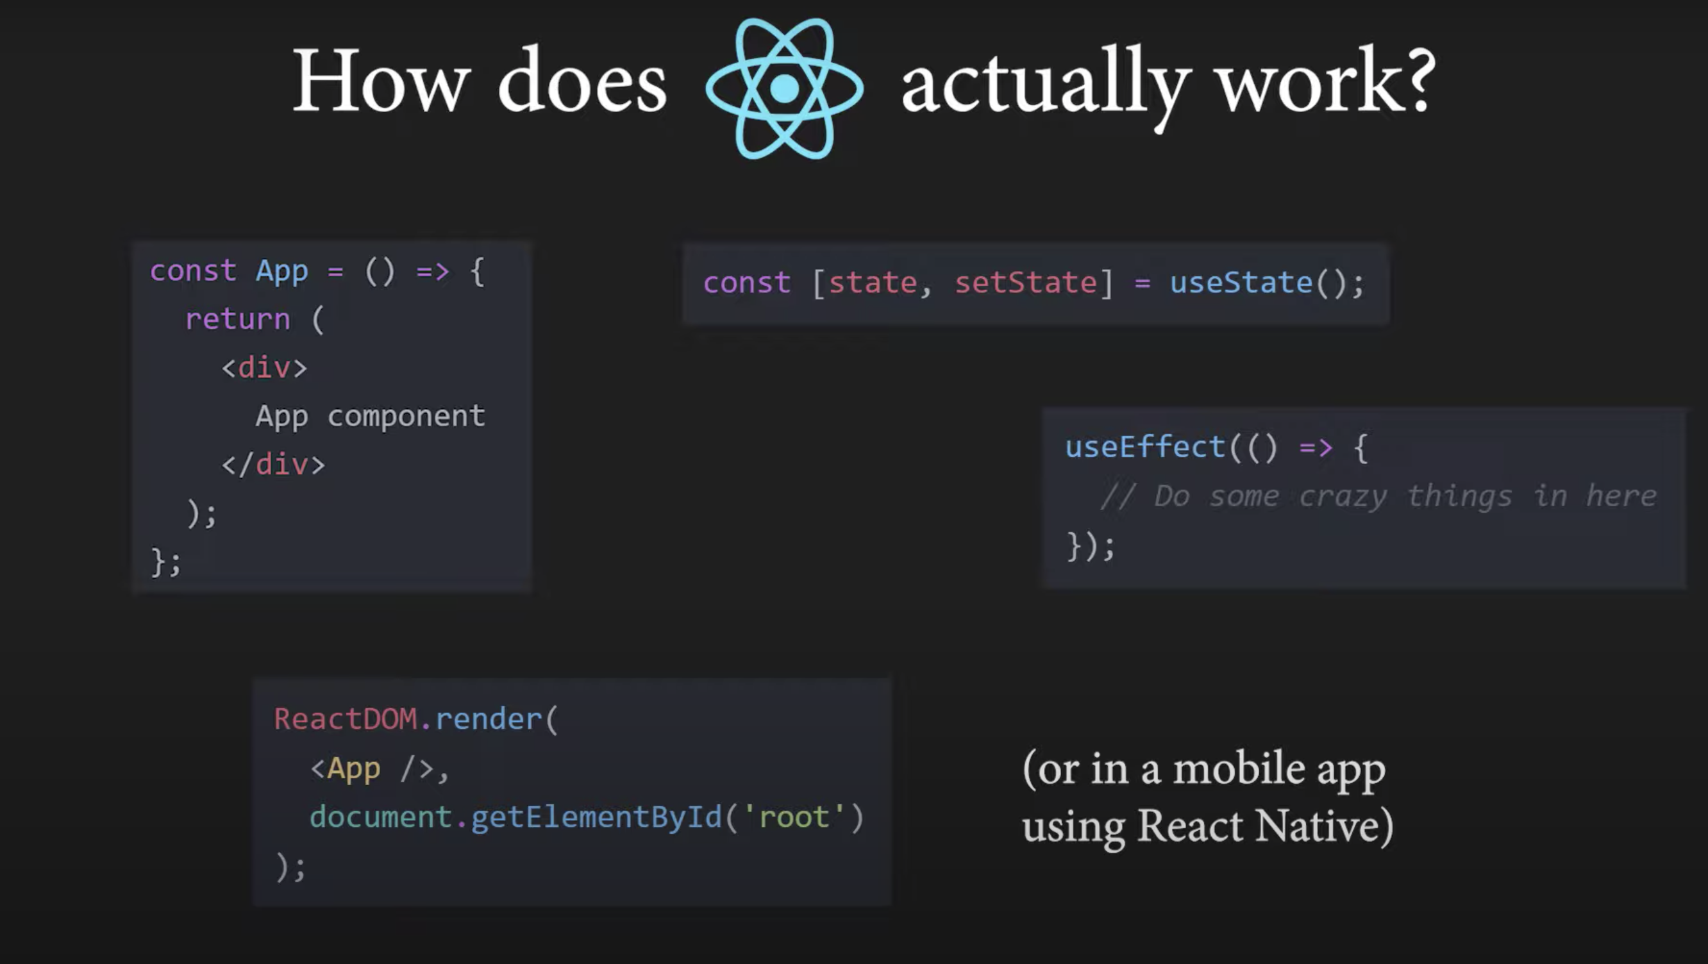

Slide 4

Components
At the heart of all react application are components
<x>
…
</x>
A component is essentially a piece of the user interface

Slide 5
When building application with react we build a bunch of independent isolated and reusable components and then compose them to build complex user interfaces

Slide 6
Every react application has at least one component, which we refer to as the root component.
This component represents the internal application and contains others child components
App
So, every react application is essentially a tree of components

Slide 7
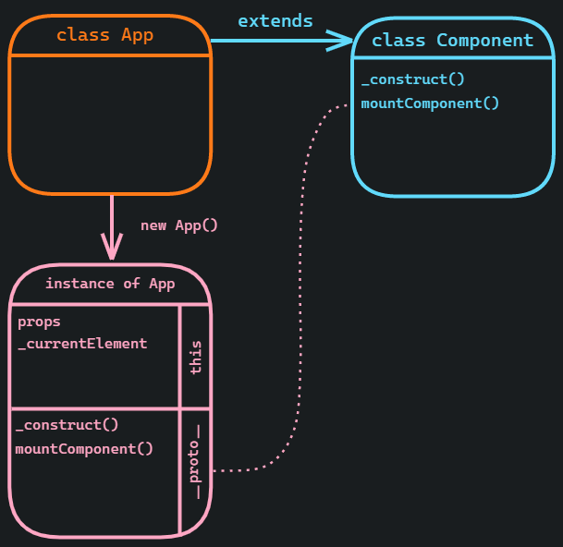
React Elements, Components, and Instances
To understand even more about React we need to know the difference between Components, Elements, and Instances

Slide 8
Elements
An element is a plain object describing what you want to appear on the screen in terms of the DOM nodes or other components. Elements can contain other elements in their props. Creating a React element is cheap. Once an element is created, it is never mutated.

Slide 9
Components
A component can be declared in several different ways. It can be a class with a render() method. Alternatively, in simple cases, it can be defined as a function. In either case, it takes props as an input, and returns an element tree as the output.
The render() method is responsible for describing the view to be rendered to the browser window.
When a component receives some props as an input, it is because a particular parent component returned an element with its type and these props. This is why people say that the props flows one way in React: from parents to children.

Slide 10
Instances
An instance is what you refer to as this in the component class you write. It is useful for storing local state and reacting to the lifecycle events.
Function components don’t have instances at all. Class components have instances, but you never need to create a component instance directly—React takes care of this.

