Slide 1
LINUX RECAP
12.04.2022

Slide 2
COMMAND PROMPT
PING- Packet Internet Groper
Ping, 1983 yılında Mike Muus tarafından yazılan bir program olup,
bilgisayarınızdan çıkan bir verinin karşıdaki sunucuya iletilme süresini gösterir.
Ping komutu, kaynak bilgisayarın belirli bir ağ hedefine erişme yetkisini test etmek için
kullanılan bir Komut İstemidir.

Slide 3
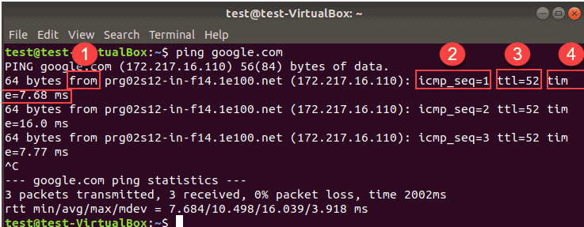
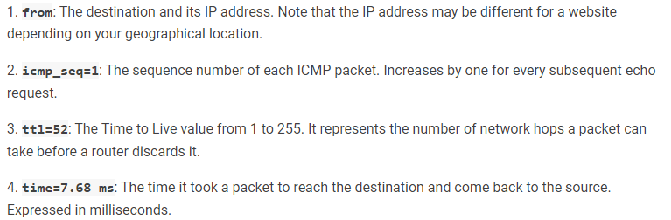
COMMAND PROMPT
PING- Packet Internet Groper

Slide 4
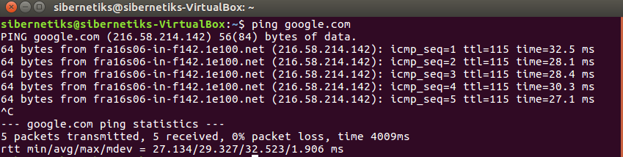
COMMAND PROMPT
PING- Let’s try
TO STOP:
CONTROL C
TO SEND A SPECIFIC
NUMBER OF PINGS:
Ping –c 5 Google.com

Slide 5
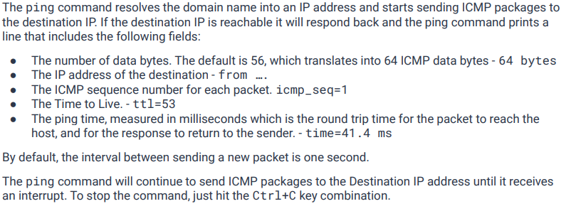
COMMAND PROMPT
PING- Packet Internet Groper

Slide 6
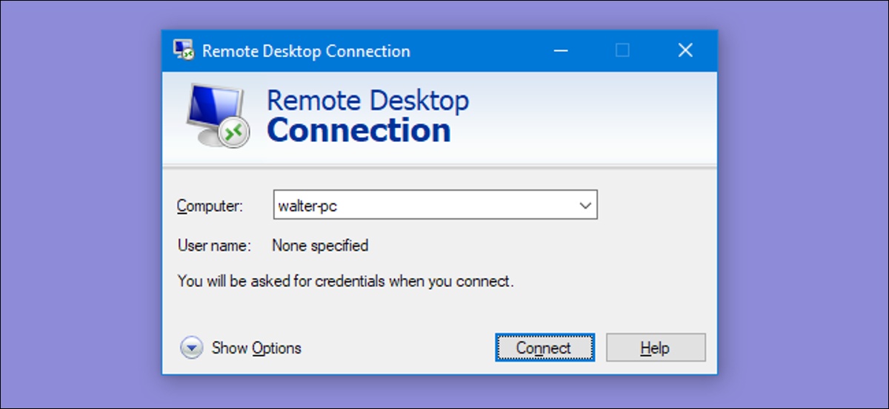
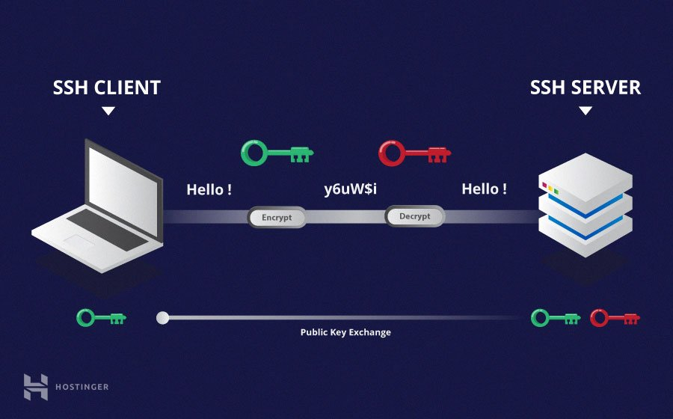
SSH Command
REMOTE ACCESS
Secure Shell (SSH) for Linux-based machines
Remote Desktop Protocol (RDP) for Windows-based machines

Slide 7
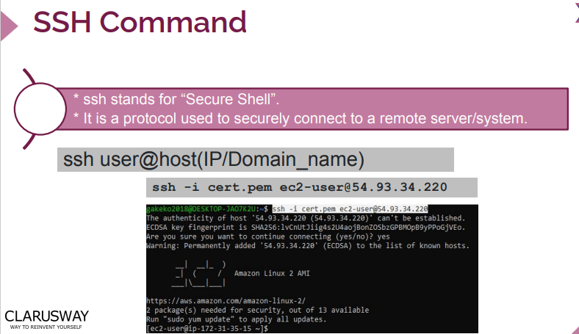
SSH Command

Slide 8

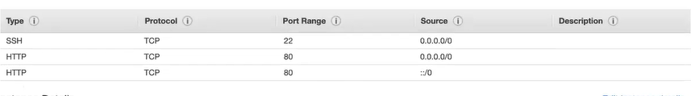
SSH Command

Slide 9
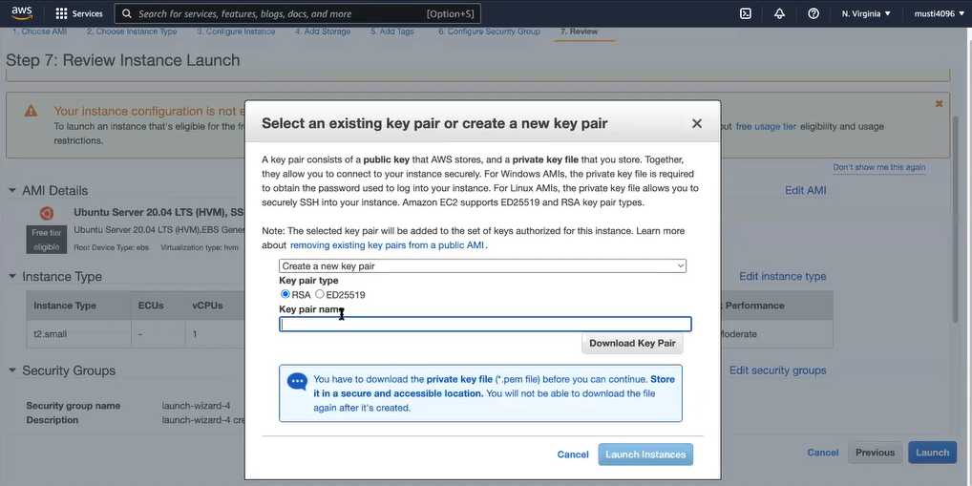
SSH Command
.Pem FILE PEM files are used to store SSL certificates and their associated private keys

Slide 10
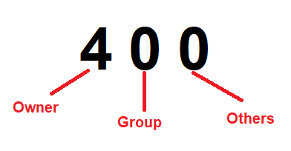
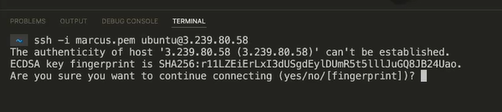
SSH Command
SSH COMMANDS
chmod 400 .pem fıle
copy marcus.pem to working directory
ssh –i marcus.pem kullanıcıadı@3.239.80.58
Public IP address

Slide 11
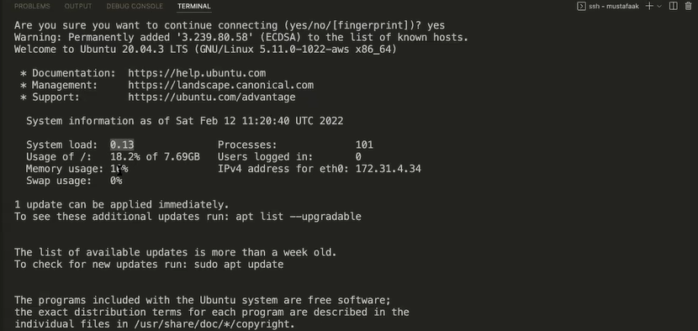

SSH Command
SSH COMMANDS

Slide 12
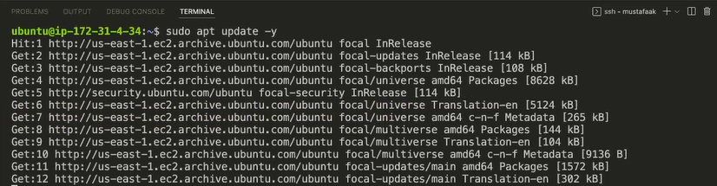
SSH Command
WORKING ON REMOTE VIA SSH

Slide 13
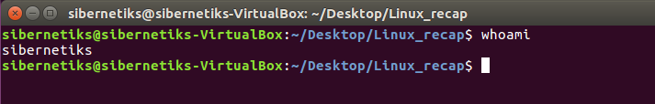
COMMAND PROMPT
whoAMI

Slide 14
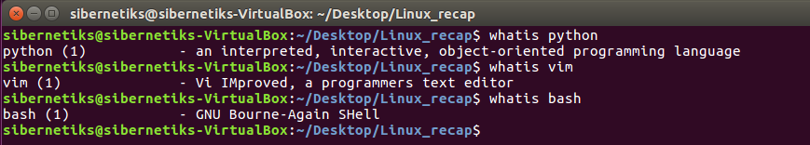
COMMAND PROMPT
WHATIS

Slide 15
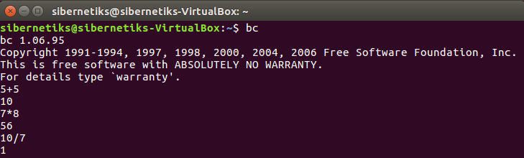
COMMAND PROMPT
CALCULATOR→ bc

Slide 16
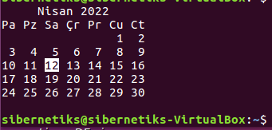
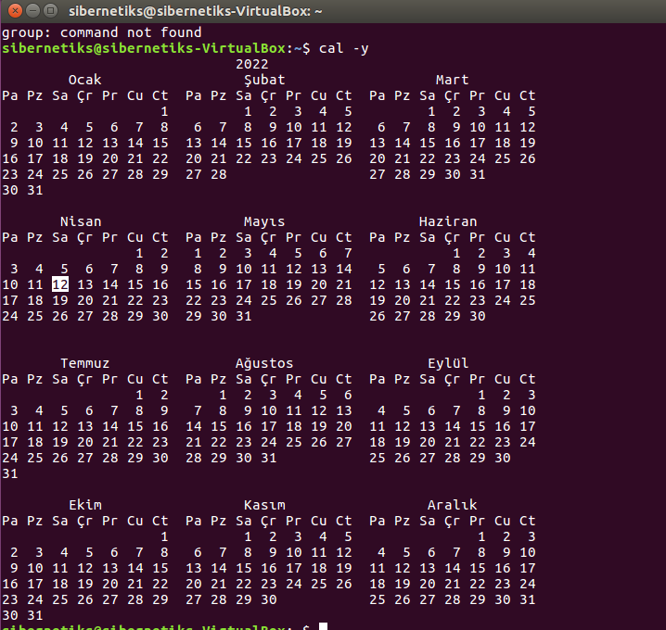
COMMAND PROMPT
cal or cal-y

Slide 17
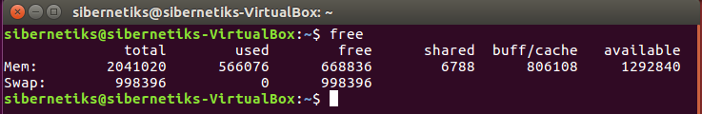
COMMAND PROMPT
free or free-h

Slide 18
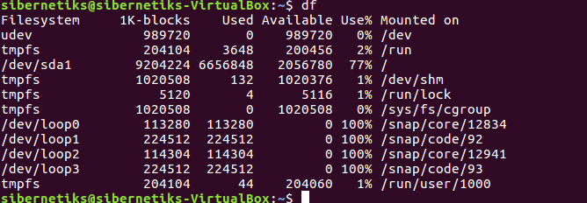
COMMAND PROMPT
df

Slide 19
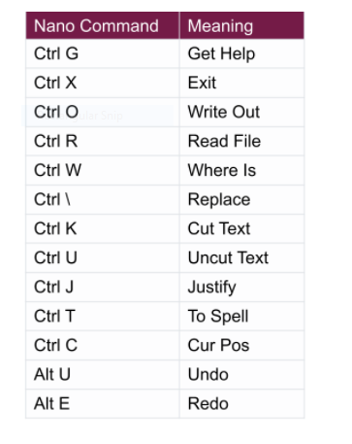
EDITORS
NANO

Slide 20
EDITORS
NANO→How to CUT and paste
Use Mouse to select, right click to copy and paster
Use cursor to go to the beginning of the text
Press CTRL K to cut the text
Press CTRL U to paste text as many times as you want

Slide 21
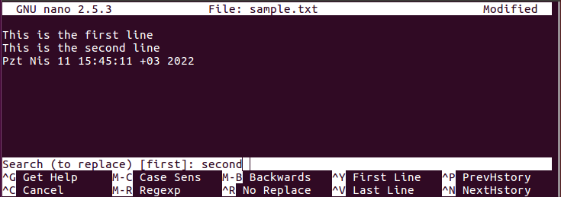
EDITORS
NANO→How to REPLACE →CTRL +\

Slide 22
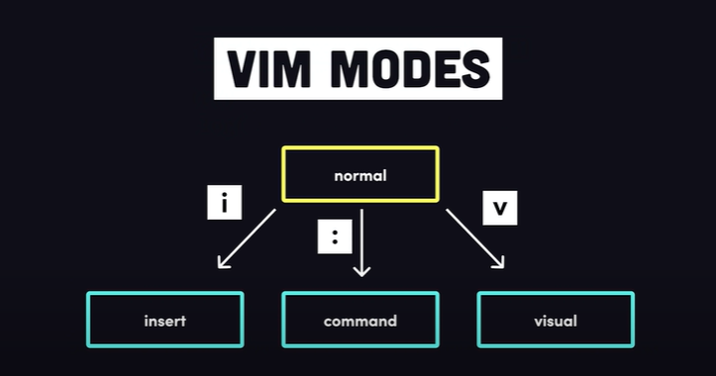
EDITORS
VIM

Slide 23
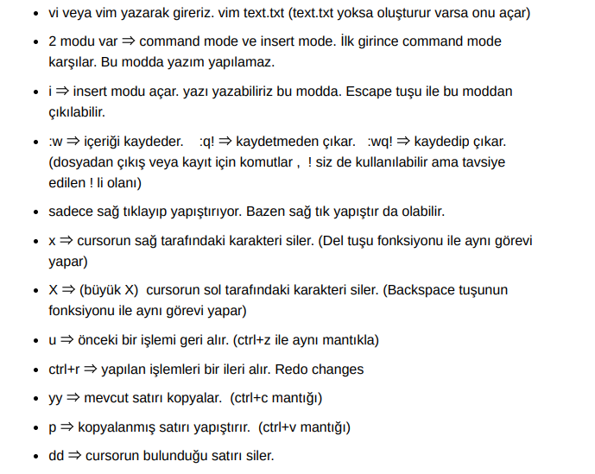
EDITORS
VIM

Slide 24
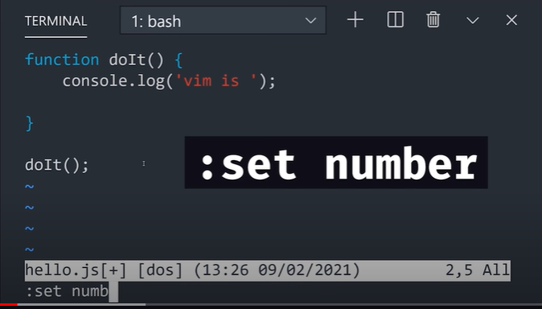
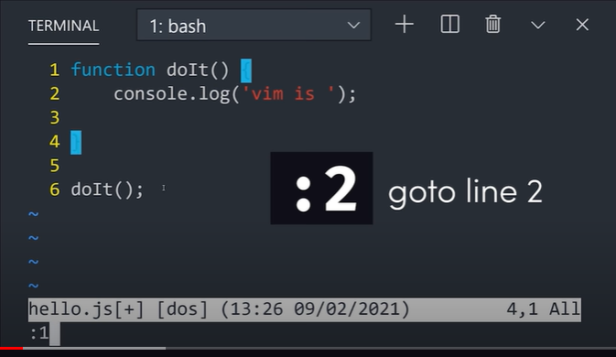
EDITORS
VIM- Useful Commands

Slide 25


EDITORS
VIM- Useful Commands

Slide 26
EDITORS
VIM→ copy and paste
Use cursor to go to the beginning of the text
In Command Mode Press Shift V
Press Y to save it into a buffer for further use
Press P to paste it

Slide 27
EDITORS
VIM→ UNDO
ESC to go into Command Mode
Press C to undo

