Slide 1
LINUX RECAP
04011.2022

Slide 2
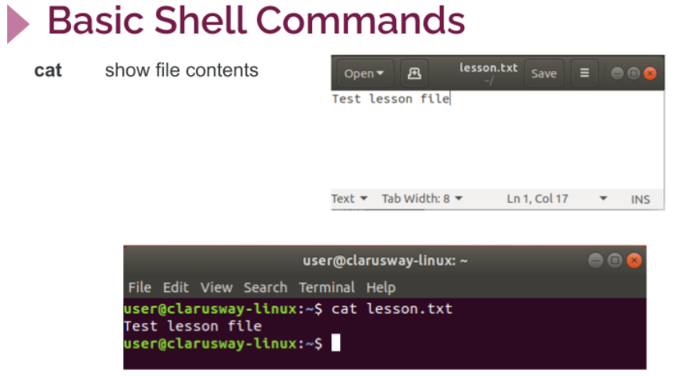
BASIC Shell commands
cat COMMAND

Slide 3
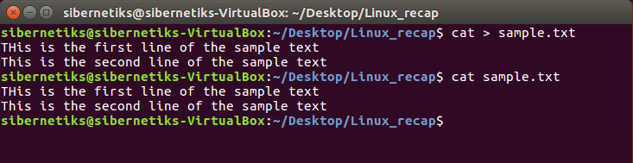
BASIC Shell commands
cat COMMAND
TO WRITE:
cat > sample.txt
TO READ:
cat sample.txt

Slide 4
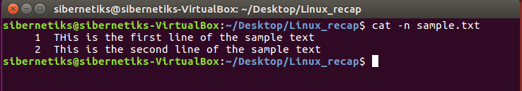
BASIC Shell commands
cat COMMAND
Reading with
line numbers

Slide 5
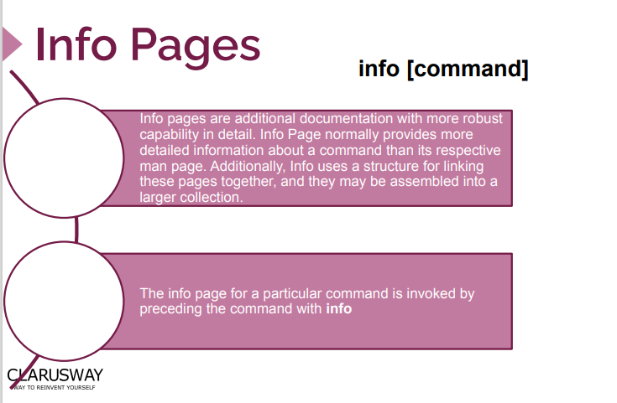
INFO PAGES

Slide 6

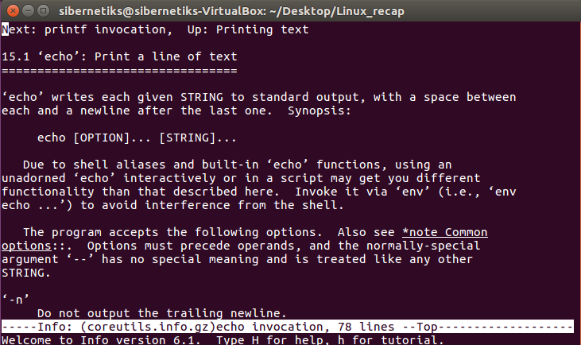
INFO PAGES
INFO
TO SEE THE INFO PAGE:
info echo
TO LEAVE THE PAGE:
Press q
TO SAVE THE PAGE:
info echo > myfile.txt

Slide 7
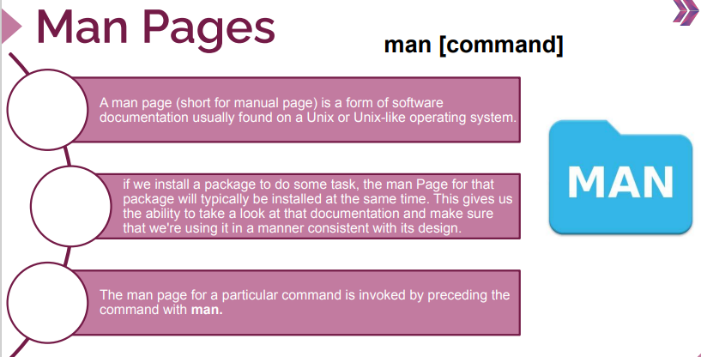
MAN PAGES

Slide 8
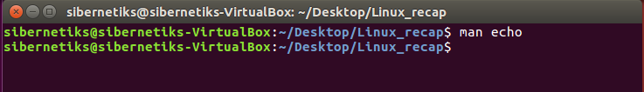
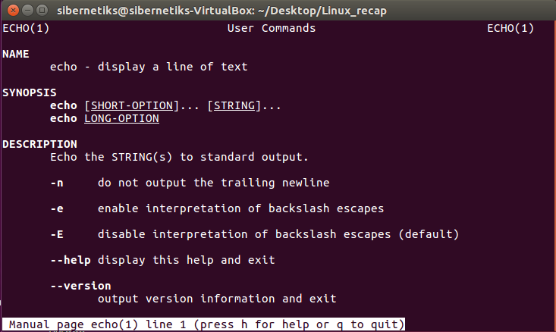
MAN PAGES
MAN
TO SEE THE INFO PAGE:
man echo
TO LEAVE THE PAGE:
Press q
TO SAVE THE PAGE:
man echo > myfile.txt

Slide 9
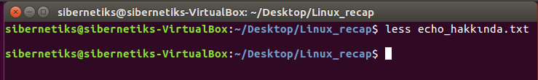
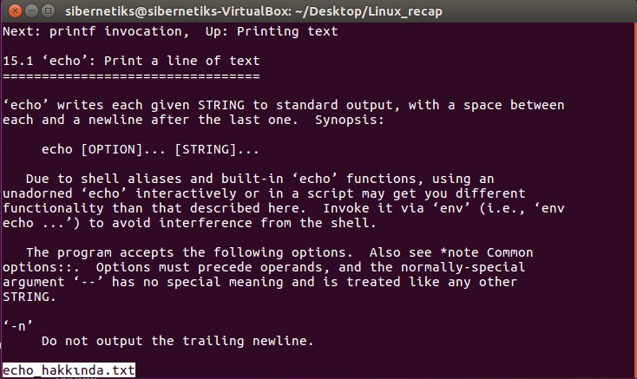
LESS AND MORE
LESS
TO NAVIGATE:
arrow keys
TO LEAVE THE PAGE:
Press q
TO SEARCH:
/wordtosearch
TO USE HELP:
Press h

Slide 10

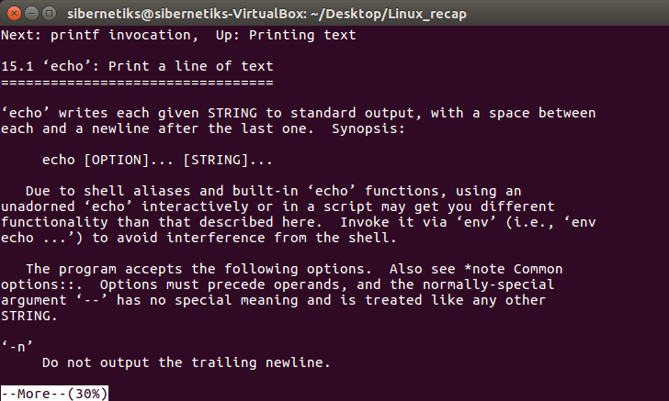
LESS AND MORE
MORE
TO NAVIGATE:
arrow keys
TO LEAVE THE PAGE:
Press q
TO SEARCH:
/wordtosearch
TO USE HELP:
Press h

Slide 11

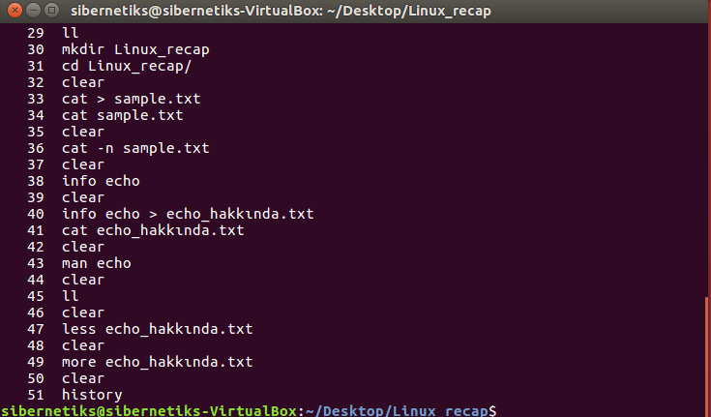
HISTORY
See and Save hıstory
TO SEE:
history
TO SAVE:
history > my_history.txt
TO CLEAR:
history -c

Slide 12
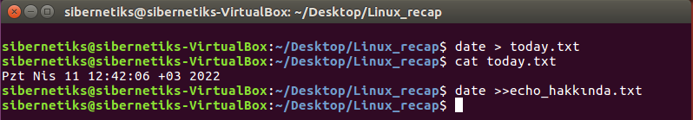
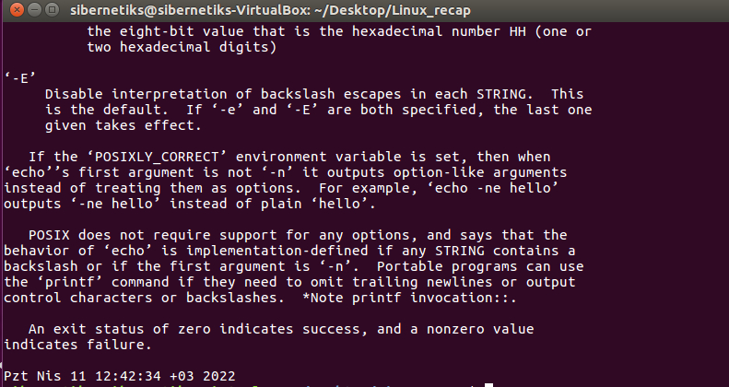
DATE
DATE
TO SEE:
date
TO SAVE DATE:
date > today.txt
TO ADD DATE:
Date >> echo.txt

Slide 13
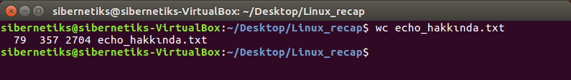
Word count
wc
FIRST NUMBER:
Line count
SECOND NUMBER:
Word count
THIRD NUMBER:
Byte count

Slide 14
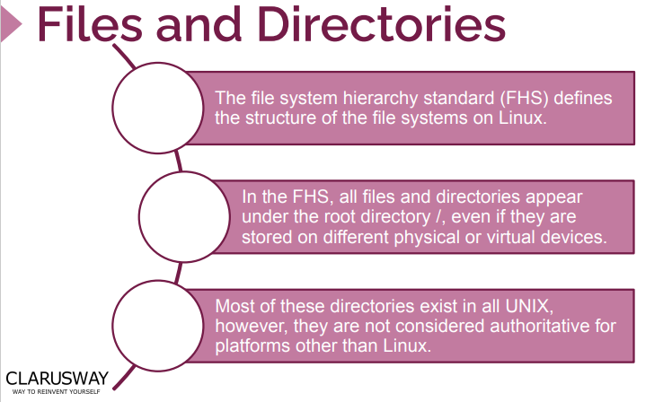
FILES AND DIRECTORIES

Slide 15
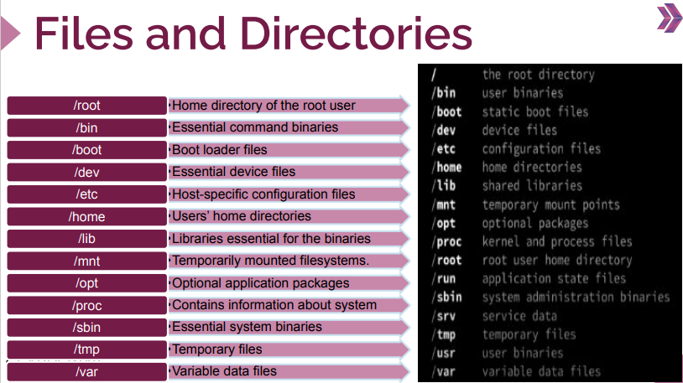
FILES AND DIRECTORIES

Slide 16
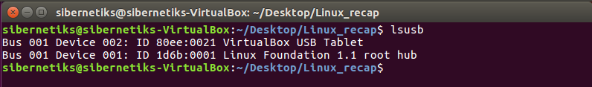
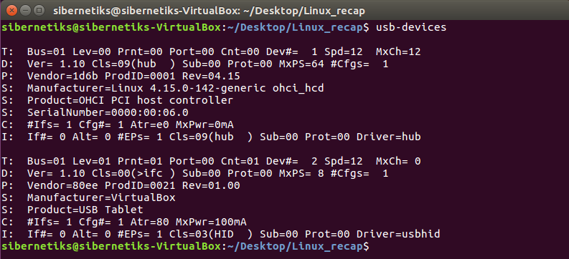
USB DEVICES
LSUSB
BASIC:
lsusb
DETAILED:
usb-devcies

Slide 17
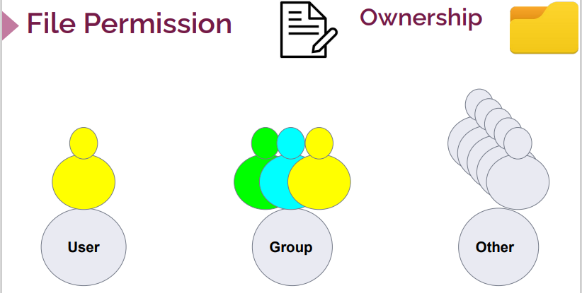
FILE PERMISSIONS
Ownershıp

Slide 18
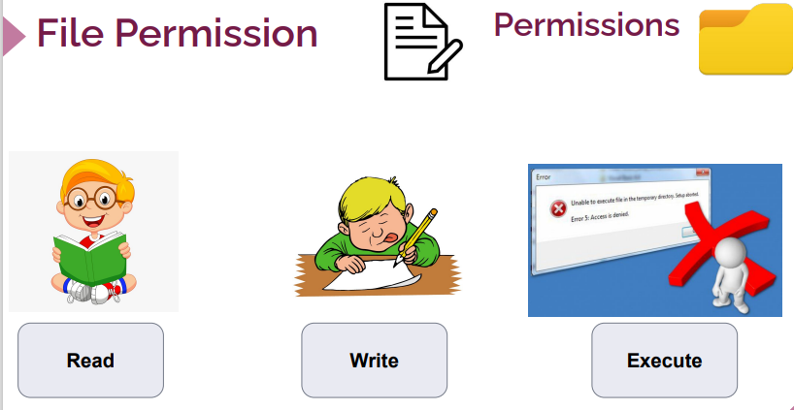
FILE PERMISSIONS
Ownershıp

Slide 19
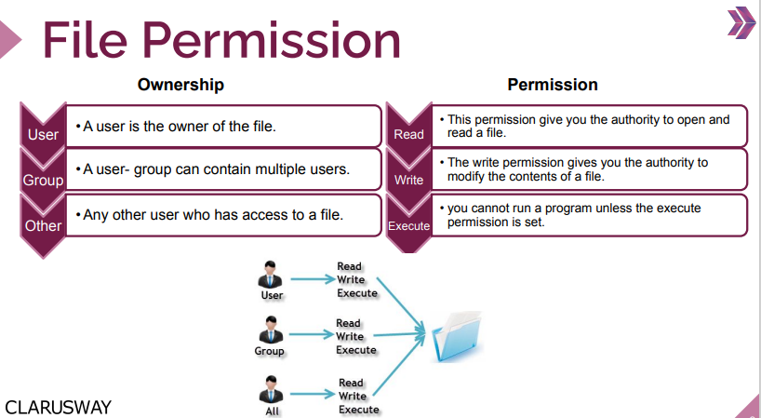
FILE PERMISSIONS
Ownershıp

Slide 20
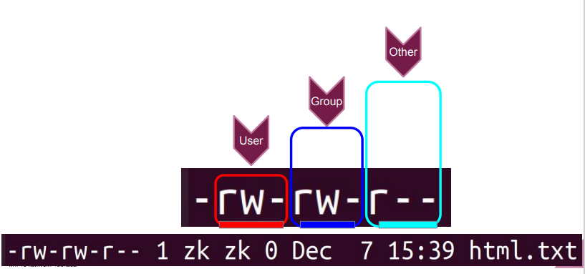
FILE PERMISSIONS
Ownershıp

Slide 21
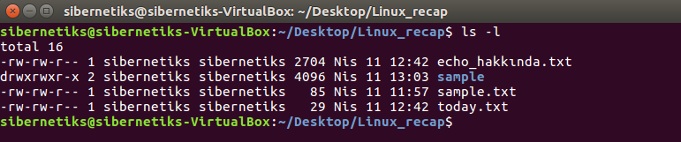
FILE PERMISSIONS
FILE OR FOLDER
Hypen -:
File
Letter d:
Folder
(directory)

Slide 22
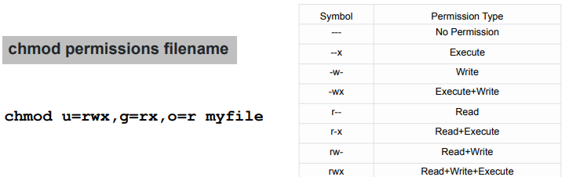
FILE PERMISSIONS
CHMOD

Slide 23
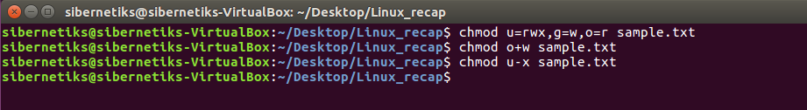
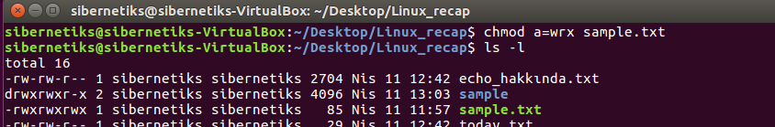
FILE PERMISSIONS
CHMOD Varıatıons

Slide 24
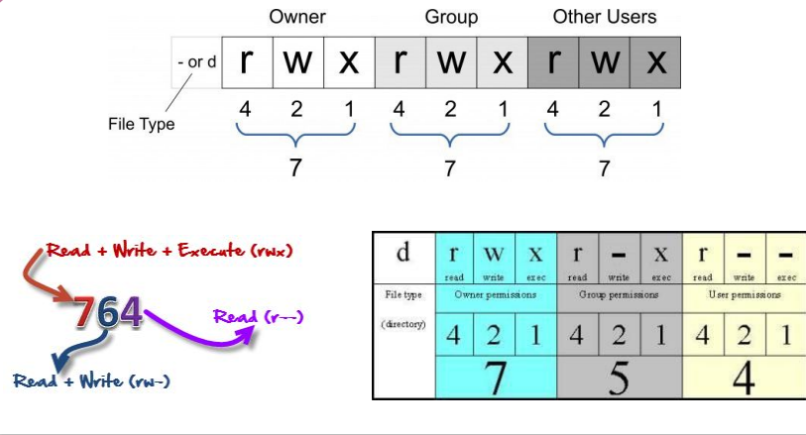
FILE PERMISSIONS
CHMOD USING NUMBERS

Slide 25
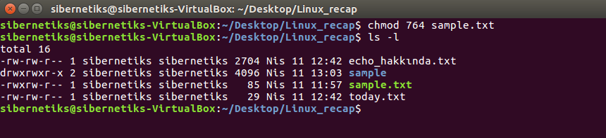
FILE PERMISSIONS
CHMOD USING NUMBERS

Slide 26
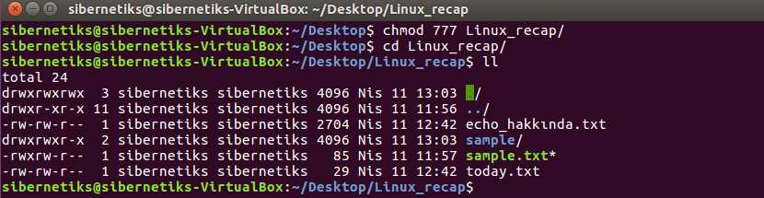
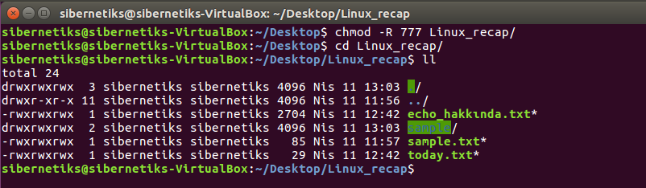
FILE PERMISSIONS
CHMOD RECURSIVE

Slide 27
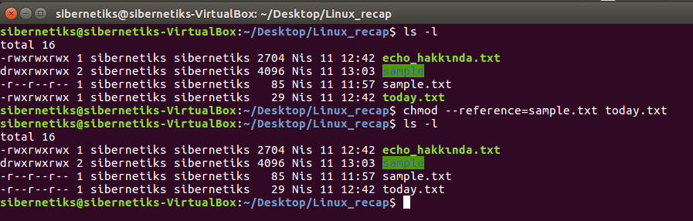
FILE PERMISSIONS
CHMOD SIMILAR FILE

Slide 28
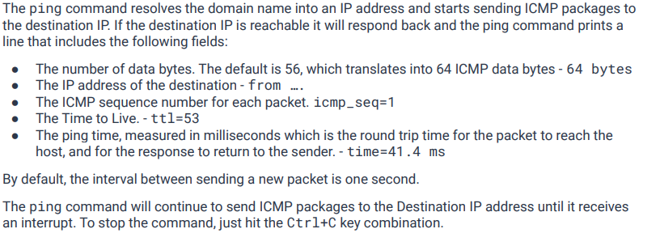
COMMAND PROMPT
PING- Packet Internet Groper

Slide 29
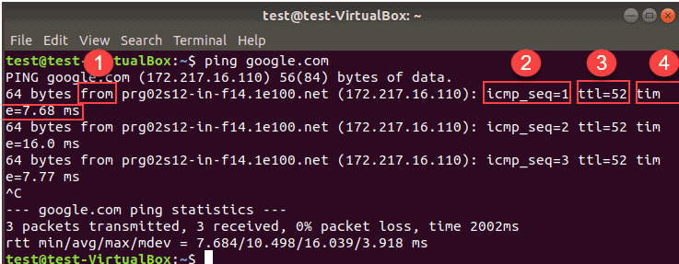
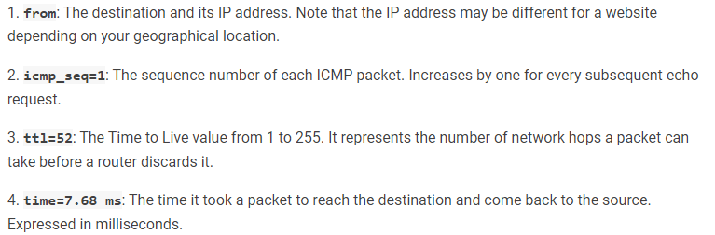
COMMAND PROMPT
PING- Packet Internet Groper
TO STOP:
CONTROL C
TO SEND A SPECIFIC
NUMBER OF PINGS:
Ping –c 5 Google.com

Slide 30
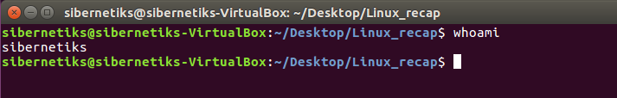
COMMAND PROMPT
whoAMI

Slide 31
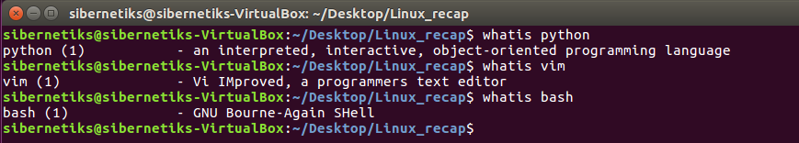
COMMAND PROMPT
WHATIS

Slide 32
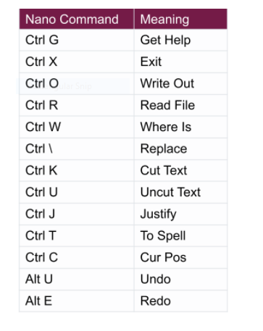
EDITORS
NANO

Slide 33
EDITORS
NANO→How to CUT and paste
Use cursor to go to the beginning of the text
Press CTRL K to cut the text
Press CTRL U to paste text as many times as you want

Slide 34
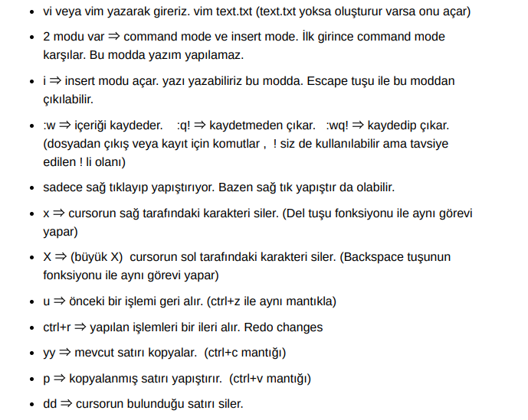
EDITORS
VIM

Slide 35
EDITORS
VIM→ copy and paste
Use cursor to go to the beginning of the text
In Command Mode Press Shift V
Press Y to save it into a buffer for further use
It will say …lines yanked
Press P to paste it

