Slide 1
Driver Drowsiness Detection
EfficientNetB0 + FastKAN · Multi-Class Image Classification · Capstone Project
Project Overview
Presenter
A computer-vision system that classifies a driver's face into four distinct alertness states in real time — supporting driver-monitoring systems and road safety applications.
Gulomjon Odamov
Capstone Defense
● MODEL READY
COMPUTER VISION
Architecture
EfficientNetB0 backbone with FastKAN classification head, trained end-to-end on driver face imagery.

Slide 2




01 — PROBLEM STATEMENT
The Problem
Driver drowsiness is a leading cause of road accidents worldwide. This system takes a single face image and predicts whether the driver is alert or exhibiting signs of drowsiness — designed for integration into driver-monitoring and road safety platforms.
System Context
Four Alertness Classes
User
notdrowsy
Driver-monitoring & safety systems requiring real-time alertness classification
Driver is alert
ML Task
sleepyCombination
Multi-class image classification — one face image in, one alertness class out
Sleepy state detected
slowBlinkWithNodding
Slow blink / nodding
yawning
Yawning detected

Slide 3
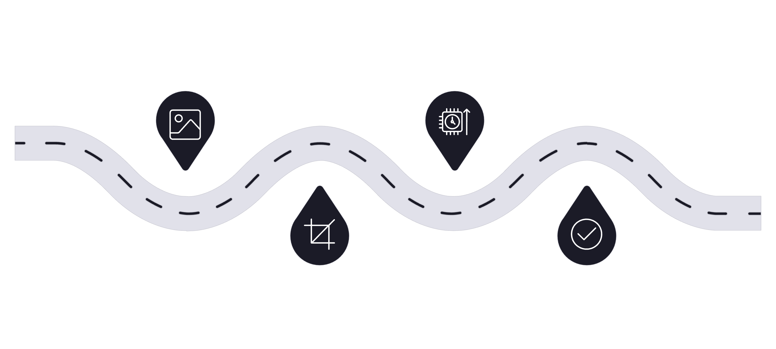
02 — DATA & METHOD
Data & Method
66,521
4
Labeled Images
Classes
NTHU-DDD dataset, near-infrared driver face imagery
notdrowsy, sleepyCombination, slowBlinkWithNodding, yawning
20
9,979
Training Epochs
Test Images
End-to-end fine-tuning with class-weighted loss
Held-out set for final evaluation
Inference Pipeline
Input
Inference
Face image from dataset
EfficientNetB0 + FastKAN forward pass
Preprocess
Output
Resize to 224×224 and normalize
Class label and confidence score
Class imbalance is handled once via a class-weighted loss function during training — no double correction applied.

Slide 4
03 — RESULTS
Results on the Held-Out Test Set
Overall Performance
Per-Class F1 Scores
98.78%
98.66%
Test Accuracy
notdrowsy
F1 = 0.9866
98.79%
99.78%
Precision
sleepyCombination
98.78%
F1 = 0.9978 — highest
Recall
98.10%
slowBlinkWithNodding
98.78%
F1 = 0.9810
F1-Score
97.92%
yawning
F1 = 0.9792 — weakest class, yet still high

Slide 5


04 — LIVE DEMO
End-to-End Live Demo
Three-Step User Flow
Sample Analysis Result
1
Upload
ALERT
Upload a driver face image in JPG or PNG format via the Streamlit web interface
Confidence: 94.2%
Driver classified as notdrowsy with high confidence
2
Analyze
Model runs inference directly in the browser application — no server round-trip delay
Deployment
Public app hosted on Streamlit Cloud
driver-drowsiness-detection-1997.streamlit.app
3
Review
Receive the predicted status label, confidence score, and full per-class probability breakdown
Model weights shipped via Git LFS · zero-install inference

Slide 6


05 — LIMITATIONS & NEXT STEPS
Honest Limitations & Next Steps
Dataset & Split Limitation: The split is per-frame, and the model is tuned to NTHU-DDD near-infrared imagery. Ordinary phone photos are out-of-distribution and can be misclassified. This is an educational demo — not intended for real safety-critical decisions.
Roadmap
1
2
3
Subject-Independent Split
Face-Crop Front-End
Recall-Focused Tuning
Evaluate on entirely unseen drivers using a driver-based or leave-one-subject-out protocol to measure true generalization beyond per-frame splitting
Integrate a face detection and cropping module so that everyday phone photos are automatically aligned to match the training data distribution
Re-weight the loss or adjust decision thresholds to maximize recall on drowsy classes — prioritizing safety by minimizing missed detections in operational settings

Slide 7
Thank You
Driver Drowsiness Detection · EfficientNetB0 + FastKAN · Capstone Project
Live Demo
Key Results
driver-drowsiness-detection-1997.streamlit.app
98.78%
98.78%
Source Code
Test Accuracy
F1-Score
github.com/Odamov490/driver-drowsiness-detection
66,521
4 Classes
Training Images
Alertness States
Questions welcome
Gulomjon Odamov · Computer Vision Capstone

