Slide 1
DCAITI-Project: rear-view mirror for cyclist on Smartphones
Oday Kabha oday.kabha@ipk.fraunhofer.de
name @campus.tu-berlin.de
name @mailbox.tu-berlin.de
Supervisor: Marcus Witzke

Slide 2
Overview
Idea
Develop Framework
System Architecture
Solution Approaches (CANBERK)
Milestone
18.11.2020
DCAITI -Projekt

Slide 3
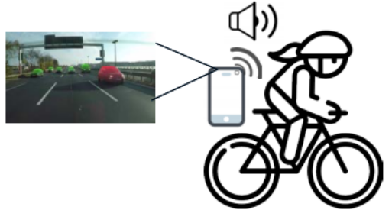
1. Idea
Object Detection & Tracking:
Smartphone cam
Additional cam
Image processing Algorithms
Measurement of Distance & Speed:
Simple smartphone cam using image processing algorithms
LiDAR
Notifications & Warnings
When objects too close or too fast
Android Notification Reciever
18.11.2020
DCAITI -Projekt

Slide 4
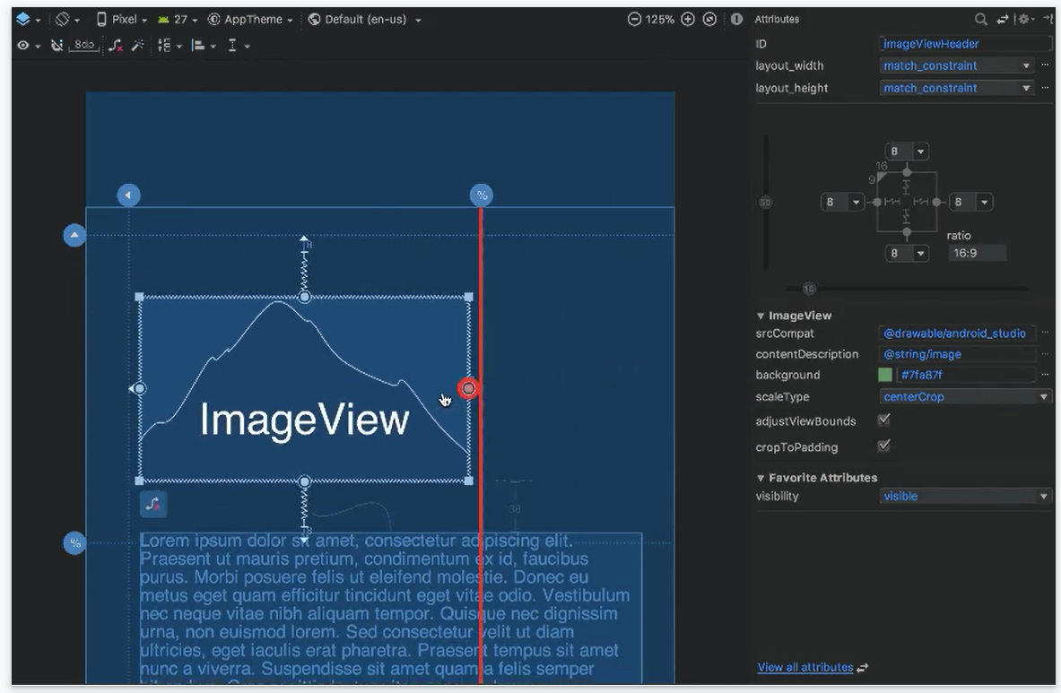
2. Develop Framework
Android Studio
1. Visual layout editor
build layouts by dragging UI elements instead of writing layout XML by hand
18.11.2020
Source: https://developer.android.com/studio
DCAITI -Projekt

Slide 5
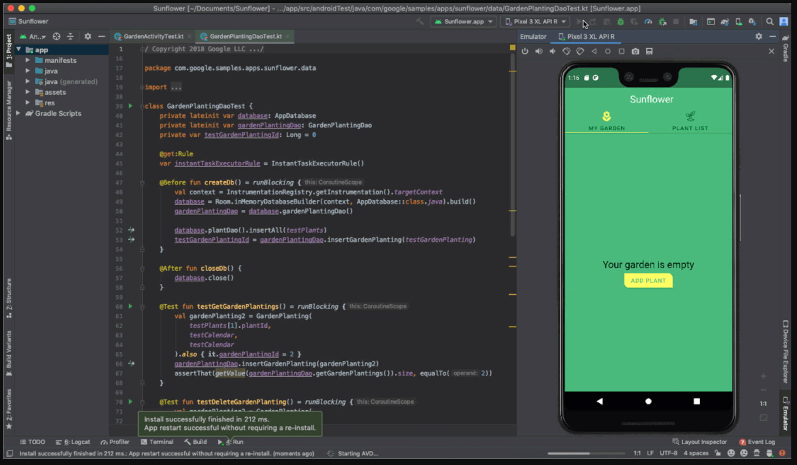
2. Develop Framework
Android Studio
2. Fast emulator
run apps on the Android Emulator
18.11.2020
Source: https://developer.android.com/studio
DCAITI -Projekt

Slide 6
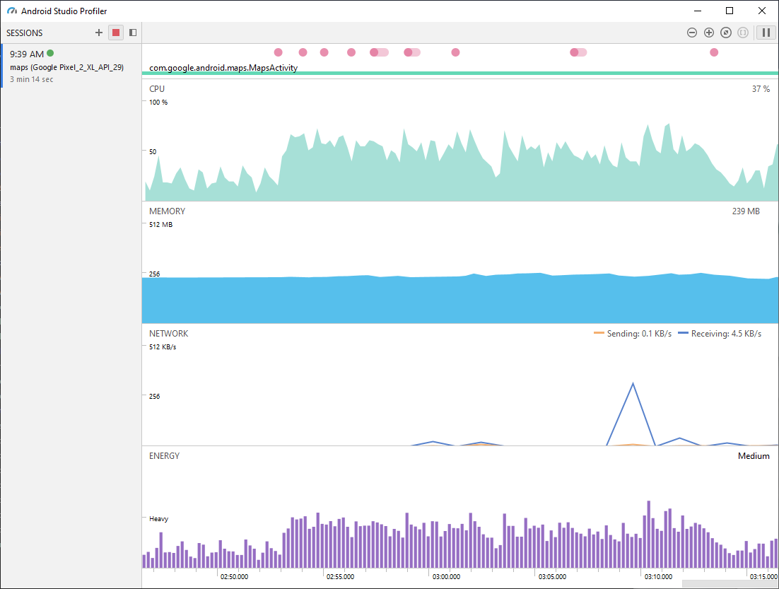
2. Develop Framework
Android Studio
3. Intelligent code editor
based on IntelliJ IDEA
4. Realtime profilers
measure app performance
18.11.2020
Source: https://developer.android.com/studio
DCAITI -Projekt

Slide 7
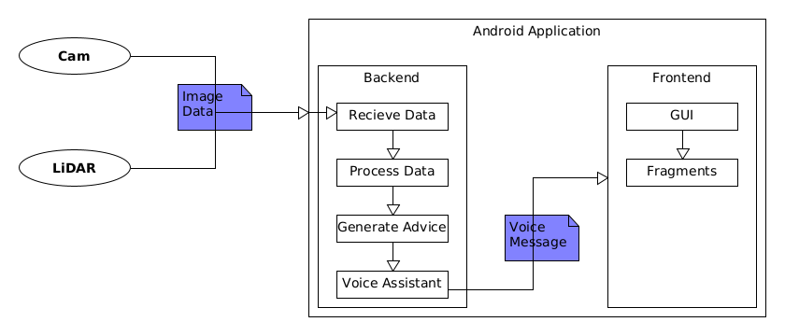
3. System Architecture

Slide 8
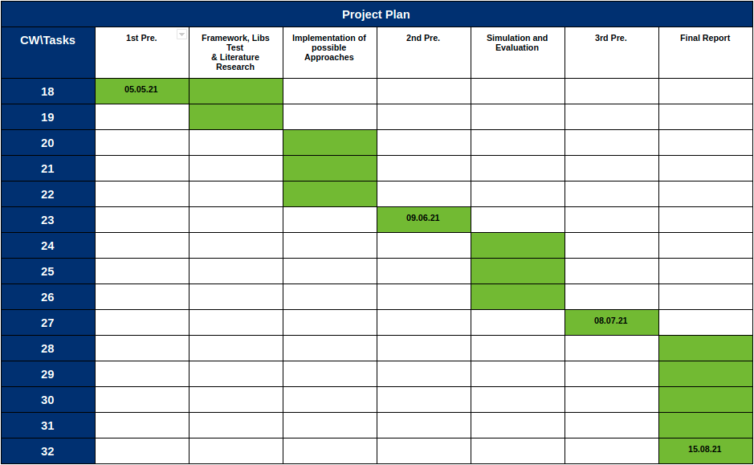
5. Milestone
18.11.2020
DCAITI -Projekt

Slide 9
Thanks for your attention!
Oday Kabha oday.kabha@ipk.fraunhofer.de
name name@campus.tu-berlin.de
name name@mailbox.tu-berlin.de

