Slide 1
DCAITI-Project: Thema
Oday Kabha oday.kabha@ipk.fraunhofer.de
name @campus.tu-berlin.de
name @mailbox.tu-berlin.de
Supervisor: Macus

Slide 2
Overview
Background
Develop Framework
System Architecture
Tasks
Milestone
18.11.2020
DCAITI -Projekt

Slide 3
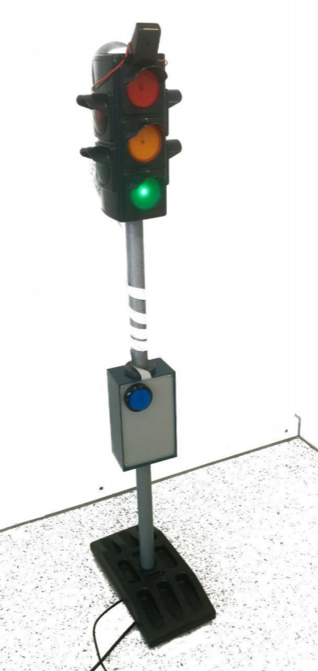
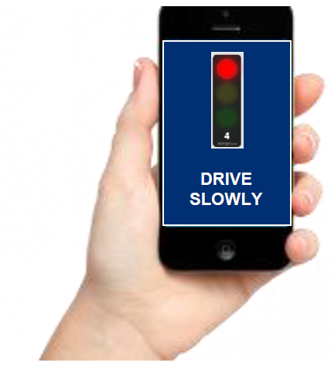
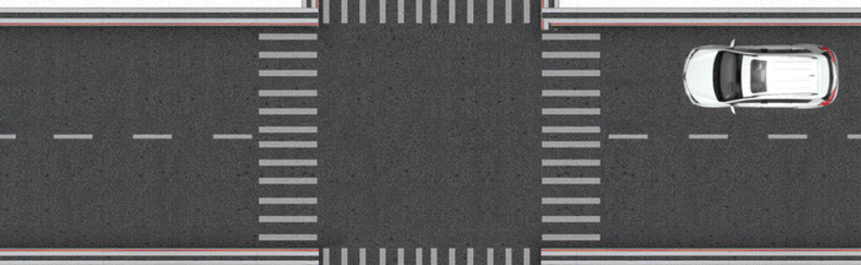
1. Background
GLOSA (Green Light Optimized Speed Advisory)
suggests speeds to vehicles to pass through an intersection
RSU (Roadside unit)
SPaT (Signal Phase and Time)
FOKUS Traffic Light Service
MAP (Map data)
Topology of the intersection
Road Users
car/ bicycle/ pedestrian
receive recommendation for action
RSU
SPaT & MAP
via automotive WiFi
18.11.2020
DCAITI -Projekt

Slide 4
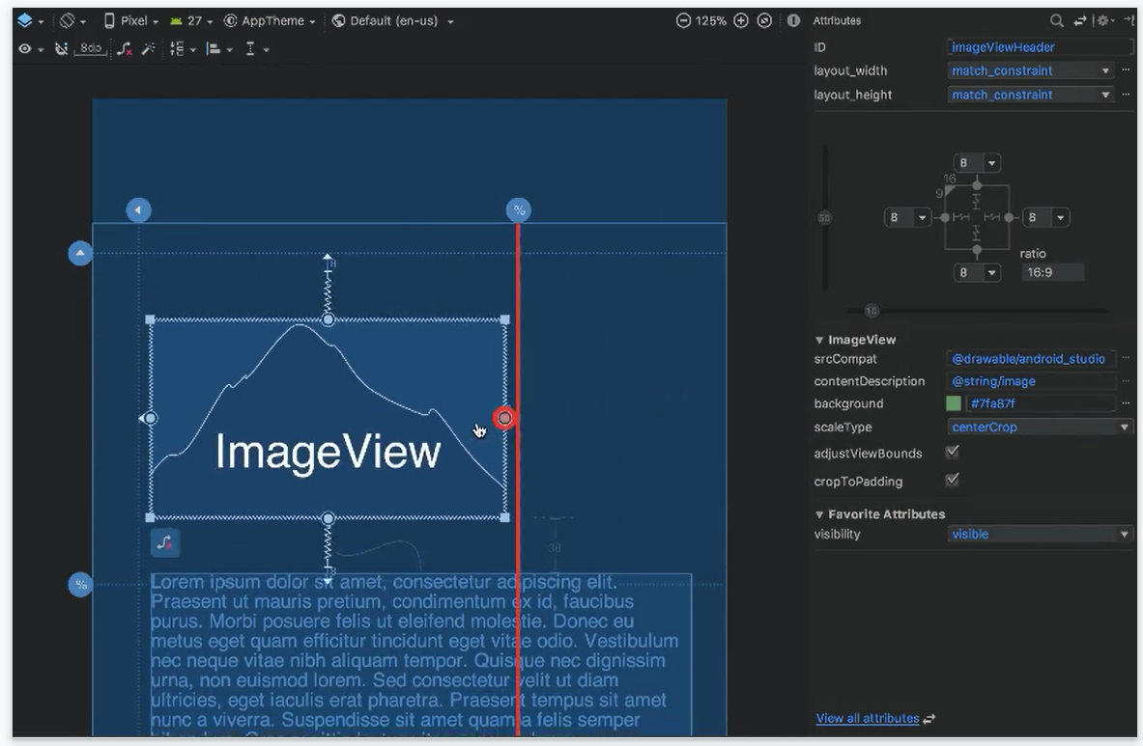
2. Develop Framework
Android Studio
1. Visual layout editor
build layouts by dragging UI elements instead of writing layout XML by hand
18.11.2020
Source: https://developer.android.com/studio
DCAITI -Projekt

Slide 5
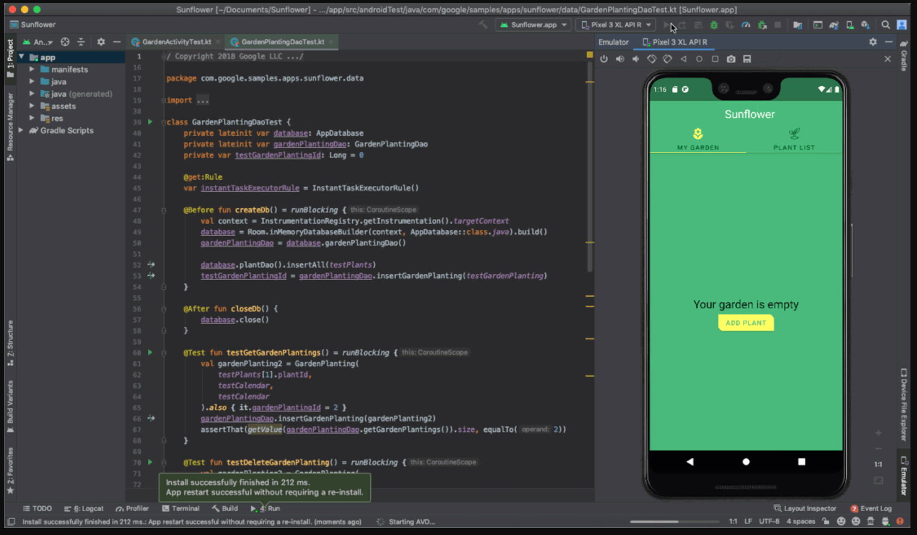
2. Develop Framework
Android Studio
2. Fast emulator
run apps on the Android Emulator
18.11.2020
Source: https://developer.android.com/studio
DCAITI -Projekt

Slide 6
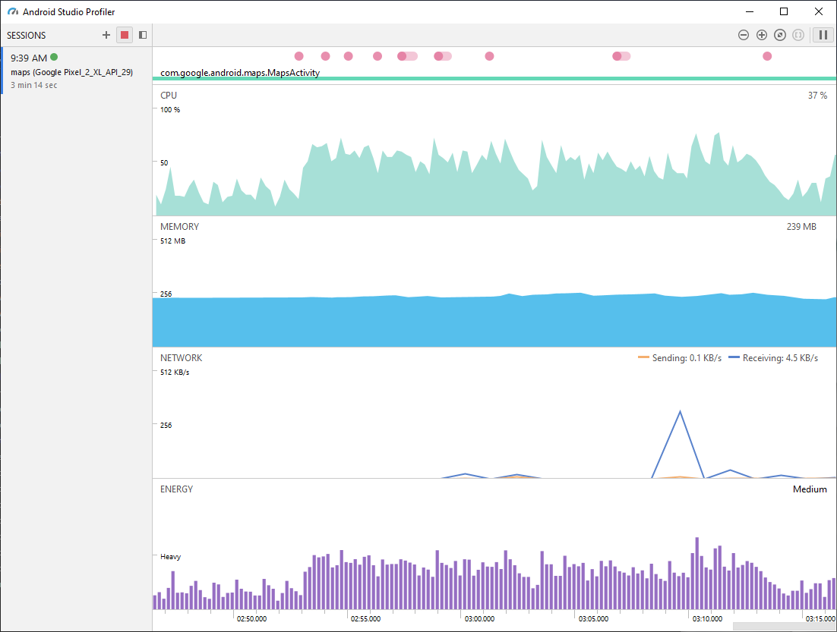
2. Develop Framework
Android Studio
3. Intelligent code editor
based on IntelliJ IDEA
4. Realtime profilers
measure app performance
18.11.2020
Source: https://developer.android.com/studio
DCAITI -Projekt

Slide 7
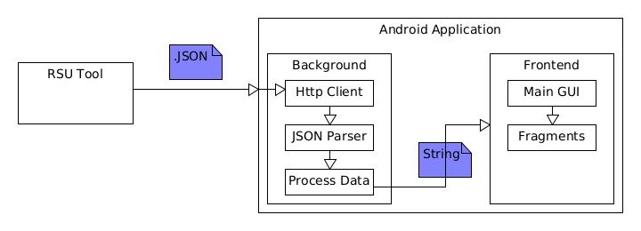
3. System Architecture

Slide 8
Request, analysis and visualization of traffic lights information
Decision of driving strategy
4. Tasks
Simulation and evaluation
18.11.2020
DCAITI -Projekt

Slide 9
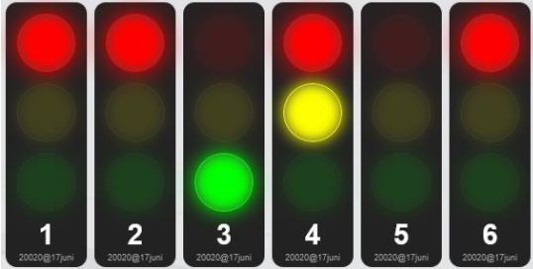
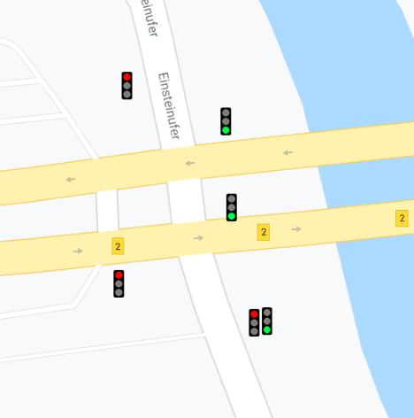
4.1. Request, analysis and visualization of traffic lights information
GUI
REST-API (RSU)
Https Request GET
Client
(e.g. Volley, Retrofit)
SPaT Parser
JSON
Traffic Lights Phase
Https Response
Map Resource
(csv, kml)
Google Maps Android API
Map Information
18.11.2020
DCAITI -Projekt

Slide 10
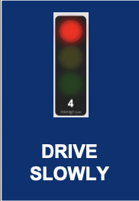
4.2. Decision of of driving strategy
Strategy
Advice
Signal Phase
User Info
Strategy Definition
Position, Speed, Direction
Signal Group
Signal, Position, Speed
18.11.2020
DCAITI -Projekt

Slide 11
4.3. Simulation and evaluation
Testcases with different signal plans of traffic lights, random users (different position, direction and speed) and assertion of driving strategies
Signal plans
Strategy
Advice
Dev-App
Generated User Info
18.11.2020
DCAITI -Projekt

Slide 12
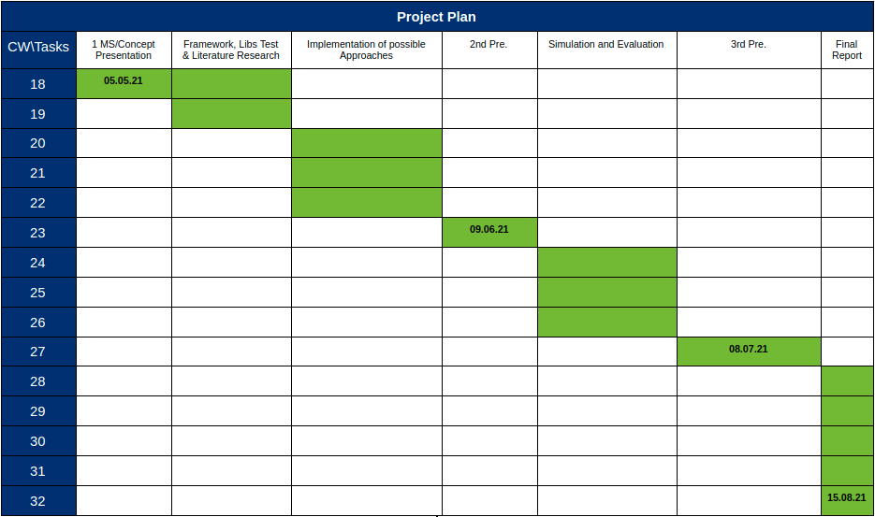
5. Milestone
18.11.2020
DCAITI -Projekt

Slide 13
Thanks for your attention!
Oday Kabha oday.kabha@ipk.fraunhofer.de
name name@campus.tu-berlin.de
name name@mailbox.tu-berlin.de

