Slide 1

Data Science– Types, Traps, and Tips

Slide 2
Data Science – 2 Main Types in Space Sciences
Experimentation
Focuses on converting instrument outputs (such as voltages) into data products for physical processes
Examples: SSD pulses to particle flux measurements, voltage to magnetic and electric fields, pixel counts to irradiance
Big Data Analytics
Focuses on large data sets taken either from real-world instrumentation or simulations.
Examples: K-means clustering, structured data classification, supervised and unsupervised deep learning, linear regression predictors

Slide 3
Data Science – 2 Main Types
Large overlaps between the two types
Big Data Analytics
Experimentation

Slide 4
Data Science – 2 Main Types
Overlap Examples
Instrumentation such as CERN can generate up to a petabyte of data per experiment
Large telescopes such as Hubble, Big Bear Solar Observatory, and Daniel K. Inouye Solar Telescope generate several terabytes of data every observational day.
The MMS spacecraft constellation generates ~100 gigabytes of data every day, though only 4 gigabytes is transmitted (Baker et al., 2016).

Slide 5
Data Science – Experimentation
Important Aspects/Issues
Statistical Significance of Measurement, Ex. - Particle Counts for specific energy bins
Natural and Artificial Noise sources, Ex. - Radio transmitters near radio astronomy arrays
Data artifacts, Ex. - Bad pixels in solar images
Post-processing techniques – removal of spacecraft spin in magnetometer measurements
Systematic offsets in datasets – subtraction of background field in ground-based magnetometers

Slide 6
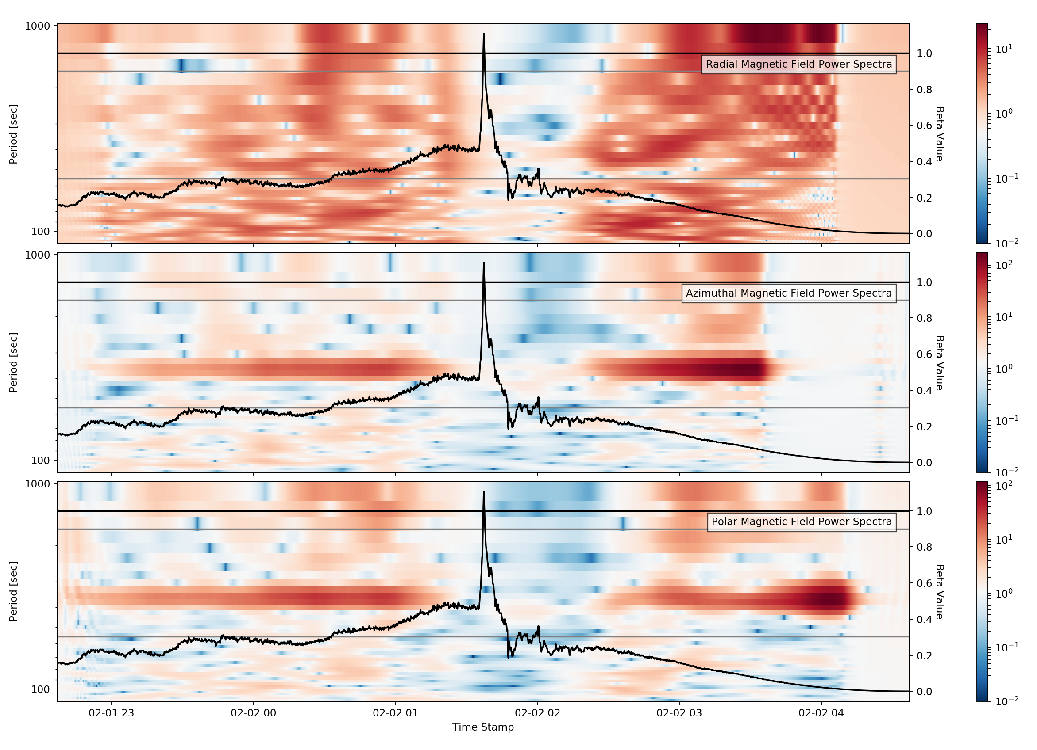
Data Artifacts-Banes of PhD Candidates Existence
Data artifacts don’t always telegraph that they are artifacts. They can appear quite physical.
A healthy dose of skepticism is always necessary when analyzing measurements. Don’t be fooled by pretty signatures!

Slide 7
Data Science - Big Data Analytics
The Problem: A staggeringly large amount of data is presented to the scientist.
The Goal: Reduction of this vast array of information into a digestable set of values or visualizations when describe intrinsic features of the dataset

Slide 8
Data Analysis – Cleaning up the mess
Most datasets don’t come tailored to being analyzed.
Issues:
Missing data in specific fields, or missing data for specific markers, such as timestamps
Corrupted entries which create unhandled exceptions in code.
Data with very large or very small values
As with experimentation, noisy data.

Slide 9
Data Analysis – AI Frameworks
Modern data analysis tools are numerous.
Python Keras library
Matlab Caffe and Tensorflow
IDL Machine Learning Framework
NVIDIA CUDA-X library
General Aspects of Training AI
Cleaning dataset
Splitting dataset into training data and test data
Training the AI from the training set
Analyzing predictive performance of the AI on the test dataset

Slide 10
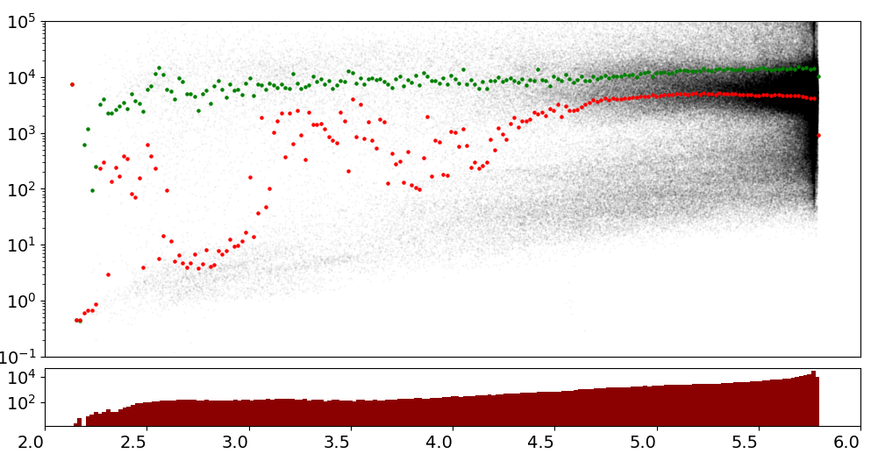
Data Analysis - Visualizations
Data visualizations and by-eye inspection are also useful.

Slide 11
Data Storage Common to Our Field
NASA CDF Files
Reliable but takes things slow.
Has its own way to doing things
CSV Files
Came out of the primordial ooze.
Will outlive cockroaches.
HDF5 Files
Extremely fast but can’t remember what day it is.
Was probably popular in high school.
SQL Databases
Extremely helpful under ideal circumstances
Go ahead and start backing it up now, it’s going to break.

