Slide 1
Reading Partner GDP PAL Chips
Miha Grčar
2024/25

Slide 2
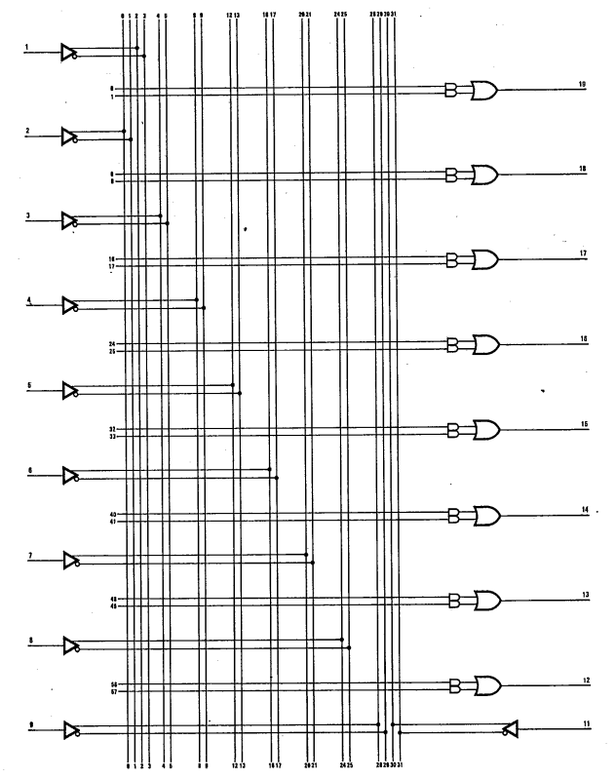
PAL 10L8
10 inputs
8 outputs
No feedbacks, no HI-Z states, no registers, no I/O pins…
Output is OR of max two AND expressions
Easy to read
Read outputs for all combinations of inputs

Slide 3
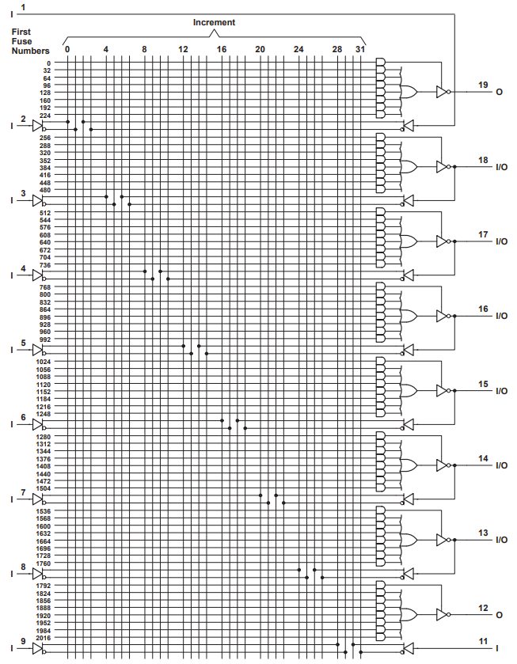
PAL 16L8
10 inputs
2 outputs
Can be set to HI-Z
6 I/O pins
Implicit feedbacks
Can be set to HI-Z (become inputs)
Setting HI-Z is max one “AND” expression
Output is “OR” of max 7 “AND” expressions

Slide 4
Reading PAL 16L8
Create initial set of all possible inputs: 0 .. 2¹⁰ – 1
For each input…
Note down the outputs
Check every I/O pin if it is in HI-Z
If HI-Z states are found, add additional inputs into the set of all possible inputs
Example
00_000000_1001101000 → 11_11110Z
Adds one new input: 00_000001_1001101000

Slide 5
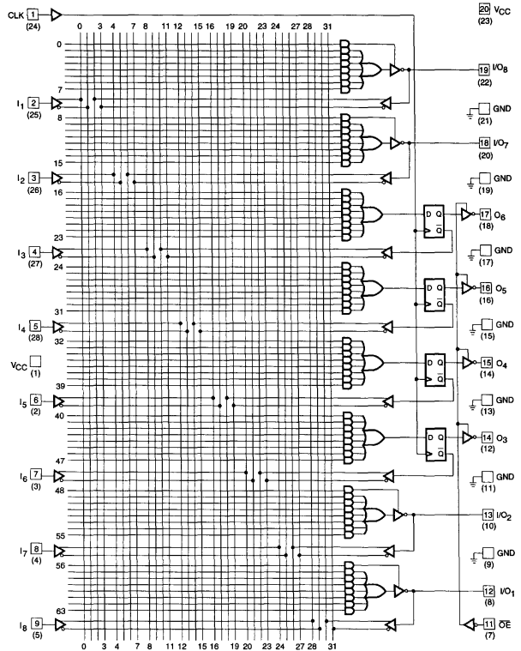
PAL 16R4
8 inputs
4 I/O pins
Implicit feedbacks
Can be set to HI-Z (become inputs)
4 register outputs
Explicit feedbacks
Store value on clock pulse
Can’t [really] be in HI-Z, but there’s OE
Setting HI-Z on I/O is max one “AND” expression
Output is “OR” of max 7 “AND” expressions

Slide 6
Reading PAL 16R4
State graph
State: 4-bit state, register outputs
Node
State – 4-bit state (register outputs)
Mappings – All possible input-to-output mappings (registers are ignored)
Inputs – Queue of all possible inputs
Outlinks – Pointers to other states in the state graph

Slide 7
Reading PAL 16R4
Get_or_create_node(state)
Create new node (= explore new state)
Create initial set of all possible inputs: 0 .. 2⁸ – 1
For each input… (no clock pulse!)
Note down the outputs (attach these to node.mappings)
Check every I/O pin if it is in HI-Z
If HI-Z states are found, add additional inputs into the set of all possible inputs
Create a queue of all the inputs that were mapped (attach it to node.inputs)
Get existing node
Simply fetch the node object corresponding to state
Same as reading 16L8!

Slide 8
Reading PAL 16R4
Main program
Set inputs to 0, fire clock pulse, read the initial state (state = register outputs)
Node = get_or_create_node(initial_state)
Main loop
Node.inputs.count() > 0:
Inputs = node.inputs.dequeue()
Read outputs with clock pulse *state transition*
New state = outputs from registers (4 bits)
Child_node = get_or_create_node(new state)
Node.outlinks[inputs] = child_node
Node = child_node (restart main loop)
Node.inputs.count() == 0:
Find path to a node that still has some unexplored inputs (restart main loop)
If no such node is found, we are done

Slide 9
Toy Example
Node B
Inputs I₁ + clock
Node A
Mappings:
Inputs I₁ → Outputs O₁
Inputs I₂ → Outputs O₂
Inputs I₃ → Outputs O₃
Inputs I₂ + clock
Node C
Inputs I₃ + clock

