Slide 1
Reading Partner GDP PAL Chips
Miha Grčar
2024/25

Slide 2
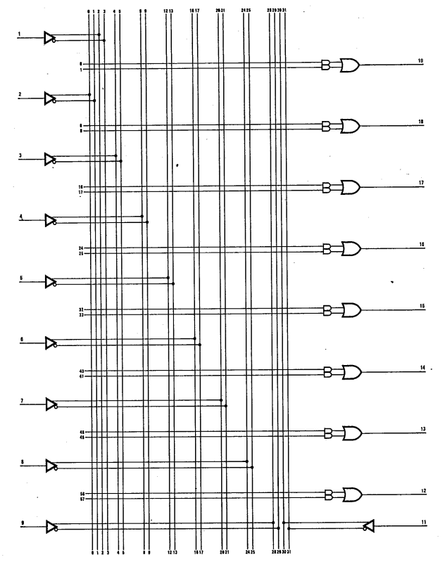
PAL 10L8
10 inputs
8 outputs
No feedbacks, no HI-Z states, no registers, no I/O pins…
Output is OR of max two AND expressions
Easy to read
Read outputs for all combinations of inputs

Slide 3
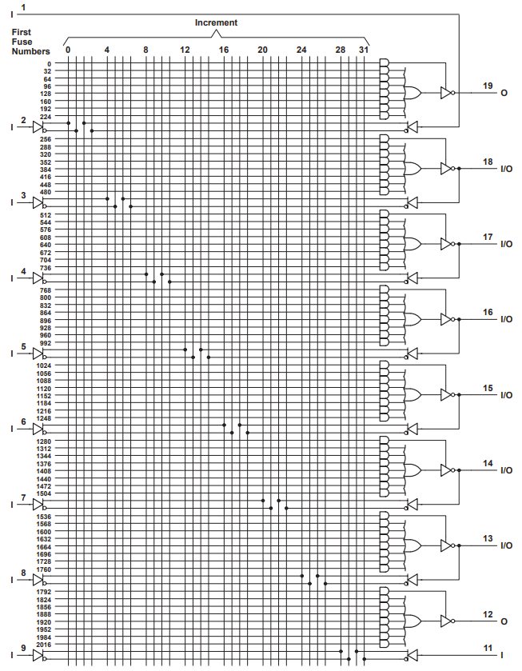
PAL 16L8
10 inputs
2 outputs
Can be set to HI-Z
6 I/O pins
Implicit feedbacks
Can be set to HI-Z (become inputs)
Setting HI-Z is max one “AND” expression
Output is “OR” of max 7 “AND” expressions

Slide 4
PAL 16L8
Reading
Create initial set of all possible inputs: 0 .. 2¹⁰ – 1
For each input…
Note down the outputs
Check every I/O pin if it is in HI-Z
If HI-Z states are found, add additional inputs into the set of all possible inputs
Example
00_000000_1001101000 → 11_11110Z
Adds one new input: 00_000001_1001101000

Slide 5
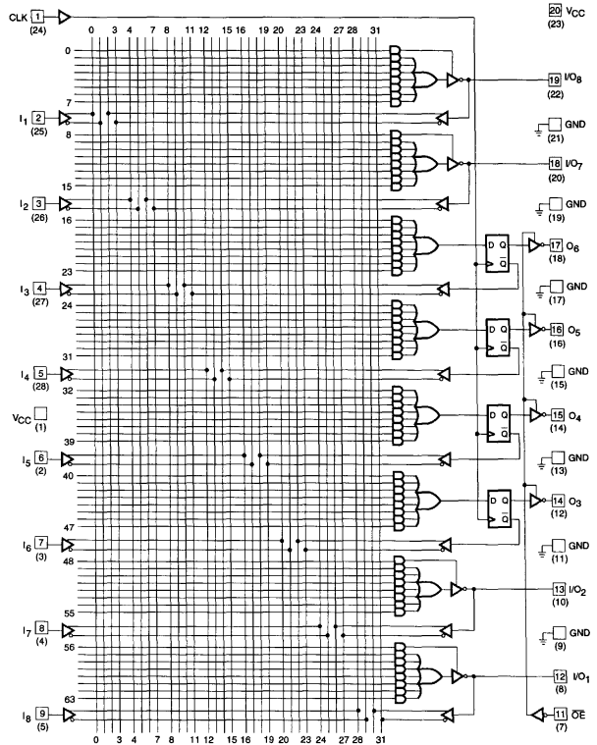
PAL 16R4
8 inputs
4 I/O pins
Implicit feedbacks
Can be set to HI-Z (become inputs)
4 register outputs
Explicit feedbacks
Register value on clock pulse
Can’t [really] be in HI-Z, but there’s OE
Setting HI-Z on I/O is max one “AND” expression
Output is “OR” of max 7 “AND” expressions

Slide 6
Outputs O₂
Inputs I
Inputs I
Outputs O₁
Inputs I + Clock
Outputs O₃
Inputs I + Clock
Inputs I
Outputs O₁
Outputs O₄
Outputs O₃
Inputs I + Clock
Inputs I + Clock

