Slide 1
Reading Partner GDP PAL Chips
Miha Grčar
2024

Slide 2
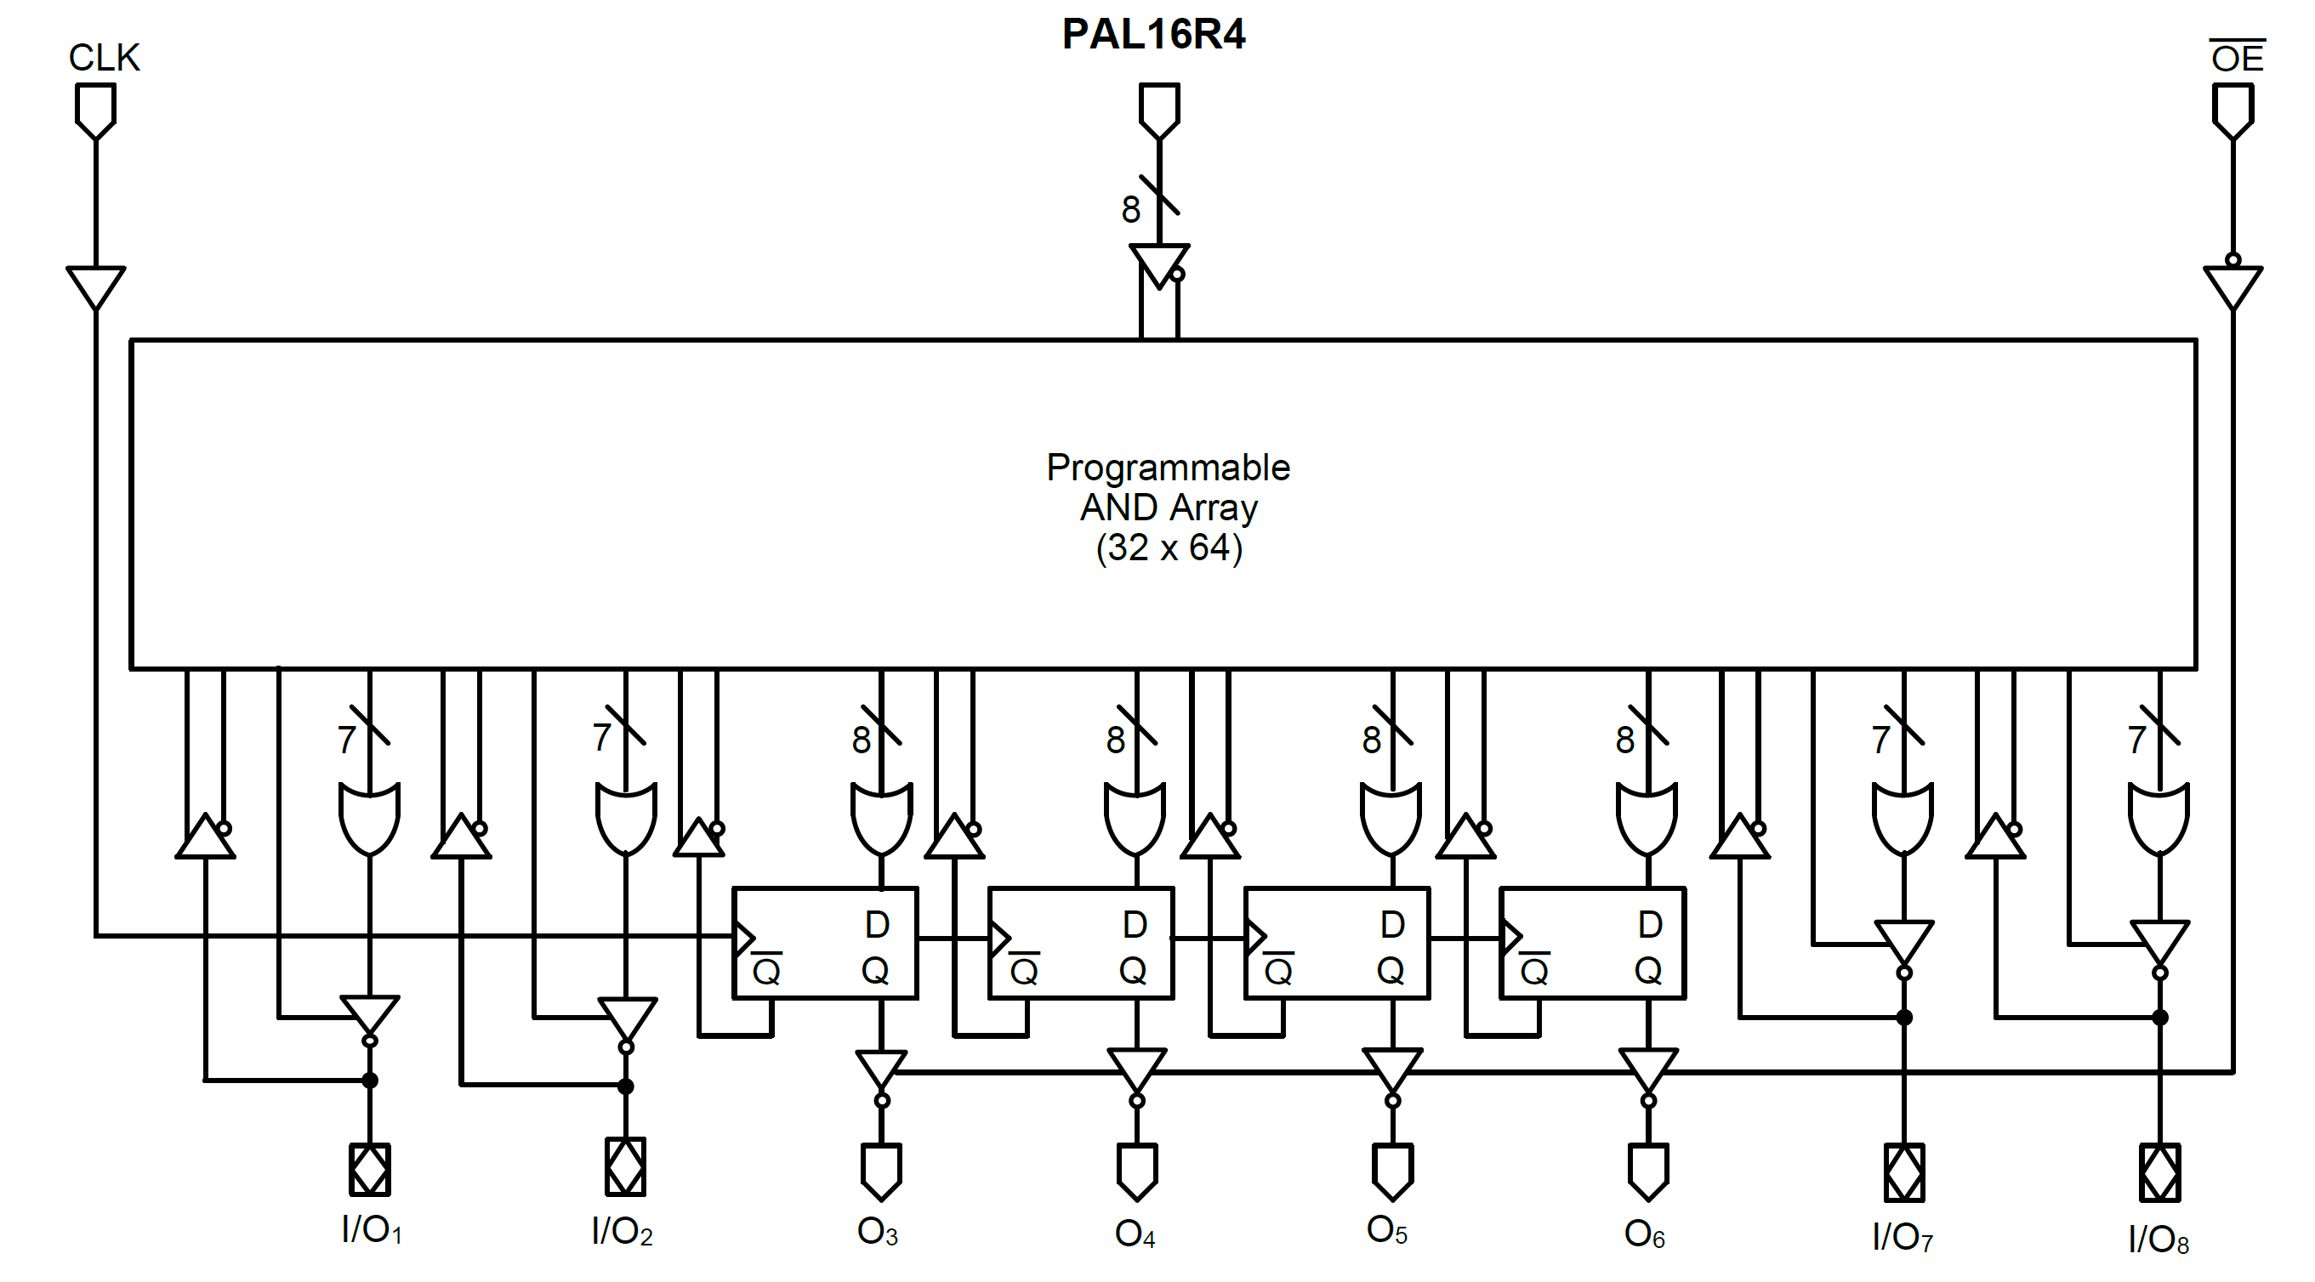
Inputs
“Simple” inputs (i2 – i9)

Slide 3
Inputs
Async feedbacks of outputs (fio12, 13, 18, 19)

Slide 4
Inputs
Sync feedbacks of registered outputs (psro14 – psro17)

Slide 5
Outputs
“Simple” outputs (io12, 13, 18, 19)

Slide 6
Outputs
Registered outputs (ro3 – ro6)

Slide 7
Outputs
OE outputs (io12oe, io13oe, io18oe, io19oe)

Slide 8
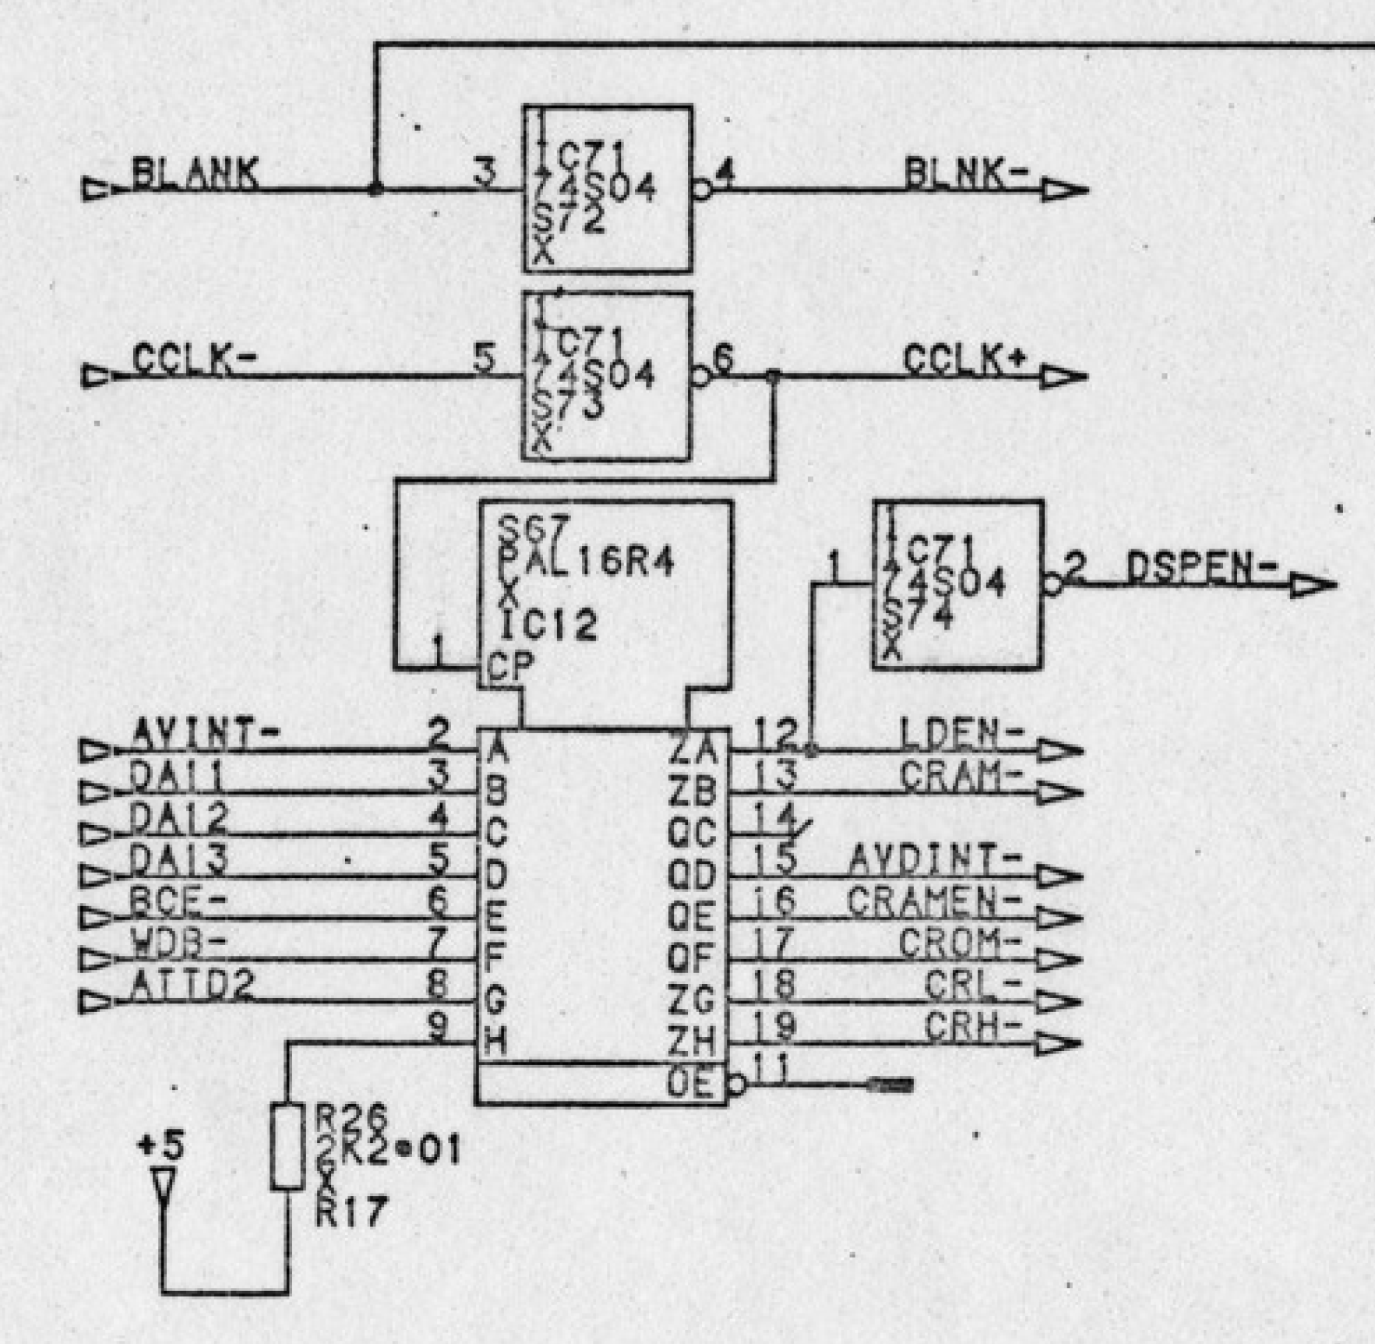
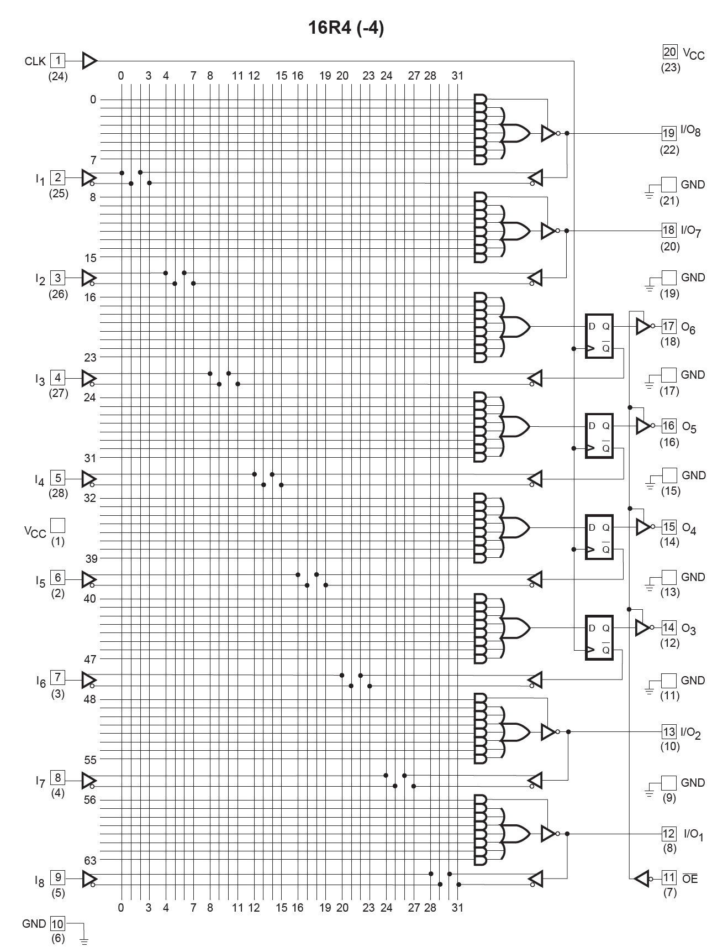
IC12 16R4

Slide 9
Outputs O₂
Inputs I
Inputs I
Outputs O₁
Inputs I + Clock
Outputs O₃
Inputs I + Clock
Inputs I
Outputs O₁
Outputs O₄
Outputs O₃
Inputs I + Clock
Inputs I + Clock

Slide 10
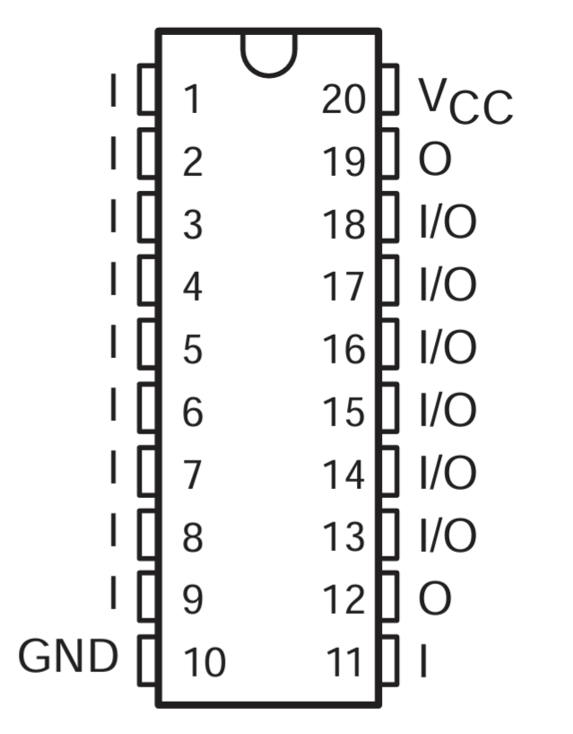
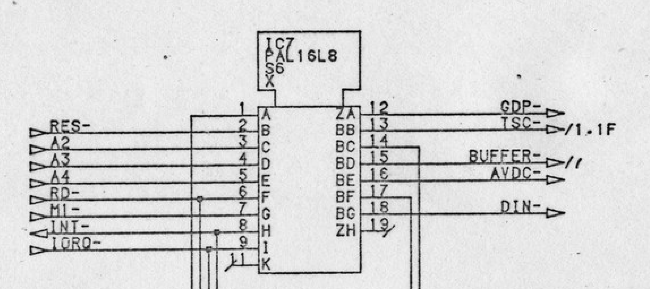
IC7 16L8

Slide 11
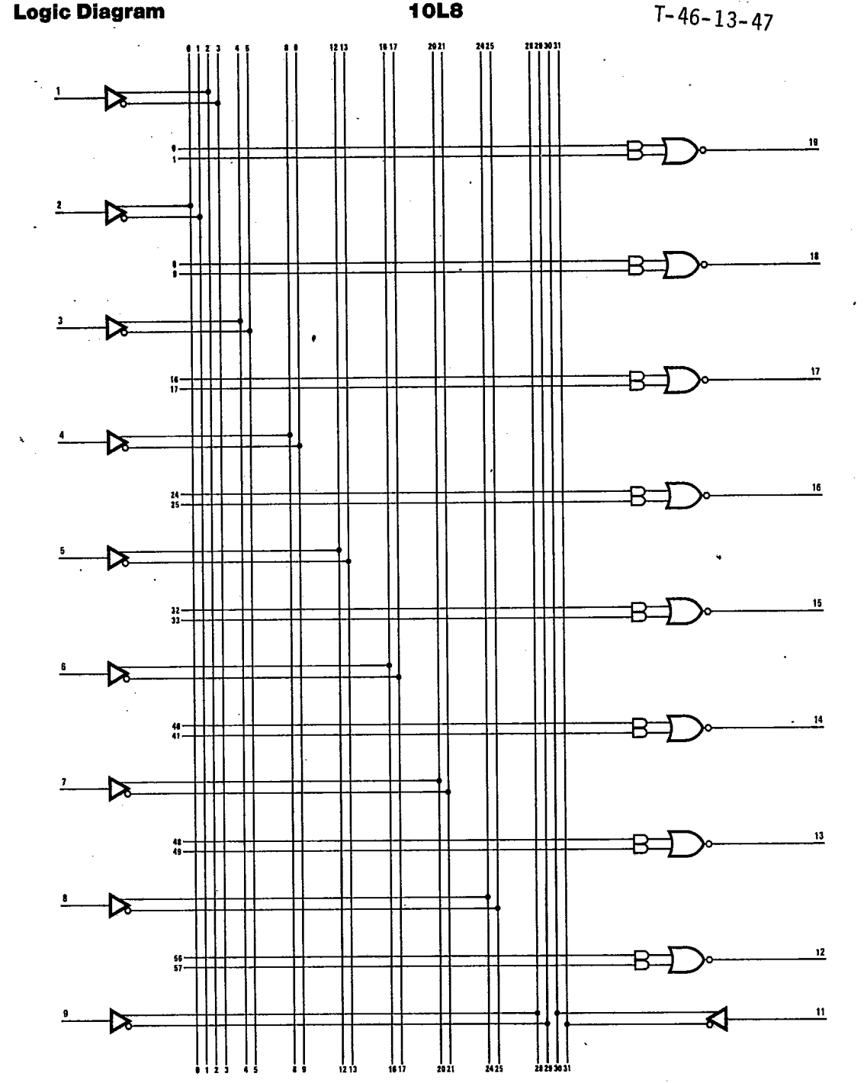
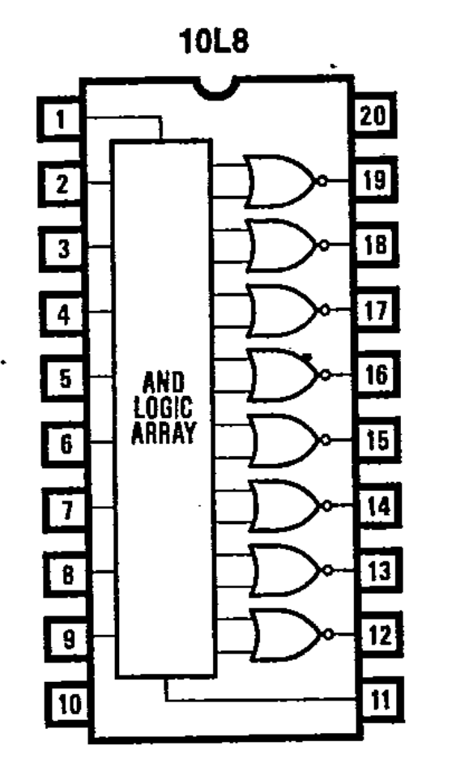
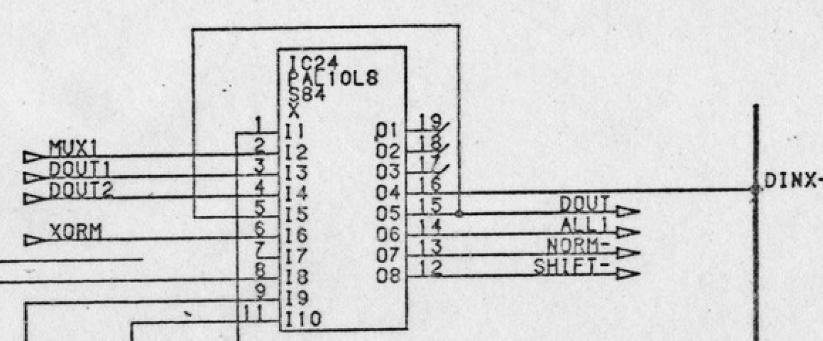
IC24 10L8

