Slide 1
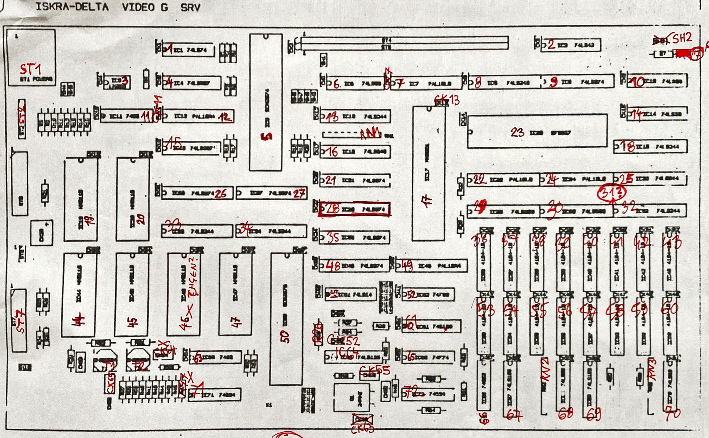
ST2
ST2
ST1
IC12
CK11
SH2
CK11
IC12
RXX
RXX
RXX
CK11
IC12
R7
CK11
RXX
IC12
CK11
CKXX
IC3
CK11
IC12
RXX
RXX
CK11
IC12
CK11
IC12
CK11
IC12
IC12
IC12
CKXX
CKXX
CK11
CK11
CK11
CK11
ST2
CK11
CKXX
IC11
CK11
IC12
CK11
IC12
IC12
CK11
CK11
IC12
RXX
RXX
RXX
RXX
RXX
RXX
RXX
RXX
CK11
RXX
RXX
RXX
RXX
RXX
RN1
IC12
CKXX
CKXX
IC12
CK11
IC12
IC12
IC12
IC12
CK11
IC12
RXX
IC12
IC12
IC12
RXX
CK11
IC12
IC12
CK11
IC12
IC12
IC12
IC12
IC12
RXX
CKXX
CKXX
CKXX
CKXX
CKXX
CKXX
CKXX
CKXX
IC12
IC12
CK11
IC12
CKXX
CKXX
CKXX
CKXX
CKXX
CKXX
IC12
IC12
IC12
IC12
IC12
IC12
IC12
IC12
IC12
IC12
IC12
IC12
CK11
IC12
CK11
IC12
IC12
CK11
SH2
CK11
ST7
IC12
SH2
IC12
CKXX
CKXX
CKXX
CKXX
CKXX
CKXX
CKXX
CKXX
RXX
RXX
SH2
SH2
CK11
SH2
RXX
RXX
CK11
IC12
IC12
IC12
IC12
IC12
IC12
IC12
IC12
RXX
RXX
RXX
IC12
RXX
RXX
RXX
CK11
RXX
IC12
CKXX
RXX
CK11
RXX
IC12
RXX
IC12
RXX
RXX
IC12
IC12
CKXX
CKXX
CKXX
CKXX
CKXX
SH2
RXX
CK11
RXX
RXX
RXX
IC12
RXX
RXX
RXX
RXX
RXX
RXX
RXX
RXX
RXX
RXX
CK11
RXX
IC12
IC12
IC12
IC12
SH2
IC12
IC12
RXX
IC12
RN1
IC12
RN1
SH2
SH2
RXX
SH2
CK11

Slide 3
ST2
ST2
ST1
IC5 * SCN2674
CK3
SH2
CK1
IC1 * 74LS74
RXX
RXX
RXX
CK2
IC2 * 74LS42
R7
SH
RXX
IC23 * EF9367
CK9
CK4
IC3 * LM393
CK5
IC4 * 74LS367
RXX
RXX
CK6
IC6 * 74LS85
CK7
IC7 * PAL16L8
CK8
IC8 * 74LS245
IC9 * 74LS374
IC10 * 74LS83
CK10
CKXX
CK11
CK11
CK11
CK11
ST2
CK13
CK10
IC11 * 7406
CK11
IC12 * PAL16R4
CK12
IC13 * 74LS244
IC17 * Z80 PIO
CK14
CK15
IC14 * 74LS83
RXX
RXX
RXX
RXX
RXX
RXX
RXX
RXX
CK16
RXX
RXX
RXX
RXX
RXX
RN1
IC18 * 74LS244
CK18
CK19
IC15 * 74LS367
CK17
IC16 * 74LS245
IC12
IC19 * HM6116
IC20 * HM6116
CK20
IC21 * 74LS374
RXX
IC22 * PAL16L8
IC24 * PAL10L8
IC25 * 74LS244
RXX
CK21
IC26 * 74LS374
IC27 * 74LS374
CK22
IC28 * 74LS374
IC29 * 25LS2538
= 74LS538
IC30 * 25LS2538
= 74LS538
IC32 * 74LS244
IC12
RXX
CK25
CK26
CK27
CK28
CK29
CK30
CK31
CK32
IC33 * 74LS244
IC34 * 74LS244
CK24
IC35 * 74LS374
CK23
CK33
CK34
CK35
CK36
CK37
IC44 * HM6116
IC45 * HM6116
IC46 * EPROM * 2732
IC47 * HM6116
IC50 * SCB2675
IC36 * D4164
IC37 * D4164
IC38 * D4164
IC39 * D4164
IC40 * D4164
IC41 * D4164
IC42 * D4164
CK38
IC48 * 74LS374
CK39
IC49 * PAL16R4
IC43 * D4164
CK40
SH2
CK41
ST7
IC51 * 74F14
SH2
IC52 * 74F00
CK42
CK43
CK44
CK45
CK46
CK47
CK48
CK49
RXX
RXX
SH2
SH2
CK50
SH2
RXX
RXX
CK51
IC61 * 74F163
IC53 * D4164
IC54 * D4164
IC55 * D4164
IC56 * D4164
IC57 * D4164
IC58 * D4164
IC59 * D4164
RXX
R26
RXX
IC60 * D4164
RXX
RXX
RXX
CK52
RXX
T1
T2
IC64
CK60
RXX
CK53
RXX
CK59
RXX
IC63
RXX
RXX
IC64 * 74123
IC65 * 74F74
CK54
CK55
CK56
CK57
CK58
SH2
RXX
CK61
RXX
RXX
RXX
CK65
RXX
RXX
RXX
RXX
RXX
RXX
RXX
RXX
RXX
RXX
CK62
RXX
IC66 * 74F00
IC68 * 74LS30
IC70 * 74LS30
IC71
SH2
IC12
IC72 * 74S04
RXX
IC67 * 74LS166
RN2
IC69 * 74LS166
RN3
SH2
SH2
RXX
SH2
CK63

