Slide 1
SYS::RR-02162 / GROUP E
RoboRally
Online
> PROGRAM
> EXECUTE
> RESOLVE
PROJECT VISION + RELEASE 1
10 MINUTES
A digital board game that keeps the chaos and removes the bookkeeping
Notes:
Welcome everyone. We are Group E, and our project is a web version of RoboRally. Our goal is to keep the social, chaotic feeling of the physical board game while making it easier to start, follow and play remotely. I will focus on the product vision and the player experience, rather than the technical implementation.

Slide 2
SYS::RR-02162
02
Why a digital RoboRally?
The physical game is difficult to start spontaneously.
01
Same room
02
Manual bookkeeping
03
Rule ambiguity
Every player needs to meet around one table.
Cards, checkpoints, damage and turn order need constant tracking.
One resolution mistake can interrupt the whole round.
The friction comes before the fun starts.
Notes:
The main problem is not the game itself. The problem is the friction around it. Everyone must be in the same place, setup takes time, and players must manually track cards, checkpoints, damage and exact execution order. A small mistake can interrupt the round and create an argument about the correct state.

Slide 3
SYS::RR-02162
03
Product vision
A shared 3D board that feels physical, while the software handles the rules.
SHARED BOARD
REMOTE PLAY
AUTOMATIC RULES
BOARD-GAME FEEL
One visible state for every player
Friends can join from anywhere
Movement and hazards resolve consistently
Robots remain tactile and readable
The product supports play. It does not replace the uncertainty that makes RoboRally fun.
Notes:
Our vision is a shared 3D board that still feels like a real board game. Players join remotely and see the same game state. The software resolves movement, hazards and progress consistently. It removes administration, but it keeps the uncertainty that creates RoboRally's funniest moments.

Slide 4
SYS::RR-02162
04
What players need to understand
CURRENT PHASE
ROBOT POSITION
+ DIRECTION
SHARED
BOARD
STATUS
+ PROGRESS
ACTION CARDS
The board stays central. Everything around it explains what happens next.
Notes:
The board is the shared centre of the experience. Players should immediately see every robot's position and direction. The interface then explains the current phase, public status and checkpoint progress. Action cards replace physical card handling. This lets players concentrate on planning instead of maintaining the game state.

Slide 5
SYS::RR-02162
05
One round from Alex's perspective
01
02
03
04
05
SEE
PROGRAM
LOCK
RESOLVE
SYNC
Inspect board state
Choose five cards
Confirm the order
Watch automatic execution
Continue from one result
Chaos remains in the outcome. Ambiguity disappears from the resolution.
Notes:
Imagine Alex joining a game. Alex first reads the shared board, then privately chooses five cards and locks the program. Once everyone is ready, the programs reveal and execute in priority order. Board elements activate, progress updates, and every player receives the same resulting state. The outcome can still be chaotic, but the resolution is clear.

Slide 6
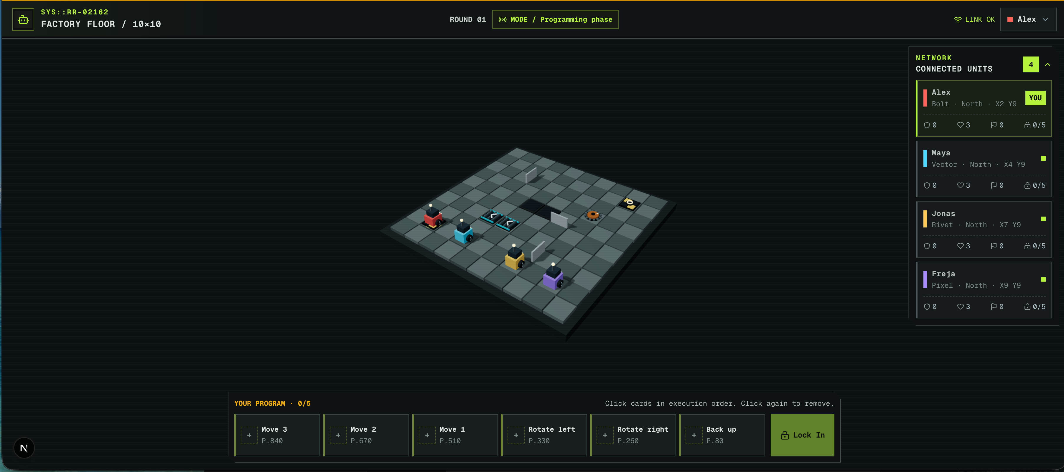
SYS::RR-02162
06
Current product mockup
BOARD
PUBLIC STATUS
PRIVATE PROGRAM
Notes:
This screen is a product mockup of the intended player experience. The board occupies the centre, robot directions are visible, player status appears to the side, and the action cards sit close to the play area. The mockup demonstrates the vision. It is not a presentation about Three.js, Next.js or backend architecture.

Slide 7
SYS::RR-02162
07
Release 1 scope
RELEASE 1
FUTURE OPTIONS
01
Visible shared game state
01
Different robot types
02
Private card programming
02
Custom programming decks
03
Automatic execution
03
Adaptive or changing boards
04
Board element effects
04
Cosmetics and progression
05
Synchronized result
First prove the shared game loop.
Notes:
For Release 1, we narrow the vision to one complete shared loop. Players need to see the state, choose cards privately, execute programs automatically, apply board effects and continue from a synchronized result. Robot classes, custom decks, adaptive boards and progression remain possible extensions. We should only commit to them after the core loop works well.

Slide 8
SYS::RR-02162
08
Suggested user stories for Release 1
01
SEE SHARED STATE
02
PROGRAM PRIVATELY
Board, robot direction, round and phase
Receive and order action cards
03
EXECUTE BY PRIORITY
04
APPLY BOARD RULES
Reveal and resolve locked programs
Conveyors, gears, walls, pits and checkpoints
05
TRACK CONSEQUENCES
06
SYNCHRONIZE RESULTS
Damage, lives and checkpoint progress
The same state for every player
Together, the stories describe one coherent playable round.
Notes:
These six stories convert the vision into Release 1 work. A player sees the shared state, programs privately, and watches priority-based execution. The game applies board rules, tracks damage and checkpoint progress, and synchronizes the final state. Together they describe one coherent playable round rather than a collection of disconnected features.

Slide 9
SYS::RR-02162
09
Scoped domain model
GAME
TRACKS
ROUND / PHASE
HAS
USES
PLAYER
BOARD
CREATES
CONTROLS
CONTAINS
PROGRAM
ROBOT
OCCUPIES
TILE
CONTAINS
MAY CONTAIN
ACTION CARD
BOARD ELEMENT
Notes:
This scoped model gives the team a shared vocabulary for Release 1. A game has players, a board and a current round or phase. A player creates a program and controls a robot. Programs contain action cards. Robots occupy tiles, while the board contains tiles and board elements. The model stays intentionally small and avoids implementation details.

Slide 10
SYS::RR-02162
10
Release 1 success
A complete round runs from card selection to a synchronized result without manual rule checking.
READABLE
RELIABLE
Players understand positions, directions and the current phase.
The game resolves the same rules and state for everyone.
QUESTIONS?
Notes:
Release 1 succeeds when a complete round runs from private card selection to one synchronized result without manual rule checking. Players should understand what is happening, and the system should resolve the rules consistently. That gives us a strong foundation for every later extension. Thank you. We are ready for questions.

