Slide 1

C# Best Practices
K. Scott Allen
@OdeToCode
Level: Intermediate

Slide 2
Agenda
Object Oriented Design
Functional Design
Language Oriented Design

Slide 3
OOP

Slide 4
Single Responsibility Principle
A class should have only one reason to change
public class Measurement
{
public double HighValue { get; set; }
public double LowValue { get; set; }
}

Slide 5
The One Class Solution
var aggregator = new MeasurementAggregator(_data);
var result = aggregator.Aggregate(2, AggregationType.Mean);
public IEnumerable<Measurement> Aggregate(
int groupingSize, AggregationType type)
{
}

Slide 6
Problems
Primitive Obsession
Difficult to change
private Measurement Aggregate(IEnumerable<Measurement> measurements,
AggregationType type)
{
Measurement result = null;
switch(type)
{
case AggregationType.Mean:
result = Average(measurements);
break;
case AggregationType.Mode:
result = Mode(measurements);
break;
}
return result;
}

Slide 7
Applying SRP
Smaller classes
Well defined roles and responsibilities
var aggregator = new MeasurementAggregator2(_data);
var result = aggregator.Aggregate(new SizeGrouper(2),
new AveragingCalculator());
public IEnumerable<Measurement> Aggregate(IGrouper grouper, IAggregateCalculation calculator)
{
var partitions = grouper.Group(_measurements);
foreach (var partition in partitions)
{
yield return calculator.Aggregate(partition);
}
}

Slide 8
Open/Closed Principle
Classes should be open for extension but closed for modification
switch(type)
{
case AggregationType.Mean:
result = Average(measurements);
break;
case AggregationType.Mode:
result = Mode(measurements);
break;
}

Slide 9
Strategies and Templates
public class AveragingCalculator : IAggregateCalculation
{
public Measurement Aggregate(IEnumerable<Measurement> measurements)
{
return new Measurement()
{
HighValue = measurements.Average(m => m.HighValue),
LowValue = measurements.Average(m => m.LowValue)
};
}
}

Slide 10
Liskov Substitution Principle
class LowFrequencyCalculator : IAggregateCalculation
{
public Measurement Aggregate(IEnumerable<Measurement> measurements)
{
if(measurements.Any(m => m.HighValue > 100))
{
throw new InvalidOperationException("...");
}
// ...
}
}

Slide 11
Interface Segregation Principle
Build cohesive abstractions
Avoid polluting interfaces
Separate clients means separate interfaces
Don’t force clients to use or implement methods they don’t use
Prefer aggregation and delegation over inheritance

Slide 12
Dependency Inversion Principle
Depend only on abstractions, not details
case AggregationType.Mean:
var calc = new AveragingCalculator();
result = calc.Aggregate(measurements);
break;
☹

Slide 13
OOP Summary is SOLID
Single Responsibility
Open / Closed
Liskov Substitution
Interface
Segregation
Dependency
Inversion

Slide 14
Functional DESIGN

Slide 15
Why Functional?
Functions are abstractions, too!
Pass functions as parameters
Easy to compose and combine
Functional programming excels at separating concerns
Programming in the small versus programming in the large
var numbers = new[] {1, 2, 3, 6, 7, 8, 10};
var odd = numbers.Where(n => n % 2 == 1);
Knows how to filter
Knows what to filter

Slide 16
Functional Advantages
Small, reusable abstractions
Reusable
private static IEnumerable<T> Filter<T>(IEnumerable<T> numbers,
Predicate<T> predicate)
{
foreach (var number in numbers)
{
if (predicate(number)) yield return number;
}
}
Lazy
var numbers = new[] {1.0, 2, 3, 6, 7, 8, 10};
var evenNumbers = numbers.AsParallel().Where(n => n%2 == 0);
Easy To Parallel

Slide 17
Removing Loops
private static IEnumerable<T> Filter<T>(IEnumerable<T> numbers,
Predicate<T> predicate)
{
foreach (var number in numbers)
{
if (predicate(number)) yield return number;
}
}
private static IEnumerable<T> Filter<T>(IEnumerable<T> numbers,
Predicate<T> predicate)
{
return numbers.Where(number => predicate(number));
}

Slide 18
Map / Filter / Reduce
Common functional parlance
With LINQ it’s Select / Where / Aggregate
public double TotalSalaryForManagers(IList<Employee> employees)
{
return employees.Where(e => e.IsManager) // filter
.Select(e => e.Salary) // map
.Sum(); // reduce
}

Slide 19
Declarative Programming
Less imperative == more declarative
Why should validation rules branch the execution path?
var errors = new List<ValidationError>();
if(string.IsNullOrEmpty(movie.Title))
{
errors.Add(new ValidationError() {Message = "…"});
}
if(movie.Duration < 30)
{
errors.Add(new ValidationError() {Message = "…"});
}
else if(movie.Duration > 360)
{
errors.Add(new ValidationError() {Message = "…"});
}

Slide 20
A Declarative Approach
Treat validation code as data to evaluate
public class ValidationRule<T>
{
public Func<T, bool> Rule { get; set; }
public ValidationError Error { get; set; }
}
new ValidationRule<Movie>
{
Rule = m => string.IsNullOrEmpty(m.Title),
Error = new ValidationError() {Message = "…"}
};
public IEnumerable<ValidationError> Validate (Movie movie)
{
Func<ValidationRule<Movie>, bool> theRuleFails = r => r.Rule(movie);
return GetRules().Where(theRuleFails).Select(r => r.Error);
}

Slide 21
Continuations
DoAsync(Work,
() => Console.WriteLine("Success!"),
()=> Console.WriteLine("Error!"));
Passing functions to describe what to do next
static void DoAsync(Func<bool> func, Action onSuccess, Action onError)
{
func.BeginInvoke((asyncResult) =>
{
bool result = func.EndInvoke(asyncResult);
if (result)
{
onSuccess();
}
else
{
onError();
}
}, null);
}

Slide 22
Functions as Data
Pass them as parameters
Return them from methods
private static Action MakeGreetingFunction()
{
if(DateTime.Now.Hour < 12)
{
return () => Console.WriteLine("Good morning!");
}
return () => Console.WriteLine("Good evening!");
}
var f = MakeGreetingFunction();
f();

Slide 23
Closures
Binding functions to state
What happens to the name parameter?
private static Action MakeGreetingFunction(string name)
{
if(DateTime.Now.Hour < 12)
{
return () => Console.WriteLine("Good morning, {0}", name);
}
return () => Console.WriteLine("Good evening, {0}", name);
}

Slide 24
Functions as Parameters
Passing anonymous methods around makes LINQ work
Also useful to abstract away what should happen around method invocation
Caching, memoization, automatic retries
Action fetchMovies = () =>
{
// ... call web serivce
};
fetchMovies.WithRetry();
static void WithRetry(this Action action)
{
int retryCount = 0;
bool succesful = false;
do
{
try
{
action();
succesful = true;
}
catch (NetworkException e)
{
retryCount++;
}
} while (retryCount < 3 && !succesful);
}

Slide 25
Language Oriented Programming

Slide 26
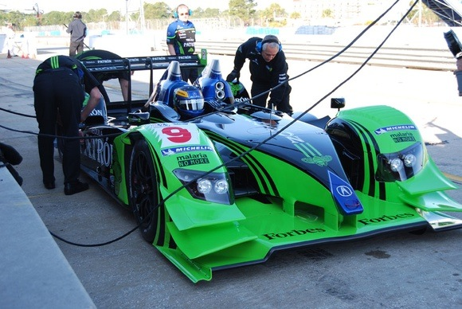
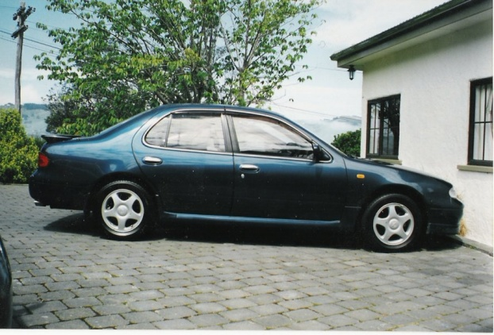
Domain
Specific
Language
General
Purpose
Language

Slide 27
Domain Specific Languages
Examples
SQL, regular expressions, CSS selectors
Benefits
Specialized language can increase productivity
Narrows gap between you and customer
Easy to separate concerns
Drawbacks
Can be expensive to create (and possibly learn)
Difficult to implement in C#

Slide 28
Language Oriented C#
Extension methods
For better APIs
Expression trees
For static reflection
Funcs and Actions
For functional, declarative programming

Slide 29
Example Scenario
Scheduling tasks for periodic execution
public class ScheduledTask {
public ScheduledTask(ITask task,
TimeSpan interval,
TimeSpan expiration) {
Task = task;
Interval = interval;
Expiration = expiration;
}
public ITask Task { get; protected set; }
public TimeSpan Interval { get; protected set; }
public TimeSpan Expiration { get; protected set; }
...
}
?
var task = new ScheduledTask(
new AccountSynchronizationTask(),
new TimeSpan(0, 0, 2, 0),
new TimeSpan(2, 0, 0, 0));

Slide 30
Goals
Readability
Easier to maintain
Essence over ceremony
Remove language clutter
var task = new ScheduledTask(
new AccountSynchronizationTask(),
new TimeSpan(0, 0, 2, 0),
new TimeSpan(2, 0, 0, 0));

Slide 31
Named parameters
Only a small step forward
Particularly useful when combined with optional parameters
Gives reader a clue when using constants
var task = new ScheduledTask(
Tasks.AccountSynchronization,
runEvery: new TimeSpan(0, 0, 2, 0),
expiresIn: new TimeSpan(2, 0, 0, 0));

Slide 32
Fluent APIs
var then = 2.Minutes().Ago();
public static TimeSpan Minutes(this int value)
{
return new TimeSpan(0, 0, value, 0, 0);
}
public static DateTime Ago(this TimeSpan value)
{
return SystemTime.Now() - value;
}

Slide 33
Putting It Together
var task = new ScheduledTask(
new AccountSynchronizationTask(),
new TimeSpan(0, 0, 2, 0),
new TimeSpan(2, 0, 0, 0));
var task = Tasks.Schedule(Tasks.AccountSynchronization,
runEvery: 2.Minutes(),
expireIn: 5.Days());

Slide 34
Validation Example
var chart = new MovieFlowchart();
chart.WithShape("CheckTitle")
.RequiresField(m => m.Title)
.WithArrowPointingTo("CheckLength")
.AndTheRule(m => !String.IsNullOrEmpty(m.Title))
.WithShape("CheckLength")
.RequiresField(m => m.Length)
.WithArrowPointingTo("BadMovie")
.AndTheRule(m => m.Length > 120)
.WithArrowPointingTo("GoodMovie")
.AndTheRule(m => m.Length == 75)
.WithArrowPointingTo("CheckReleaseDate")
.AndTheRule(m => m.Length.HasValue)
. . .
.WithShape("BadMovie").YieldingResult(MovieResult.BadMovie)
.WithShape("GoodMovie").YieldingResult(MovieResult.GoodMovie);

Slide 35
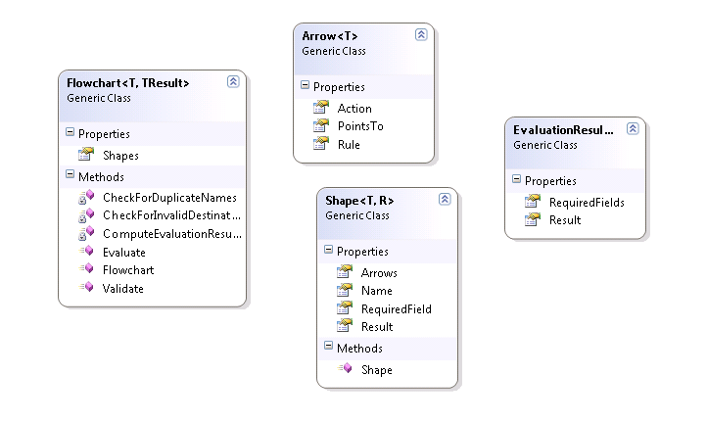
Semantic Model

Slide 36
Building the Fluent API / DSL
public static Flowchart<T, R> WithShape<T, R>(
this Flowchart<T, R> chart, string shapeName)
{
var shape = new Shape<T, R> { Name = shapeName };
chart.Shapes.Add(shape);
return chart;
}
public static Flowchart<T, R> YieldingResult<T, R>(
this Flowchart<T, R> chart, R result)
{
chart.LastShape().Result = result;
return chart;
}

Slide 37
Expression<T>
public PropertySpecifier(Expression<Func<T, object>> expression)
{
if(expression.Body is MemberExpression)
{
var me = expression.Body as MemberExpression;
_propertyName = me.Member.Name;
}
else if(expression.Body is UnaryExpression)
{
var ue = expression.Body as UnaryExpression;
var me = ue.Operand as MemberExpression;
_propertyName = me.Member.Name;
}
}

Slide 38
My Top 10 Rules

Slide 39
Rule #10: Avoid Regions
public class AccountManager
{
#region UserManagement
...
#endregion
#region RoleManagement
...
#endregion
#region DataAccess
...
#endregion
}

Slide 40
Rule #9: Exceptions Are Errors
public bool Login(string userName, string password)
{
if (String.IsNullOrEmpty(userName))
{
return false;
}
// ....
return true;
}

Slide 41
Rule #8: Avoid Boolean Parameters
public void WriteFile(byte[] contents, bool flush)
{
// ....
}
storage.WriteFile(data, false);
public void WriteFile(byte[] contents)
{
WriteFile(contents, false);
}
public void WriteFileAndFlush(byte[] contents)
{
WriteFile(contents, true);
}
private void WriteFile(byte[] contents, bool flush)
{
// ...
}

Slide 42
Rule #7: One Parameter
public void LoginUser(string username, string password,
IPAddress ipAddress, bool persist)
{
// ...
}
public void LoginUser(UserLoginRequest request)
{
// ...
}

Slide 43
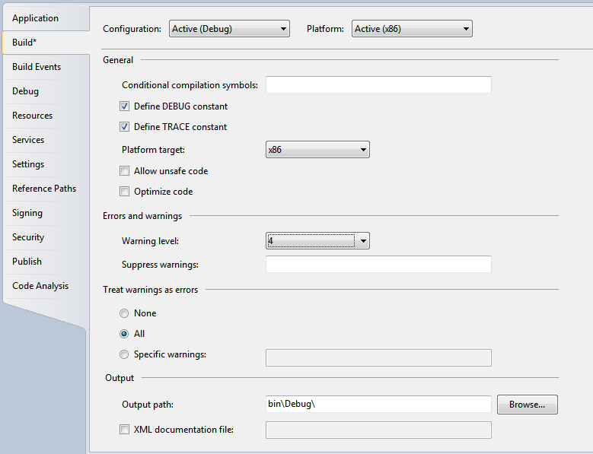
Rule #6: Warnings Are Errors

Slide 44
Rule #5: Encapsulate Complex Expressions
if (account.Balance > 0 && !account.IsVip && account.DueDate > CurrentDate)
{
// send off a warning
}
if (account.IsPastDue)
{
// ...
}

Slide 45
Rule #4: Avoid Multiple Exits
if (account.Balance < 10000)
{
return false;
}
else if (account.IsPastDue)
{
return false;
}
else if (account.IsVip)
{
return false;
}
return true;
var isValid = true;
if (account.Balance < 10000)
{
isValid = false;
}
else if (account.IsPastDue)
{
isValid = false;
}
else if (account.IsVip)
{
isValid = false;
}
return isValid;

Slide 46
Rule #3: Try To Avoid Comments
// ensure we don't send a notification to
// important people
if (account.IsVip && account.IsPastDue)
{
SendNotification = false;
}
CancelNotificationForVipAccounts();

Slide 47
Rule #2: Keep Methods Short
private string BuildLogParameters(HttpContext context, string SubModuleKey, string ownerType, string PageType, string Url)
{
StringBuilder _parameters = new StringBuilder("");
if (PageType == "Rapid") //should no longer have any overlap between indigo and rapid;
{
_parameters.Append("R,");
}
else if (PageType == "Indicator")
{
_parameters.Append("I,");
}
else
{
_parameters.Append("U,");//Unknown
}
_parameters.Append(SessionObject.UserId + ",");
_parameters.Append(SessionObject.PatientDataAccess + ",");
_parameters.Append(System.DateTime.Now);
_parameters.Append(",");
_parameters.Append(SubModuleKey + ",");
_parameters.Append(ownerType + ",");
if (context.Request.QueryString == null)
{
_parameters.Append("null");
}
else
{
_parameters.Append(context.Request.QueryString.ToString());
}
_parameters.Append(",");
if (context.Request.QueryString["VisitIdentity"] != null)
{
_parameters.Append(context.Request.QueryString["VisitIdentity"].ToString());
}
else
{
_parameters.Append("null");
}
_parameters.Append(",");
_parameters.Append(context.Request.RawUrl);
_parameters.Append(",");
_parameters.Append(PageType[0]);
_parameters.Append(",");
if (SubModuleKey == "0" || ownerType == "0")
_parameters.Append(((Page)context.CurrentHandler).Title);
else
_parameters.Append("");
_parameters.Append(",");
_parameters.Append(Url);
return (_parameters.ToString());
}

Slide 48
Rule #1: Keep Classes Small
private string BuildLogParameters(HttpContext context, string SubModuleKey, string ownerType, string PageType, string Url)
{
StringBuilder _parameters = new StringBuilder("");
if (PageType == "Rapid") //should no longer have any overlap between indigo and rapid;
{
_parameters.Append("R,");
}
else if (PageType == "Indicator")
{
_parameters.Append("I,");
}
else
{
_parameters.Append("U,");//Unknown
}
_parameters.Append(SessionObject.UserId + ",");
_parameters.Append(SessionObject.PatientDataAccess + ",");
_parameters.Append(System.DateTime.Now);
_parameters.Append(",");
_parameters.Append(SubModuleKey + ",");
_parameters.Append(ownerType + ",");
if (context.Request.QueryString == null)
{
_parameters.Append("null");
}
else
{
_parameters.Append(context.Request.QueryString.ToString());
}
_parameters.Append(",");
if (context.Request.QueryString["VisitIdentity"] != null)
{
_parameters.Append(context.Request.QueryString["VisitIdentity"].ToString());
}
else
{
_parameters.Append("null");
}
_parameters.Append(",");
_parameters.Append(context.Request.RawUrl);
_parameters.Append(",");
_parameters.Append(PageType[0]);
_parameters.Append(",");
if (SubModuleKey == "0" || ownerType == "0")
_parameters.Append(((Page)context.CurrentHandler).Title);
else
_parameters.Append("");
_parameters.Append(",");
_parameters.Append(Url);
return (_parameters.ToString());
}

Slide 49
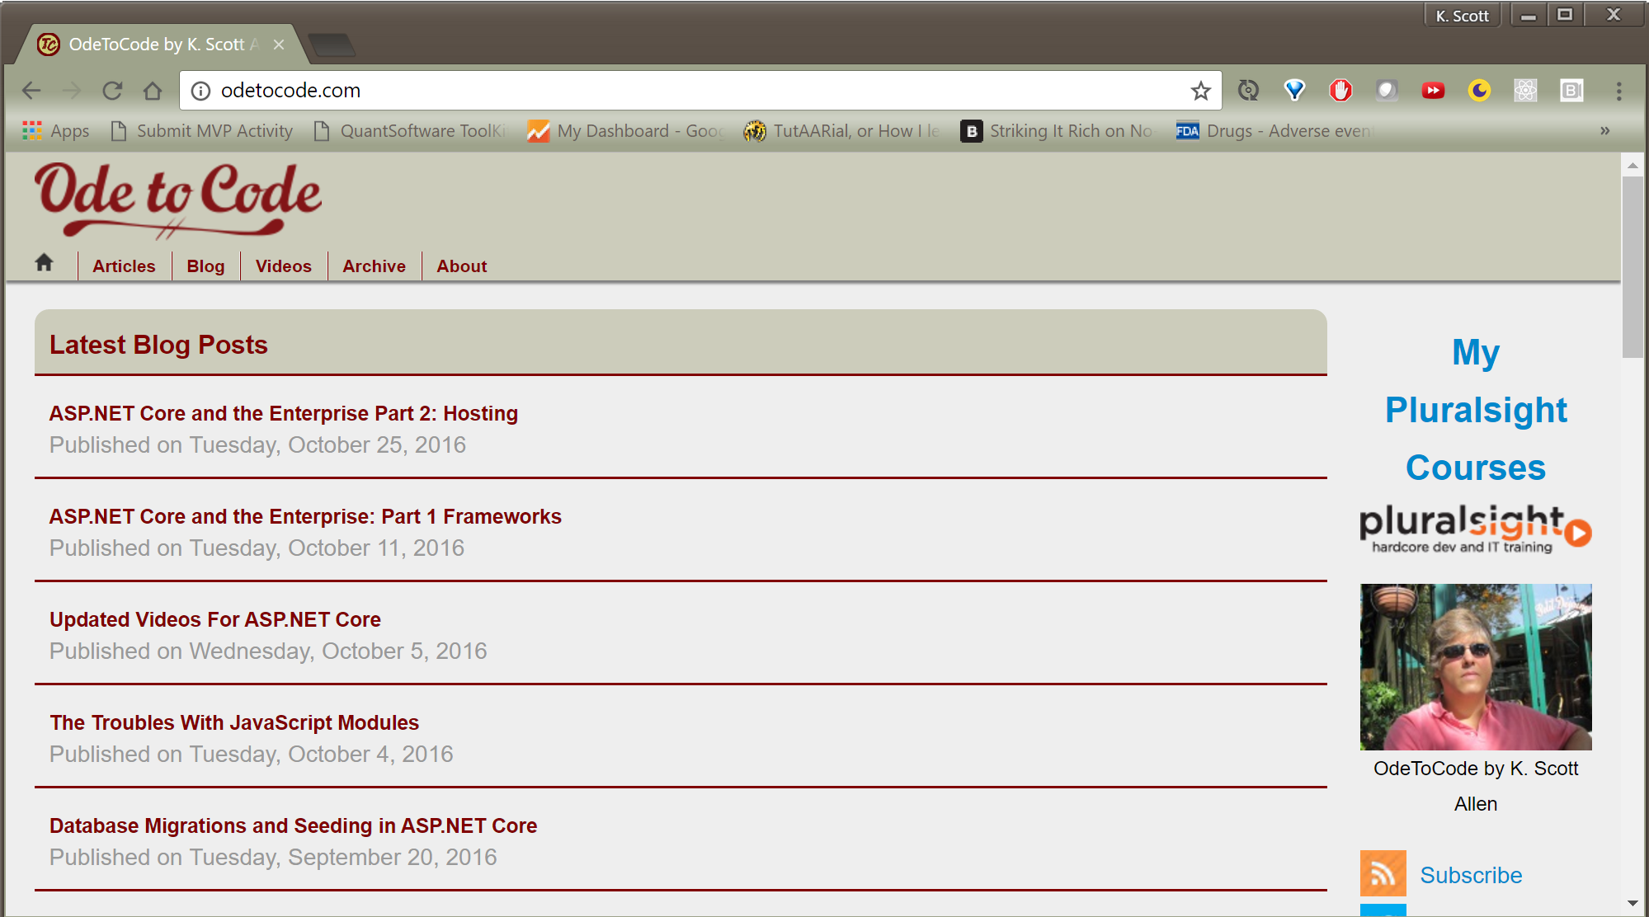
Summary
Code: https://github.com/OdeToCode/csbp
scott@OdeToCode

