Slide 1
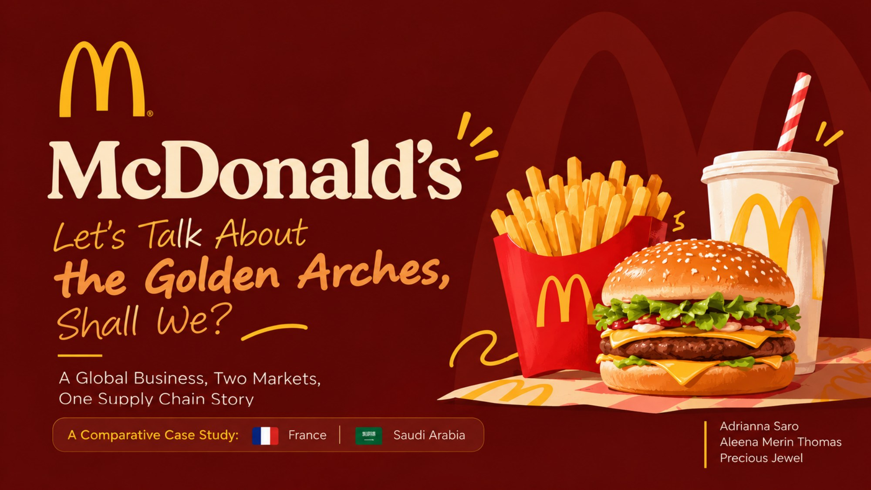
Notes:
Introduce the team and the topic: McDonald's as a global business, compared across France and Saudi Arabia, with a focus on the supply chain.

Slide 2
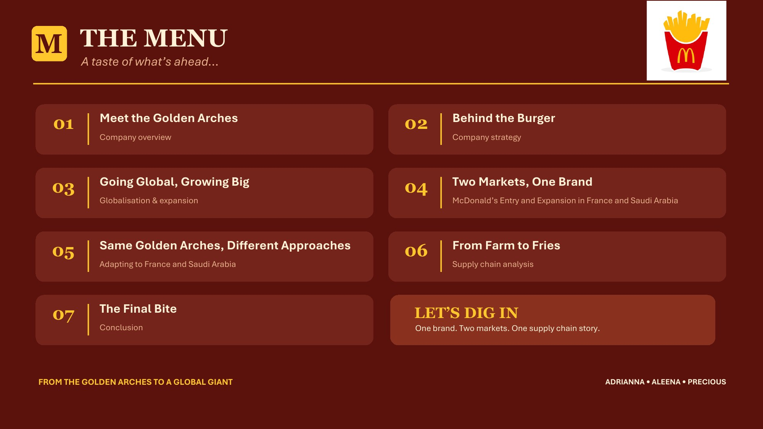
Notes:
Walk through the seven sections of the presentation.

Slide 3
Meet the Golden Arches
40,000+
Founded
1940: Richard and Maurice McDonald, San Bernardino
restaurants worldwide
Franchising
1955: Ray Kroc's first franchise, Des Plaines, Illinois
100+
Headquarters
Chicago, Illinois, USA
countries
Revenue
About US$26 billion (2024)
~95%
Business type
Quick-service restaurants and real-estate owner
run by franchisees
Figures approximate: check against the latest McDonald's Annual Report.
Notes:
McDonald's started as a single drive-in run by two brothers. Its Speedee Service System turned food preparation into an assembly line. Ray Kroc saw the potential to replicate that system, and franchising became the engine of growth. Today most restaurants are owned and run by local franchisees, while McDonald's provides the brand, the system and often the property. That model explains how McDonald's entered France and Saudi Arabia in different ways.

Slide 4
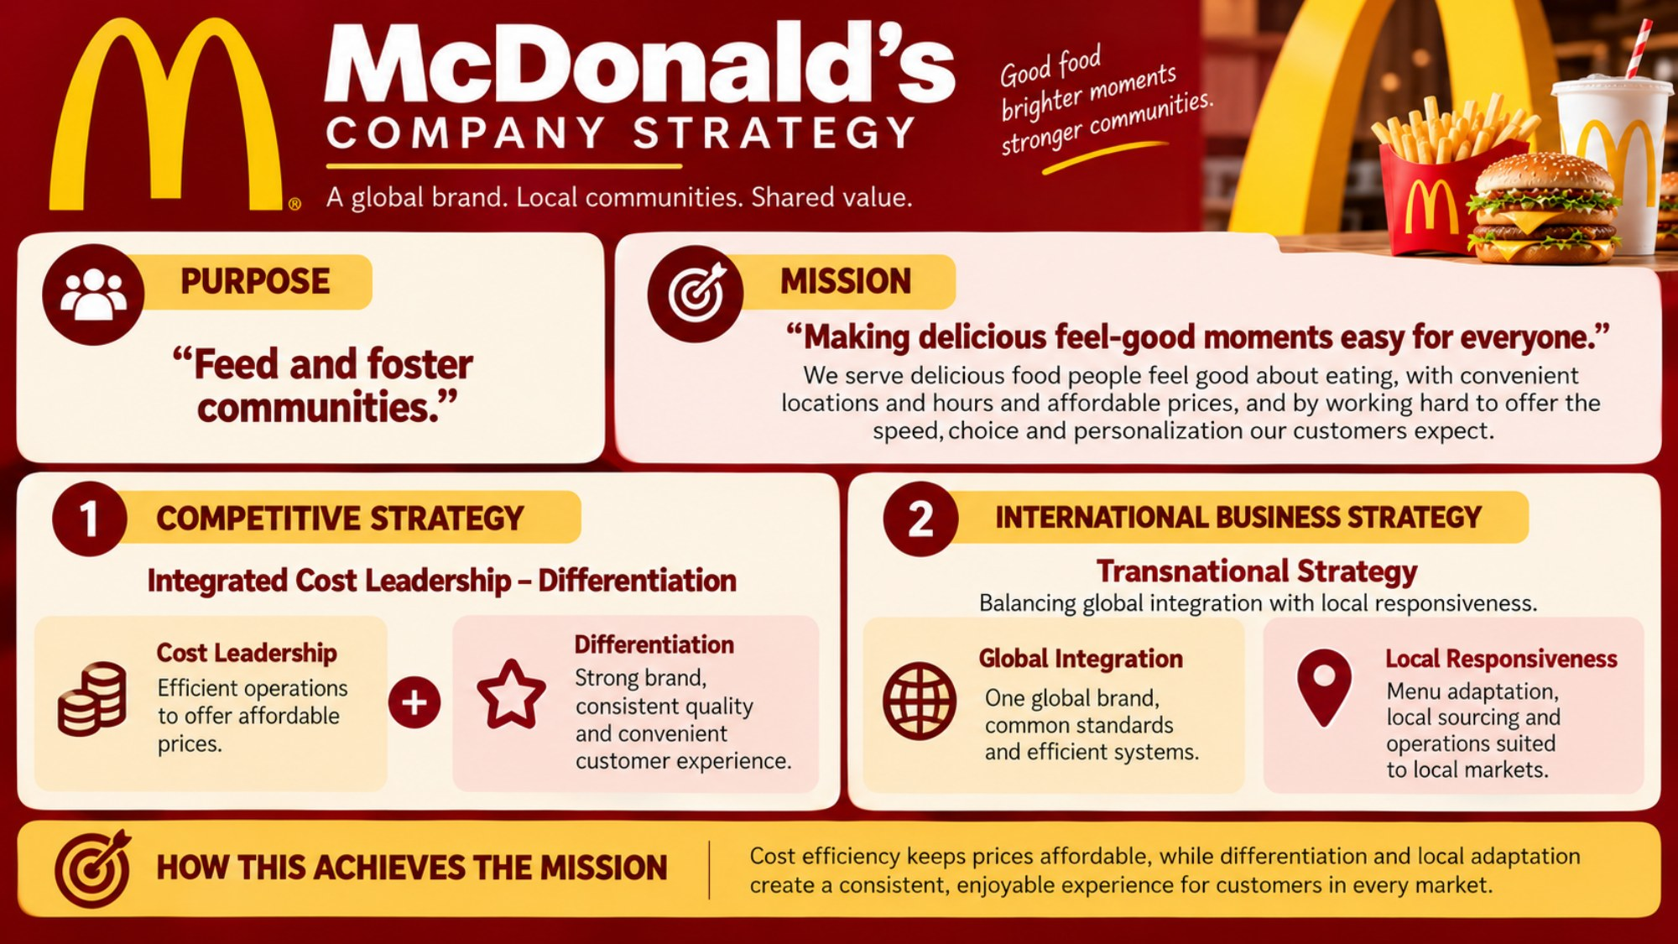
Notes:
Purpose: feed and foster communities. Mission: making delicious feel-good moments easy for everyone. Competitive strategy: integrated cost leadership and differentiation. International strategy: transnational, balancing global integration with local responsiveness.

Slide 5




Going Global, Growing Big
1967
1971
1972
1990
1993
Canada and Puerto Rico
Japan, Germany, Australia
France (Créteil)
Moscow and Shenzhen
Saudi Arabia (Riyadh)
Conventional franchising
Developmental licensing
Joint venture / partner
Company-operated
Local owners run restaurants; McDonald's often owns the property
One local partner gets rights for a country or region and funds growth
McDonald's shares ownership with local investors
McDonald's owns and runs the restaurant itself
e.g. France, UK, USA
e.g. Saudi Arabia, Middle East
e.g. China (CITIC and Carlyle, 2017)
e.g. A minority of restaurants
Our two cases: France is an International Operated Market; Saudi Arabia is a Developmental Licensed Market.
Notes:
McDonald's does not use one entry mode everywhere. In mature, high-income markets like France it keeps tight control through conventional franchising and owning property. Where local knowledge, regulation or capital matter more, such as Saudi Arabia, it licenses the whole market to local partners. This lowers McDonald's risk and investment while still collecting royalties.

Slide 6
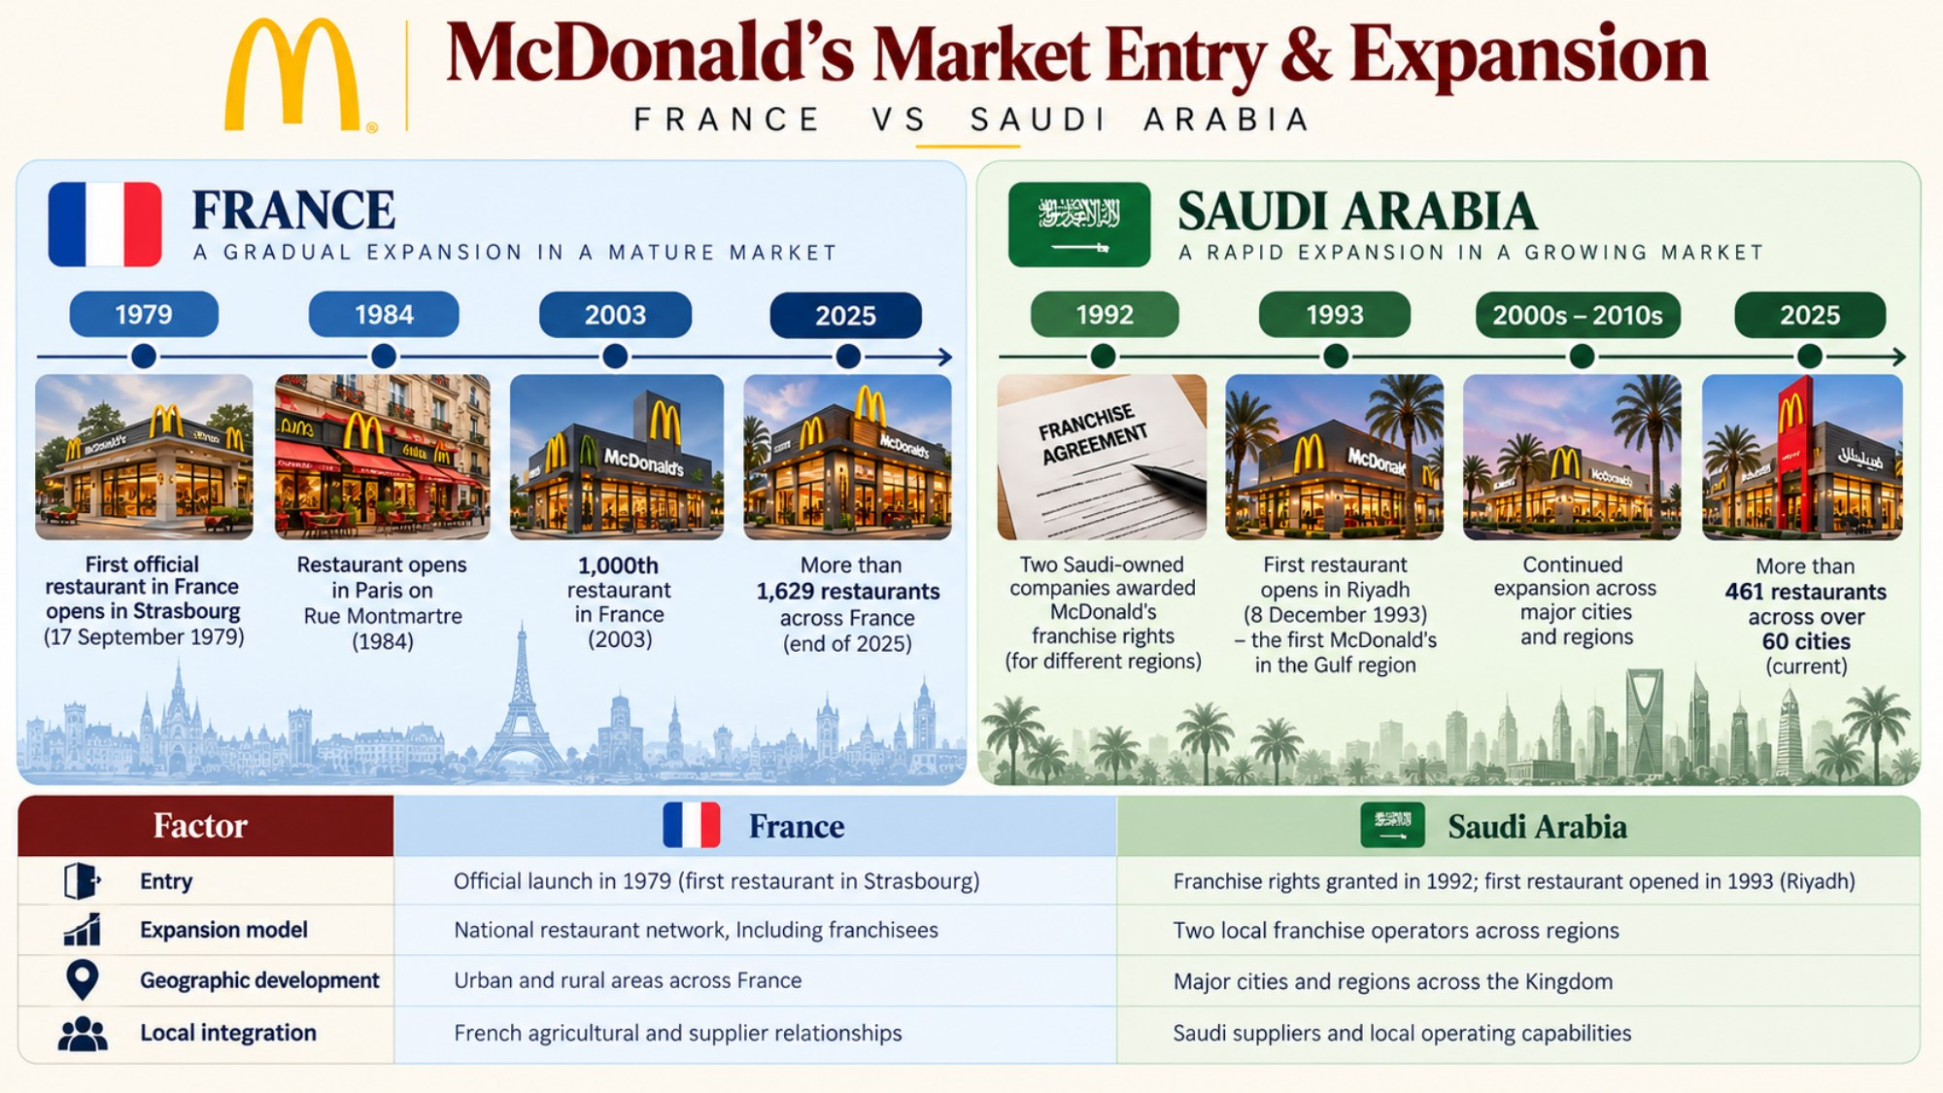
Notes:
France: first official restaurant in Strasbourg in 1979. An earlier franchise opened in Créteil in 1972 under Raymond Dayan and was ended in 1982. Saudi Arabia: franchise rights granted to two Saudi companies in 1992; first restaurant opened in Riyadh in December 1993. Verify current restaurant counts before presenting.

Slide 7
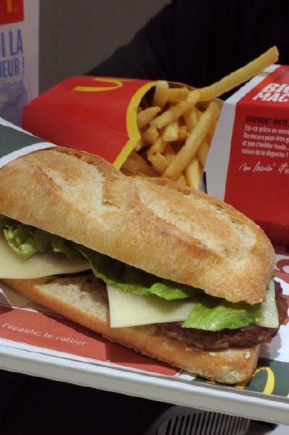
McDonald's Adaptation in France
1. Product adaptation
McBaguette (2012): baguette-style bread and French cheese
McCafé pastries and macarons
2. Local sourcing
Uses French agricultural ingredients
Works with French farmers and suppliers
3. Marketing and customer relevance
Connects with French food culture
Keeps its global brand while adapting the menu locally
Notes:
France needed McDonald's to respect French food culture. The McBaguette, launched in 2012, uses baguette-style bread and French cheese. Local sourcing from French farms supports quality and reputation.

Slide 8
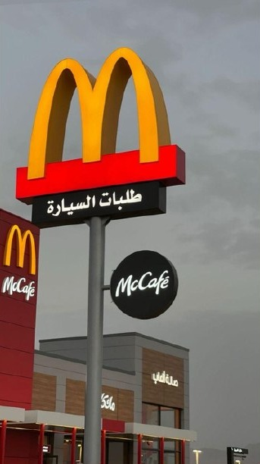
McDonald's Adaptation in Saudi Arabia
1. Halal requirements
Meat and relevant ingredients must meet halal requirements
Approved suppliers and quality controls ensure compliance
2. Supply-chain adaptation
Supplier checks and halal certification support compliance
Sourcing and preparation follow Saudi food rules
3. Local business operations
Operates through local Saudi franchise businesses
Local partners bring knowledge of the Saudi market
Notes:
In Saudi Arabia, adaptation starts with compliance: every meat product must be halal-certified, and suppliers are audited. McDonald's works through local licensed partners who understand the market and its regulations.

Slide 9



Saudi Arabia: Menu and Culture
McArabia
Ramadan
Grilled chicken or kofta in Arabic flatbread
Special menus and late hours for iftar and suhoor
Family dining
No pork
Family seating areas and a strong drive-thru focus
No pork products anywhere in the supply chain
Notes:
Saudi rules on gender-separated seating and closing during prayer times have been relaxed since 2019. Check the current rules and mention the change as an example of adapting to a shifting environment.

Slide 10
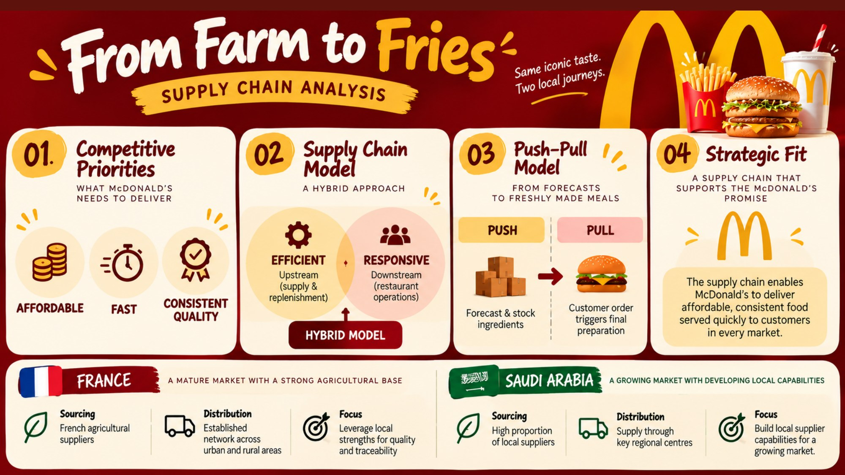
Notes:
Competitive priorities: affordable, fast, consistent quality. A hybrid supply chain: efficient upstream, responsive downstream. Push upstream from forecasts; pull in the restaurant when the customer orders. This fits the McDonald's promise.

Slide 11
Two Countries, Two Supply Chains
Stage | France | Saudi Arabia
Sourcing | Mostly French farms: beef, potatoes, wheat, dairy | Local plus imported; halal-approved suppliers
Key requirement | Traceability and French origin | Halal certification (SFDA rules)
Distribution | Logistics partner serving urban and rural France | Regional centres; long distances need a strong cold chain
Main risk | Farm costs and strict environmental rules | Import dependence and shipping disruption
Focus | Use local strength for quality | Build local suppliers (Vision 2030)
Takeaway: France's supply chain is local and mature; Saudi Arabia's is compliance-driven and still localising.
Notes:
McDonald's does not own its suppliers. It relies on long-term partnerships, Ray Kroc's three-legged stool of franchisees, suppliers and the company. Upstream, both countries push from forecasts; downstream, restaurants pull when a customer orders. France draws on a large farming base, so the focus is quality and traceability. Saudi Arabia must guarantee halal compliance and manage imports, so the focus is certification, cold chain and developing local suppliers. Check the French sourcing percentage in McDonald's France reports.

Slide 12



How McDonald's Makes Money
Rent
 | France | Saudi Arabia
Model | Conventional franchising | Developmental licence
Earns | Rent + royalties + fees | Mainly royalties
Risk | Higher investment, more control | Lower investment, less control
Charges franchisees rent on property it owns or leases
Royalties
A share of franchisee sales (about 4–5%)
Initial fees
One-off fee when a restaurant opens
Company sales
Full revenue from restaurants it runs itself
Royalty rate approximate: verify in the Annual Report.
Notes:
McDonald's is often described as a real-estate company that sells burgers. Rent from owned property gives stable income even when food sales dip. In France it earns rent, royalties and fees; in Saudi Arabia the licensee funds the restaurants, so McDonald's earns mainly royalties with lower risk.

Slide 13
Marketing in Two Markets
Element | France | Saudi Arabia
Positioning | Quality, local sourcing, French ingredients | Family, value, convenience
Language | French; nickname "McDo" | Arabic and English
Key moments | Seasonal menus, McCafé pastries | Ramadan campaigns, national day offers
Digital | App, loyalty rewards, delivery partners | App, delivery apps (HungerStation, Jahez)
Challenge | Anti-globalisation feeling (1999 Millau protest) | Fast-growing QSR competition
Notes:
France needed McDonald's to prove it respects French food culture, so marketing stresses farmers and ingredients. In Saudi Arabia the message centres on families, value and religious and cultural occasions.

Slide 14




Operations: The McDonald's System
Standard kitchen workflow
Training
"Made for You" assembles food when ordered, with fixed cooking times
Hamburger University and local training; same service standards worldwide
Quality and food safety
Local rules
Strict supplier audits; halal certification in Saudi Arabia
France: reusable dine-in tableware (2023). Saudi Arabia: Saudization hiring quotas
Notes:
The system is the same everywhere; what changes is the local rules it has to follow. France's anti-waste law requires reusable tableware for dine-in. Saudi Arabia's Saudization rules set local hiring quotas.

Slide 15

The Final Bite
1
One global system
Same brand, standards and core menu everywhere
2
Two entry models
Franchising in mature France; licensed partners in fast-growing Saudi Arabia
3
Local adaptation
French ingredients and culture; halal, family dining and Ramadan
4
Supply chain makes it work
Efficient push upstream, responsive pull in the restaurant
Same Golden Arches, different recipes for success.
Notes:
McDonald's success abroad comes from balancing global integration with local responsiveness, the transnational strategy from earlier. France and Saudi Arabia show that balance in two very different settings. The brand stays the same; ownership, menu and sourcing change to fit each market. Thank you. We're happy to take questions.

Slide 16
References
McDonald's Corporation, Annual Report / Form 10-K (latest year)
McDonald's Corporation, Our Purpose & Impact (corporate.mcdonalds.com)
McDonald's France, corporate site and impact reports (mcdonalds.fr)
McDonald's Saudi Arabia, licensee corporate sites (mcdonalds.com.sa)
Saudi Food and Drug Authority (SFDA), halal requirements (sfda.gov.sa)
French Ministry of Ecological Transition, AGEC anti-waste law
Chopra, S. and Meindl, P., Supply Chain Management: Strategy, Planning, and Operation, Pearson
Bartlett, C. and Ghoshal, S., Managing Across Borders
Porter, M., Competitive Strategy
Notes:
Format references in the course's required style (e.g. Harvard or APA) after checking each source.

