Slide 1


Slide 2

The Ultimate Guide to Git & GitHub
Get ready to learn everything you need to know about the world's most popular version control platform: GitHub!

Slide 3

Introduction to Version Control
1
History
2
Benefits
Learn about the evolution of version control and the role it plays in modern software development.
Discover how version control can help you manage your code, collaborate with others, and improve your development process.
3
3
Key Concepts
Key Concepts
Understand important version control concepts like repositories, commits, branches, and pull requests.

Slide 4

What is Git?
created by Linus Torvalds in April 2005
a command line distributed version control system
cross-platform
open-source and free!!!

Slide 5
Installing/learning Git
Git Installation: http://git-scm.com/
Git Hub : https://github.com/

Slide 6
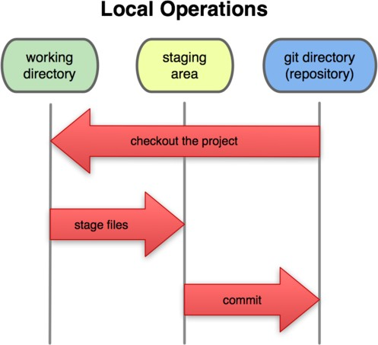
Local git areas
Unmodified/modified Files
Staged Files
Committed Files

Slide 7
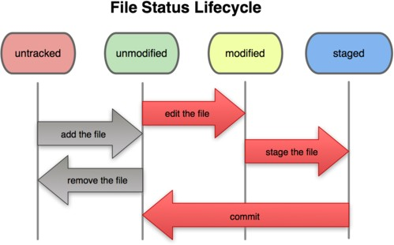
Basic Git workflow

Slide 8
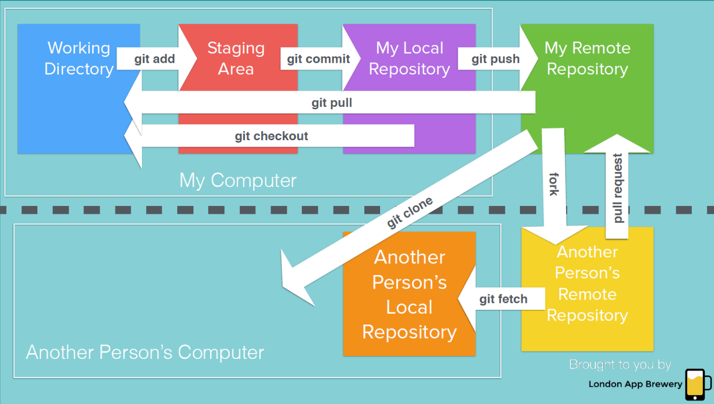
Git snapshots

Slide 9
Basic Command of Linux
cd – change the directory
ls – lists files and directories
mkdir - create a folder or directory
touch – create a file
rmdir – remove a directory

Slide 10
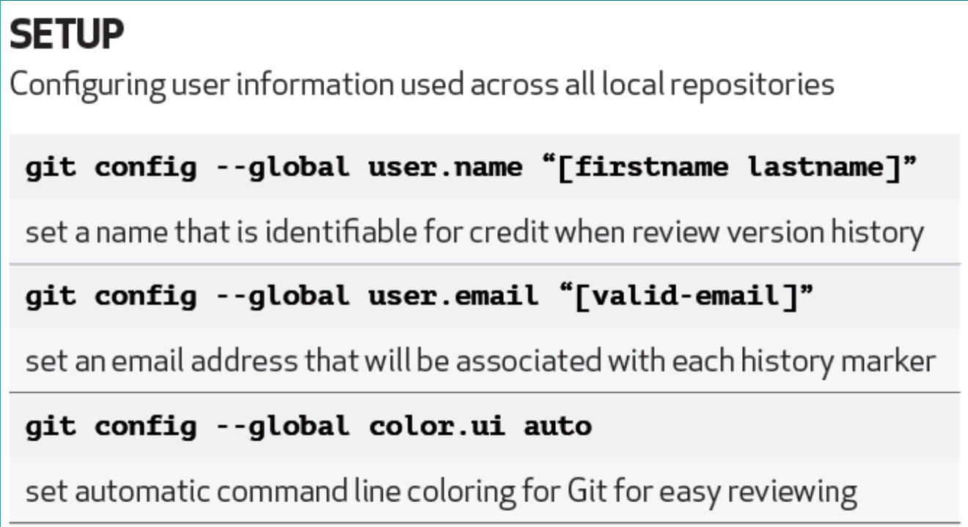
Time to work with Git

Slide 11
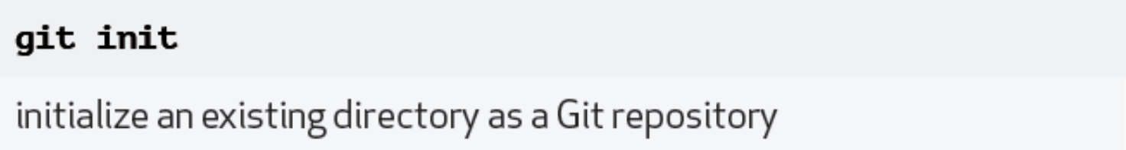
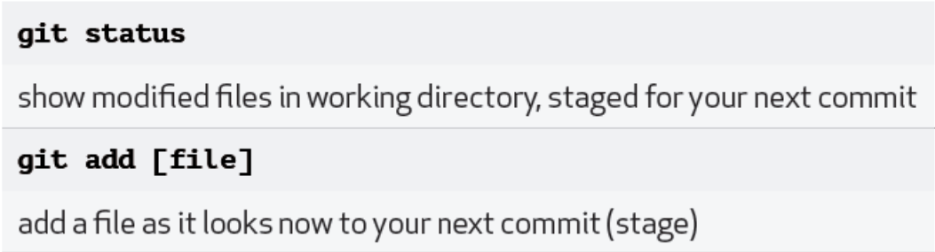
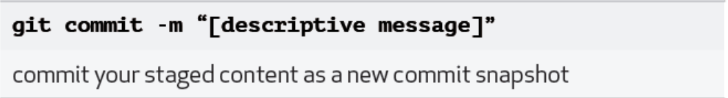

Slide 12
It’s an Assignment 😢
1)Make one Repository by your ID number and upload any five codes of your Practicle List on GitHub.
Note:-“You have to attach a screen short in which your ID and your 5 files are visible ”.

Slide 13
Branching
1
What Are Branches?
Learn about the concept of branches and how they can help you manage your code.
Creating a New Branch
2
Create a new branch for your project using the command-line or the GitHub web interface.
3
Making Changes in a Branch
Make changes to your project in the new branch and commit your changes.

Slide 14
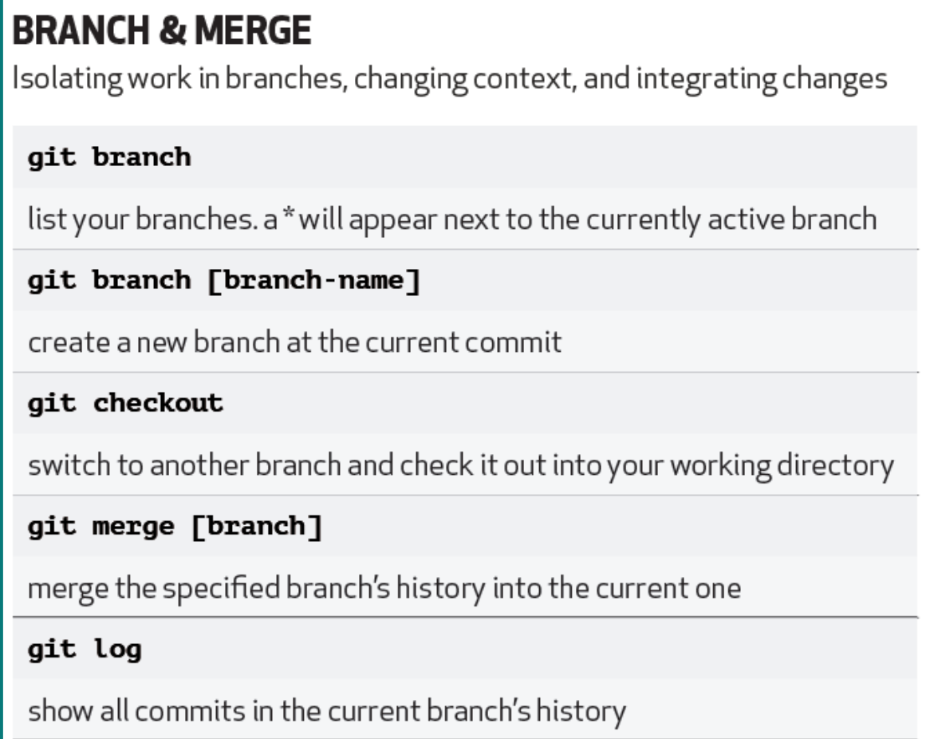

Slide 15
Cloning a Repository
1
Step 1: Find the Repository
Find the repository you want to clone on GitHub.
Step 2: Copy the Clone URL
2
Copy the repository's clone URL to your clipboard.
3
Step 3: Clone the Repository
Use Git to clone the repository to your local machine.

Slide 16
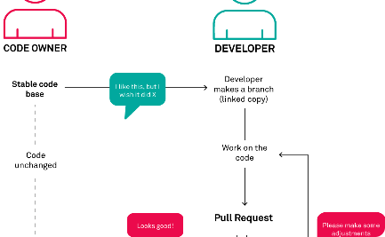
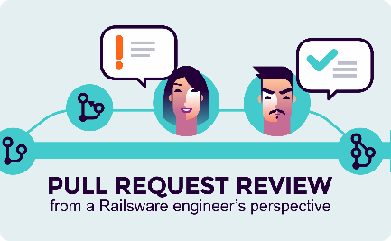
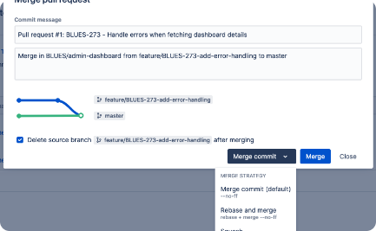
Pull Requests
Step 1: Create a Pull Request
Step 2: Review Changes
Step 3: Merge the Changes
Create a pull request on GitHub to merge your changes into the main branch.
Review the changes made in your pull request and provide feedback to the author.
Merge the changes from the pull request into the main branch.

Slide 17

Collaborating with Others
1
Invite Collaborators
2
Work on a Shared Repository
3
Code Review
Invite others to collaborate on your code by adding them as collaborators to your repository.
Review each other's changes and provide feedback for continuous improvement.
Learn how to work on a shared repository with other collaborators, resolving merge conflicts and pull requests.

Slide 18
Let’s do another Assignment🫡
make a repository named BranchTutorial. You have to make 3 different branches other than the master named Ramesh, Suresh, and Mahesh. You have to make 3 empty text files named rameshFile,sureshFile, and maheshFile and commit these files in respected branches like rameshFile in Ramesh Brach. Then you merge only the Ramesh branch with the master branch.
Note :-“You have to attach the screen short of git log output after creating each branch and the screen short of git log output after merging branch”.

Slide 19
THANK YOU …

