Slide 1
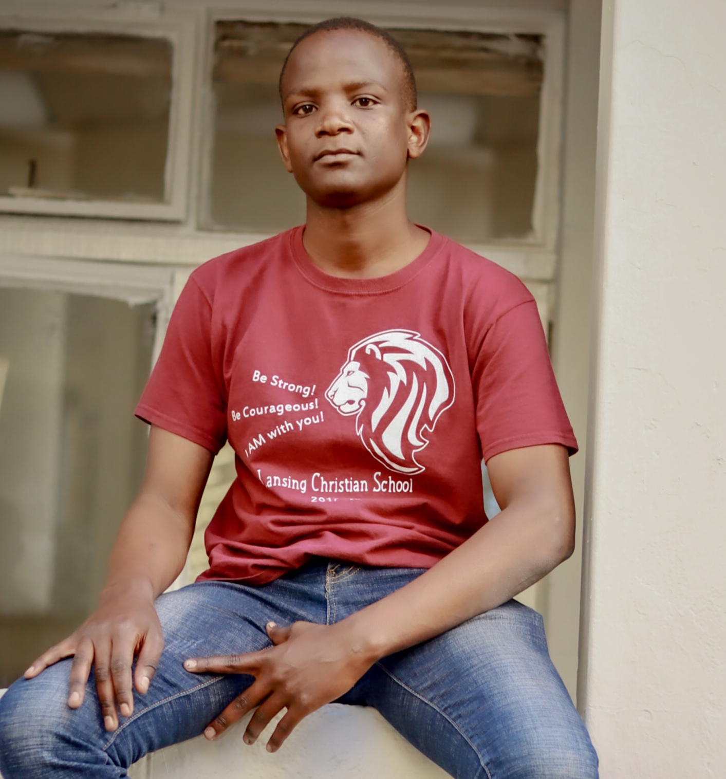
Meet the
Speaker.
George Odero
BTech Geoinformation Technology.
Technical University of Kenya.
Machine Learning Engineer. Geospatial Data Scientist. Geospatial Analyst
FOLLOW ODERO ON
LINKEDIN
linkedin.com/in/oderogeorge
EMAIL
oderobtechgeo@gmail.com
oderogeorge308@gmail.com
PHONE
0790749497

Slide 2
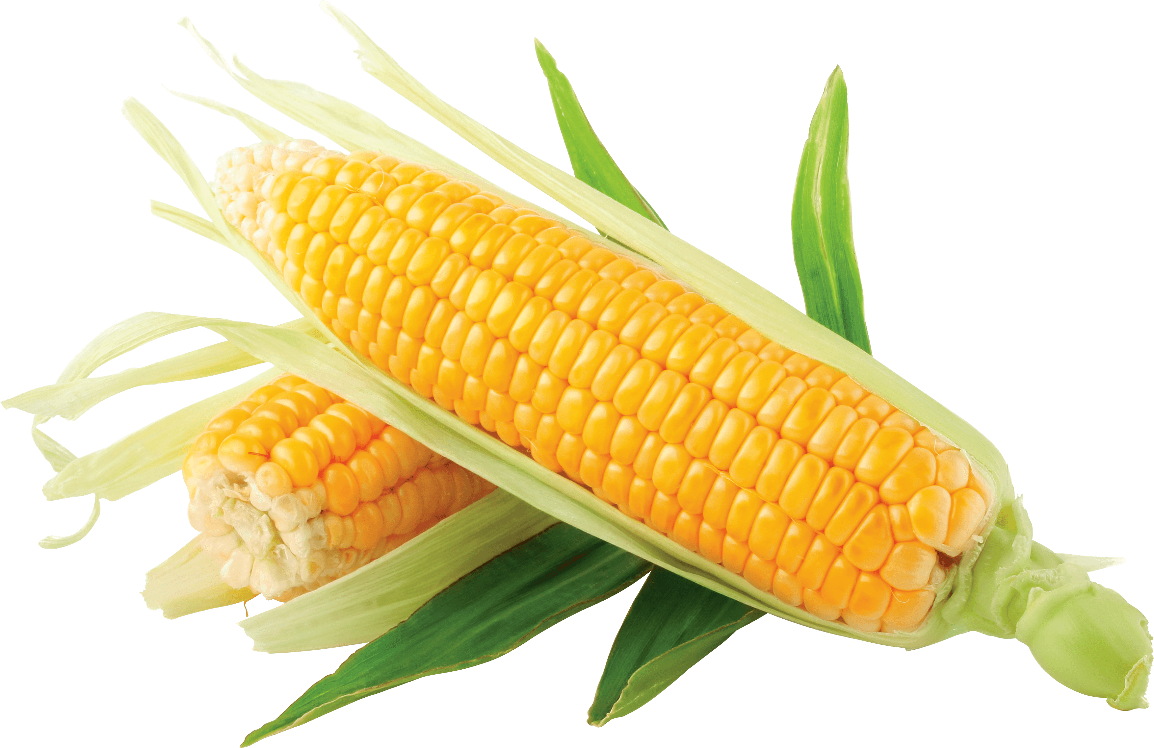
Spatiotemporal Visualization of Corn Yield In Georgia State, U.S.A

Slide 3
INTRODUCTION
Food insecurity is a major problem in our country today thus as GIS experts we need to study this into details since it will help in addressing SDG number 2, hunger in order to achieve vision 2030.
This can be achieved by spatiotemporal visualization of corn yield production through the use of open source python programming languages to create an interactive web map.
Due to lack of data availability in Kenya, I chose to work with data from United States Department of Agriculture (USDA) in order to study corn yield trends in a decade span of time. Similar implementation can be applied in Kenya if there can be enough data to be accessed.

Slide 4
OBJECTIVES
Main objective of this project, was to geographically study yield production of corn in each county of Georgia state, in a span of 10 years (spatiotemporal mapping) using open source python packages, to generate an interactive web map, so that, when a user click a polygon he/she is able to view a trendline of corn yield in each county of Georgia.

Slide 5
METHODOLOGIES
Data Collection
Data was downloaded from non commercial website sources, for example https://quickstats.nass.usda.gov https://quickstats.nass.usda.gov
Processing entails wrangling, cleaning and manipulation of messy data using python pandas library. Microsoft Excel can also achieve that for non programmers.
Data was analyst using python numpy library. Slopes(change in value of corn per unit time) were computed in each county of Georgia state
Then I generated trendlines in each county of Georgia using python matplotlib library. An interactive WEBMAP was also generated inline with Choropleth map using python folium library to study geographic distribution of corn yield value in each county of Georgia
Finally, I published my map in a Github live server so that users can interact with it anytime they go online.
Codes are available in my Github repository. odero54@github.com
Processing
Analysis
Visualization
Publication

Slide 6
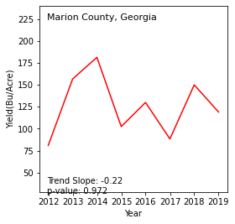
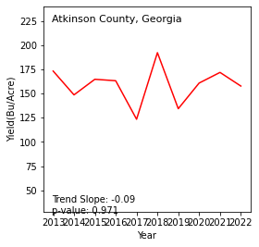
RESULT DEMO

Slide 7
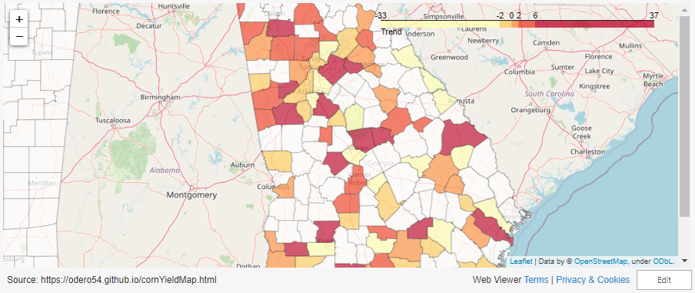
RESULT DEMO CONT…

Slide 8
References
https://odero54.github.io/cornYieldMap.html
https://gadm.org/download_country.html
https://www.census.gov/cgi-bin/geo/shapefiles/index.php
https://quickstats.nass.usda.gov

Slide 9
THANK YOU!!!

