Slide 1


Slide 2
HIGH-FI PROTOTYPE Milestone
GABE / KAT / LEIGH / ODETTE

Slide 3
WHAT IS WONDERLUST?
LEARN IN YOUR SPARE TIME
“KILL TIME, NOT THE CAT”

Slide 4
Problem and Solution
Problem:
When people are waiting, they usually bored with Facebook, Twitter, Email…
Solution:
A mobile application that gathers knowledge, organize the information that interests the user
Notes:
The problem is that people usually waste time when they wait for a bus, wait in a line, or wait for somebody else. We do not want people to waste time, we want people to learn something when they have a short period of time
The solution is we are going to build an mobile application which gathers knowledy, organize the information that interests the user

Slide 5
OVERVIEW
Heuristic Evaluation Results
Overview of Revised Design
Prototype Implementation Status
Demo
Notes:
Here is what I am going to talk about today. I am going to talk about our heuristic evaluation results together with our revised design. Then I am going to talk about the prototype implementation status, and then I am going to do the demo

Slide 6
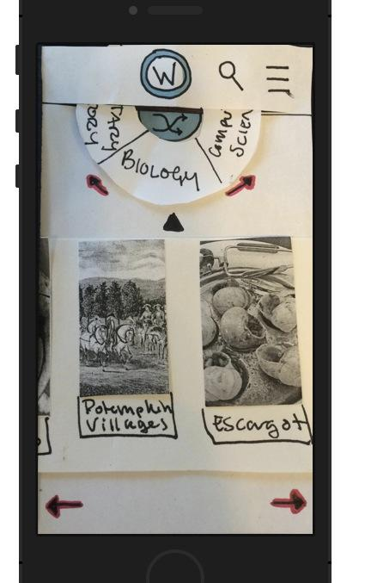
Heuristic Evaluation
Violated: Consistency and Standards
Description: search button is not consistent (searches for different things)
Notes:
In the previous prototype, we have a search button on top of the page. And in each page, the search button search button have different functionality. On the home page, it is for search an article, on the favorite it is for search a saved article, and on the category page, it is for search a category

Slide 7
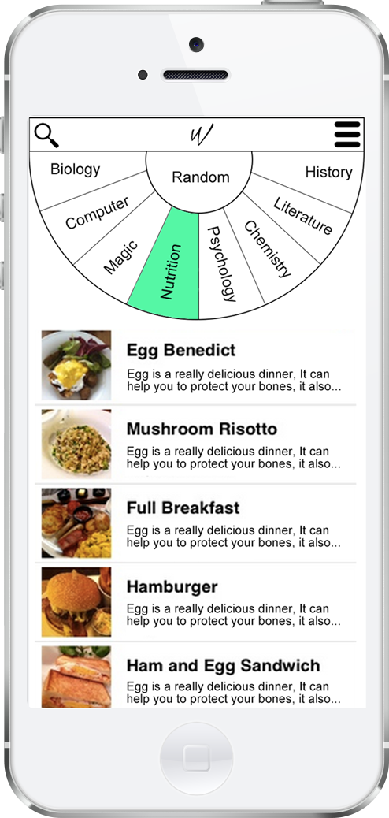
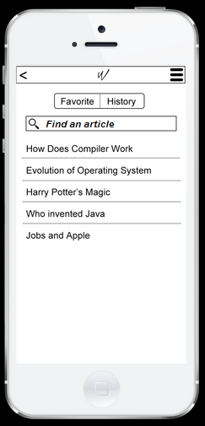
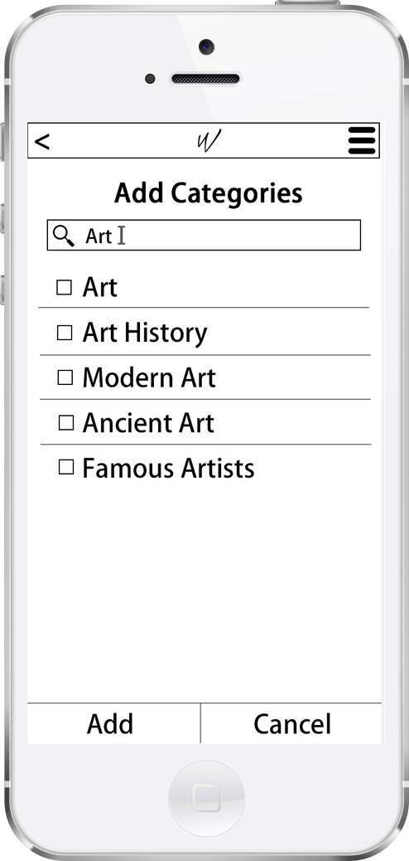
Heuristic Evaluation
Solution:
Home screen’s search is for global article
Search bar in Favorite/History for specific content
Moved search for new category to the ‘Add category’ page
Notes:
Our solution is that, we have different search button on different page. on the home page, and this button is for search a global article. on Favorite/history page, we also have a search bar, this is for search a saved article. And on Add categories, the search bar is for search a new category. This will not confused user because it is obvious to see the function of the search on different page

Slide 8
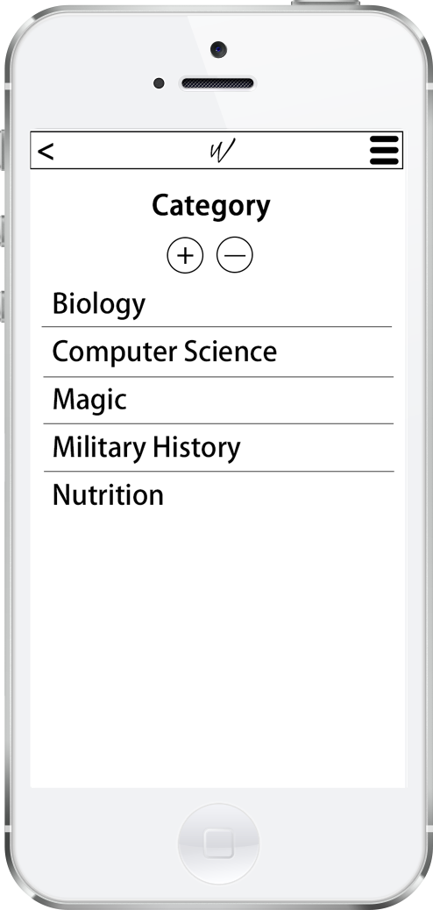
Heuristic Evaluation
Violated: User Control and Freedom
Description: cannot remove categories
Solution:
Added ‘Remove category’ button to the category page
Notes:
In the previous design, we do not have the remove category function, and in this design, we add the remove category button on the category page. If the user click the minus sign, there will be remove category button on the side. and the user can click to remove specific category.

Slide 9
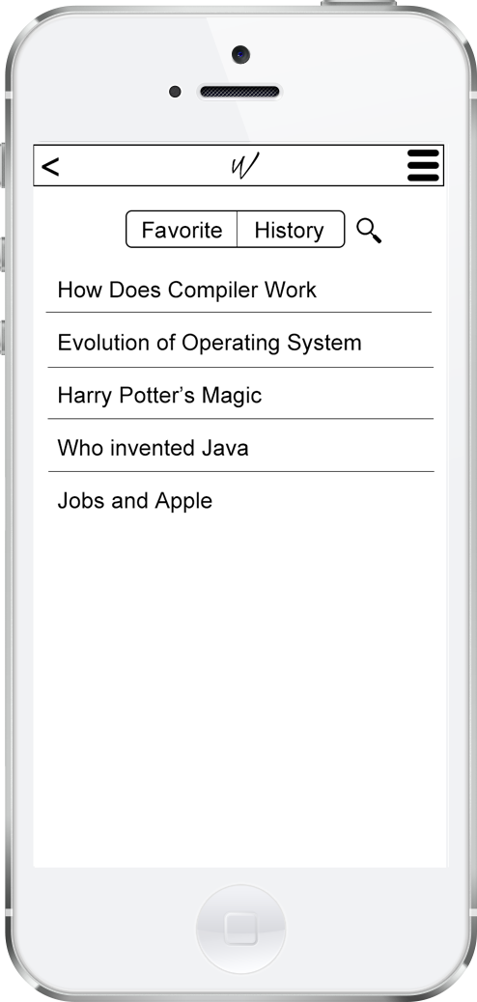
Heuristic Evaluation
Violated: Aesthetic and Minimalist Design
Description: duplicated history and favorite screen
Solution:
combine history and favorite into one screen
Notes:
We had a very similar history and favorite page which may confuse the user. So we combine the history and favorite into one screen and use a segment control to switch between the history and favorite

Slide 10
Heuristic Evaluation
Violated: Flexibility & Efficiency of Use
Description: can only see three categories at a time
Solution:
make the radius of the wheel larger so see more categories
Notes:
In the previous design, the wheel is so small so that it can only show three categories which will make the user to scroll a lot in order to get to the categories they want to look at. In our revised design, we increase the radius of the wheel so that the user can see eight different category at a time. And in the previous design, people can only see two different articles, whcih makes them to swipe to get to the article they like. Thus, in this revised design, change the orientation of the article so that it can show 5 articles at a time

Slide 11
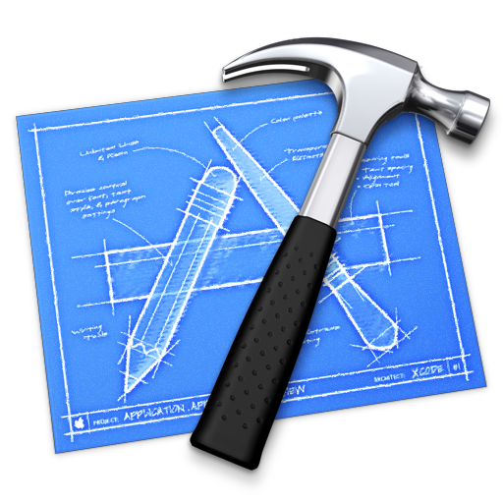
Prototype Implementation Status
Platform:
ios
Tools：
Xcode and Objective-C
Uses UI Table View Controller to display categories, and articles
Notes:
Now, lets talk about the prototype implementation status. We are going to build an ios application using the Xcode and objectinve C. We mainly uses the UI table view controller to display categories and articles

Slide 12
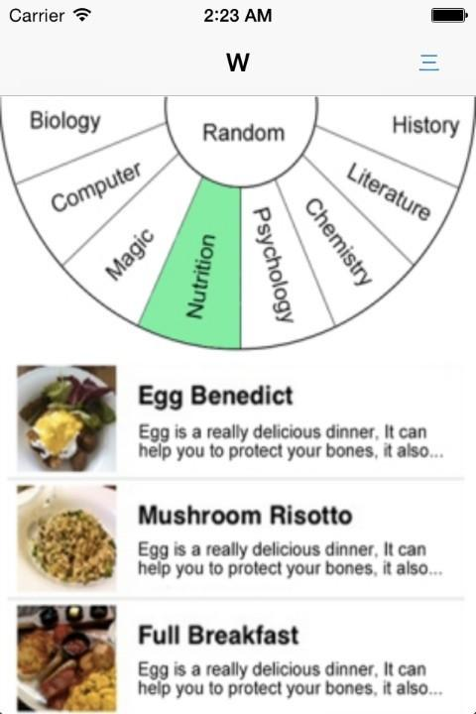
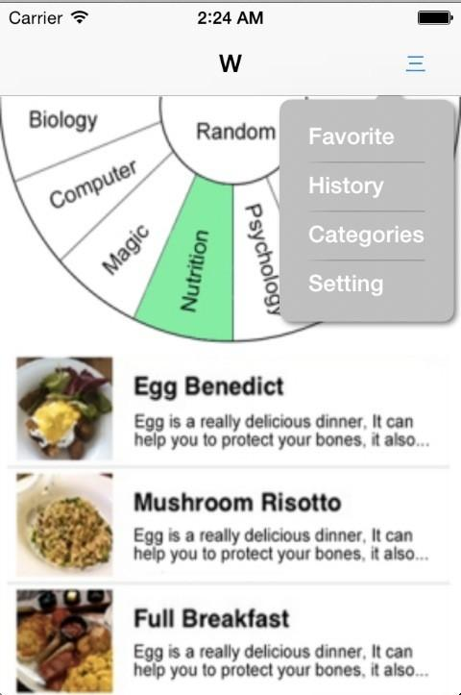
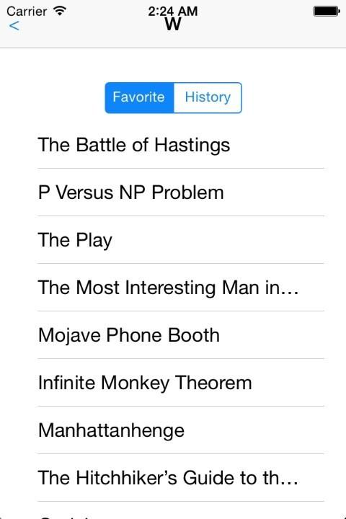
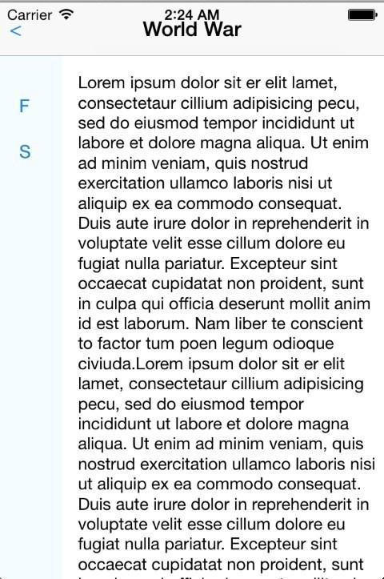
Prototype Implementation Status
Retrieve Article
Notes:
Here is the one task we have implemented so far. which is retrieve an saved article. On the home page, if you click the menu, it will popup a submenu. And you can click the favite tab to go the favorite page. On the favorite there is a list of your saved articles. If you click the title of the articles, you can get to the article

Slide 13
Unimplemented Features
Main Page: show article images, and allow swipe
Add Category: add prepared categories
Save to favorite: use an array to save
Search: search prepared content
Notes:
Here is a list of our un implemented feature. We need to implement the main page which contains the wheel to select the categories. And we need to implement the add category and save to favorite function. And finally we need to implement the three search function

Slide 14
Plan
Leigh:
Wheel
Transition of pages using segues
Navigation bar
Kat:
Hard code the articles and categories into a dictionary
Implement three search functions
Odette:
Articles Table on Home Page and Favorite Page
Category Table on Category and Add Category Page
Buttons on all pages
Segmented Control on Favorite and History Page
Search Bar
Notes:
Here is our plan to implement the prototype. Leigh is going to implement the wheel and the transition of the page using segues, and navagation bar. Kat is going to hard code the carticles and categories into a dictionary. And she is going to implement the three search functions. Odette is going to focus on the articles table and category table, and the segmented control on the favorite and history page. And the search bar

Slide 15
Timeline
By Friday, 11/28:
Finish the basic structure so that we can work together
By Tuesday, 12/02:
Finish all the functionality
By Friday, 12/05:
Finish all the missing detail
Notes:
In order to make sure we finish the project on time, we setup three deadline. by The First deadline, we are going to finish all the interface so that we can corporate with each other. By the second deadline, we are going to finish implement the function. And if we still have any missing detail, we are going to finish it by the final deadline
By Friday, 11/28:
Kat will hard-code the articles and categories, Leigh will finish the wheel, Odette will setup all the buttons and tables
By Tuesday, 12/02:
Kat will finish the three search functions, Leigh will finish the page transition and navigation, Odette will finish the table demonstration
By Friday, 12/05:
Finish all the missing detail

Slide 16
Hard-coded Data
Hardcode article title, image and content in an article dictionary
Nest articles into a category dictionary
Favorites and History will only exists in memory
Notes:
Here is what we need to hard code. We are going to put the article title, image, and the content into an NS dictionary. And we are going to put the article into the category dictionary. And we are not going to touch the file system or the core data. We just going to save the favorites and history in memory.

Slide 17
Issues and Questions
How to implement the wheel: how to make the texts rotate to a direction that is user is comfortable with it
How to make a uniform header
Notes:
Here are the two questions we have so far, one is how to implement wheel. We need to rotate the text on the wheel into a direction so that it will fit the area and the user can see it comfortablely. The second question is how to make a uniform header so that we do not need to copy the header many times

Slide 18
Demo

Slide 19
THANK YOU!

