Slide 1


Slide 2
LO-FI PROTOTYPE
GABE / KAT / LEIGH / ODETTE

Slide 3
OVERVIEW

Slide 4
OVERVIEW
MISSION STATEMENT
TASKS
PROTOTYPE
METHOD
RESULTS

Slide 5
OVERVIEW
MISSION STATEMENT
TASKS
PROTOTYPE
METHOD
RESULTS

Slide 6
OVERVIEW
MISSION STATEMENT
TASKS
PROTOTYPE
METHOD
RESULTS

Slide 7
OVERVIEW
MISSION STATEMENT
TASKS
PROTOTYPE
METHOD
RESULTS

Slide 8
OVERVIEW
MISSION STATEMENT
TASKS
PROTOTYPE
METHOD
RESULTS
CHANGES

Slide 9
MISSION STATEMENT

Slide 10
MISSION STATEMENT
To harness,
enable,
and reward
our impulse
to learn about the world
during snatches of
otherwise wasted time.

Slide 11
MISSION STATEMENT
To harness,
enable,
and reward
our impulse
to learn about the world
during snatches of
otherwise wasted time.

Slide 12
MISSION STATEMENT
To harness,
enable,
and reward
our impulse
to learn about the world
during snatches of
otherwise wasted time.

Slide 13
REPRESENTATIVE TASKS

Slide 14

REPRESENTATIVE TASKS
BROWSE

Slide 15

REPRESENTATIVE TASKS
BROWSE
RETRIEVE

Slide 16

REPRESENTATIVE TASKS
BROWSE
RETRIEVE
DISCOVER

Slide 17
PROTOTYPE

Slide 18
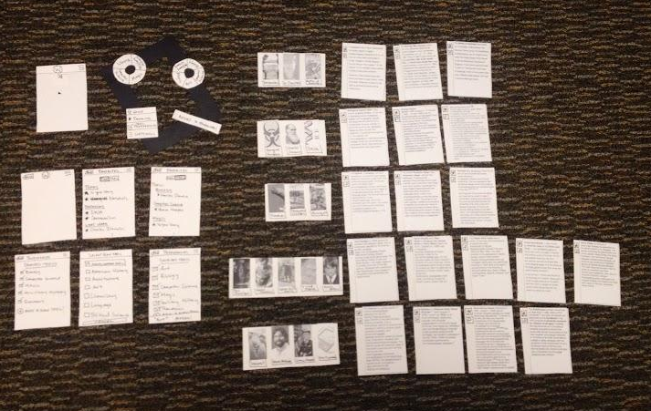
PROTOTYPE

Slide 19
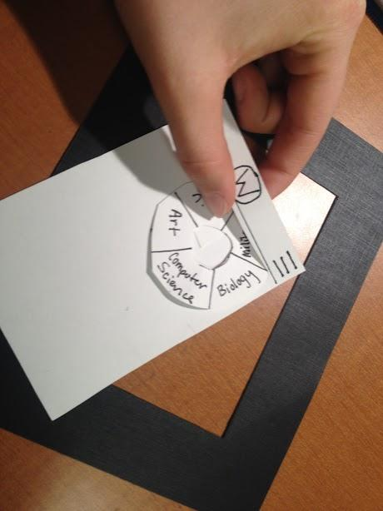
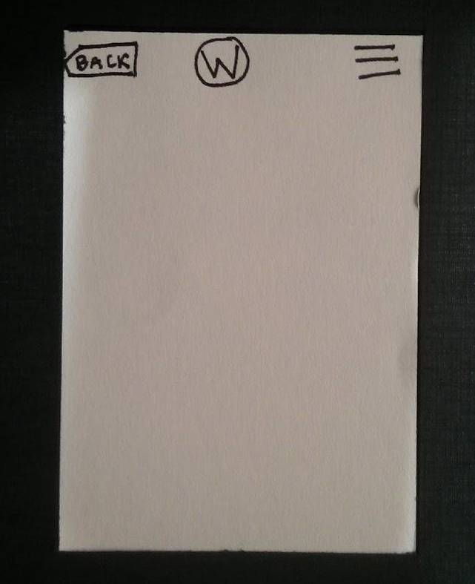
PROTOTYPE

Slide 20
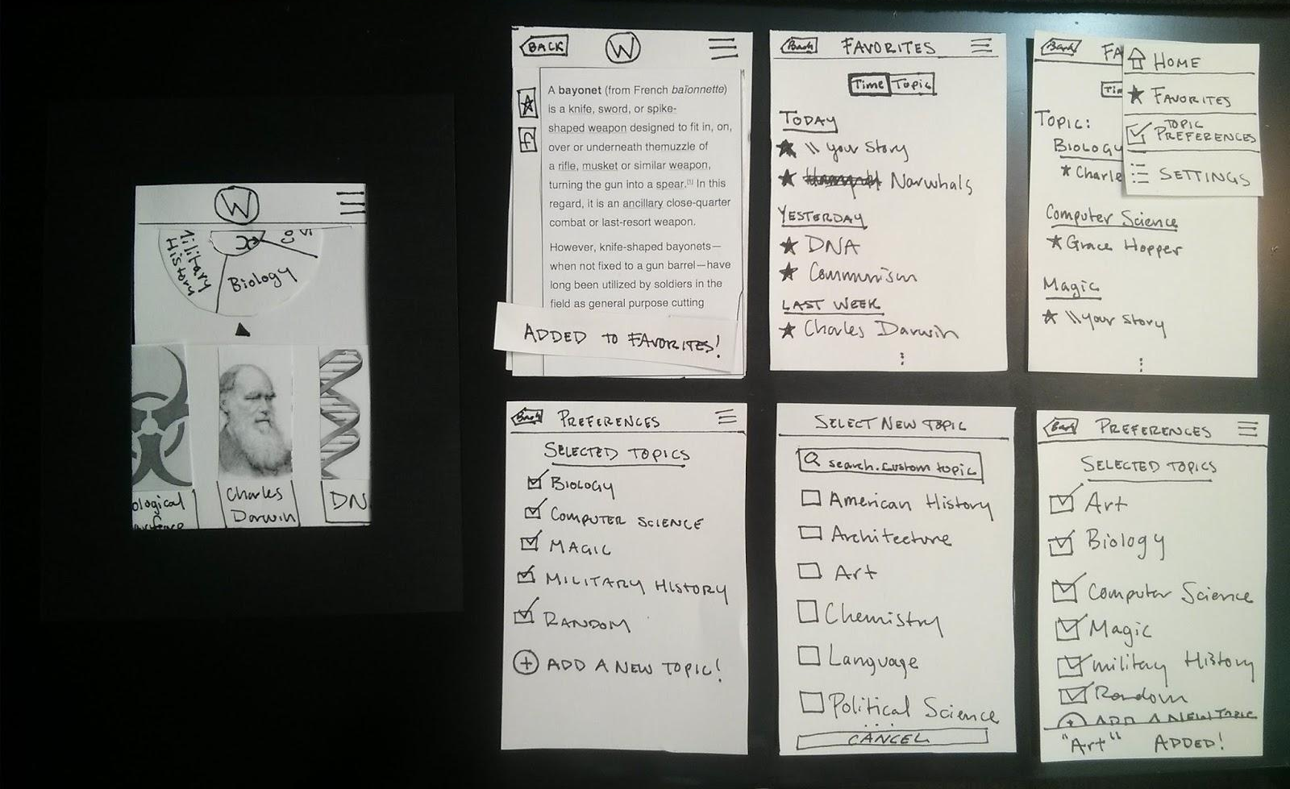
PROTOTYPE

Slide 21
BROWSE

Slide 22
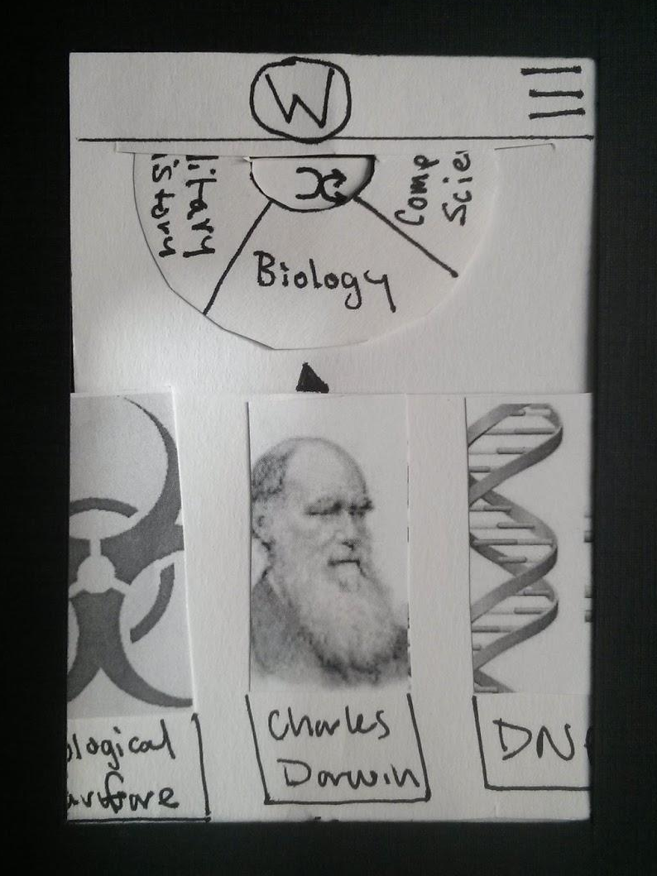
BROWSE

Slide 23
BROWSE

Slide 24
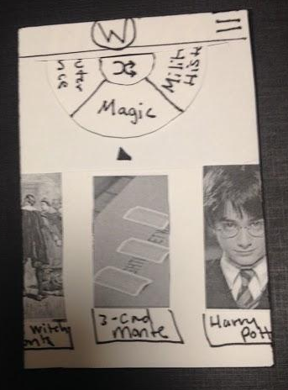
BROWSE

Slide 25
BROWSE

Slide 26
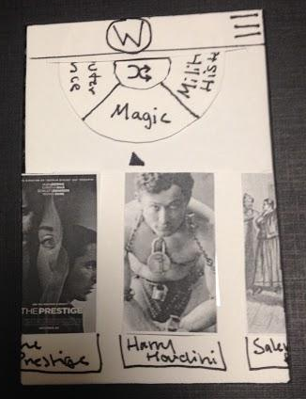
BROWSE

Slide 27
BROWSE

Slide 28
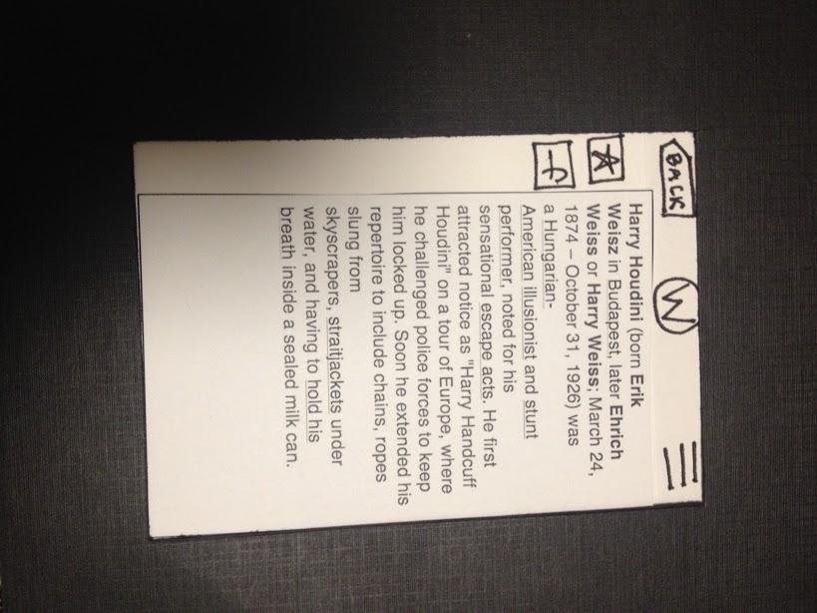
BROWSE

Slide 29
BROWSE

Slide 30
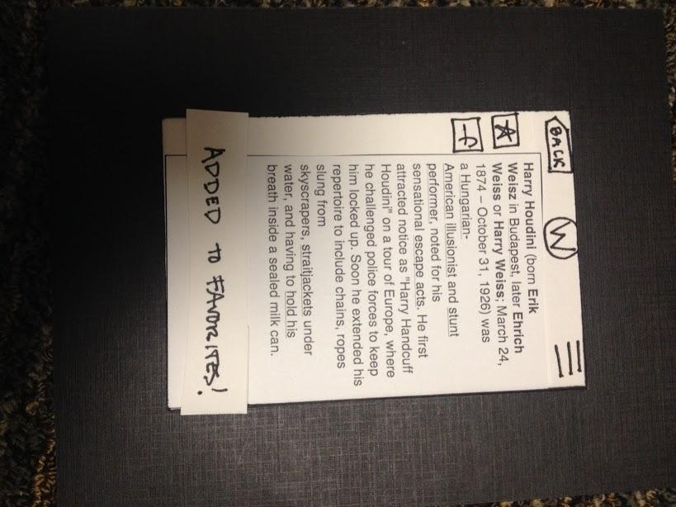
BROWSE

Slide 31
RETRIEVE

Slide 32
RETRIEVE

Slide 33
RETRIEVE

Slide 34
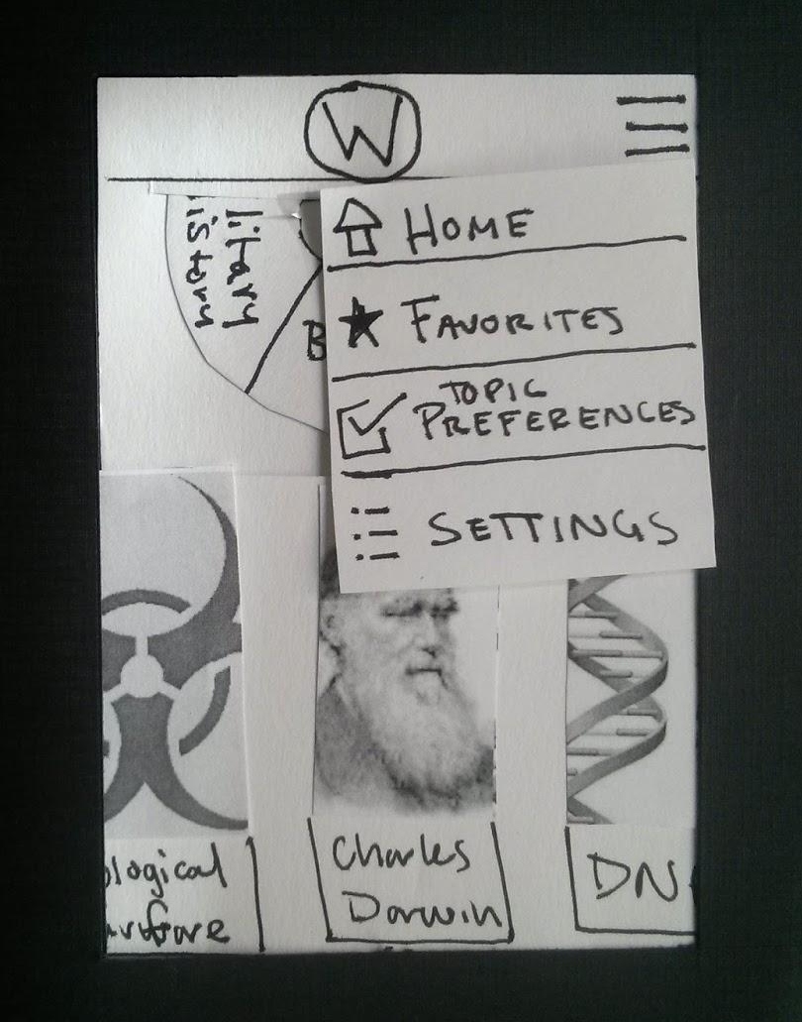
RETRIEVE

Slide 35
RETRIEVE

Slide 36
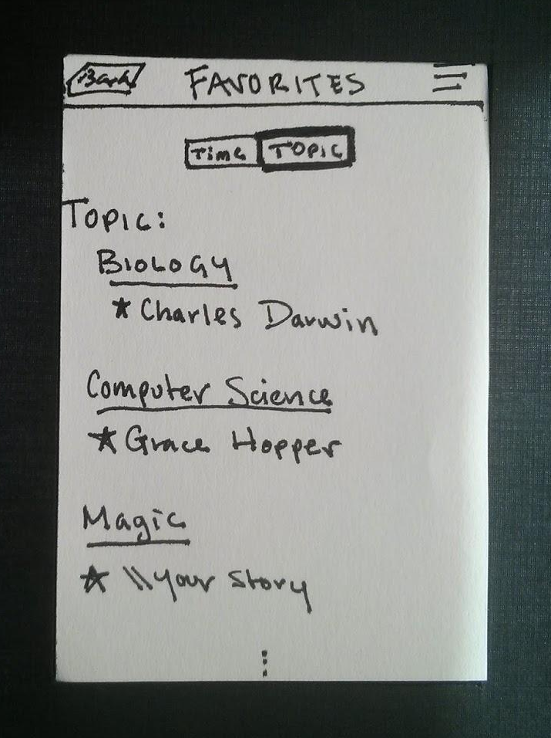
RETRIEVE

Slide 37
RETRIEVE

Slide 38
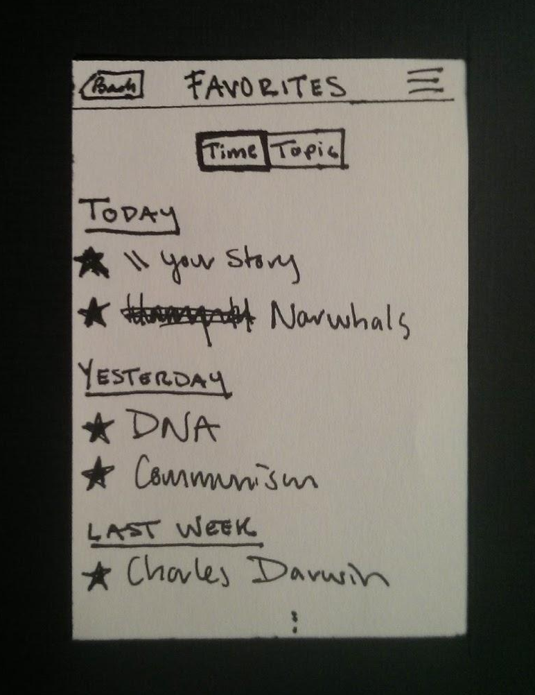
RETRIEVE

Slide 39
DISCOVER

Slide 40
DISCOVER

Slide 41
DISCOVER

Slide 42
DISCOVER

Slide 43
DISCOVER

Slide 44
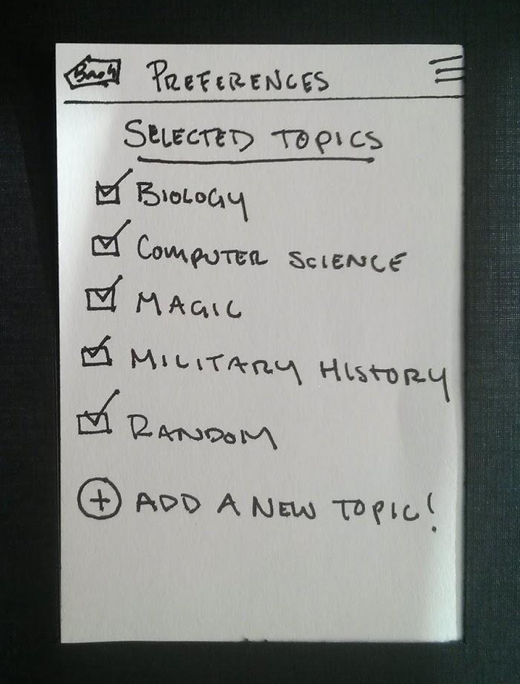
DISCOVER

Slide 45
DISCOVER

Slide 46
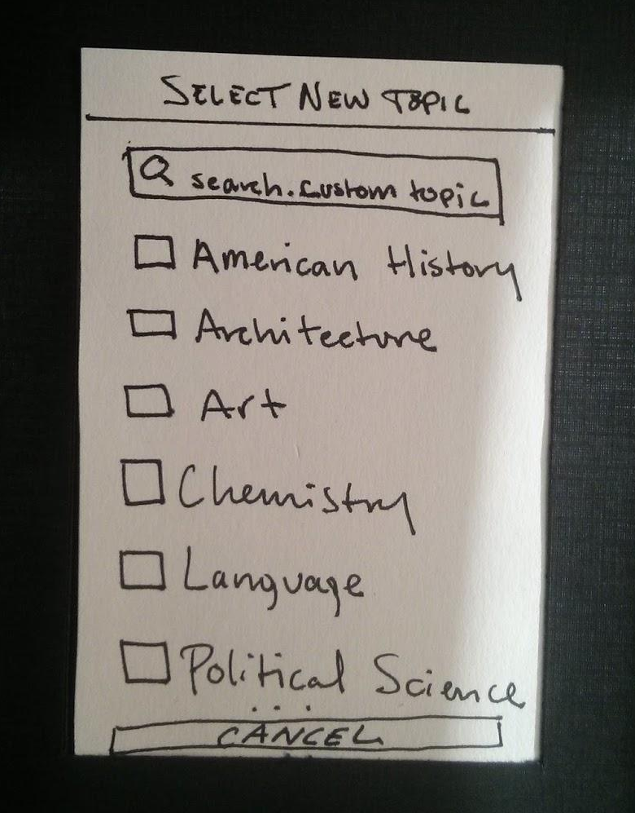
DISCOVER

Slide 47
DISCOVER

Slide 48
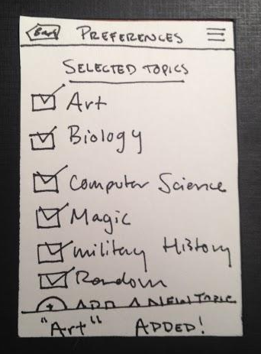
DISCOVER

Slide 49
METHOD

Slide 50
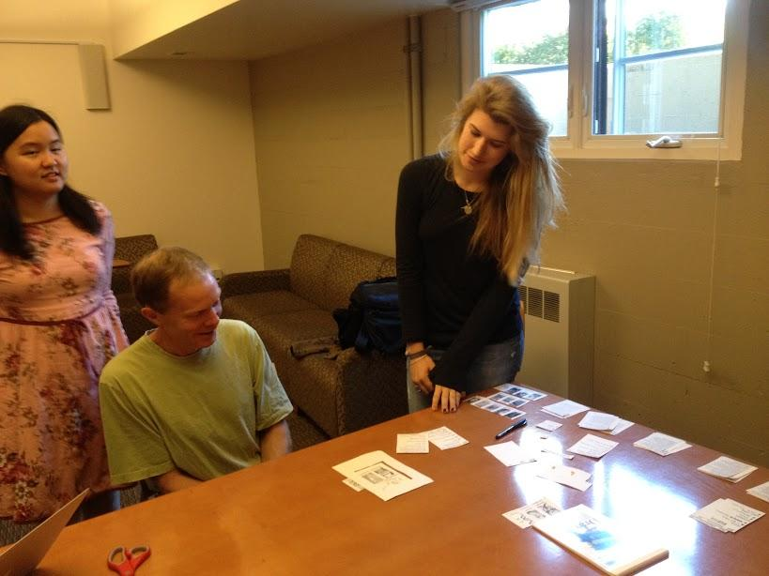
METHOD

Slide 51
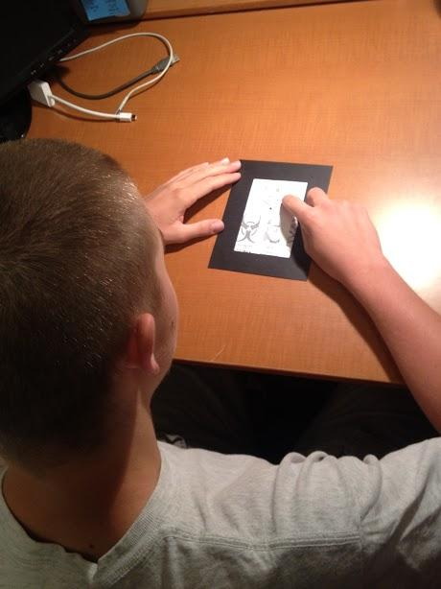
METHOD

Slide 52
RESULTS: Δ

Slide 53
RESULTS: Δ
Topic Preferences
Permanence
Navigation Out
Search Bar
Wikipedia
W Logo
Wheel w/ many topics

Slide 54
RESULTS: Δ
Topic Preferences
Impermanence→ Search Bar
Navigation Out
Search Bar
Wikipedia
W Logo
Wheel w/ many topics

Slide 55
RESULTS: Δ
Topic Preferences
Impermanence→ Search Bar
Navigation Out
Search Bar
Wikipedia
W Logo
Wheel w/ many topics

Slide 56
RESULTS: Δ
Topic Preferences
Impermanence→ Search Bar
Navigation Out
Wikipedia
W Logo
Wheel w/ many topics

Slide 57
RESULTS: Δ
Topic Preferences
Impermanence→ Search Bar
Navigation Out
Wikipedia
W Logo
Wheel w/ many topics

Slide 58
RESULTS: Δ
Topic Preferences
Impermanence→ Search Bar
Navigation Out
Wikipedia
W Logo
Wheel w/ many topics

Slide 59
RESULTS: +

Slide 60
RESULTS: +
Intuitive
Uncluttered
Wheel
Shuffle

Slide 61
RESULTS: +
Intuitive
Uncluttered
Wheel
Shuffle

Slide 62
RESULTS: +
Intuitive
Uncluttered
Wheel
Shuffle

Slide 63
RESULTS: +
Intuitive
Uncluttered
Wheel
Shuffle

Slide 66


Slide 67


Slide 68


