Slide 1
Master Thesis
Progress Report
Bashir ud Din
Computer Simulation Student

Slide 2
Rivet Data Acquisition
Modified the Rivet Technique to read the
particles' Momentum,Energy,Mass and ID for the all the datasets in the directory.
Managed to run Rivet on cluster.
Output as a text file.

Slide 3
Setting up Python
Converted the text file into a pandas readable so that it could be worked on in python environment involving the following steps:
1)Data cleaning using regex.
2) Experimenting with different file formats
3) Datatype conversion to compress the file
Set up an IntelliJ project including remote interpretor and running notebooks on remote machine.
Set up a version Control.

Slide 4
Exploratory Data Analysis
Data Exploration including
1) Features' Stats
2) Missing Values
3) Features' Density plots
4) Duplicates removal
5) Normalization/Standardization

Slide 5
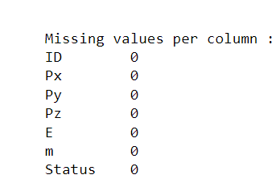
Exploratory Data Analysis
Missing Values per Column

Slide 6
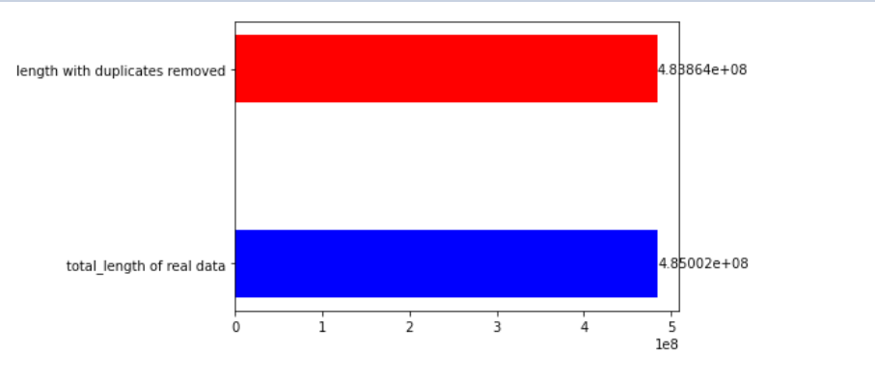
Exploratory Data Analysis
Duplicates removed

Slide 7
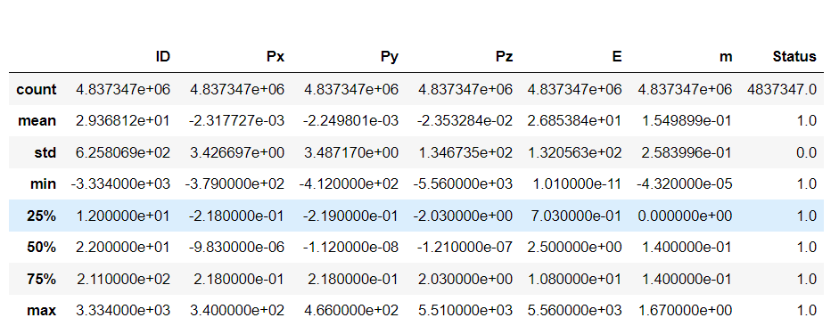
Exploratory Data Analysis
Features basic Stats

Slide 8
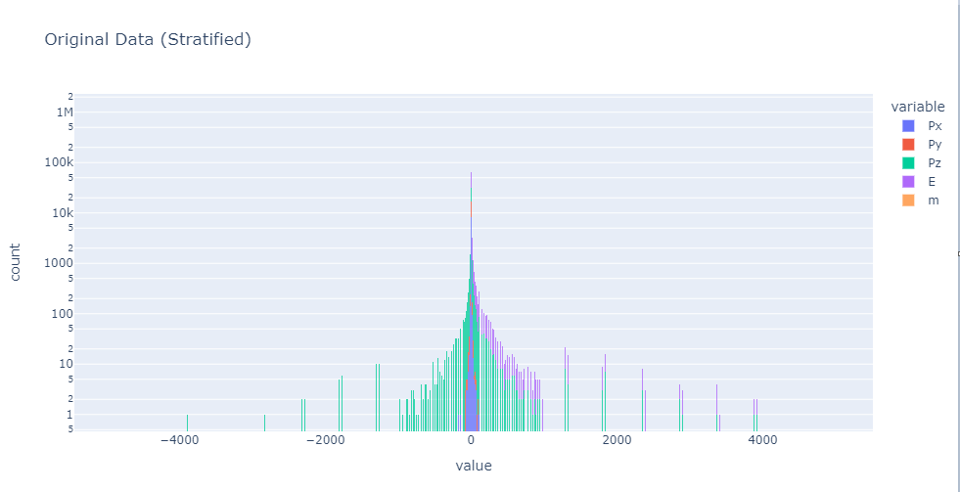
Data Distribution

Slide 9
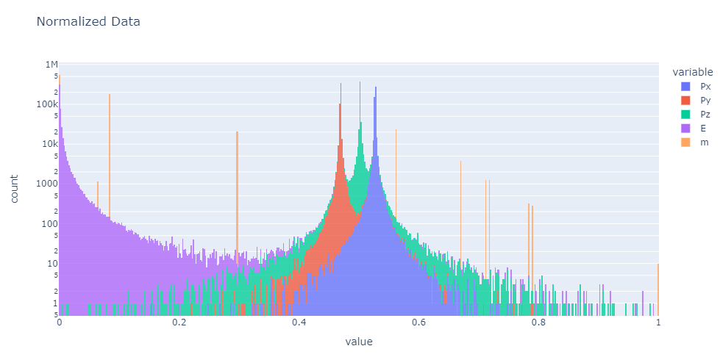
Normalization

Slide 10
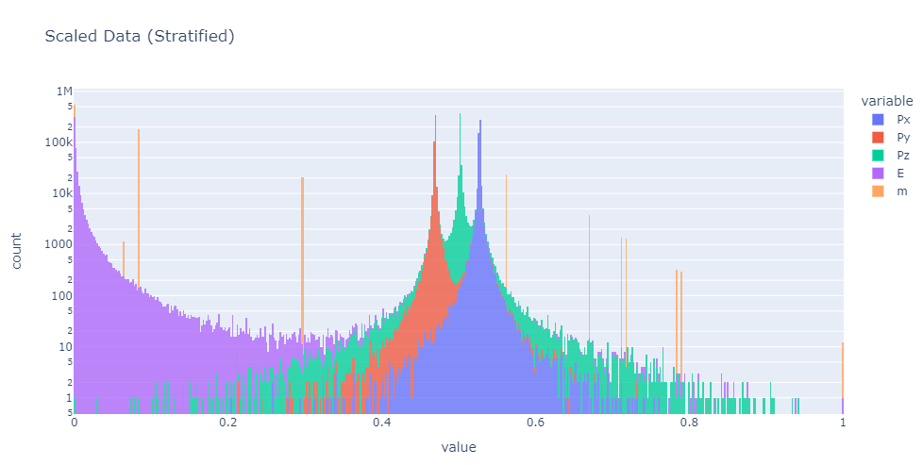
Scaling

Slide 11
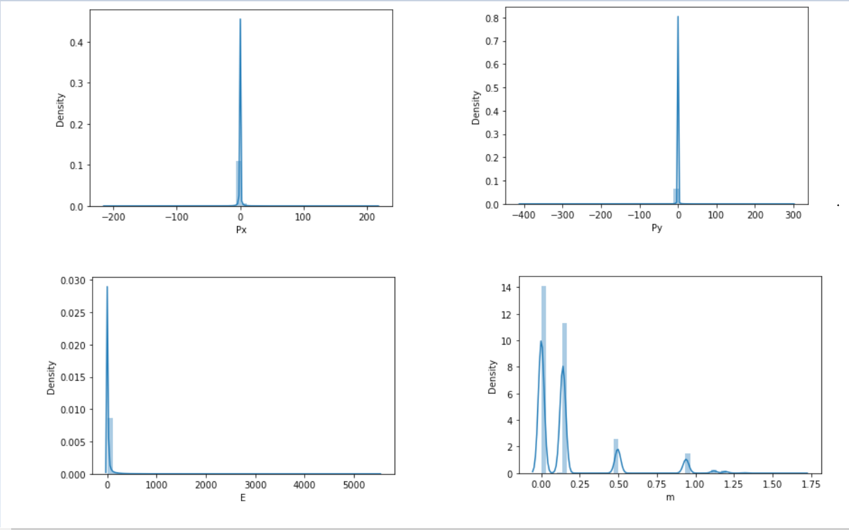
Density Plots

Slide 12
Running Python on Cluster
Experimented with running python on cluster using virtual environment with all dependencies
Plotted the entire dataset( ~4,85 billion points),took almost 10 hours to complete the job
Better Solution is to sample data over Energy feature using stratified sampling and using plotly module instead of conventional libraries

Slide 13
Next Steps
Would like to discuss the next steps in terms of training neural network and sampling the data for quick results.

