Slide 1


Stuart Hansen
University of Wisconsin - Parkside

Slide 2
Curricular Fit
Late CS2 or early Data Structures
Discrete Math background is required
  Matrix Multiplication
  Binary data representations

Slide 3
Historical Background
Early computer input would frequently contain errors
1950 Richard Hamming invented the error correcting algorithm that now bears his name
Early ACM guidelines included a Files course, which often covered error correcting codes

Slide 4
How Hamming Codes Work
One parity bit can tell us an error occurred
Multiple parity bits can also tell us where it occurred
O(lg(n)) bits needed to detect and correct one bit errors

Slide 5
Hamming (7, 4)
7 bits total
  4 data bits
  3 parity bits
Can find and correct 1 bit errors
  or
Can find but not correct 2 bit errors

Slide 6
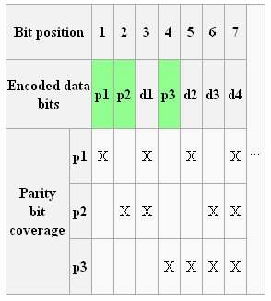
Hamming Bits Table

Slide 7
Example
Byte 1011 0001
Two data blocks, 1011 and 0001.
Expand the first block to 7 bits: _ _ 1 _ 0 1 1.
Bit 1 is 0, because b3+b5+b7 is even.
Bit 2 is 1, b3+b6+b7 is odd.
bit 4 is 0, because b5+b6+b7 is even.
Our 7 bit block is: 0 1 1 0 0 1 1
Repeat for right block giving 1 1 0 1 0 0 1

Slide 8
Detecting Errors
0 1 1 0 1 1 1
Re-Check each parity bit
Bits 1 and 4 are incorrect
1 + 4 = 5, so the error occurred in bit 5

Slide 9
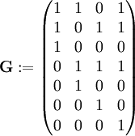
Matrices and Hamming Codes
Can both encode and detect errors using modular matrix multiplication
Code generation matrix G

Slide 10
Hamming Niftiness
Students still like to know how things work.
Assignment integrates binary data representations, matrix multiplication and programming.
Alternative data representations are intriguing.

Slide 11
Watch out!
Inelegancies
  (Java’s) Integer.toBinaryString()
  Integer math rather than bitwise operators
Students want to see the 0s and 1s

Slide 12
Variations on a Theme
Input can be:
  String of 0s and 1s
  Integers
  Arbitrary sequence of bytes
Processing can be:
  Brute force
  Matrix multiplication
Output can be:
  Bytes
  Bitstream

Slide 13
Improvising on a Theme
Hamming (7,4) leaves one bit empty per byte.
  This bit can be used for a parity check of the entire code block
  Allows program to distinguish between 1 and 2 bit errors
Hamming (15, 11) etc.
Reed-Solomon and other error correcting codes.

Slide 14
Questions?

