Slide 2
GraphX

Slide 3
Wat is het doel van de component?
GraphX provides several ways of building a graph from a collection of vertices and edges in an RDD or on disk.
GraphX is a thin layer on top of the Spark general-purpose dataflow framework

Slide 4
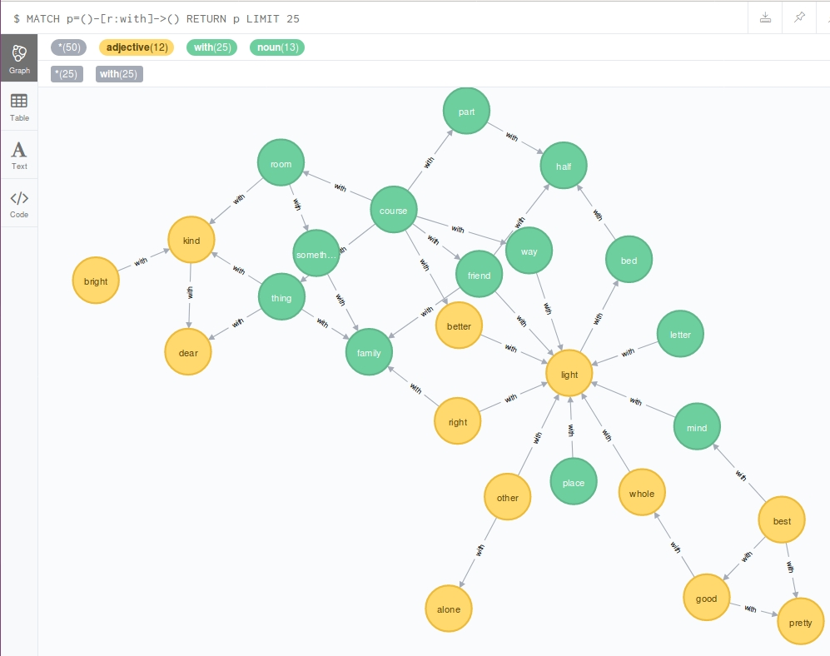
Waarvoor kan het gebruikt worden?
GraphX is Apache Spark's API can be used for graphs and graph-parallel computation.

Slide 5
Welke zijn de belangrijkste termen/concepten binnen de component?
Flexibility - Seamlessly work with both graphs and collections.
You can view the same data as both graphs and collections, transform and join graphs with RDDs efficiently, and write custom iterative graph algorithms using the Pregel API.
Speed - Comparable performance to the fastest specialized graph processing systems.
Comparable performance to the fastest specialized graph processing systems.
Algorithms - Choose from a growing library of graph algorithms.
In addition to a highly flexible API, GraphX comes with a variety of graph algorithms, many of which were contributed by our users.

Slide 6
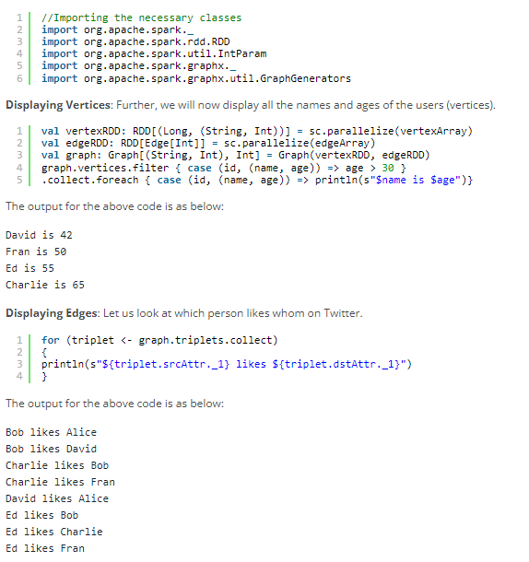
Geef en beschrijf ook een stukje voorbeeldcode van je component.

Slide 7
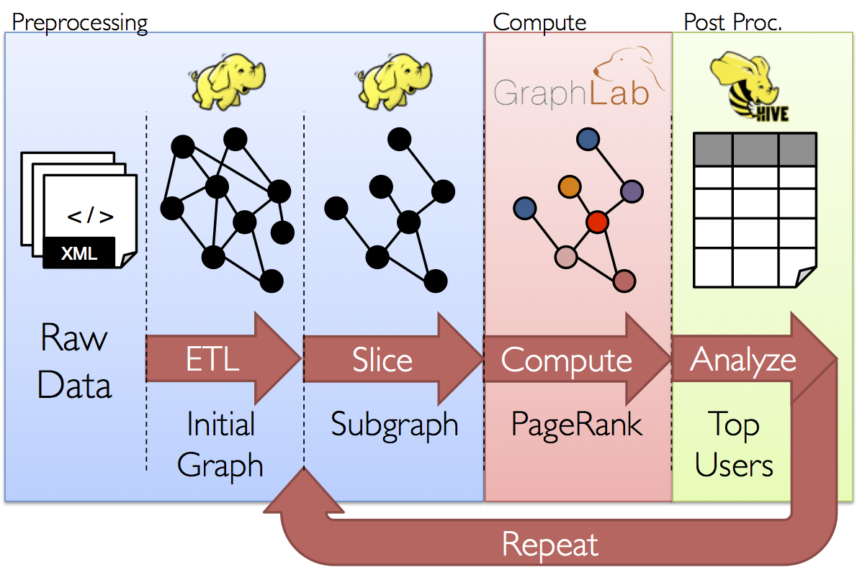
Welke best practices zijn er?

Slide 8
Bronnen
https://spark.apache.org/graphx/
https://spark.apache.org/docs/1.2.1/graphx-programming-guide.html

