Slide 1
ENGI 301 Project_02 Proposal
Odnan Galvan

Slide 2
Functionality (current state)
Currently PocketBeagle sits on a breadboard at the bottom of a box, with all interactive parts of the product on top of the box.
The size of breadboard and location of pins of the pocketBeagle complicate connections and make everything messier that necessary.

Slide 3

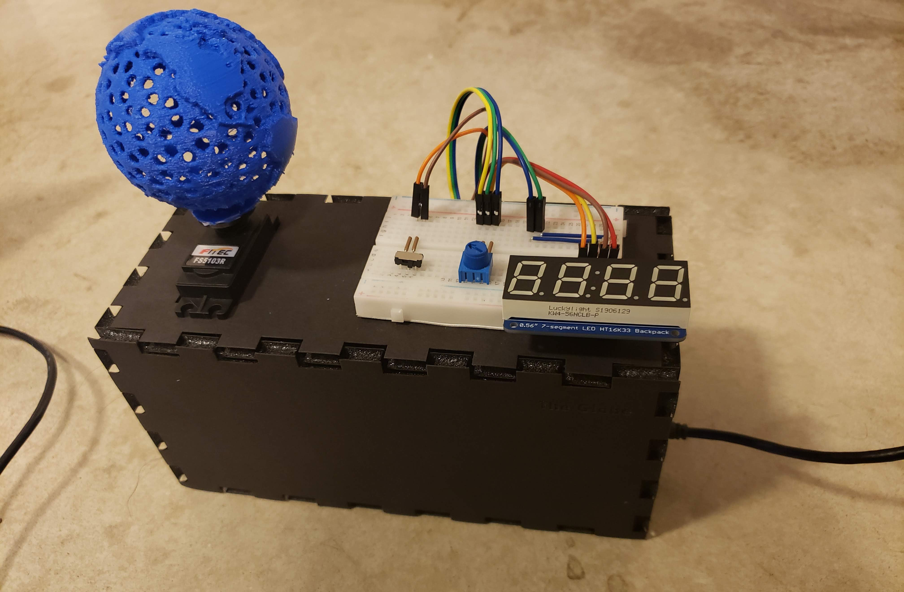
Functionality (PCB purpose)
I hope to implement the PCB as the roof of the box, with only a thin layer covering it. This would allow components on top of the box to sit in their regular position, connecting to the PCB underneath them.
The components inside the box, such as the PocketBeagle and light sensor, would be welded into board upside down, essentially hanging upside down.
This would reduce the height needed for the box and no more wires would be required.

Slide 4
Functioning Block Diagram
Potentiometer
PocketBeagle
WIFI Adapter
DN
Switch
DP
GND
ID
3.3V_OUT
Light Sensor
SDA
SCL
Continuous Rotation Servo
PWM
μUSB Host
Connector
5 Volts
Adafruit 4 Digit LCD
USB0
GPIO 14
GPIO 15

Slide 5
Mechanical Block Diagram (tOP)
LCD Display
Servo
1.7”
2.3”
Potentiometer
Switch
5”

Slide 6
mechanical diagram (Bottom)
WIFI Adapter
Servo
PocketBeagle
1.7”
2.3”
Micro USB
1.38”
Light Sensor
LED
2.2”
5”

Slide 7
Mechanical Diagram (overall view)
WIFI Adapter
LCD Display
Servo
PocketBeagle
1.7”
2.3”
Micro USB
1.38”
Light Sensor
Potentiometer
LED
Switch
2.2”
5”

