Slide 1

Welcome to PUZZ
Welcome

Slide 2

PROBLEM
With over half a million orders every day online food industry is clocking with 15% growth rate every quarter. With This Rapid Growth Comes Huge Competition, which brings hundreds of cuisines on your fingertips,but according to paper published in International Journal of Environmental Research and Public Health.
One problem which remains constant is What To Order? which is faced by approx 63.87% of people.
With Hundreds of options from cuisines to dishes around its very easy for any user to get lost in the whole menu which results in 23.8% leaving the app without ordering.

Slide 3
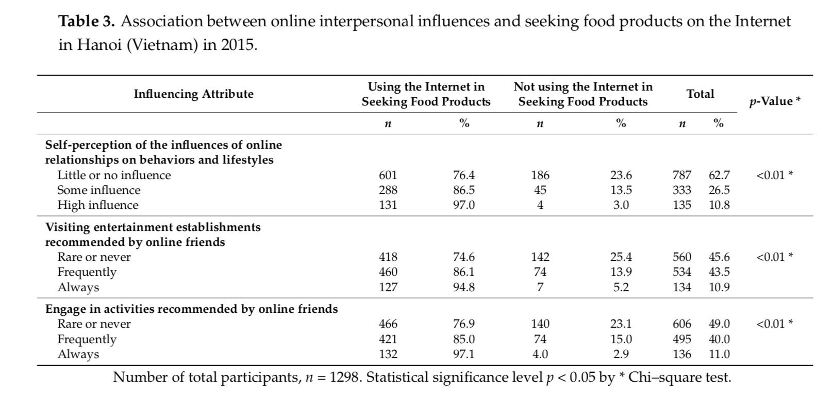
RESEARCHED DATA
97% People have high influence of Behaviour and Lifestyle on Online Food Ordering
Opinions and Recommendations Influence 94.8% People

Slide 4
SOLUTION
Analysing The User’s Eating and Sleeping Patterns.
Analysing The Scientific Needs of the body.
Predicting the current mood of the user.
Recommending combinations of meals judging all the
above factors.
Finally Recommending multiple Combinations which satisfies the users need ,Hence Reducing all the hassle.

Slide 5
PROTOTYPE MODEL
We predict the user’s mood by analysing their day to day activities.
For prototype we are using a small questionnaire to predict the user’s mood, which will be replaced with an algorithm to predict mood by user’s activity.
The questionnaire acts as a replacement for machine learning algorithms for the predictions.
Once we predict the mood we will suggest the user multiple different meal that will satisfy them based on our mood analysis.
The food suggestions are based on scientific analysis on how to increase endorphins, dopamine and serotonin while maintaining a healthy caloric maintenance diet.

Slide 6

PREDICTION ALGORITHM
Step 1: Asking the user’s name.

Slide 7
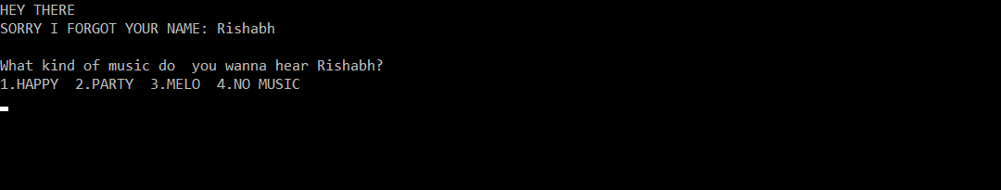
Step 2: Asking the user’s Music choice.
*We will replace this by analysing the recent music choices of the user.

Slide 8
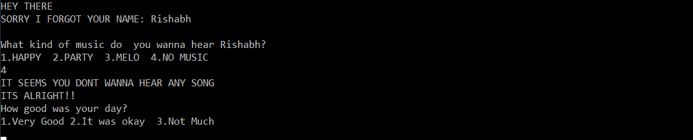
Step 3: We ask the user how was their day.
*We will replace this by analysing the current day activity, Facial recognition and Web Searches.

Slide 9
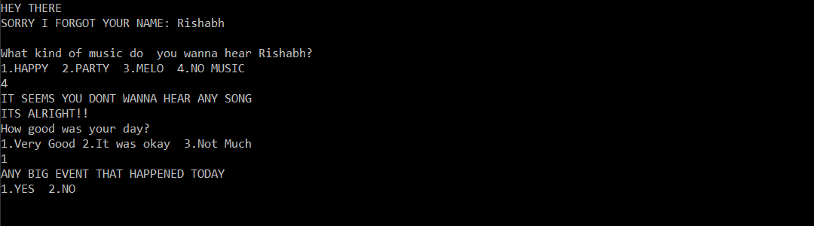
Step 4: We ask the user if any big event has happened.
*We will replace this by analysing the current day activity, Facial recognition and Web Searches.

Slide 10
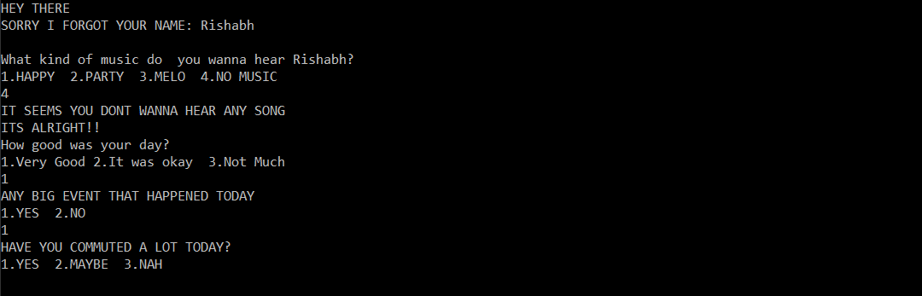
Step 5: We ask the user if they commuted a lot on that day.
*We will replace this by analysing the footsteps and location tracking.

Slide 11
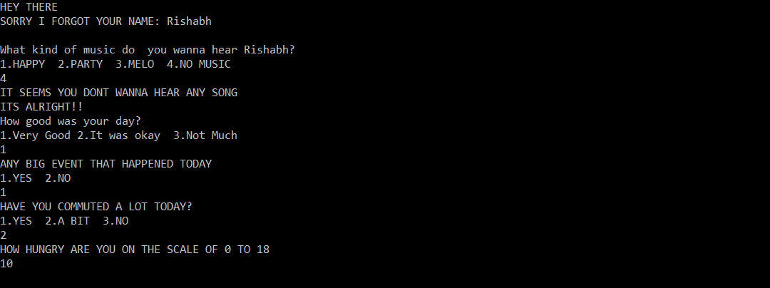
Step 6: We ask the user how hungry they are.
*Our algorithm will automatically calculate this and predict food accordingly.

Slide 12
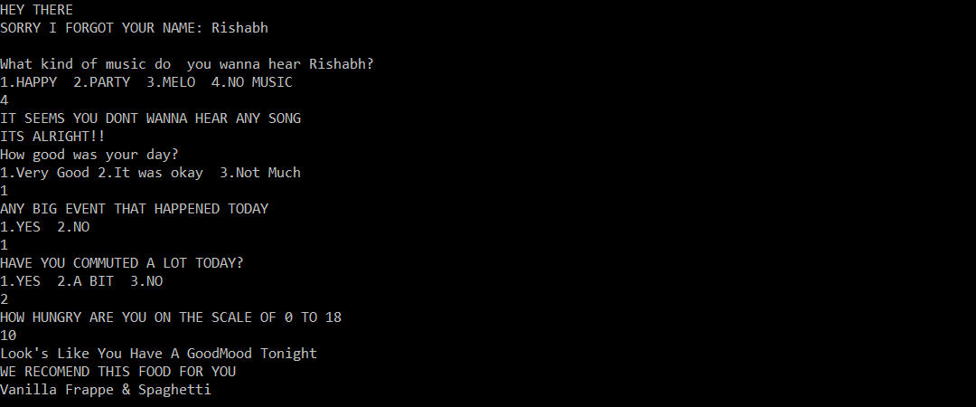
Step 7: Our algorithm predicts the food choice accordingly.
*Our algorithm will automatically calculate this and predict food accordingly.

Slide 13
CURRENT ALGORITHM
We predict the mood by the questionnaire.
Each question is assigned a priority value.
We have seperate lists of foods based on density and sugar level in the food.
Later combinational value of different food items is compared to the priority value.
Using approximation, multiple combinational dishes are recommended to the user.

Slide 14
ALGORITHM DEVELOPMENT
Integration of Deep machine learning of user’s mood and patterns.
We will predict the mood of user by monitoring the user’s activities like:
Facial Recognition
REM and Deep Sleep Patterns
Movement Patterns
Web History
Recent Music choices
Phone History

Slide 15
Thank You!

