Slide 1
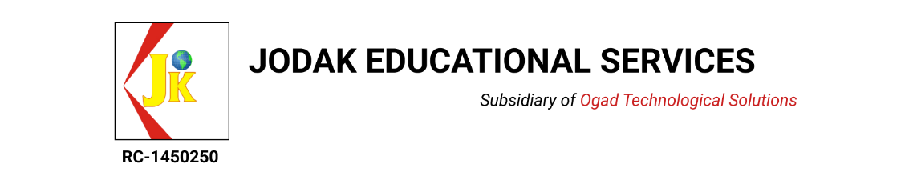
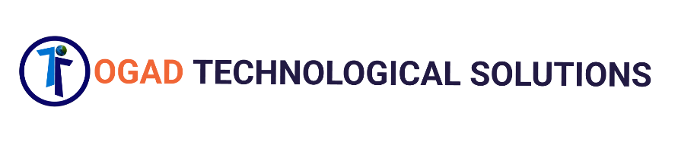
UI/UX DESIGN TRAINING COURSE

Slide 2
WHAT IS UX DESIGN?
UX stands for user experience or user experience design. It’s also sometimes abbreviated as UXD, UED or XD.
UX is the naked experience of a product: how a product functions, not how it looks.
UX Design is the process of enhancing user satisfaction of a product through increased usability, accessibility, and pleasure provided in the interaction with the product. User experience design encompasses note only traditional human–computer interaction design, but also all aspects of a product or service as perceived by users.
UX design is more TECHNICAL and ANALYTICAL, UI Design refers to GRAPHICAL DESIGN with more complex responsibilities.

Slide 3
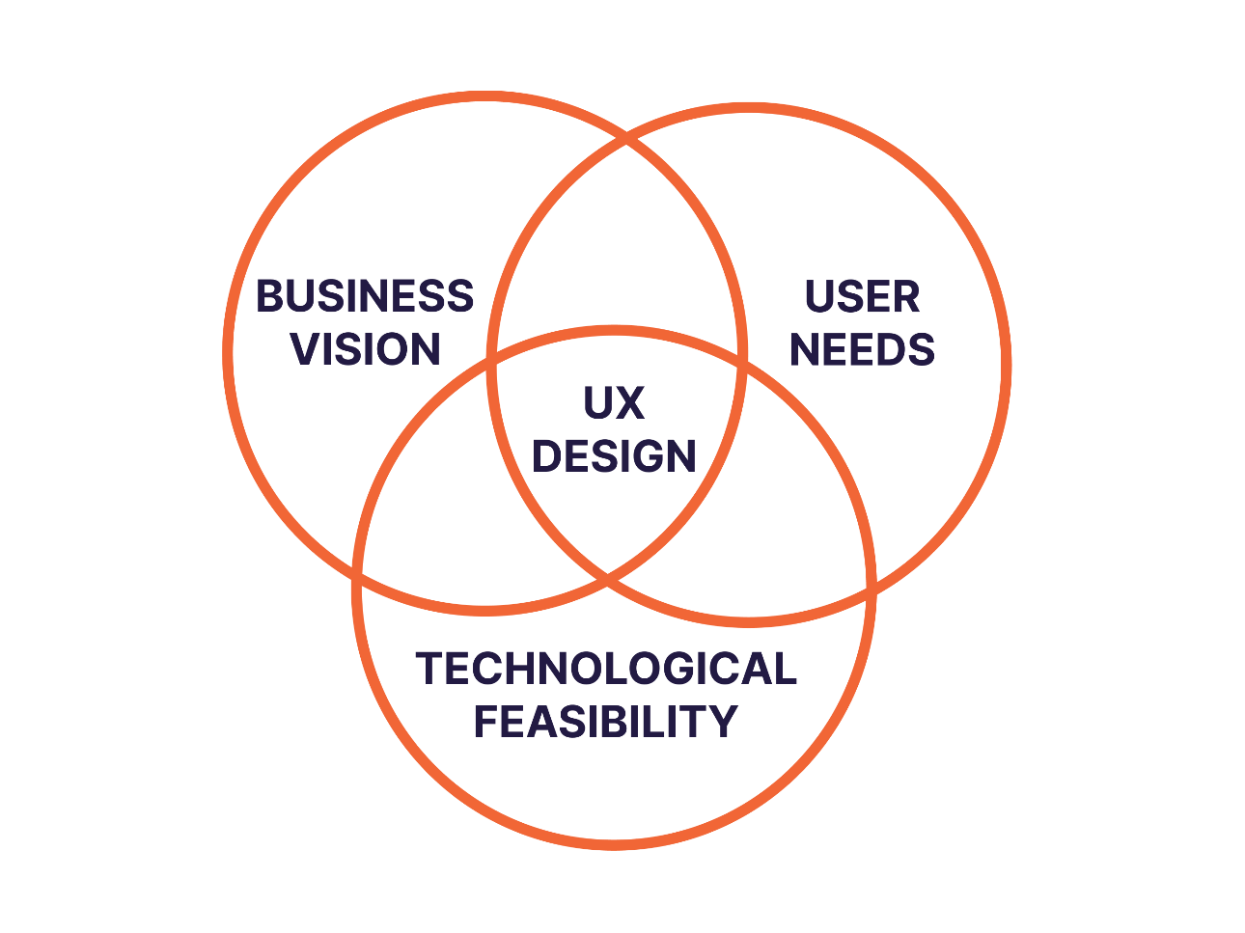
UX design is the merger of user needs, business vision and technological feasibility. The result of UX design is a set of low-resolution wireframes (a basic visual guide for how a product will function) that are deeply connected with user research.

Slide 4
WHAT IS UI DESIGN?
UI stands for User Interface or User Interface Design. It’s also sometimes known as user interface engineering.
UI is the design of user interfaces for machines: how a product looks and feels, not how it functions.
UI Design is the process of making the user's interaction as simple and efficient as possible, in terms of accomplishing their goals (also known as user-centered design).
UI design is the merger of user needs and visual design. The result of UI design is a set of high-resolution wireframes (a visual representation of a product).

Slide 5
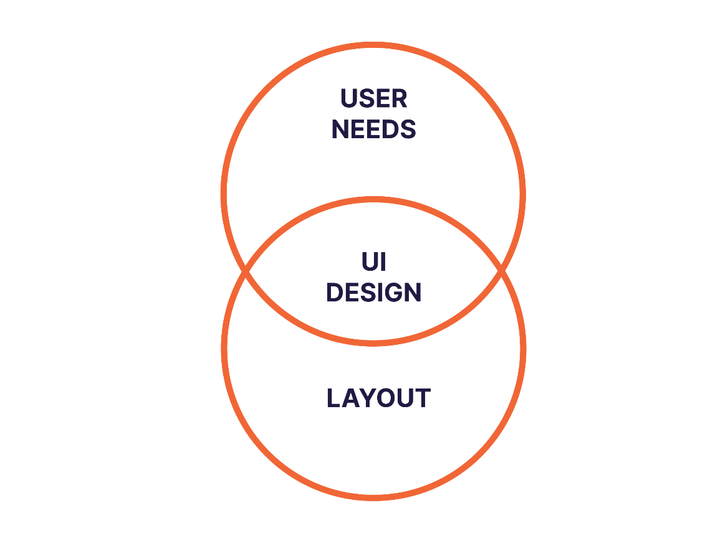
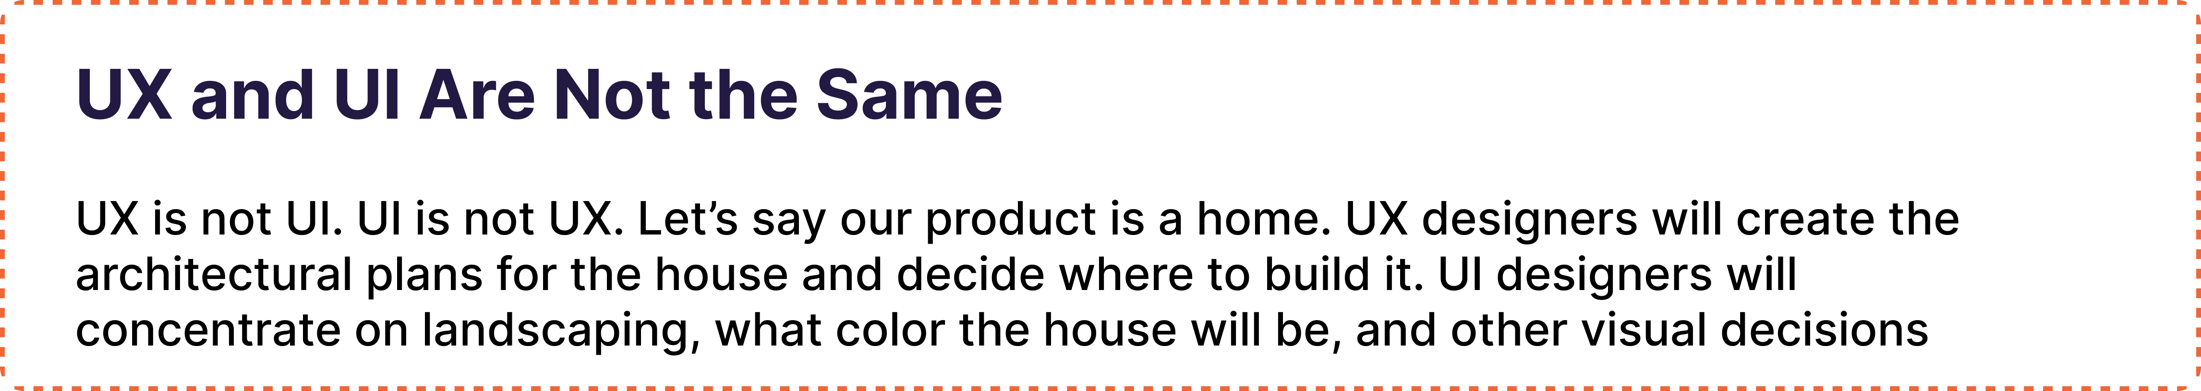

Slide 6
VISUAL NOISE
Visual noise as you can guess from its title is all about a screen or part of a digital product which has so much information and many elements on it.
When you are designing an app or a website, you need to pay attention to details a lot because by the end of the day we want to design a screen which is user friendly and easy to work through.
So make sure to eliminate all the unnessary elements or information from your screen. If you are not sure whether your design has visual noise or not, it is recommended to ask for users’ feedback.

Slide 7
ICONOGRAPHY
Iconography is a visual language used to demonstrate aspects, content or functionality. Icons are meant to be simple and clear, visual elements that are recognizable immediately.
You do not have to redesign well-known icons such as Home icon, Search icon e.t.c.
But what if you needed to design some icons specifically for your project? Well in that case, you should design icons which are in harmony with your design and other icons.
Note: Icons need to be understood easily by users, so make sure to show consistency in your design.

Slide 8
What is the process of UX?
UX has 3 key phases
Discovery
Ideation
Validation.
However, UX design is cyclical and you will often need to repeat certain steps and even the entire process multiple times.
The final outcome will be a set of low-resolution wireframes: a draft of the function and structure of a product.

Slide 9
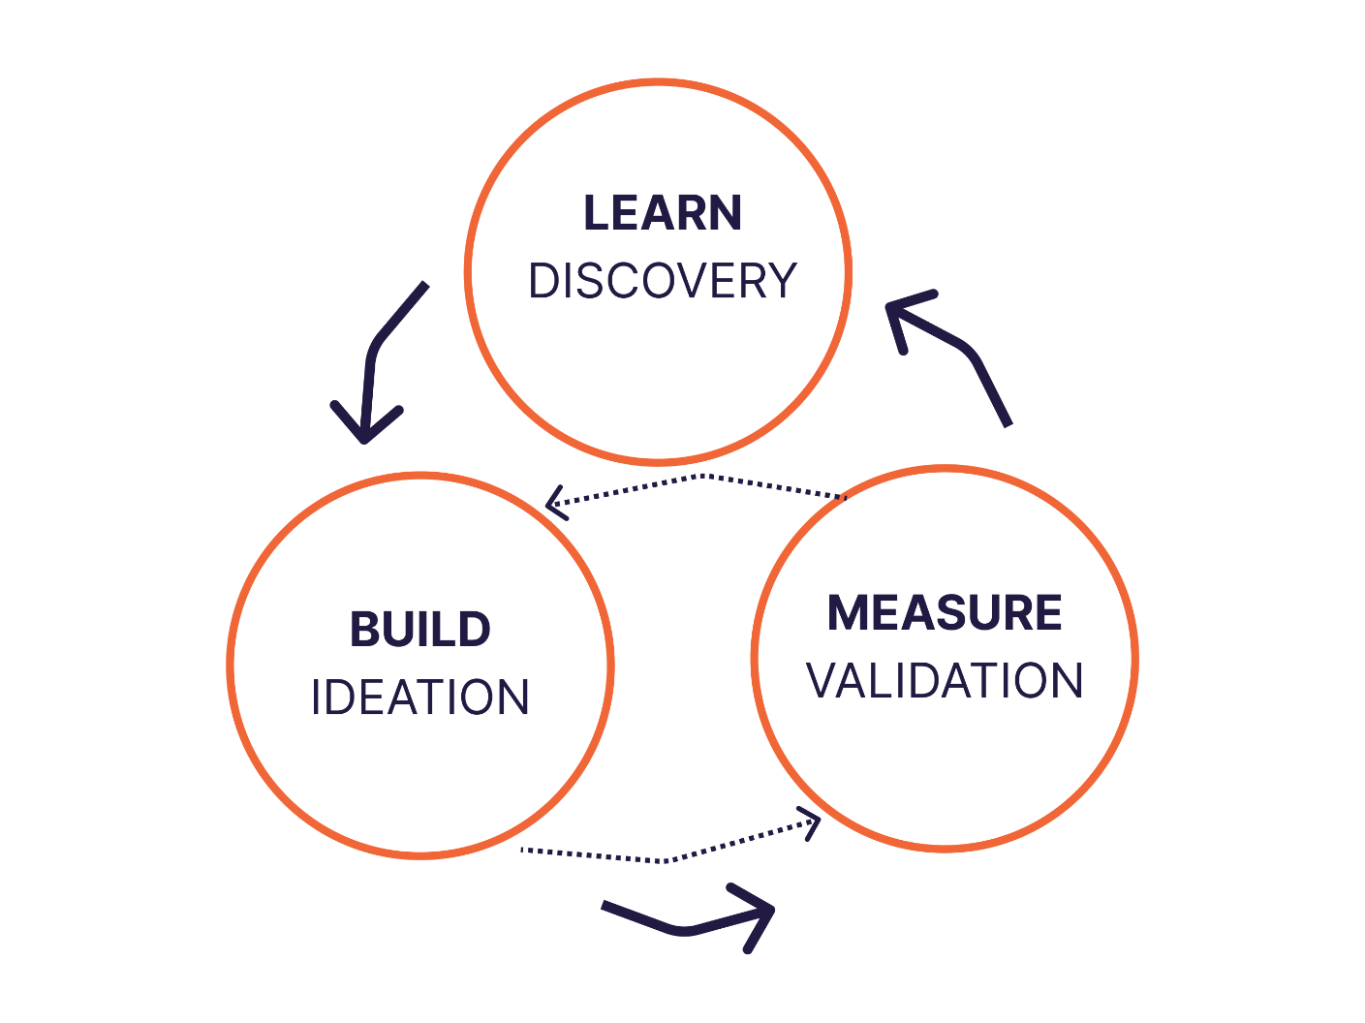
What is the process of UX?

Slide 10
Ideate
Discover
UX always starts with discovery—interviewing potential customers to understand what the target audience needs and talking to stakeholders to understand their goals and competitive analysis. Discovery is all about WHY - xxx. During discovery you will validate your problem (your product is there to solve that problem), identify your end users, and determine project goals.
Next comes ideation—using a variety of tools to imagine a solution that solves the user problem, while aligning with the company goals within technological possibility. Ideation is the process of finding out HOW. How will you create a solution that solves the users deepest needs in a delightful manner? Designers will implement a variety of tools to figure out how to solve the user problems. This process is very much like a funnel, where the solution is very wide at the beginning, and the goal of the process is to quickly, envision and test products with target customers in order to pivot and define. During ideation you will organize your discovery, explore options, and develop wireframes and prototypes.

Slide 11
Validate (Test, Prototype)
The UX process ends with validation—the testing of wireframes and prototypes to iterate on the interface until it’s intuitive and delightful. Validation is when we finally know WHAT we’re building. During this phase, designers will create wireframes or prototypes, and test them with users during a process called usability testing to evaluate how an actual user will react to the product. The designer observes, asks open-ended questions and iterates on the wireframes based on this feedback. Validation testing is giving those wireframes or prototypes to real users. You’re tracking actual interaction with the prototype here as well as confirming previously held assumptions. The results of validation testing should be changes in flow and layout, though likely not scope anymore. During validation you will validate your ideas, learn, and plan for the next iteration.

Slide 12
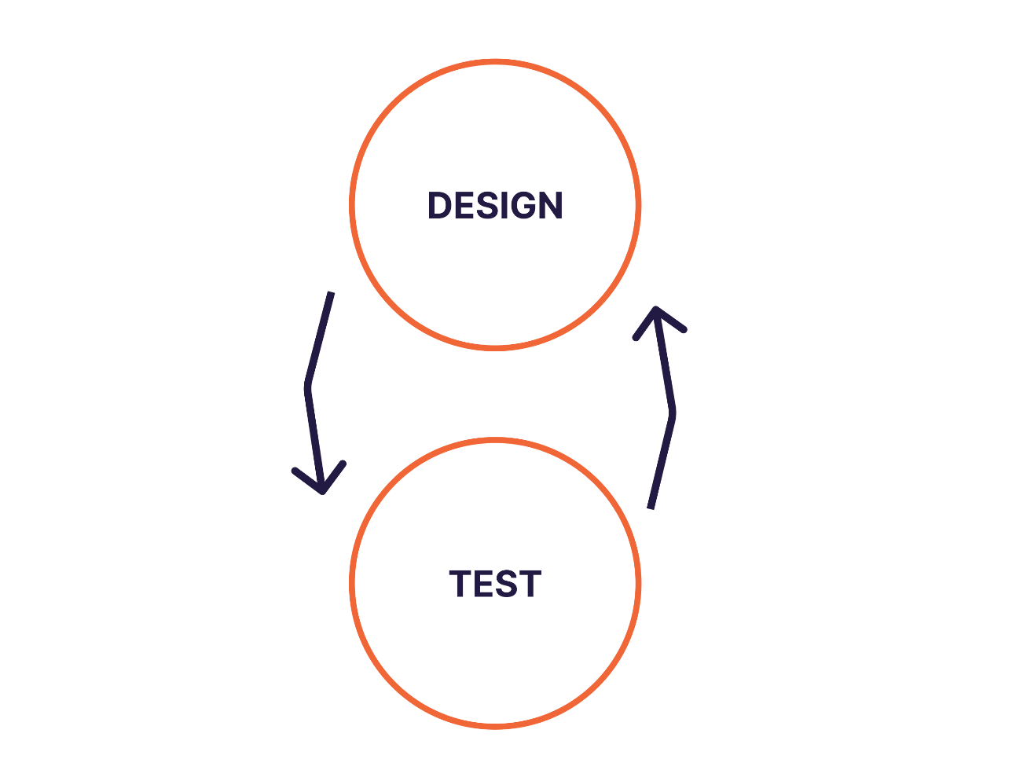
What is the process of UI?

Slide 13
What is the process of UX?
UX has e key phases: design and testing. UI design precedes the development of the product's functional elements.
UI design is the creation of the finished interface; its focus is on the visual and emotional feel of the product. UI design establishes the layout, colors, typography and interactivity to visually communicate the flow of the screens in an intuitive manner. The UI design process must balance technical functionality and visual elements to create a system that is not only operational but also usable and adaptable to changing user needs.

Slide 14
Validate (Test, Prototype)
Design
After ideation is design —this puts your ideas to the test. During design you will commit to internally validated ideas and test those ideas with users. After you complete the design process, you will likely bring what you’ve learned back to step 2 (ideation) and repeat this step again. This can happen multiple times
After you design, you will test to validate your design ideas. During testing you will test your ideas with users. After you complete the testing process, you will likely bring what you’ve learned back to step 1 (design) and repeat this step again. This can happen multiple times.

Slide 15
DESIGN GUIDE
What are design guide?
A design guide is a system that can help you to keep your design consistent. It can also accelerate your design process.
Things that can be included in your design guide are:
UI Element
Typography
Iconography
Sizing and Spacing
Color Palettes

Slide 16
SPACING
Consistency plays a key role in UI design. So when you are designing you need to measure everything and keep it consistent.
As a designer, spacing is up to you but once you set it, you need to use the same spacing patterns in your designs.

