Slide 1
Question:
04
Which category attracts most funding?

Slide 2
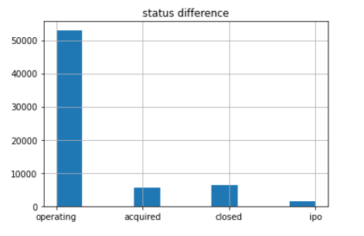
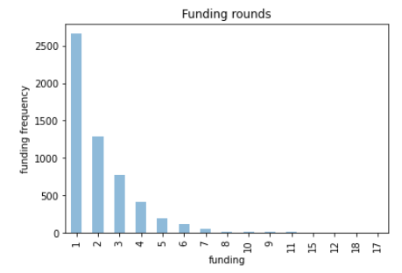
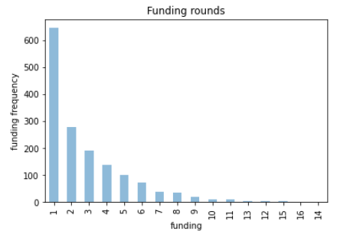
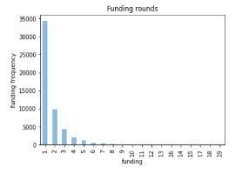
Acquired companies
IPO companies
Operating companies

Slide 3
Question:
05
How many investors do we have in different countries and which country dominates?

Slide 4
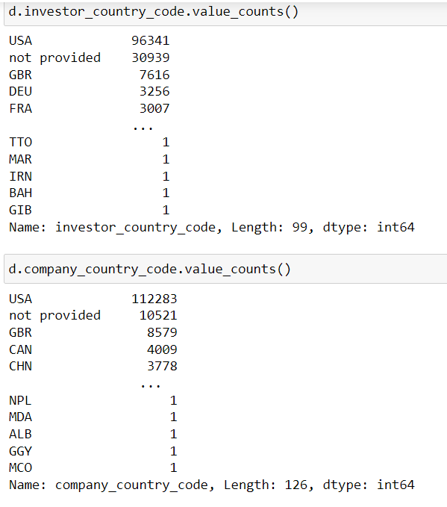
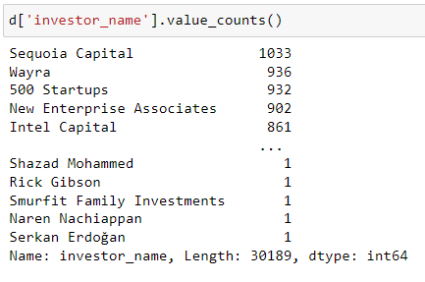
Most famous investors
Investor and company country codes

Slide 5
Question:
06
Can the factors that affect a start-up’s growth be determined?

Slide 6
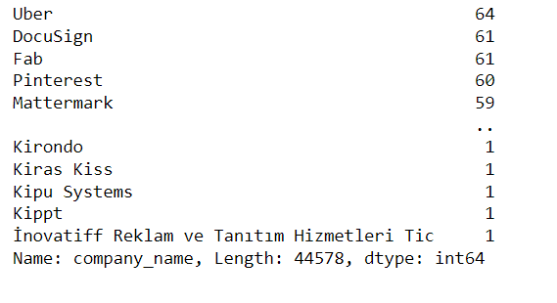
Most famous companies among investors
How many specializations do we have?

Slide 7
Question:
07
Companies specializations and the ones of interest in the investor’s point of view

Slide 8
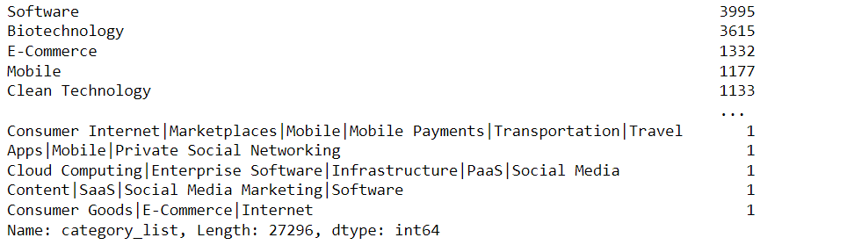
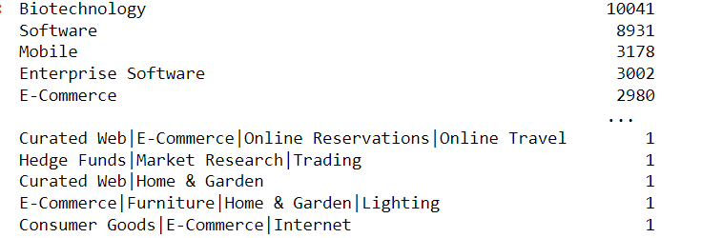
Important fields in companies point of views
Important fields in investors point of views

Slide 9
Question:
08
Are most of the investors also acquirers?

Slide 10
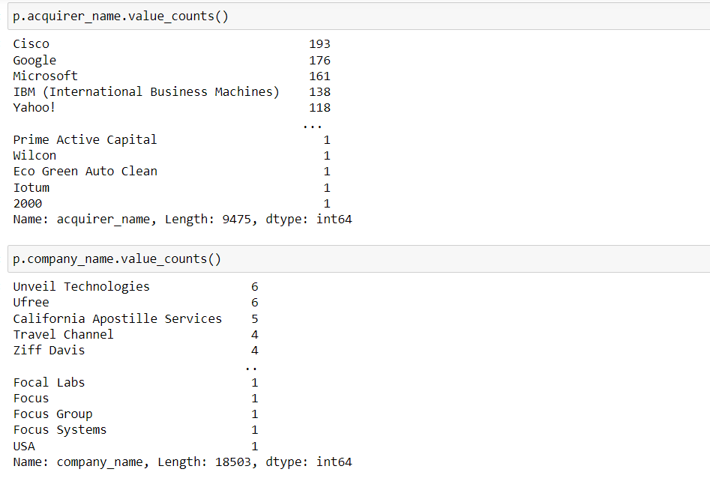
Acquirer names and company names in the acquisition data set

Slide 11
Question:
09
Can the number of technologies used by companies affect the rate of its success or failure?

Slide 12
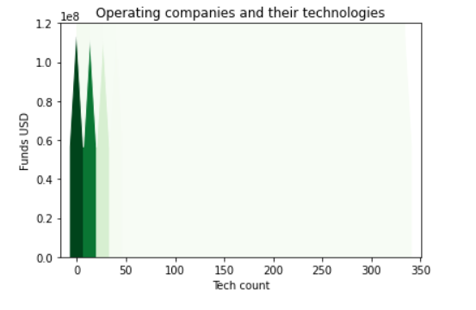
Cases
High funding and little technology count
High funding and high technology count
Low funding and high technology count
Why acquisition happens?

