Slide 1
Water Crystal Project Magi Report #01
Huy Van Quang Nguyen^{1,2}, Prof. Frederic Andres²
¹ University of Science, VNU-HCM, Vietnam
² National Institute of Informatics, Japan

Slide 2
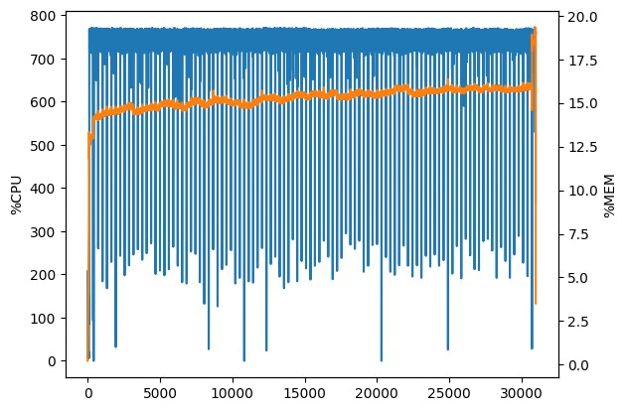
1. Request for more CPU cores
Currently, we are allocated a virtual machine which has 8 CPU cores and 128GB of RAM.
The graph shows the CPU and RAM usage of our program when training models: over 750% of CPU cores and 15% of RAM was used.
--> Almost all 8 CPU cores were used.
--> We need more CPU cores to speed up the training process: maybe 16 or 32 instead of 8.

Slide 3
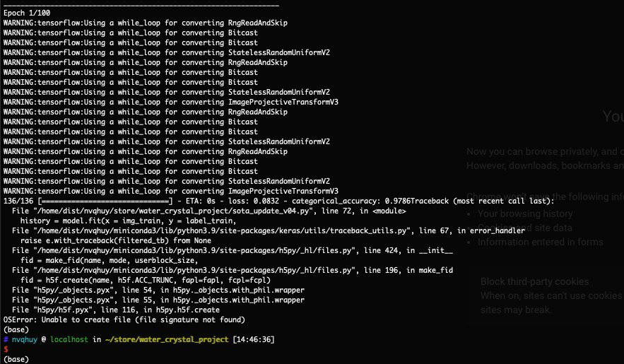
2. A bug related to the “store” directory
Sometimes, we encounter a bug like that photo: OSError - Unable to create file (file signature not found).
--> The reason may be related to the I/O process of the “store” directory. The connection may not be stable and can be down even if we use tmux.
--> To keep connection alive, we run another computer 24/24 and use it to log in the magi cloud as a temporary solution.
--> Exact reasons? Permanent solutions?

Slide 4
THANK YOU FOR LISTENING

