Slide 1

Water Crystal Synthesis 23/03/2023
Authors: Ashraf Haress, Mohamed Negm, Farah Aymen
Supervised by: Prof. Andreas Pester

Slide 2
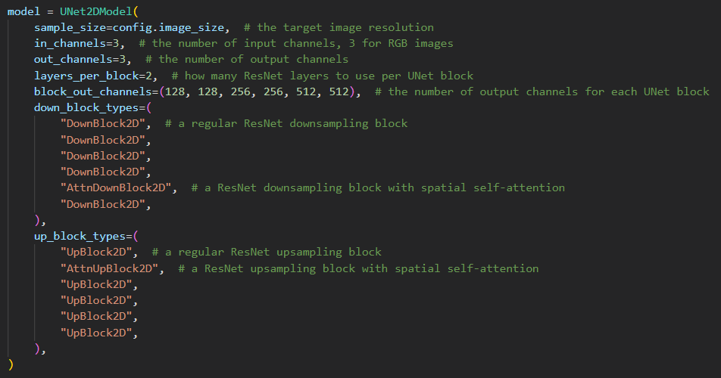
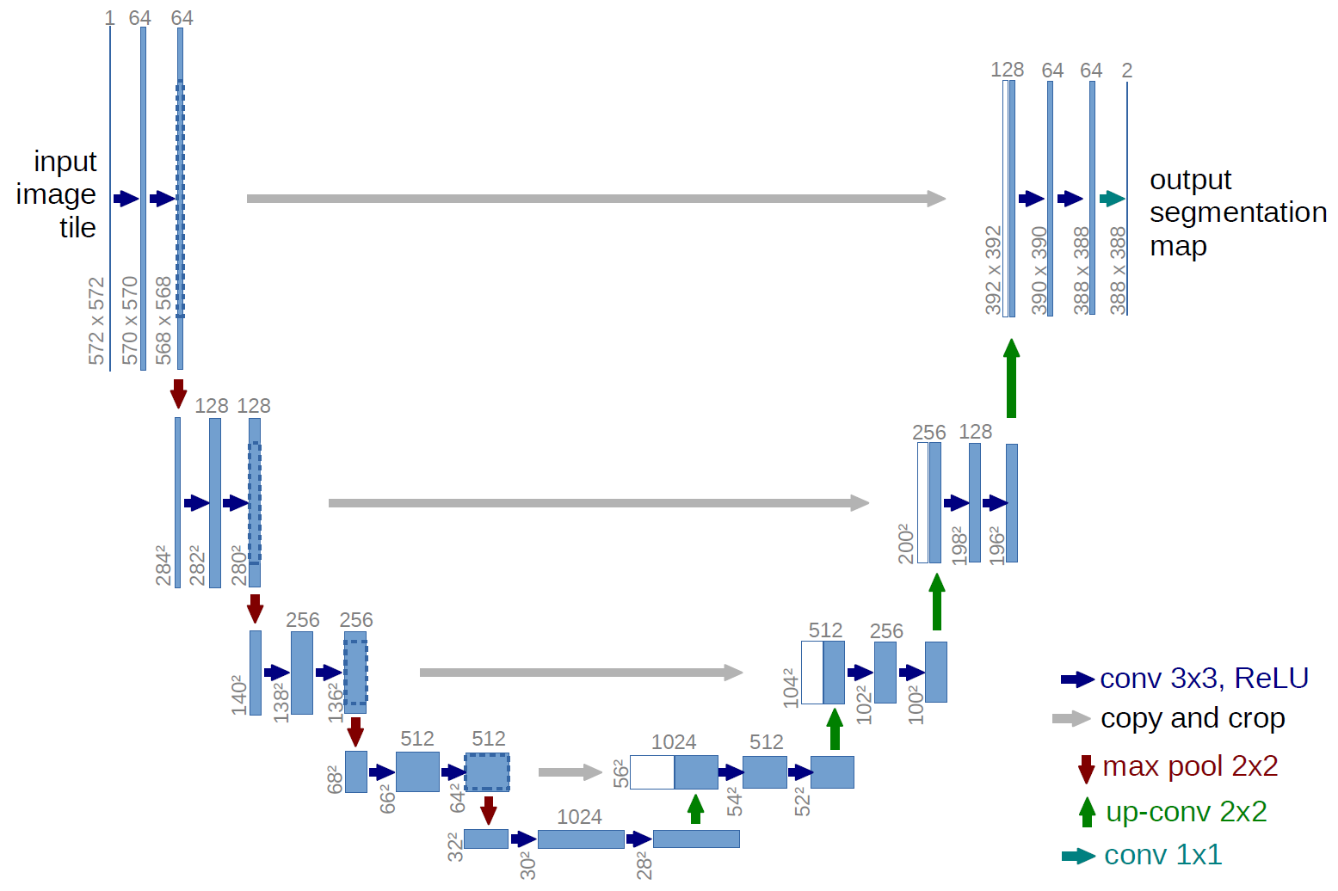
Diffusion Model Used
Visualized: (diff. values)

Slide 3
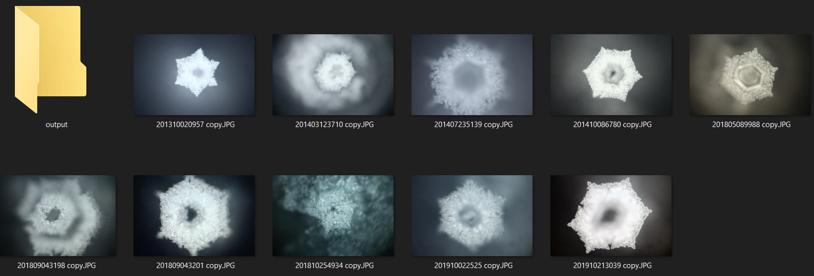
Images Used: 10

Slide 4
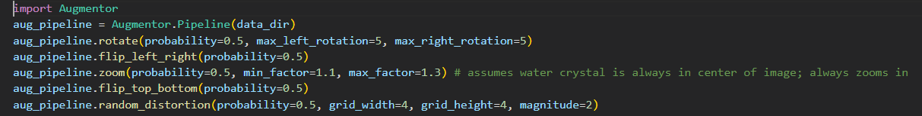
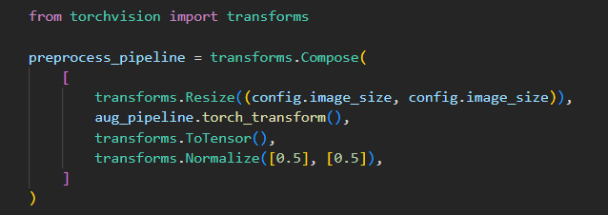
Augmentation Used:

Slide 5
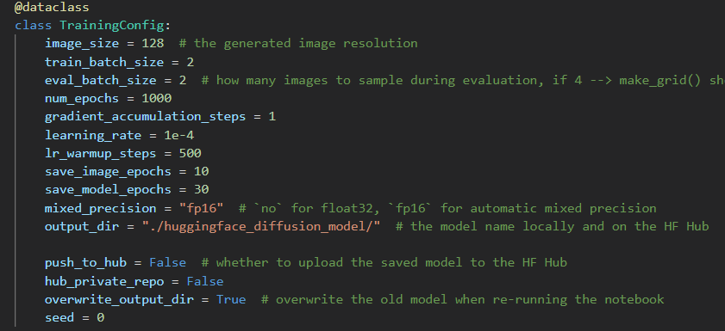
Training Configuration Used:

Slide 6
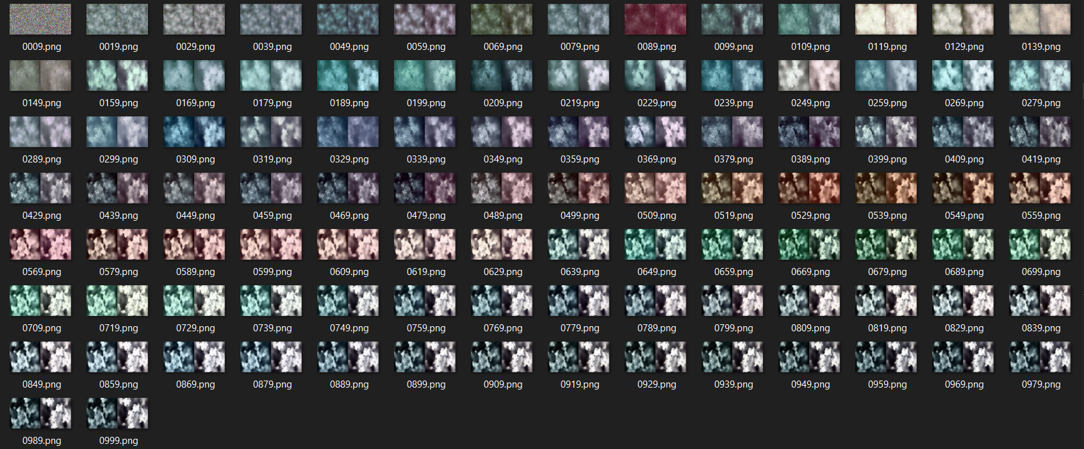
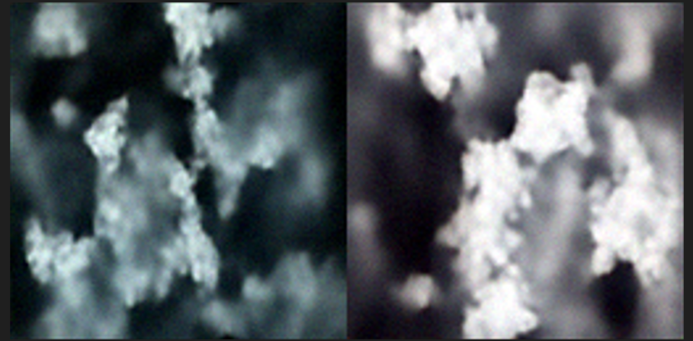
Results

Slide 7
To do:
Train on full dataset
Train on HPC to run more Epochs
Change model architecture?
Pre-trained model?

Slide 8
Thank You!

